Slide 1
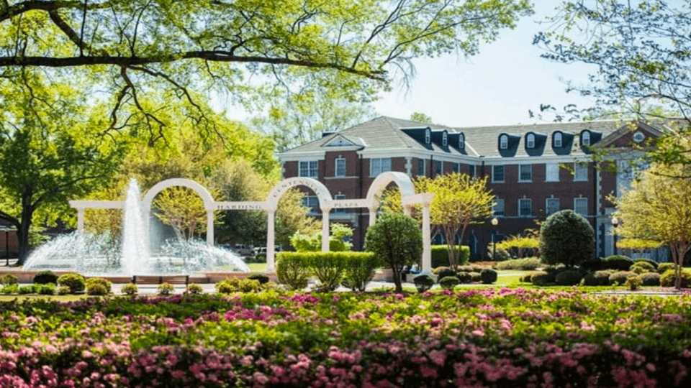
University of Central Arkansas
Whit Ables Madeline Howard *Douglas Robinett Amari Yarber
Notes:
*Denotes team leader

Slide 2
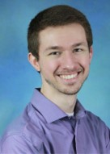
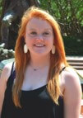
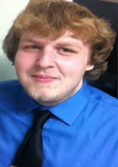





Meet the Muggles of UCA
Whit Ables
1st Year CSPA Graduate Student with an assistantship in Transfer Services and Academic Advising
Madeline Howard
1st Year CSPA Graduate Student with an assistantship in Housing and ResLife
Team Leader Douglas Robinett
1st Year CSPA Graduate Student with an assistantship in Housing and ResLife
Amari Yarber
1st Year CSPA Graduate Student with an assistantship in The Leadership Studies Department
Notes:
All students in this group are first-year College Student Personnel Services and Administration (CSPA) graduate students at the University of Central Arkansas.

Slide 3
Outline
Learning Outcomes
Defining freedom of expression, civil discourse, and counter discourse
Current hierarchy of registered student organizations and current policies on outside speakers
Proposed changes in policy: strengths, limitations, and outcomes of change
The importance of the student body’s utilization of freedom of expression at higher education institutions
Moving forward: the future of higher education and freedom of expression
Student affairs professionals will be able to:
  recall the definitions of freedom of speech, civil discourse, and counter culture
  compare freedom of speech and civil discourse and how they have evolved with the emergence of counter culture
  evaluate their campus culture and assess the ways in which the campus could improve the oversight of their student organizations
  value differing perspectives of their student population and organize events to promote these perspectives
  critique their current policies regarding RSO’s and guest speakers

Slide 4
Theories
Kohlberg’s Theory of Moral Development (1981)- Students that participated in the outburst on the campus were in the individualistic and instrumental morality stage (Florida State University, 2011)¹
  Rest’s Neo Kohlbergian Approach (2000)- Students focus on their personal interests more so than looking at the “bigger picture” of campus/social norms (Florida State University, 2011)
Sanford’s Theory of Challenge and Support (1966)- For growth to occur, students need an appropriate amount of support for the needs of the task. The growth of the student is heavily influenced by the campus environment (both inside the classroom and out (Boehman, 2010)²
Perry’s Theory of Moral Development (1960’s)- Students initially come to a higher educational institution with a dualistic ideology, absolute right and absolute wrong; the hope is that by the end of their four years, students see the world through a pluralistic- commitment- point of view (Boehman, 2010) ³
Notes:
¹ This stage is apart of the preconventional level which is the idea that students are not concerned about, or are unaware of, social norms. These same students are more focused on personal/self-interests than the needs of their surrounding peers.
² Students coming to campus for their first time are not use to the new environment of balancing their lives by themselves. Majority of traditional (17-19 years old) college students are use to their parent's planning and making decisions for their lives. The theory explains that the institution needs to find the proper balance of support for each student on their campus. Since this is impossible to accomplish on any campus, there are events such as the public uproar on the campus that leads to the students involved having conversations with Dean of Students. The purpose of these conversations is to assess the support that is currently given to students, and then determine what needs to change on the campus to better the entire community.
³ To go off of Sandford’s Theory, Perry’s Theory students come to campus with the idea that they is only right and wrong answers; meaning that the same student views their ideologies, even if it is the minority opinion, as the absolute truth and righteousness. This mentality creates a drift from listening to the other side/perspective and can, as we see, lead to an backlash and uproar of public opinion. Over time, Perry states that students become more educated and are better suited to view the world with a pluralistic point of view (cognitive dissonance). Pluralism allows the student to see that other perspectives and experiences exist for the students around them, and that the students over viewpoint is not the “absolute” truth, nor is it the “absolute” wrong.

Slide 5
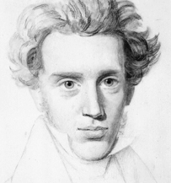
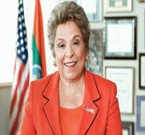
“People demand freedom of speech as a compensation for the freedom of thought which they seldom use.”
-Søren Kierkegaard (19th Century Danish Philosopher)
“You can't have a university without having free speech, even though at times it makes us terribly uncomfortable. If students are not going to hear controversial ideas on college campuses, they're not going to hear them in America. I believe it's part of their education,”
-Donna Shalala (2008 Medal of Freedom recipient)

Slide 6
First Amendment Overview
First Amendment to the Constitution guarantees the freedom of expression without penalty
Freedom of expression includes the following: freedom of assembly, freedom of religion, freedom of speech, freedom of the press
Freedom of speech is an individual's right to voice their own ideas, beliefs, or thoughts without penalty or punishment by the law
CAUTION - FREEDOM OF SPEECH DOES NOT PROTECT ALL SPEECH*
Notes:
*All public higher educational institutions are bound by the constitution to protect the rights of its students. Private institutions on the other hand are not subjected to the same regulation; majority of these institutions hold themselves to a high regard and see themselves as “bastions of free thought and expression” (Foundation for Individual Rights in Education, n.d.)

Slide 7
Protected Freedom of Speech
Not Protected
The choice to not speak (specifically, the right not to salute the flag)
Allowing students to wear black armbands to school to protest war
The use of certain offensive words and phrases to convey political messages
Contributing money (under certain circumstances) to political campaigns
Advertising commercial products and professional services (with restrictions)
Engaging in symbolic speech, (ex. burning the flag in protest)
Encouraging actions that would harm others
Making or distributing obscene materials (ex. child pornography)
Burning draft cards as a form of anti-war protest
Permitting students to print articles in the school newspaper over objections of the school administration (libel)
Students making an obscene speech at a school-sponsored event (slander)
Students advocating illegal drug use at a school-sponsored event

Slide 8
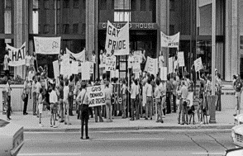
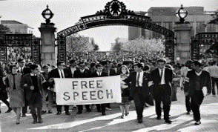
Freedom of Speech Throughout History
Political Movements
  Students for a Democratic Society (SDS)
  Young Americans for Freedom
  The Student Nonviolent Coordinating Committee
  The Southern Christian Leadership Conference (SCLC)
Civil Rights Movements
  Freedom Riders
  The Congress on Racial Equality (CORE)
  Free Speech Movement - 1964
  Feminist Movement
  LGBTQ Movement
Notes:
Organizations/Events that stemmed from “The Rise of the “NEW LEFT”
Staff members amongst college campuses,predominantly those within Housing and Residence Life, would entrap LGBTQ students. Once entrapped, there would be a conduct hearing where they would then be expelled from the university for “conduct unbecoming a student”.

Slide 9
What is Civil Discourse
What is Not Civil Discourse
Discourse with the intention of encouraging learning and understanding
Programs implement civil discourse adapted by higher education institutions (Linvell & Pyle, 2017)
  “To be properly prepared for the world they will be entering, students must explore and be armed to engage in meaningful civil discourse” (p.2)
Social media creates new opportunities and risks for civil discourse (Junco & Chickering, 2010)
  Student affairs professionals can hold programs to help students use civil discourse in social media to avoid or mediate online disputes
Civil discourse is not longing “civil” when one of the participating parties:
  Personally threatens the other party
  Takes away the rights and/or safety from the other party
  Demonstrates prejudice hatred toward a specific person or group of people
The goal of civil discourse is education and understanding
  This is not possible when one or more parties are dismissive (or worse) toward the ideas and perspectives of others
This type of discourse is NOT protected by freedom of speech
“If we are going to have a functioning and healthy democratic society, we need to be open to civil discourse. In other words, we have to be able to disagree without being disagreeable” - Glenn Antizzo

Slide 10
One Step Further: Counter Discourse
Counter-discourse: conversation, debate, or manner of thinking that goes against an institutionalized beliefs, norms, or discourses
Promotes thinking “outside” of institutionalized norms and helps give a voice to marginalized or underrepresented cultures and populations
Protected by freedom of speech
Examples:
  Institution administrators need to use counter-discourse to address challenges with assessment (Boud, 2007)
  Counter-discourse is utilized in higher education institutions to increase diversity in the workforce and in the student population (Alexander, Cleland, & Nicholson, 2017)

Slide 11
Registered Student Organizations (RSO’s)
Organizations that are recognized by the institution for being important to civic, educational, social, and/or professional development in the student population
  Can use campus facilities
  Host activities and non-profit events sponsored by the institution
  Can request funding from the institution
RSO’s can also invite outside speakers to their meetings and events
  However, sometimes these speakers can either be harmful, causing issues with the organization, the student body, and even with the campus’ Office of Student Involvement and campus administration
Issues created by outside speakers have a long-reaching effect on almost everybody involved and sometimes demand changes in policies*
  Example: Texas A&M had policy changes to require outside speakers to be sponsored by an RSO (CNN, 2017)
Notes:
*we recognize that other non-Slyvendorepuff University associates, organizations, or individuals have the right to reserve on-campus spaces (the campus community . However, these events are not sponsored by the university and actions, discussions, and other happenings are not reflective of the university or its mission statement. In addition, the viewpoints and perspective of RSOs are not wholly reflective or representative of Slyvendorepuff University’s values or mission.

Slide 12
Slyvendorepuff University
Mission
  The mission of Slyvendorepuff University is to cultivate well-rounded and educated students by providing leadership opportunities that continue to thrive in a richly diverse and globally aware community.
4-year public institution
The campus is composed of 10,000 students
  The population is 85% Caucasian, 10% African American, 4% other, and 1% international
  We are a non-religious affiliated institution
Located in Narnia
  The institution prides itself on its scenery and natural aesthetics*
Notes:
*One of the institutions backing is Tangible Culture. We are a notable because we have a magical scenery, not comparable to any muggle made institution.

Slide 13
Hierarchy at Slyvendorepuff University
President
VP of Student Affairs*
(Albus Longbottom)
Dean of Students
(Ronald Granger)
Office of Student Affairs
Office of Student Involvement
Outside Speakers
Student Government Association
RSO-”The Society That Shall Not Be Named”

Slide 14
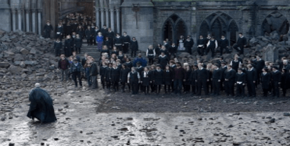
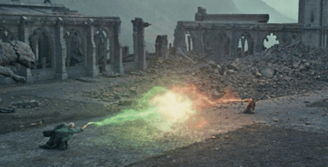
Current Policies
All RSO’s are welcomed to be created on this campus ¹
RSO’s bringing in guest speakers have to:
    Go through SGA for funding
    Reserve their own space through the OSI website
      Communicate with Physical Plant to set-up tables/chairs ²
    Make their own flyers to pass out around campus
      Approved by the office of Housing and Residence Life to post in the residential halls
Having a neutral location
  Ballroom, tiered classroom, theater, or auditorium
Notes:
¹ In adherence to Healy v. James (1972), all student organizations are allowed to be created on a public university’s campus simply because the fear of disruption is a possibility. The only way in-which an institution could not allow for a student organization to not be created is if it “would seriously interfere with learning on the campus” (Oklahoma State University, n.d.).
² Physical Plant is a campus resources for anything happening outside of any building (academic or student affairs related).
Slyvendorepuff University believes is structured as a siloes off university in-which each department is responsible for their own staff and student population. Departments do not reach out with each other and stick to their own, respective, buildings on campus. This type of administrative model of running the institution is successful for budgeting and using taxpayer money responsibility, but leaves too much trust and responsibility, especially with RSO’s, to not have issues when bringing in guest speakers. This lack of oversight with this RSO was a direct correlation to the outburst having been able to form on campus.

Slide 15
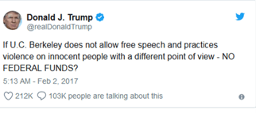
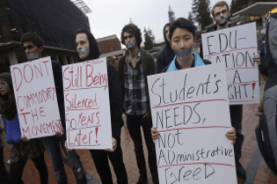
The Good, the Bad, and the Counter-Discourse
Due to technology becoming so dominant in today's culture, the RSO hosting the event no longer bares the negative publicity, it's the entire institutions reputation
  The President of the United States has been getting involved with protests happening on higher educational campuses (Janshik & Lederman, 2017)
RSO’s are one avenue on the institutions campus that produces strong leaders and an autonomous voice for students, especially minority students, to be active within their collegial community (Stanford University, n.d.)
Notes:
Both the President's quote, and the picture, relate to the 2017 protest at U.C. Berkeley

Slide 16
Updated Hierarchy at Slyvendorepuff University
President
VP of Student Affairs*
(Albus Longbottom)
VP of Academic Affairs
Dean of Students
(Ronald Granger)
Dean of Academic Affairs
Office of Student Affairs
Office of Student Involvement
Outside Speakers
Department of Defense against the Dark Arts
Student Government Association
RSO-”The Society That Shall Not Be Named”
Faculty Member (Professor Snape)
Notes:
A topic specific hierarchy map for the chain-of-command of an RSO group, and faculty member counter-part

Slide 17
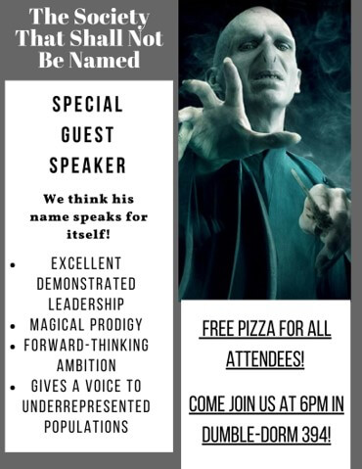
New Policy
RSO’s bringing in guest speakers have to:
    Have a faculty/staff advisor knowledgeable of the subject ¹
    Go through SGA for funding
    Send OSI an email to reserve a space and provide information about event ²
      Communicate with Physical Plant to set-up tables/chairs
    Make their own flyers to pass out around campus
      Approved by the office of Housing and Residence Life to post in the residential halls
Notes:
¹ Knowledgeable here means in the sense of the topic, or focus, of the group. It is not expected that the faculty member is an expert in the field, but holds enough knowledge about the institutions missions and values to protect the institution (Hippocratic Oath).
² RSO’s are also now required to provide more information to OSI when reserving a space. Included information includes: who the guest speaker is, a video/blurb/outline about the presentation. We as an institution are not trying to limit freedom of speech, but to assure that no hateful speech is given that would cause another outburst on the campus.

Slide 18
Freedom of Speech Today and Higher Education
Without the free flow of information from all demographics on a higher educational institution, there would never be improvements within society
  We have seen now-protected groups get expelled and attacked on campuses due to their identities and ideologies
  Higher education institutions must continue to do better for their students such as listening to their needs and wants so there is not a repeat of history
Freedom of speech is at the crossroads of ethics and law, which means that even if something is ethically right, it doesn’t mean that it’s always protected by the law
Policies should never remain static
  Contrarily, policies should be dynamic and allow for constant maintenance to accommodate for the ever-changing environment on higher educational campuses

Slide 19
References
Alexander, K., Cleland, J., & Nicholson, S. (2017). Let us not neglect the impact of organizational culture on increasing diversity within medical schools. Perspectives on medical education, 6(2), 65-67.
Boehman, J. (2010). Student Development Theories. Retrieved February 13, 2018, from https://facultystaff.richmond.edu/~jboehman/sdt.pdf
Boud, D. (2007). Reframing assessment as if learning were important. Rethinking assessment in higher education: Learning for the longer term, 14-25.
Florida State University. (2011, April 10). Moral Development. Retrieved February 13, 2018, from https://studentdevelopmenttheory.wordpress.com/morality/
Foundation for Individual Rights in Education. (n.d.). Private Universities. Retrieved February 16, 2018, from https://www.thefire.org/spotlight/public-and-private-universities/
Jaschik, S., & Lederman, D. (2017, February 2). Amid Violence, Yiannopoulos Speech at Berkeley Canceled. Retrieved February 12, 2018, from https://www.insidehighered.com/news/2017/02/02/violent-protests-visiting-mob-lead-berkeley-cancel-speech-milo-yiannopoulos
Junco, R., & Chickering, A. W. (2010). Civil discourse in the age of social media. About Campus, 15(4), 12-18.
Linvill, D. L., & Pyle, A. S. (2017). Inquiry-based civil discourse education. Communication Teacher, 31(4), 214-219.
Oklahoma State University. (n.d.). Healy v. James, 408 U.S. 169 (1972). Retrieved February 10, 2018, from http://media.okstate.edu/faculty/jsenat/jb3163/healy.html
Stanford University. (n.d.). Local Autonomy. Retrieved February 12, 2018, from https://sal.stanford.edu/other/critical-university-policies/local-autonomy
What Does Free Speech Mean? (n.d.). Retrieved February 16, 2018, from http://www.uscourts.gov/about-federal-courts/educational-resources/about-educational-outreach/activity-resources/what-does

Slide 20
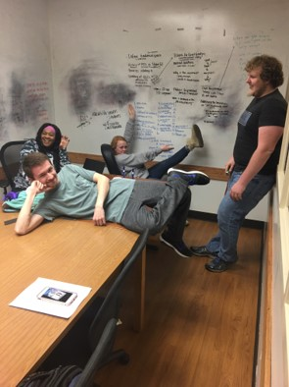
THANK YOU

