Slide 1
Virtual Case Study Competition
University of Arkansas
Team Leader: Ashton Braddock

Slide 2
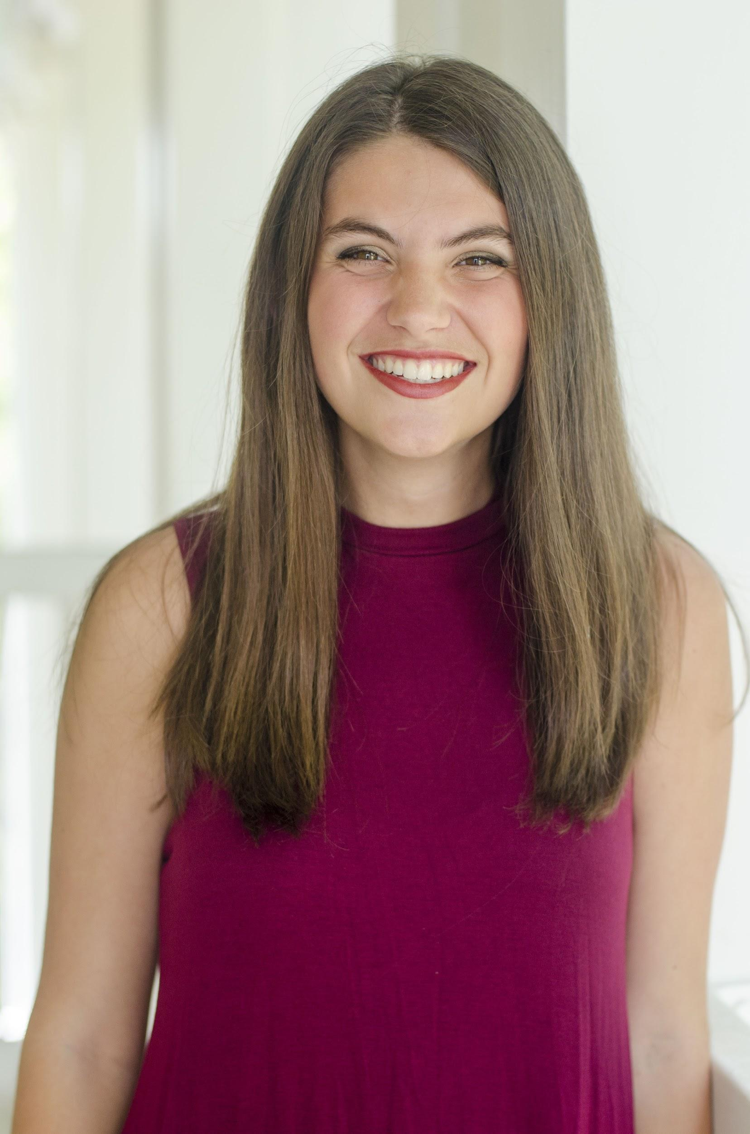
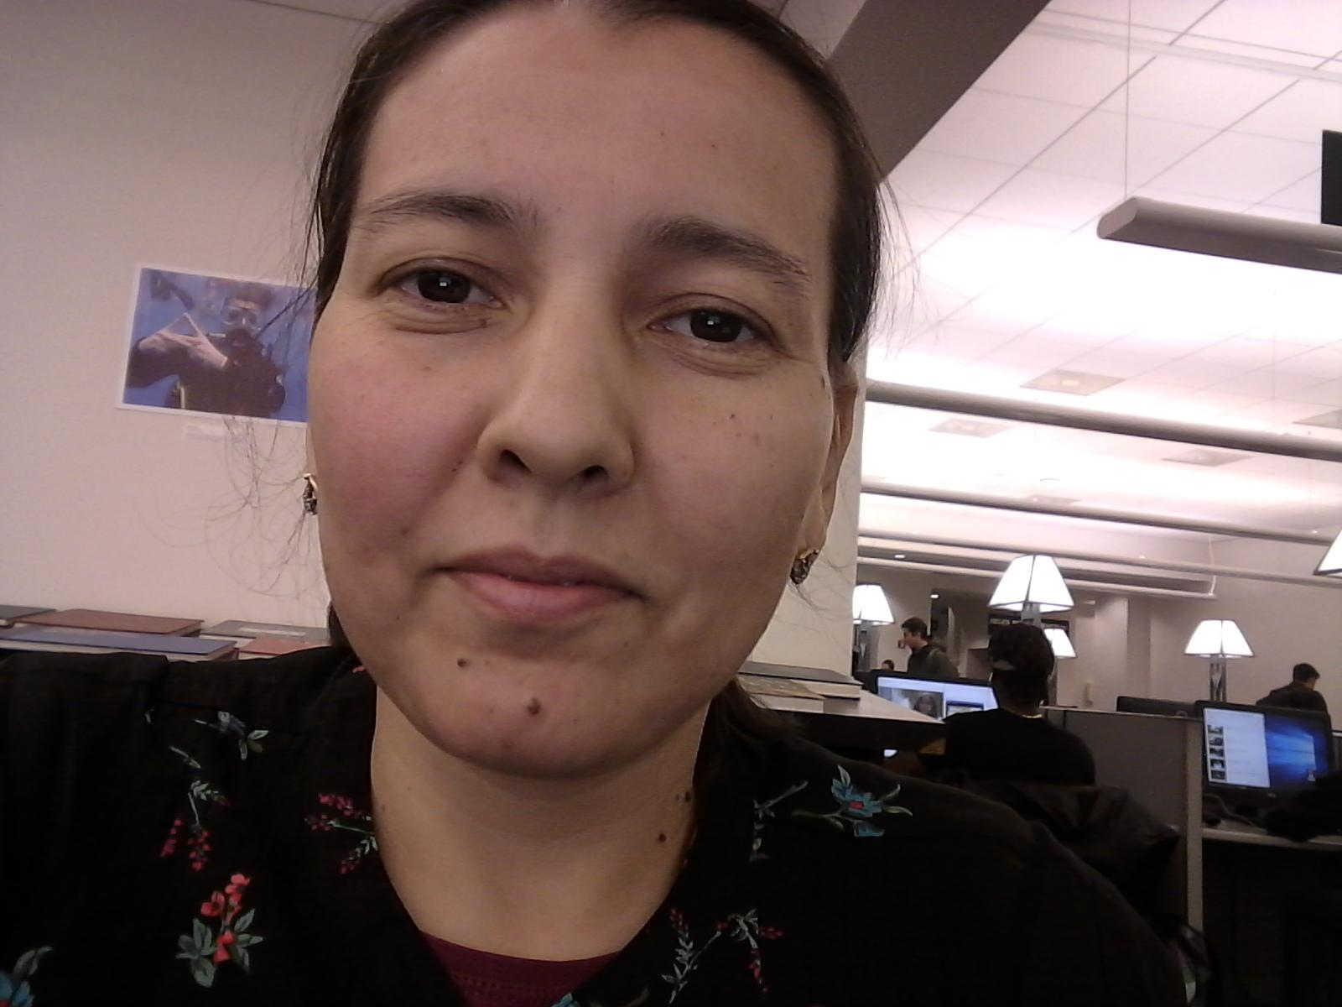
University of Arkansas Team Members
Ashton Braddock Morgan Pulliam Guljahan Gochova

Slide 3
Overview of Case

Slide 4
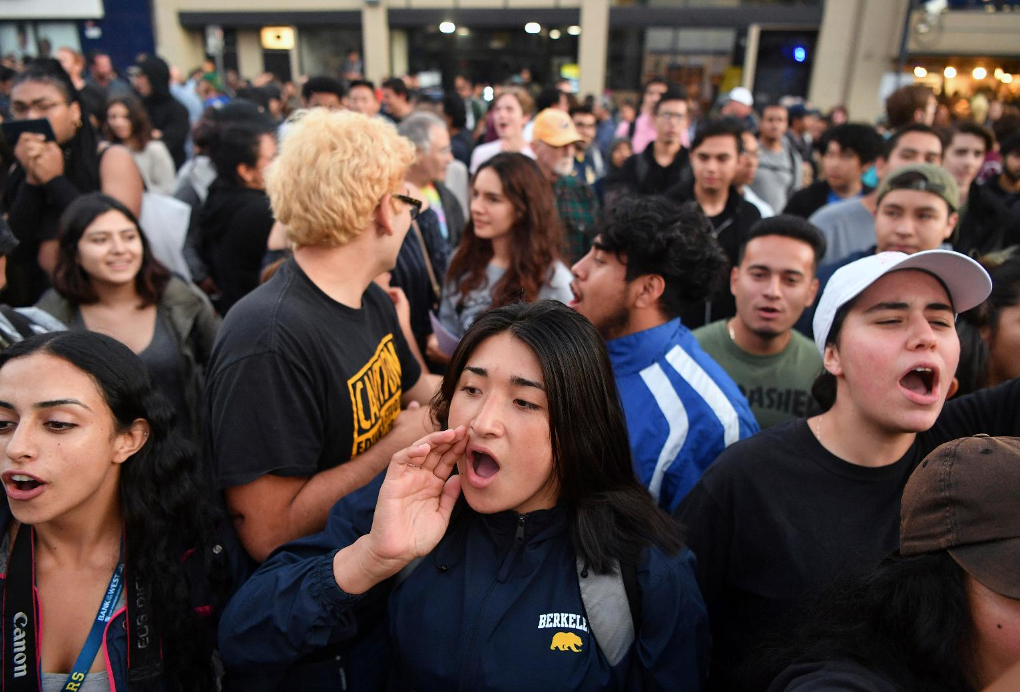
The Case:
A student organization sponsored a forum that led to outbursts, shouting, and shoving
Police dispersed the attendees with no injuries or arrests
VP of Student Affairs, Albert Longbottom, would like to make changes and begins the process of assembling a committee to ensure safety at campus events
media:733adb47e06742b1a3f3810aa67d0039Free_Speech-Berkeley_23301.jpg

Slide 5
University Guidelines
Notes:
Fictional Guidelines we created

Slide 6
Institutional Terms for Guidelines
University Entity
Students
Faculty/Staff
Administration
Student Organizations
Departments
Non-University Entity
No affiliation with the university
Community Member
Outside Speaker

Slide 7
Current University Guidelines for Events
Non-university entities:
  Required to make reservations to use the space at least three business days before their scheduled appearance
  Only allowed to use university facilities or outdoor space for a maximum of five days per semester
  Can use university spaces any days
  Permit to use the space is only good for one 24 hour day

Slide 8
Concerns
Damages to Property
Safety of Students
Security
Student and Faculty Complaints
Constitutionality of Guidelines
Publicity
With Current Guidelines
Notes:
Publicity- Bad publicity to the university because of an event

Slide 9
Addressing the Concerns

Slide 10
Concerns the New Guidelines Will Address
Damages to Property
-Who will be responsible for damages to property?
-What are the consequences?
Safety of Students
-Who will be responsible for keeping students safe?
-What are the consequences?
Security
-Who will pay for security?
Student and Faculty Concerns
-Create a system for university entities to submit concerns
Constitutionality of Guidelines
-5 day cap is not constitutional
-Add additional constitutional restrictions
Publicity
-Negative news that could defame the university

Slide 11
New Proposed Guidelines

Slide 12
New Proposed Guidelines
Required to make reservations to use the space at least three business days before their scheduled appearance
Prohibited from using the spaces on “dead days”, which include study days and days in which finals are taking place
Permit to use the space is only good for one eight-hour day
Use of university spaces cannot interfere with the educational mission of the university
Priority speaking
  If a new speaker wants to use a space, let them have priority over someone who regularly uses the space to increase diverse perspectives being heard
Must get proper approval of event

Slide 13
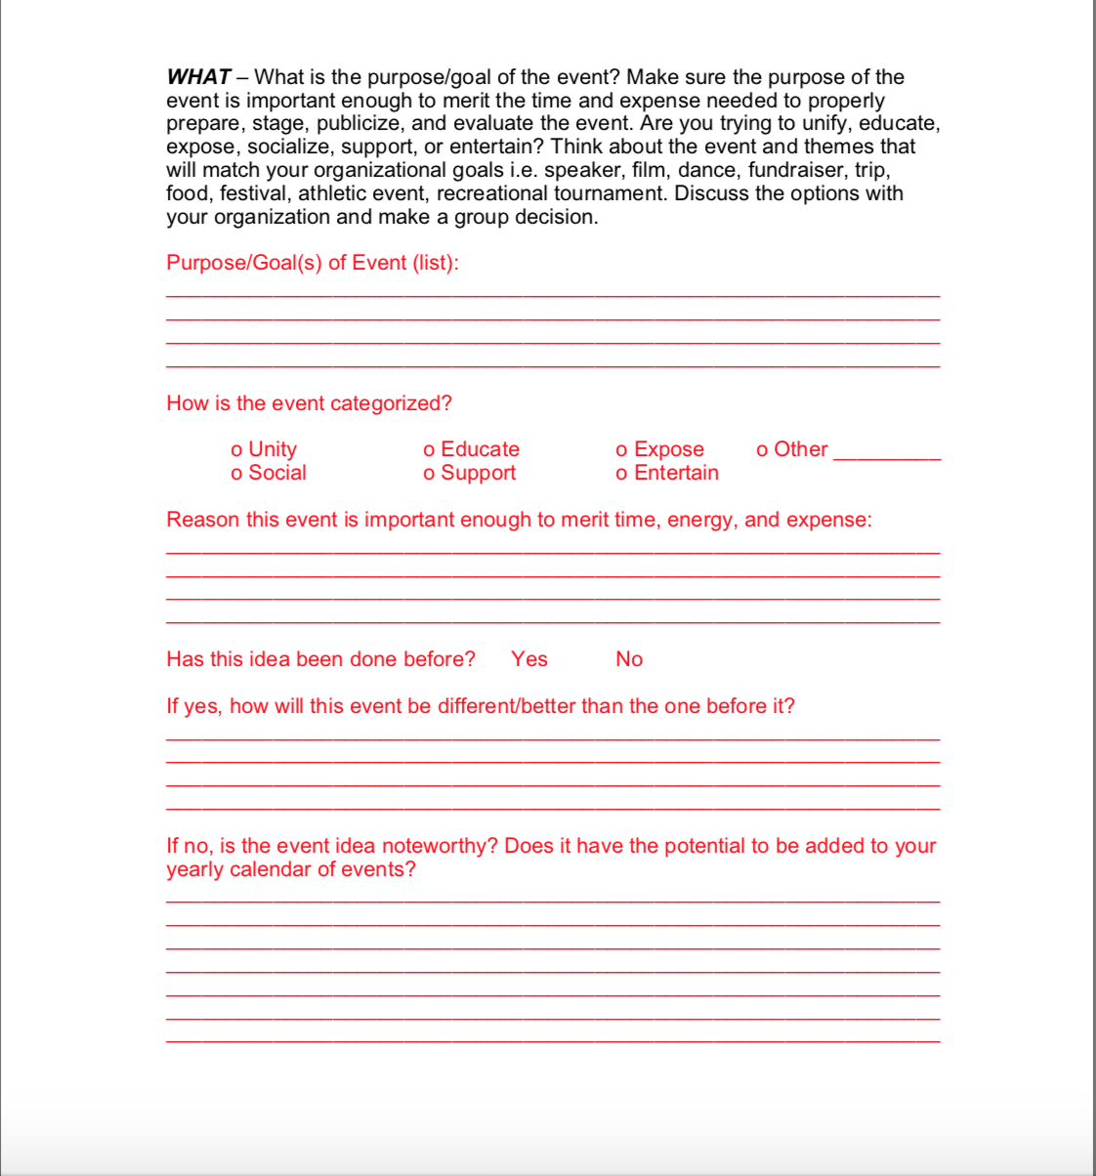
Approval of Event/Speaker
Example
All events must have a faculty/staff advisor and sponsor of the event.
Faculty/ staff must be present at event.
Organization or individual must fill out an activity form with all details of the event:
Date/Time/Location
Expected attendance
Sponsoring Group
Synopsis- Purpose of event
Security needed?
Amplified sound?
Food?
Attendance by non-university entities?

Slide 14
Approval of Event/Speaker
How events will be approved:
Event form signed off by faculty/staff advisor
  Other departments involved (i.e. athletics, landscaping, etc) must also approve
Submit form to RSO office for approval by Campus Activities staff
Submit form for approval from Division of Student Affairs staff
If deemed controversial by the Division of Student Affairs, event form may proceed to chancellor/president

Slide 15
Security
The student organization or department that is bringing the speaker will be required to pay for all security costs
  If the speaker volunteers to pay for security costs, that will also be acceptable
If an RSO and the event is approved, RSO funding can be used to pay for the security costs
Security- Training
Prepare training for the university police department to ensure they are aware of free speech limitations and when they have a right to step in
Ensure law enforcement is aware of what they can and cannot do when outbursts occur on campus due to an outside speaker
Be prepared to provide barricades

Slide 16
Damages to Property
Safety of Students
The student organization or department bringing the speaker will be responsible for taking care of any university property used
Any damages that occur as a result of an outside speaker will be the responsibility of the organization to fund the repair of the damages
If damages occur due to misconduct by a student, the student will proceed through the Student Conduct process
Faculty/staff advisor must be present at all events
If a student is to be injured, the person responsible will suffer consequences
  If a student is responsible, he will proceed through Student Conduct process
  If a non-university entity is responsible, the police will be contacted if necessary

Slide 17
Training
Student organization leaders:
New student leaders must attend a training on the guidelines
Training will be offered twice a semester
Train students on guidelines and responsibilities for planning and executing events
Discuss time, place, and manner restrictions
Faculty/ Staff
All faculty must attend a training going over the new guidelines
  New employees must attend training on guidelines
Every year, employees must complete a continuing education seminar reviewing the guidelines
Discuss time, place, and manner restrictions
For both, set up an online complaint/concern system in which employees and students can submit their concerns. This will help university administrators be aware of issues arising on campus related to outside speakers and help them better address the issues.

Slide 18
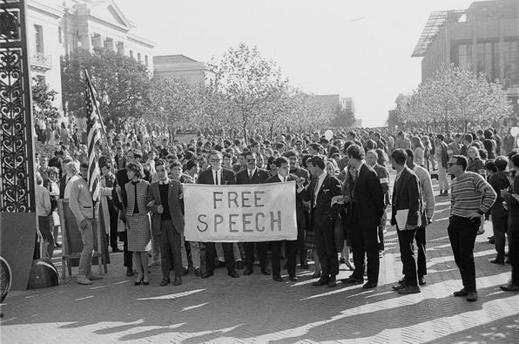
Training
Hold seminars to train employees and students on their First Amendment rights
Discuss the implications of time, place, and manner restrictions
Explain public forums
https://www.mercurynews.com/2017/08/24/uc-berkeley-tries-to-reclaim-its-free-speech-legacy/

Slide 19
Responsibility of Student Organization
BEFORE / DURING THE EVENT
Plan in detail all the event well in advance (at least two weeks)
Make a list of predictions what kind of problems might arise and discuss their prevention with RSO advisor, make a record of the outcome of this discussion
Train members of RSO for a particular event / speech
Act in accordance with the university regulations, state, federal and local law
Contact police if necessary in any case of unsafety
Be responsible for reporting incidents
AFTER THE EVENT
Report the outcome/feedback to advisor and RSO office
Fill out an event evaluation form to examine what worked well /did not work well
Who, how ,and to what extent benefited from the event/speech

Slide 20

Publicity
Consult legal counsel
Review other institutions’ guidelines for dealing with bad publicity
Have Communications office prepare for negative publicity due to outbursts on campus
Discuss stances and actions administration will take

Slide 21
Consensus
Remove the 5 day cap from the guidelines
Make permit good for only 8-hours instead of 24
Enforce rule that speaker cannot interfere with the educational mission
Explicitly state security/safety guidelines
Train faculty/ staff on new guidelines
Set up online concern system

Slide 22
WHY?
Revising the guidelines to limit speech based on time, place, and manner restrictions is necessary to ensure proper order on campus. In order to limit the problems on campus related to outside speakers, employees and students need to be well versed on guidelines as well as the rationality behind them. Limiting controversial speech on “dead days” and in ways that would affect students’ education is pertinent.
Implementing a detailed event approval process will ensure the university is aware of the events happening on campus and the risks that arise. Failure to follow these guidelines would result in immediate dismissal of the event.

Slide 23
Following these guidelines will result in more structured events and less negative consequences on campus.

