Slide 1
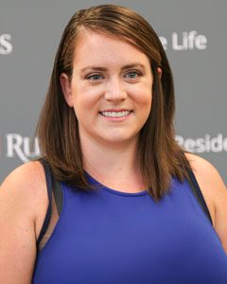
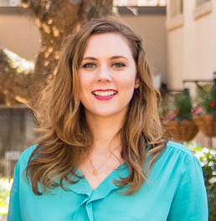
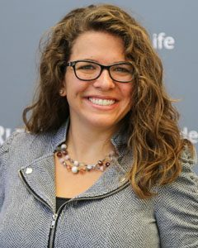
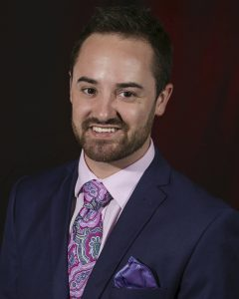
College of Ottery St. Catchpole
Collegiality. Community. Commitment.
Maribeth Scott, Team Leader Rutgers University
Madison Edwards Rutgers University
Micaela Ensminger Rutgers University
Joshua Phillips Rutgers University

Slide 2

Come gather ‘round people
Wherever you roam...
COSC
Collegiality. Community. Commitment.
Notes:
(Dylan, 1964)

Slide 3
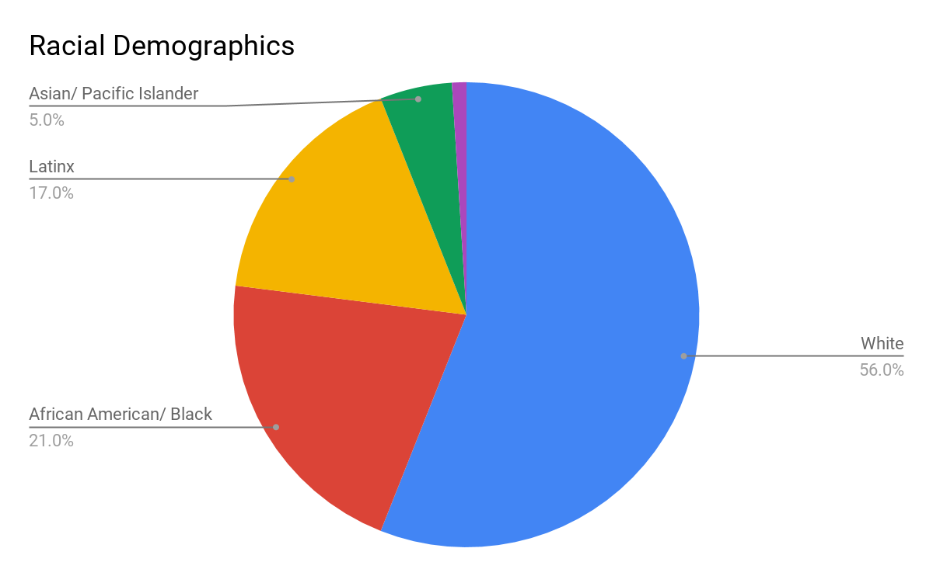
College of Ottery St. Catchpole (COSC)
The College of Ottery St. Catchpole is (COSC) is a mid-size public institution located in suburban northern Virginia.
Primarily White Institution (PWI)
  56% White
  21% African American/ Black
  17% Latinx
  5% Asian/ Pacific Islander
  1% Native/ Indigenous
7,500 student population
Variety of student organization representing both cultural and political diversity
Mascot: Ollivander the Otter
COSC
Collegiality. Community. Commitment.

Slide 4
Mission and Values
The College of Ottery St. Catchpole strives to be a haven of high-quality liberal arts education that remains focused on holistic development.
Mission: The College of Ottery St. Catchpole provides students opportunities for growth and development in civic engagement, leadership, and critical thinking in order to become active citizens in an increasingly global world.
Our school is centered on three foundational principles and values:
Collegiality: As fellow citizens and scholars in a democratic society, we build an atmosphere of informed and impassioned inquiry, advocacy, and collegiality free of bias in all aspects of the university experience.
Community: As a public institution, we value a diverse, inclusive, and engaged community of students, faculty, staff, and off-campus community members working together for the common good.
Commitment: We are committed to respecting the traditions and history of the COSC campus while also upholding the dignity and well-being of all members of the COSC community.
COSC
Collegiality. Community. Commitment.

Slide 5
It’ll soon shake your windows and rattle your walls...
COSC
Collegiality. Community. Commitment.
Notes:
(Dylan, 1964)

Slide 6
Overview of Incident
Recognized student organization brought Lucius Umbridge to campus
  Event was open to all of campus as well as community members
  Central themes of talk were “purity,” “power,” and “nationalism”
Event became violent
  Students began shouting and eventually began pushing one another
Campus police were on-site
  Dispersed crowd and community members
  No injuries or arrests
Dean of Students office charged with identifying a committee to review guidelines for speakers and events
COSC
Collegiality. Community. Commitment.

Slide 7
Admit that the waters
Around you have grown...
COSC
Collegiality. Community. Commitment.
Notes:
(Dylan, 1964)

Slide 8
Overview of Policies at the Time of the Incident
Adapted piecemeal as institution grew over time
  Primarily reactionary in nature
  Forms were rarely revised
  Departments were siloed
3 paper forms for student clubs to submit for approval:
1. General event notification to Campus Activities Board (CAB)
2. Space reservation
3. Campus police (if needed based on expected attendance)
Forms required for hosting non-COSC affiliated speakers
Lack of accountability or consequence for clubs who do not follow procedure
No formal oversight of outdoor space by Space Management Team
No vetting process for guest speakers
No formal guidelines regarding (im)proper student conduct at CAB-approved events
COSC
Collegiality. Community. Commitment.

Slide 9
Overview of Current Forms
Form 1 (General Info)
Submitted to CAB
Sponsoring Club(s)
Speaker’s Name
Speaker’s Contact Info
Speaker’s Contract and Payment Info
Date, Time, Duration of Event
Nature of Event (Lecture, Rally, Workshop, etc.)
Marketing for Event (digital copy of poster, email, etc.)
Form 2 (Space Reservation)
Submitted to Student Affairs Space Management Team
Sponsoring Club(s)
Speaker’s Name
Date, Time, Duration of Event
Nature of Event (Lecture, Rally, Etc.)
Expected Number of Attendees
Openness of Event (Open to Public, Ticketed Event, Etc.)
Campus Police Requested or Required?
Form 3 (Request for Officers)
Submitted to Campus Police
Sponsoring Club(s)
Date, Time, Duration of Event
Nature of Event (Lecture, Rally, Workshop, etc.)
Location of Event
Open To Public? Y/N
Students Only? Y/N
Admissions Fee? Y/N
Expected Attendees?
Number of officers requested?
Overtime needed? Y/N
COSC
Collegiality. Community. Commitment.

Slide 10
Campus Police Presence
Police presence can be requested at any event
Police presence is required if event attendance is anticipated to be 100+
  Process:
    Student club completes Form 3
    Chief of Police decides number of officers needed based on projected attendance
Cost of police presence:
  Officially and currently, if 2+ officers are required/requested, the student clubs are responsible for covering the cost of the officers’ overtime pay at $60/hour
  In practice, the Division of Student Affairs covers these costs most of the time
COSC
Collegiality. Community. Commitment.

Slide 11
You better start swimming or
You’ll sink like a stone…
COSC
Collegiality. Community. Commitment.
Notes:
(Dylan, 1964)

Slide 12
Problems Identified
Forms are repetitive and not a good use of time and resources
No single individual or team has all of the pertinent information regarding events
Three different approving/denying parties create a convoluted system:
a. No accountability on student clubs to complete form revisions if any party denies
b. Creates discrepancies in records among departments regarding events
Events and actions of COSC-affiliated speakers and clubs often not accounted for in form submission process
No one manages the outdoor spaces on campus
Discrepancy between practice and policy as to who pays for campus police presence and overtime
COSC
Collegiality. Community. Commitment.
Notes:
Problem 3: For example, if CAB and Space Management have approved the event, but Campus Police has denied the request, there is no accountability for students to then revise the two other forms, or report back to CAB/Space Management that changes will be made to their proposed event.

Slide 13
Don’t stand in the doorway, don’t block up the hall
For he that gets hurt will
be he who has stalled...
COSC
Collegiality. Community. Commitment.
Notes:
(Dylan, 1964)

Slide 14
Timeline: Short-Term
Staffing
Appointment of CAB advisor (a volunteer staff member who will approve/deny events)
Forms
Purchase Wufoo access; transfer forms from hard copy to online
Meeting
Campus Police and senior student affairs leadership
Committee Formation
Create new “Campus Activism Committee”
Immediate
Immediate
Immediate
Within 1 month
COSC
Collegiality. Community. Commitment.
Notes:
Staffing & Forms - Students will be made aware of this process ASAP.
- A leader from the sponsoring org(s) should gather all necessary information and fill out a comprehensive form online (using the new Wufoo platform) including the following, no fewer than 6 weeks away from their proposed event (longer if requesting a frequently used space/large space):
- Within 1 week, the new CAB advisor will schedule a meeting with this student leader to go over details and highlight anything that may need revision. This is also a time in which both parties should bring up any concerns that may have arisen that are outside the scope of the form:
-Example 1: Students are planning a march for BLM and have concerns about an overt police presence.
-Example 2: Advisor knows the reputation of the speaker and suggests a higher police presence outside of the event and/or ticketing admission (still free) even if the anticipated attendance might not otherwise suggest it.
*This should be an open conversation, and we put our trust in our student leaders to bring forth their questions and concerns.
-Within 2 weeks, any changes to the proposal should be made to the original Wufoo form and resubmitted (if necessary).
-Final submissions will be approved through CAB advisor. Once form is Approved, Space Management and Campus Police will get an automated kickback so they are aware of the event (4 weeks prior).
Meeting - This meeting will be to address the fact that the COSC SA team feels that errors were made during the time of the incident, particularly that there were documented physical altercations but no arrests were made, nor were students referred to conduct for their behavior. We wish to discuss, from both parties perspectives, ways in which protocol was and was not followed, and how we can do better in the future.
Committee Formation - A group of staff, faculty, students and other stakeholders will be formed to help shape new policy, provide valuable insight based on their relationship to the university, and benchmark best practices for COSC to adopt moving forward.

Slide 15
Timeline: Long-Term
Town Hall
Bring student voices into policy and procedure changes moving forward
Education
Implement workshops on exploring civil discourse & difficult dialogue
Budget
Reallocate funds to pay for Campus Police presence at speaker events to CAB
Restorative Justice
Implement processing circles for future events
Assessment
Small and large scale assessment to examine success of policies and stakeholder satisfaction
2 months
~3-6 months
~6-8 months
Ongoing
Ongoing
COSC
Collegiality. Community. Commitment.
Notes:
Budget - Funds will be reallocated so that CAB has a Campus Police budget line item. Each group will no longer be responsible for their own campus police budget, which is a deterrent to 1) hosting large scale events and 2) utilizing the proper avenues. This system now allows diversity of thought, civic discourse. This budget will be reallocated from Division of Student Affairs.
Restorative Justice – Restorative justice can only be used for non-violent violations of community standards (Goldblum, 2009). For violent violations, standard punitive conduct processes still apply. By using a restorative justice model going forward, we hope that students realize that their actions are considered violations of people, relationships, and community (Goldblum, 2009). Processing circles will occur after events where students become impassioned or enraged and will consist of two parts: 1) separate circles for each view point for open expression) of emotion and/or pain caused from said event 2)opportunity to come to discuss implications of community harm and ways we can repair or move forward from damage.

Slide 16
Town Hall & Student Involvement
Student activism and involvement is developmental, not detrimental (Biddix, Somers, & Polman, 2009)
Town Hall
Invite students to learn about and process potential policies in a brave space
Bring in advisors and student leaders from student groups (cultural centers, political groups, etc.) to ensure wide representation
Campus Activism Committee
Ensure student voices are heard through committee representation of student leaders
Put our mission into action: give students a chance to demonstrate civic leadership & democratic engagement (Hamrick, 1998)
Civil Discourse Workshops
Students and administrators collaborate to explore what a culture of civil discourse could look like for this campus
Educates university stakeholders about laws and rights, while also working to change attitudes and culture
COSC
Collegiality. Community. Commitment.
Notes:
Town Hall - Involving students in the process of implementing and evaluating new policies and procedures is critical to the success of this initiative. Research shows that students are more likely to view administrators in a positive light if they are able to work alongside staff and faculty in their activism efforts (Harrison & Mather, 2017). Hosting a town hall will allow students to learn about the proposed policies and procedures, and give students a space to process and discuss issues surrounding activism (Uecker, 2011). Research shows that students tend to view university administrators as gate keepers rather than collaborators when it comes to activism (Hoffman & Mitchell, 2016), so we will invite advisors from student organizations representing cultural and political diversity to begin the process of student and staff collaboration with an administrator that students trust.
Campus Activism Committee – Students will be invited to the table in order for administrators to remain transparent to the student body with any policy changes moving forward. This provides us an opportunity to put our university mission into action by allowing students to practice collegiality, community and commitment.
Civil Discourse Workshops - We will continue to nurture relationships between students and staff through collaborative civil discourse workshops. These workshops will not prescribe what civil discourse should be, but rather allow students and administrators to co-create a culture of collegiality and civil discourse moving forward. Workshops will provide a space for students and staff to learn from each other and think more critically about civil discourse and free speech (Jacoby, 2017). Through this we seek to improve student-staff relationships and foster an environment for student development and learning.

Slide 17
Assessment & Evaluation
Comprehensive
Integration
Utilize assessment methods to evaluate success of policies, stakeholder satisfaction, and identify possible improvements
in all steps
Large Scale: Campus Climate Survey
In the Spring 2019 semester, COSC will implement its first campus climate instrument, the Diverse Learning Environments (DLE) Survey
Small Scale:
Post-Workshop Survey
Students and administrators will fill out a short survey to give a snapshot of learning and satisfaction of workshop curriculum and strategies
Assessment Cycle
Small scale assessments will occur after every workshop and after the town hall; Large scale assessment will occur 1x a year for first two years, then every other
year after that
COSC
Collegiality. Community. Commitment.
Notes:
Comprehensive Integration - We will follow an eight step assessment process to guide our assessment cycle in order to ensure we are doing thorough and accurate assessment work (Schuh, Biddix, Dean & Kinzie, 2016).
Large Scale: Campus Climate Survey - Through the DLE, we will be able to:
1. Get a sense of perceptions of campus identity/diversity; student actions to bias; and the feelings of how diverse viewpoints are welcomed or not welcomed on our campus.
2. Benchmark against other similar institutions who will have participated in the DLE.
3. Better understand our students viewpoints, particularly around diversity, inclusion and acceptance at their COSC home.
4. Move ahead with previously mentioned long-term solutions, while continuing to get new ideas of how we can make our campus community more safe, inclusive and collegial.

Slide 18
Benchmarking: Magic10 Conference
Topics for Benchmarking
Speaker Policies
Protest and Demonstration Policies
Reactionary Measures
Budgets
Models of Partnership Between SA Leaders and Campus Police
Assessment Methods
Restorative Justice Practices
Peers and Aspirational Peers
in Magic10 Conference
St. Mungo’s Medical University
Lumos College
Weasley & McGonagall University
College of King’s Cross
University of Grimmauld
Hogsmeade University
Godric’s Hollow College
The Gringotts School
Granger School of Science and Math
College of Ottery St. Catchpole
COSC
Collegiality. Community. Commitment.

Slide 19
Proposed Budget: Overview
Small Scale Assessment Materials $100
Campus Climate Survey $3,500
Wufoo $350
Overtime for Campus Police $7,500
Town Hall Marketing $100
Workshop Marketing $100
Grand Total: $11,650
COSC
Collegiality. Community. Commitment.
Notes:
Campus Climate Survey – Estimate from UCLA HERI (2017)
Wufoo – Estimate from Wufoo (2018)

Slide 20
References
Biddix, J. P., Somers, P. A., & Polman, J. L. (2009). Protest reconsidered: Identifying democratic and civic engagement
learning outcomes. Innovative Higher Education, 34, 133-47. doi:10.1007/s10755-009-9101-8
Dylan, B. (1964). The times they are a-changin’. On The times they are a-changin’ [CD]. New York City: Columbia
Records. (1963).
Goldblum, A. (2009). Restorative justice from theory to practice. In J.M. Schrage & N.G. Giacomini (Eds.) Reframing
Campus Conflict: Student Conduct Practice Through a Social Justice Lens. Virginia: Stylus.
Hamrick, F. A. (1998). Democratic citizenship and student activism. Journal of College Student
Development, 39(5), 449.
Higher Education Research Institute (2017). Fee calculator. Retrieved from https://heri.ucla.edu/fee-calculator/
COSC
Collegiality. Community. Commitment.

Slide 21
References (Continued)
Hoffman, G. D., & Mitchell, T. D. (2016). Making diversity "Everyone's business": A discourse analysis of institutional
responses to student activism for equity and inclusion. Journal of Diversity In Higher Education, 9(3), 277-
289.
Harrison, L. M., & Mather, P. C. (2017). Making meaning of student activism: student activist and administrator
perspectives. Mid-Western Educational Researcher, 29(2).
Jacoby, B. (2017). The New Student Activism: Supporting Students as Agents of Social Change. Journal Of College And
Character, 18(1), 1-8.
Uecker, T.W. (2011). How Do Campus Administrators Go Beyond the First Amendment in Achieving Balance Between
Free Speech and Civil Discourse? In P.M. Magolda and M. B. Baxter-Magolda (Eds.), Contested Issues in
Student Affairs: Diverse Perspectives and Respectful Dialogue (pp. 354-364). Sterling, Virginia: Stylus
Publishing.
Wufoo (2018). Plans & pricing. Retrieved from https://www.wufoo.com/pricing/
COSC
Collegiality. Community. Commitment.

