Slide 1
Case Study
Old Dominion University
By: Abagael Woleschok, Brandon Bassham, Hannah Sawyers, and Jenna Read

Slide 2
“If we protect college students today from opposing views and diverse perspectives through ‘speech codes’ or other restrictions on free expression, we do them a great disservice, because we’re leaving them unprepared for the intellectual and social fray that they will enter the moment they step off our campuses”
President Teresa Sullivan, University of Virginia

Slide 3
University Demographics
Four Year Public Institution
Urban Setting
20,000 Undergraduate Students
4,500 Graduate Students
Minority Serving Institution
Military Affiliated

Slide 4
What’s Already in Place
University Offices and Student Organizations:
  Must fill out an Event Request Form
  Preferred location, type of event, event name, and who is sponsoring the event
  Events will be approved if a location is available for use
Off-Campus guests:
  Must fill out an Off-Campus Sponsor Event Form with the same information
  While the University will assist any quest in the reservation process, there is no policy stating this does or does not equal University support/sponsorship
Campus Security:
  Are not required to be at any events on campus
Advisors
  Are not required to attend the events of any student organization they advise

Slide 5
Proposed Changes

Slide 6
Designated Forums
Designated Forums:
  Parts of the campus only available during certain times approved by the University
  Times and locations can be reserved to ask for approval or the University may determine this beforehand
  Examples include
  Only available to groups of 50 people or less
  Does need reservations or prior approval

Slide 7
Public Forums
Public Forums:
  University designated areas where public expression/speech is allowed
  Can be University streets, sidewalks, parks, and other common areas
  Only available to groups of 25 people or less
  Open to groups not sponsored by Offices or Student Organizations
  Does need reservations or prior approval

Slide 8
Non-Public Forums
Non-Public Forums:
  Areas not traditionally used for public communication
  Will only be used for their intended purpose and not for public expression
  Examples include, but are not limited to, classrooms, residence halls, offices, academic buildings, administration buildings, libraries, and laboratories
  Outside Speakers/Guests can reserve these locations per approval by the University
  Does need reservations or prior approval

Slide 9
Event/Crowd Size
Certain buildings/Forums will have crowd restrictions to reduce risk to event goers
  Outside events not designated at Public Forums will have an attendance limit of fifty people
  Any event expected to go above the 50 people limit must reserve locations such as auditoriums, stadiums, meeting rooms, and other University approved areas that were built with this purpose
Security
  The sponsoring organization or external group will notify Campus Safety (university police) if anticipated attendance is more than 200 people
  If deemed necessary by Campus Safety, the sponsoring organization or external group will provide contracted security personnel

Slide 10
Disclaimers for Outside Speakers/Events
Ideas or expressions put forth in expressive activities/events are not necessarily the views of the University, its officers, administrators, or leaders, unless otherwise noted
The University will reserve the right to end/deny any event disrupting or will potentially disrupt the normal operations of the University including , but not limited to, classes and Residence Halls. The University may also end/deny any event that may result in physical damage of university property or invade the rights and safety of students or Faculty/Staff

Slide 11
Disclaimers for Outside Speakers/Events
Sound Equipment will be allowed unless otherwise stated, but cannot interrupt academic courses or cause disruption at Residence Halls or Academic offices
No event may inhibit vehicular or pedestrian traffic
The university reserves the right to locate any assembly (with Campus Guest insight) so as to ensure that the activity does not interfere with the normal operation of the university or interfere with the rights of others
The University will not permit targeted harassment or threats, or speech that creates a pervasively hostile environment for vulnerable students

Slide 12
Event Request Forms
Must be filled out and submitted for any event that must be registered on a timely basis of at least two weeks before the event date
Will require:
  Sponsor(s) of the event
  Contact information for one individual who will be present during the course of the event
  Location, date and time requested for the event
  Advisor of Student Organization (if applicable)
  General purpose of the event
  List of planned activities (i.e. speech or rally, march with signs, distribution of literature, sit-in)
  Special equipment requested
  Anticipated attendance

Slide 13
Events Request Forms
This information will be reviewed by a committee of two people to determine the ability of space, promote campus safety, and ensure policies and procedures are followed.
Off-Campus Guests will be required to submit a contract with the University or sponsoring Office Organization that will also be reviewed

Slide 14
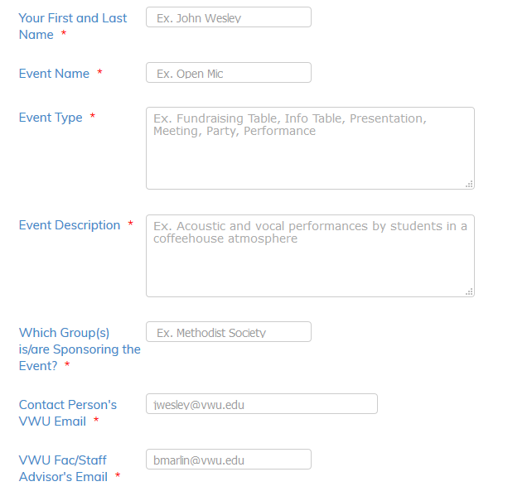

Slide 15
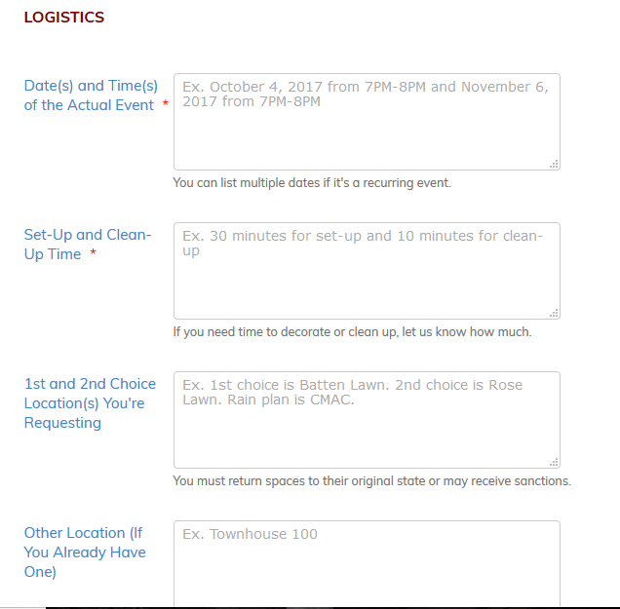

Slide 16
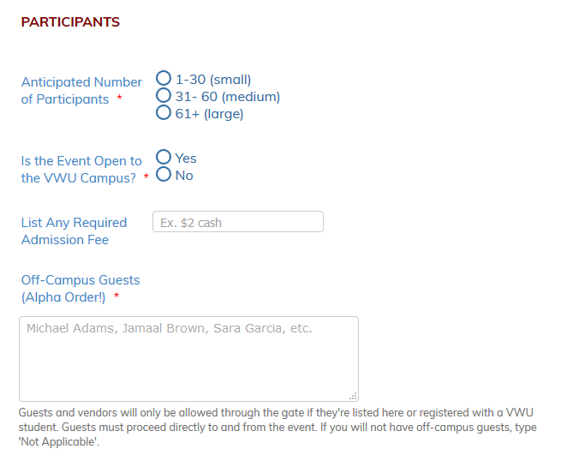

Slide 17
Time, Place, and Manner Restrictions
Expressive activities must not:
Attract a crowd larger than the requested location of activity can safely contain
Disrupt university activities inside or outside of buildings (including classes)
Disrupt previously scheduled campus events
Obstruct entrances or exits to buildings
Obstruct vehicular or pedestrian traffic
Represent a threat to public safety, according to the discretion of university police
Include camping or the use of temporary shelter
Affix items to permanent structures
Light any material on fire; hand-held candles may be used with prior permission

Slide 18
Cost
Who pays for the speaker to come to campus?
  Upon the approval of the speaker, the conversation will happen of how much the university is going to cover for the speaker to come
Who pays if there are damages?
  If damage is done during the event, the speaker will be responsible for paying 25% of the amount of damages and the student organization will be responsible for the other 75% of the cost of damages.

Slide 19
References
Appendix XI: Texas A&M Rules on Freedom of Expression. (n.d.). Retrieved February 21, 2018, from student-rules.tamu.edu
Freedom of Expression Policy. (n.d.). Retrieved February 21, 2018, from http://dos.uga.edu/content_page/freedom-of-expression-policy

