Slide 1

Addressing Outside Speakers/Events at Hogwarts University
Louisiana State University Case Study Group
Team Leader: Tori Callais, Matt Dean, Danielle Ford, Brittani Williams

Slide 2
Overview
Comparison of what exists and the proposed guidelines
Guidelines for Students and Student Organizations
Guidelines for University Leadership
Guidelines for Faculty and Staff

Slide 3
Current Guidelines
Proposed Guidelines
Register every student organization event with the Office of Student Organizations
Preapproval may be requested without clear guidelines as to how content is selected
Must reserve space ahead of time
Must advertise for individual events
** Current guidelines do not specifically outline procedure for outside speakers and events, very broad and unclear**
Train leadership, faculty, and staff on 1st amendment rights of students
Campus Emergency Plan( How to Respond) for if an event creates a safety concern
Policy for what spaces on campus allow unscheduled public speaking areas
Preapproval process for all student organizations events with specific guidelines to how to reserve a space, how to reserve security, etc.
Promote free exchange of ideas for the campus community in general as long as they do not: interfere with a spaces normal/primary use, conflict with scheduled uses of the space, delay traffic (pedestrian, vehicle), interfere with normal routine/activities. (Defending individual rights in HE, n.d.)

Slide 4
Guidelines for Students and Student Organizations
Notes:
It is important for students to understand their rights but also for them to understand the limits to their rights: freedoms are not absolute. Certain forms of speech are not protected by the First Amendment and may also be unlawful. Students have the right to dissent or engage in protest but only if done lawfully. We detail what constitutes peaceful dissent, which allows students to understand their rights. We also detail procedures that follow our updated policy regarding registered student organizations bringing non-campus affiliated speakers to campus. We do not wish to impede upon student rights, but instead, help them understand their responsibilities as members of our campus community.

Slide 5
Rights & Responsibilities for
HU Students & Student Organizations
Hogwarts University is steadfastly committed to protecting First Amendment rights to Free Speech and Freedom of Expression.
As guaranteed by the Constitution, “students [do not] shed their constitutional rights to freedom of speech or expression at the schoolhouse gate”.
However, First Amendment rights are not absolute.
Speech can be limited if it “involves substantial disorder or invasion of the rights of others”.
Notes:
Tinker v. Des Moines Indep. Community School Dist., 393 U.S. 503, 506 (1969).

Slide 6
The views of non-University affiliated speakers are in no way endorsed by the University.
Invitations to speak at HU give no allowance for unlawful or illegal conduct.
Certain types of speech are not protected; speakers who use forms of unprotected speech will not be allowed to continue.
Students, student organizations, and guests must comply with requests from campus police and other campus officials. Failure to comply may result in disciplinary action.
Students and student organizations who invite non-University affiliated speakers to campus are hosts of said speakers and are responsible for their conduct.

Slide 7
Examples of Unprotected Speech
Obscenity
Fighting Words and True Threats of Violence
Incitement of Disruption or Illegal Activity to Breach the Peace
Defamation
Notes:
Alexander, K. W., & Alexander, K. (2017). Higher education law: policy and perspectives. New York: Routledge.

Slide 8
Dissent
Students may dissent peacefully, but if the dissent interferes with the speaker’s right to speak and the audience’s right to listen, and/or causes or threatens imminent harm, HU campus police and other university officials may remove the dissenters from the event.
Peaceful dissent may include:
  Picketing or distributing literature outside the event as long as it does not block access to the event
  Silent or symbolic protest (such as wearing clothing, gesturing, or standing) is allowed as long as it does not interfere with the audience’s ability to listen or see the speaker
  Chanting or making other noise is not allowed as it impedes the speaker’s ability to speak and audience’s ability to listen
  Engaging in violent or physical acts is never permitted.
Notes:
http://www.studentaffairs.pitt.edu/wp-content/uploads/2016/11/Event-Scheduling-and-Protest-Guidelines_11_2016.pdf

Slide 9
Office of Student Organization’s Guidelines for Inviting Non-University Affiliated Speakers to Campus
Registered Student Organizations (“RSOs”) shall submit an event proposal and University approved contract, which is required for all on-campus events sponsored by a RSO to the OSO. This shall be submitted no later than ten (10) business days before the event.
Security may be required to provide a safe environment for the HU community. OSO will determine if security is required. The hosting RSO shall be responsible for any and all security costs and will be required to contact HU campus police to arrange security.
In all advertisements and communications, the RSO is required to add the following disclaimer: Hogwarts University is committed to providing a safe and secure environment that encourages free expression of thoughts, ideas, and opinions. The use of HU property by any guest or group does not imply or constitute endorsement of said guest or group’s views.

Slide 10
Guidelines for University Leadership Positions
Notes:
From the VPSA to the President of the university, university leadership is responsible for establishing and implementing the policies and procedures of the university in regards to Freedom of Speech issues. University leaders can proactively mitigate risks to the campus while simultaneous reaffirming the universities commitment to the ideals of free speech through the creation and public dissemination of an astute policy statement and emergency management plan. By working together with legal counsel and non-university affiliated partners such as local law enforcement and government officials, leaders can evaluate every situation, in a case by case manner, ensuring that the university’s response encompasses all applicable legal and safety concerns and aligns with the values and mission of the university

Slide 11
Role of university leadership
In today’s environment, universities be proactive in tackling issues of free speech and campus climate.
Leaders are responsible for:
Setting and implementing the institution’s policies and procedures in regards to Freedom of Speech issues,
Creating a comprehensive policy statement that clearly articulates the university’s stance on free speech,
Conducting risk management and campus climate assessments,
Developing a detailed emergency management plan.

Slide 12
Emergency management plan
A well conceived emergency management plan should:
Be based on risk management, campus climate assessment, peer institution research,
Detail chain of command and procedures for what to do if a campus security issue occurs,
Be developed in advance and well disseminated throughout proper organizational channels in order to address risk management concerns and to coordinate a unified response by the university,
Involve all levels of the institution, as well as include any necessary (state/local) governmental actors along with university administration, faculty, staff, and students,
Be updated regularly to account for changes in both laws and universities structures. .

Slide 13
Leadership response to an event/speaker
Should an unforeseen problematic event/speaker arise, a coherent press release, drafted in conjunction with legal counsel, should be swiftly released in order to address any concerns and reiterate the position of the institution.
All staff and faculty should be well-trained to direct any questions to appropriate media relations office.
While university leadership should make every attempt to accommodate free speech, every event or speaker should be evaluated on an individual basis in regards to campus climate and safety.
A cost-benefit analysis should be used by leadership to decide if not allowing a controversial event or speaker on campus is more inline with the mission of the university and beneficial to the institution’s reputation in the court of public opinion than the risk of a potential first amendment based law suit.

Slide 14
Faculty & Staff
Campus Climate Preservation Initiative (CCPI)
Notes:
This portion of the training goes over an initiative set forth by the Office of Student Organizations, to help faculty and staff employed by this office navigate speakers and protest on campus. The slides cover best practices that should be executed as needed with an explanation of how the best practice should be implemented. Lastly, this section covers additional problem solving strategies in the event that a campus climate survey indicates that more information/resources are needed.

Slide 15
CCPI Overview
“The school’s interest are often to preserve operations without disruption and maintain campus safety, as well as to prevent interference with the rights of its students” (Responding to Campus Protests, 2014)
The Office of Student Organizations stakeholders must relay to the campus our “commitment to the free exchange of ideas and responsibility to protect health and safety of the students and preserve the institution’s educational mission” (Responding to Campus Protests, 2014)
It is the position of faculty and staff (also referred to as stakeholders) of this department to support and protect the students while ensuring that their rights are exercised.
Elected response team members will be instructed by to facilitate the CCPI

Slide 16
CCPI Stakeholder Best Practices/Implementation
Speakers/Protesters –
  Notify speaker(s)/protester(s) of speech protections under the first amendment and any legal limitations
  It is ok for the office to utilized off campus resources, such as local police officers as security
Notification–
  Inform students of support within 24 hours of controversial speaker/disruptive protest (Quick Response)
Campus Climate–
  Notify campus police of the situation to assess campus conditions
Assess–
  Poll campus climate with survey before the speaker/protest is scheduled and also within 7 days of controversial speaker

Slide 17
CCPI Problem-Solving Strategies
What Happens When Best Practices Aren’t Enough?
Coordinate extended service hours with campus mental health clinic
Provide students with a list of laws that could be violated during acts of protect or controversial speakers. It is not about limiting students rights, but informing them of the legal ramifications ahead of time so they can plan accordingly.

Slide 18
In conclusion
This committee hopes to guide our university to have a more holistic approach when it comes to outside speakers/events. The safety of our campus community is always our priority, while also encouraging free exchange of ideas. It is our hopes that these proposed guidelines will not only inform students or their rights, but also our professionals who work with students.

Slide 19
References
Alexander, K. W., & Alexander, K. (2017). Higher education law: policy and perspectives. New York: Routledge.
Defending individual rights in higher education. (n.d.). Retrieved February 5, 2018, from https://www.thefire.org/
Event Scheduling and Protest Guidelines. (n.d.). Retrieved February 5, 2018, from http://www.studentaffairs.pitt.edu/wp-content/uploads/2016/11/Event-Scheduling-and-Protest-Guidelines_11_2016.pdf
Kaplin, W. A., & Lee, B. A. (2014). The Law of Higher Education. John Wiley & Sons.
Responding to Campus Protests: A Practitioner Resource -- LEGAL LINKS Connecting Student Affairs and Law Vol 1 Issue 2; 2014 EDUCATION LAW ASSOCIATION A Joint Publication with the Education Law Association & the NASPA Research and Policy Institute
Tinker v. Des Moines Indep. Community School Dist., 393 U.S. 503, 506 (1969).

Slide 20
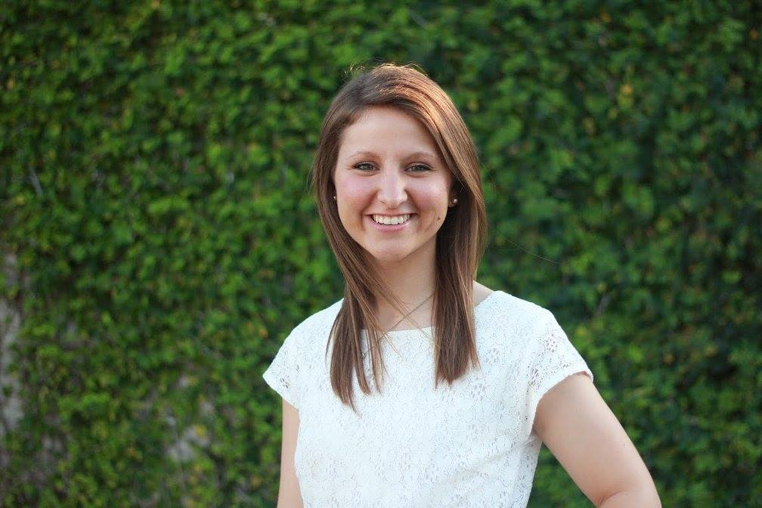
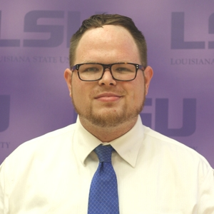
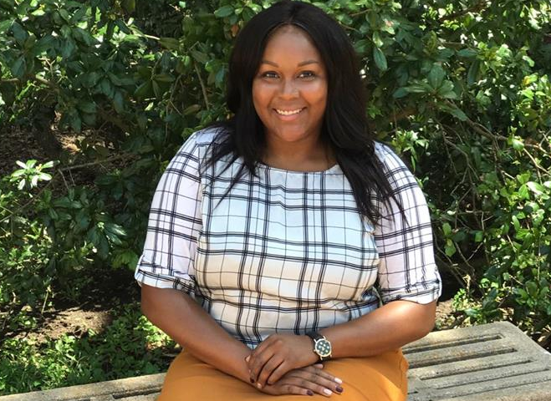
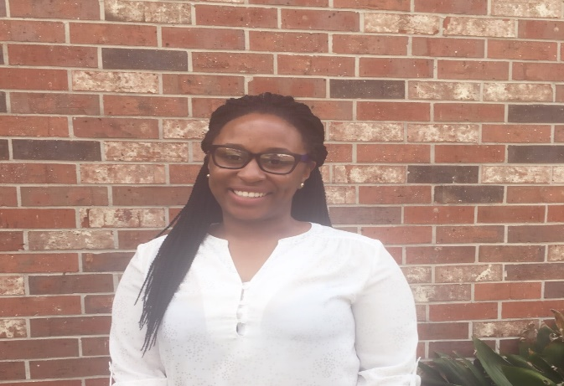
Meet the Authors
Team Leader:
Tori Callais
vcalla1@lsu.edu
Matt Dean
mdean16@lsu.edu
Danielle Ford
dford23@lsu.edu
Brittani Williams
brittaniw@lsu.edu

