Slide 1
StudentAffairs.com Virtual Case Study: Scamander University
Molly Callahan, Wonjae Kim, Gina Mariano, & Emily Zarych
Notes:
Hello everyone.
For our presentation today we will be covering recommendations for controversial speakers on campus specifically for Scamander University. Though what we offer are guidelines, we hope that you will take our suggestions back to your departments to plan more effectively for controversial speakers.

Slide 2
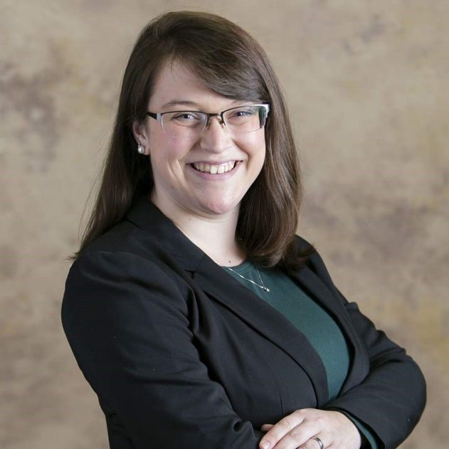
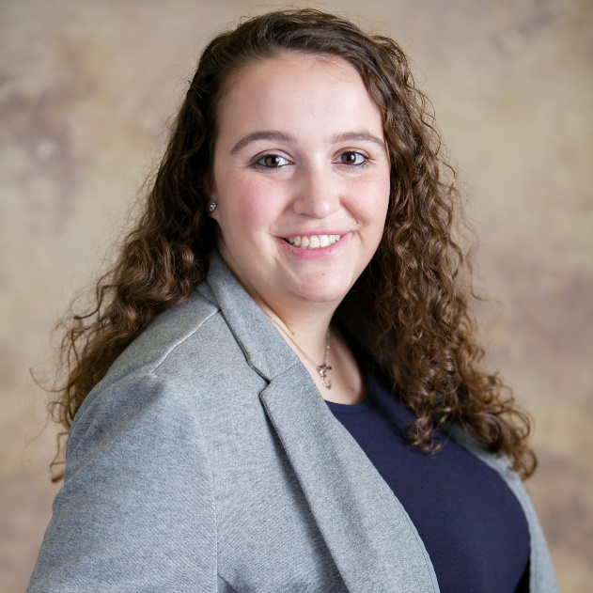
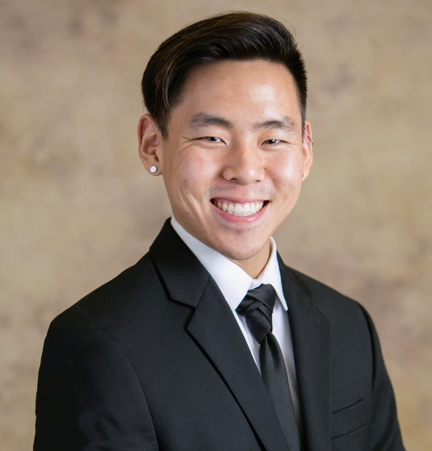
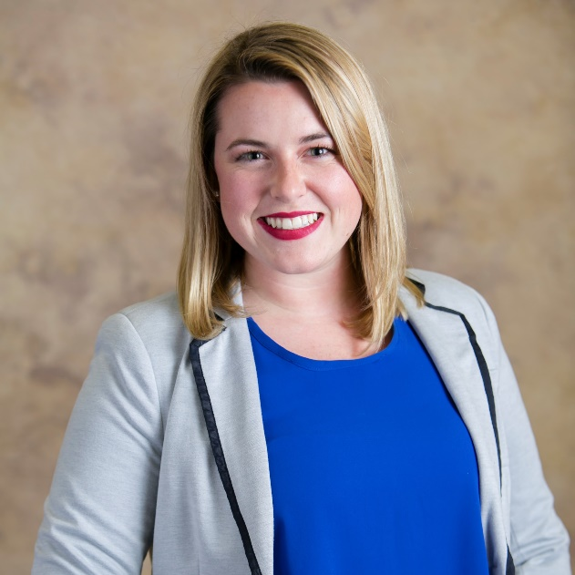
Team Introduction
Hello! My name is Wonjae Kim and I am a first year graduate student in the Counselor Education M.Ed. program at Clemson University. I am the Graduate Assistant for Freshman Academic Programs!
Hello! My name is Emily Zarych and I am a first year graduate student in the Counselor Education M.Ed. program at Clemson University. I am the Graduate Assistant for Leadership Development.
Hello! My name is Molly Callahan and I am a first year graduate student in the Counselor Education M.Ed. program at Clemson University. My assistantship is with University Housing and Dining as a Graduate Community Director.
Hello! My name is Gina Mariano and I am a first year graduate student in the Counselor Education M.Ed. program at Clemson University. I work as the Graduate Assistant in Tiger Media with Campus Activities and Events!
Notes:
Before we begin our presentation, we would like to introduce ourselves.

Slide 3
Objectives
As a result of this presentation, the audience will be able to:
identify theories of student development used to guide our discussion on best practices.
articulate the purpose of First Amendment training and Diversity & Inclusion Training.
list examples of factors to be considered when inviting a speaker to campus.
Notes:
The purpose of this presentation is to provide a space to reflect and discuss campus culture, particularly with regards to free speech and the First Amendment. Campuses nationwide are being faced with major decisions about what kind of speakers and events they can safely and reasonably host. Considerations include student safety, campus security, the definition of free speech, and legal questions.

Slide 4
Theoretical Framework
Chickering
Baxter Magolda
Developmental Vectors
Internal Definition
Developing Competence
Intellectual competence
Managing Emotions
Developing Mature Interpersonal Relationships
Tolerance, acceptance and appreciation of difference
Integrity
Congruence between actions and behaviors
Thinking is black and white
Absolute thinking
Rely on perspectives of others
Cross Roads
Emergence of the inner voice
Environmental Influences to Consider
Self Authorship
Friendships and Student Communities
Student and Faculty Relationships
Student Development Services and Programs
Gray Area
Contextual knowledge
Independent beliefs
Notes:
Chickering’s Developmental Vectors and Baxter Magolda’s Self Authorship Theory (Patton and Renn 2018) were the guiding factors in collecting our guidelines. It is our job to meet students where they are at and by recognizing where they are developmentally we will be able to better assist them in navigating their experiences in college. Considering how Chickering’s environmental factors impact our students, it is critical that we acknowledge all of the psychosocial possibilities for which a student’s development can be influenced positively or negatively.
Baxter Magolda’s epistemological approach to ways in which students think about and consider information is an important conduit to addressing the goals of students bringing speakers to campus. By having critical conversations with your students about their goals and reasoning, you as the helper can assist students in making the best decisions for themselves and their organizations.

Slide 5
Current Guidelines
Student Organization Training on Event Planning
Allows student leaders to be trained on the reservation process and best practices for planning events
Provides information about policies and procedures for facilities use, advertising, and resources available
Centralized Reservation System
Universal digital system run by Campus Activities and Events which allows individuals or organizations to reserve spaces campus-wide
Notes:
Our university has a few systems already in place to assist students and their groups with space reservations. Currently, we host a semesterly training for student leaders to learn about event planning for on-campus events. In this training, we explain the process for reserving spaces through our centralized reservation system, as well as our facility use policy, our advertising policy, and resources available to students and student groups for event planning and hosting. We also provide student leaders with an opportunity to workshop best practices for planning an impactful event with our Graduate Assistants in Campus Activities and Events.
Our centralized reservation system serves as our hub for all campus space reservations. It allows us to coordinate across campus and provide the best service possible to those looking to host events on campus. The system is coordinated by Campus Activities and Events. Through this system we can see what events are happening where and which organizations are putting on those events.

Slide 6
Facility Use Policy
Registration of Free Speech
Ensures that the space requested will be available.
Alerts the university to security measures that may need to be implemented.
Learning First
Activities cannot interfere with the learning of students on campus.
Planning your event around classes that may be happening.
Noise Level
Noise level must be less than 80 decibels and must not carry any farther than 50 feet from the speaker.
Emergency Personnel
University officials or emergency personnel have the final say in whether an event may continue relative to the safety of the attendees or other students.
(Clemson University 2017)
Notes:
Per the current university Facility Use Policy, Scamander University does not want to infringe on the free speech rights of our students and faculty. However, in order to keep our university a safe place for learning, we will refer to the Facility Use Policy here to guide student groups in their use of free speech on campus. We recommend that students register their free speech events with the Facility Reservation System using the Free Speech Registration Form. The most important guidelines of the Facility Use Policy regarding free speech remind students that though their right to protest is upheld, that they must also uphold other students’ rights to a safe place to learn. Before a free speech demonstration should take place, students need to review the policy in regards to where they are planning to have a controversial speaker or free speech demonstration. The parameters of the demonstration including location, noise level and interference with classroom instruction need to be carefully examined before bringing a controversial speaker to campus or even planning an alternative protest event. Most importantly, if a university representative, police officer, or representative from the fire department finds these events dangerous to the campus community, the students must end the event immediately.

Slide 7
First Amendment Training
Why?
Eliminating myths about the First Amendment
Educating students about their rights related to free speech
How?
Semesterly trainings from the Public Relations department
Private trainings using resources from the Public Relations department
For Whom?
Leaders of student organizations
Faculty Advisors
Notes:
Taking your students through a First Amendment Training will be very beneficial regardless of whether or not they decide to bring a controversial speaker to campus. The First Amendment is often understood as being the “free speech”’ amendment but it does not protect all forms of free speech. Students who are aware of the types of speech that are protected can better plan events that will not infringe on those rights. The resources for a First Amendment Training can be found on the Scamander Public Relations page including Frequently Asked Questions and activities to facilitate dialogue about free speech issues on campus. The Public Relations department also does private trainings through their offices for organizations that may require it such as news gathering organizations or political organizations. Anyone can benefit from the First Amendment Training but we especially recommend this for student organization leaders and advisors for those organizations.

Slide 8
Diversity and Inclusion Training
Why?
Create an environment for teachable moments, dialogue, and learning
How?
Through small groups facilitated by trained campus partners
Through activities designed to push people to their learning edge
For Whom?
Leaders of student organizations
Faculty Advisors
(Tisch 2018)
Notes:
We will develop a diversity and inclusion training that will be required of anybody that would like to hold an event on campus. Through a combination of small group facilitation and activities, this training will be a space for students and advisors to engage with one another on why it is important to be mindful of other people’s identities. The training will then move into how to plan respectful, informative, and entertaining events. This training will need to be retaken by an organization if they elect a new student leader or if it has been one year since the training was completed.

Slide 9
Crisis Prevention - Facility Reservation System
Centralized Registration System: online system managed by Campus Activities and Events used to centralize all requests
Approval of events will be based on the following criteria:
Is there a venue with sufficient space for the estimated attendance?
Is there funding for the event?
Has the affiliate provided sufficient time for advertisement?
Has the affiliate notified the office in a timely manner to allow for other organizations to offer alternative programming?
Approval cycle occurs biweekly
Campus Activities and Events will disseminate the information to offices within Student and Academic Affairs
The information will also be posted on WizardQuest
Notes:
All campus affiliates who wish to use any space on campus for an event must use the Centralized Registration System. This system, which is managed through Campus Activities and Events, allows for organization in the management of these requests and allows for proactive planning of alternative programs and security protocol, which helps to maintain the safety of students and attendees. The approval of the events will be based on the following criteria:
Is there a venue with sufficient space for the estimated attendance?
Is there funding for the event?
Has the affiliate provided sufficient time for advertisement?
Has the affiliate notified the office in a timely manner to allow for other organizations to offer alternative programming?
The office will organize and approve the events biweekly. Once all of the events are approved, the office will disseminate the information to the directors of all offices within Student and Academic Affairs within the given cycle. It is the responsibility of the directors to then distribute the information to their respective student organization leaders. The information will also be posted on WizardQuest, the online student organization network.

Slide 10
Security Measures
In the interest of safety, ask yourself and students the following:
Location of the Event
Can the location handle the anticipated crowd the speaker will garner?
Accessibility to the Event
Will the public be admitted to the event?
If the event is college affiliates only, how will proof of affiliation be ensured?
Layout of the Space
If at any point safety codes are broken, what is the response to these violations?
Recommended Room Capacity
Will attendees have individual seats or is this event standing room only?
Will you be able to adhere to room capacity?
Notes:
Security is a critical component for planning any free speech event or controversial speaker. In order to have a safe event, we have outlined some guidelines to keep in mind when planning this event. The location is the first component of planning the event. The location determines how many people will be able to attend and what the setup of the event will be. The accessibility of the event relates to who will be allowed to attend. This could relate to ticketing, card swiping or pre-registering. The layout of the space relates to fire code. The space should be setup to maximum capacity while also keeping in mind how many people are in the room at any given time. Finally, working with the fire department before the event to determine the room capacity will be extremely beneficial for you and your students. This can prevent violation of fire codes before the event happens.

Slide 11
Education of Campus Police and Security
With an increasing number of incidents being documented regarding police and their treatment of people with mental illness and people of color, we are recommending education and training for campus police.
By preparing officers with de-escalation training, the chance of crisis occurring because of a speaker coming to campus will dramatically be reduced (Compton, 2008).
Maslow’s Hierarchy of Needs emphasizes the fulfillment of basic psychological and safety needs before students can begin to feel a sense of belonging.
Inclusive practices allow for marginalized populations on campus to feel safer and more comfortable.
Notes:
Campus police are an integral part in bringing speakers to campus. Student organizations rely on campus police for security before, during, and after the event. The campus police department needs to be adequately trained to work with all types of students on campus including those with mental illness and students of color. Our hope is that by training campus police and security with de-escalation training, we can better serve marginalized populations on campus. Framed through Maslow’s Hierarchy of Needs, safety is a significant component that, as educators, we need to give to all students. By introducing inclusive practices in campus police education and training, we can further provide an environment for all students to thrive.

Slide 12
Working with Campus Partners
Further suggestions to consider as you move forward:
Campus Police and Public Safety
Providing advance notice
Engage in conversations with campus police about any speaker that may gather a large crowd
Day-of operations
How early and late will security need to be present?
Department of Transportation Services
Will traffic patterns or parking need to be supervised?
Residence Life
If there will be a large population of visitors on campus, connect with housing partners so they can inform their staff about anticipated guests within residential spaces.
Counseling Services and Wellness
Consider reaching out to counseling and psychological services and other wellness offices
Providing resources for students to process will assist in campus climate before, during, and after the speaker comes to campus.
Notes:
As you move forward from this presentation, we encourage you to work with campus partners. Even if the Campus Activities and Events department is alerted to a controversial speaker, it is better to coordinate with other offices as soon as possible. By coordinating with other offices on campus, the organization can be sure to uphold best practice with the campus community. When campus partners are alerted by the hosting organization, they are better able to equip themselves with the necessary resources to prepare rather than if they see a flyer advertising the event. The campus partners mentioned above are some of the significant offices we thought to coordinate with. However, we understand that there are more partners on campus that you may want to coordinate with depending on the topic of your event. When planning an event, you want to be mindful of your relationship with campus partners so alerting them to controversial events ahead of time can be very helpful.

Slide 13
Media Influence
Internal Media
Meet with the Public Relations department before the event is marketed
Keep a consistent message within your organization and the university.
(Reason and Lutovsky 2007)
External Media
Create a Communication Plan to respond to media attention.
Understand the goal of external media is to convey crisis and controversy.
(Zdziarski, Dunkel and Rollo 2007)
Notes:
Talk to the Public Relations department at Scamander University before marketing the event. The public relations professionals are trained to create plans with external media before crises happen. However, meeting with the Public Relations department will also alert the university to your event rather than them finding out from the press. These professionals will be able to help you and your students talk to the media if the media should come to you. Only one of the students should be speaking to the Public Relations department in order to keep the message consistent. The organization should be briefed on this message and instructed to relay this. Furthermore, the message should reflect why the organization is bringing the controversial speaker to campus as it aligns to the values of the organization and the university.
Once you have spoken with the Public Relations department at Scarmander University, the next best step would be to create a Communication Plan. This Communication Plan will outline how you will work with the media in the aftermath of the event. Once the media is alerted of a controversial speaker, they will most likely want to interview attendees, coordinators and advisors of the event. Students in the organization need to be aware of how they should be responding to external media questions with a consistent answer throughout. On the other hand, students need to expect that the media will ask questions that create further controversy, as that is their job. Especially if a crisis were to occur in relation to a controversial speaker, students need to be prepared that the media will expand this idea in order to place blame.

Slide 14
Marketing and Communication
Registering the event (Hope 2018)
Alerts other offices on campus to controversial speakers so they can best help their students.
Realizing the event impacts all students on campus.
Aligning to the Mission (Hope 2018)
Thinking about the purpose of the controversial speaker.
How does this speaker relate to personal, organization and university values?
Respectfulness
Communicating to attendees that disrespect will not be tolerated but peaceful protest will be.
Heckler’s Veto (Wright 2017)
Notes:
As students plan controversial speakers, a significant concept is remembering who could be impacted by the speaker. This is why registering the event with the Facility Reservation System is key. Once the Facility Reservation System is aware of the event, they can begin to alert campus partners of students that may be impacted. For example, if an anti-LGBT activist is coming to campus, the Gender and Sexuality Center should be notified so that they can both alert their students as well as create an alternative program which we will discuss in more detail next. In terms of marketing, students need to reflect on the mission of both their organization and the university. Advisors should guide students to think about the purpose of bringing the controversial speaker on campus. This purpose should be reflected in the marketing done for these controversial speakers. On social media, the connection of the mission to the speaker should continue to be carried through. The organization should also communicate to attendees that unlawful behavior will not be tolerated. Attendees to the event must be respectful of what the controversial speaker has to say otherwise they will be removed. Furthermore, attendees should be aware of the heckler’s veto which states that those who come to an event just to badger the speaker will be removed. Educating students on this policy before the actual event is important in making sure that all students are prepared to be respectful.

Slide 15
Alternative Opportunities
Based on the biweekly email from Campus Activities and Events, student organizations will have the opportunity to provide alternative programming if they feel a speaker will be triggering to students.
Potential programs include:
providing a space for dialogue regarding the topic the speaker is presenting on.
create an event that is diametrically opposed to the event (e.g. if an anti-LGBTQIAA+ speaker is coming, planning a drag show)
providing space for self-care (e.g. yoga for wellness event, paint night)
Notes:
When student organizations are bringing controversial speakers to campus, the administration may still struggle with the ethical implications of allowing a speaker that could cause verbal or mental harm to student populations on campus. By leaving room for alternative programming and providing student organizations with the information necessary to prepare an alternative event, we are setting up our campus for opportunities for civil discourse and dialogue.

Slide 16
References
Clemson University. (2017). Facility Use Policy. Retrieved from: https://www.clemson.edu/campus-life/activities-events/venues/facilityuse.html
Development of self-authorship. (2016). In L. D. Patton, K. A. Renn, F. M. Guido, & S J. Quaye (Eds.), Student development in college: theory, research, and practice (3rd ed., pp.355-378). San Franciso, CA: Jossey-Bass & Pfeiffer.
Hope, J. (2018). Stay true to institution's mission while addressing First Amendment issues. Student Affairs Today, 20, 1–5. doi:10.1002/say.30432
Psychosocial identity development. (2016). In L. D. Patton, K. A. Renn, F. M. Guido, & S J. Quaye (Eds.), Student development in college: theory, research, and practice (3rd ed., pp. 287-313). San Franciso, CA: Jossey-Bass & Pfeiffer.
Reason, R. D., & Lutovsky, B. R. (2007). You are not alone: resources for the college administrator. In J. F. L. Jackson & M. C. Terrell (Eds.), Creating and maintaining safe college campuses: a sourcebook for evaluating and enhancing safety programs (pp. 241-260). Sterling, VA: Stylus Publishing, LLC.
Tisch, J. M. (Ed.). (2017). Proceedings from Institute for Democracy & Higher Education ‘17: Free Speech & Inclusion on Campus. Medford, MA: Tufts University.
Wright, R. (2017). The heckler's veto today. Case Western Reserve Law Review, 68(1), 159-188.
Zdziarski E. L., Dunkel N.W., & Rollo J.M., (2007). Campus crisis management: A comprehensive guide to planning, prevention, response and recovery. San Francisco, CA: Jossey-Bass.
Compton, Michael T,M.D., M.P.H., & Chien, V. H., B.A. (2008). Factors related to knowledge retention after crisis intervention team training for police officers.Psychiatric Services, 59(9), 1049-51. Retrieved from http://libproxy.clemson.edu/login?url=https://search.proquest.com/docview/213083379?accountid=6167
Notes:
These are the references outlined that we used in the presentation.

