Slide 1
Addressing the Increasing Population of Students with ASD at Wilbur College
College of William & Mary
Team Leader: Rachel Schotz
Amelia Seagle
Ryan Zapolski

Slide 2
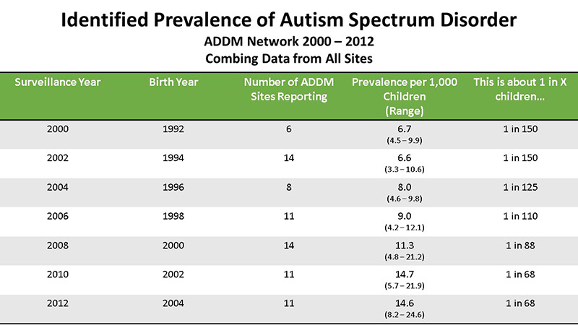
Population of Students with ASD
“There are no clear statistics on college enrollment of students with ASD, but it is estimated that they comprise anywhere from 0.7 percent to 1.9 percent of the college population with an 80% incompletion rate” (VanBergeijk, Klin, & Volkmar, 2008).
Birth years with a large increase in diagnosis are starting to search for and apply to colleges and universities.
(Center for Disease Control and Prevention, 2016)

Slide 3
Wilbur College est 1906
Student Population: 8,324 students
6,497 undergraduate
1,827 graduate
Percent of student population that is considered ASD: 3.2%
266 students

Slide 4
Existing Support for Students with ASD
Early move-in and separate orientation
Student bi-weekly meetings with a member of the Counseling Center or Office of Accessibility Services
Recent initiative to change language has taken place
“Disability” “Accessibility”
2016: 80% rated this “Above Satisfactory”

Slide 5
Why Do More?
Because of the Increase of Students with ASD:
Social involvement is important
Need a structured environment
Opportunities for campus activities to have an effective approach
Need for reducing stigmas attached to students with special needs
Opportunity to increase interaction with diverse students

Slide 6
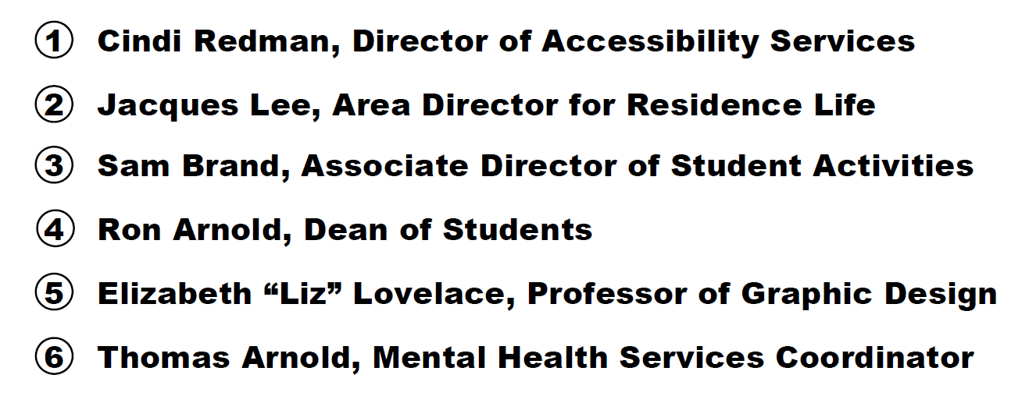
Creating a Task Force

Slide 7
Our Proposition
We hope to increase the campus involvement of students with ASD by:
...offering a separate activities fair the day after the campus-wide fair
Less crowded and easier to navigate
Peer buddy as an option for guidance through the fair
Catered to students’ interests as indicated by their summer survey
...providing a virtual activities fair
Accessible to ALL students
Eliminates uncomfortable social situations
Reduced stimulation for those with sensitivity to light and noise (Shmulsky, Gobbo, & Donahue, 2015, p. 238)

Slide 8
Intended Outcomes - Personal
As a result of the virtual activities fair, all students at Wilbur College, including those with ASD, will have access to identifying clubs of interest.
As a result of meeting with their trained staff member the week before the fair, students with ASD will be able to advocate for themselves on the Activities Fair E-vite regarding whether they need a peer buddy or not.
As a result of meeting with their trained staff member the week before the fair, students with ASD will be able to set goals for how many clubs/organizations they will talk with at the fair and how many clubs/organizations they will join.

Slide 9
Intended Outcomes - Social
As a result of our activities fair, students with ASD will be able to interact with the number of clubs/organizations they set in their goals.
As a result of the virtual and in-person fairs, students with ASD will be able to sign up for at least one social club of interest.
As a result of our activities fair, students at Wilbur College will engage with other diverse students in an open and safe environment.
As a result of the virtual and in-person fairs, students with ASD will be able to participate in a campus ritual without feeling overwhelmed/overstimulated.

Slide 10
Intended Outcomes - Academic
As a result of meeting with their academic adviser’s within a few days after the fairs, students with ASD will be able to increase their time management skills by organizing their schedules to allot for their new clubs and activities.

Slide 11
Outreach to Students with ASD
Survey sent out to students with ASD and their parents
Flier sent out with orientation materials
E-vite sent out mid-summer
Announcement made at orientation
* Fliers will also be on-hand in Accessibility Services, the Counseling Center, and Academic Advising

Slide 12
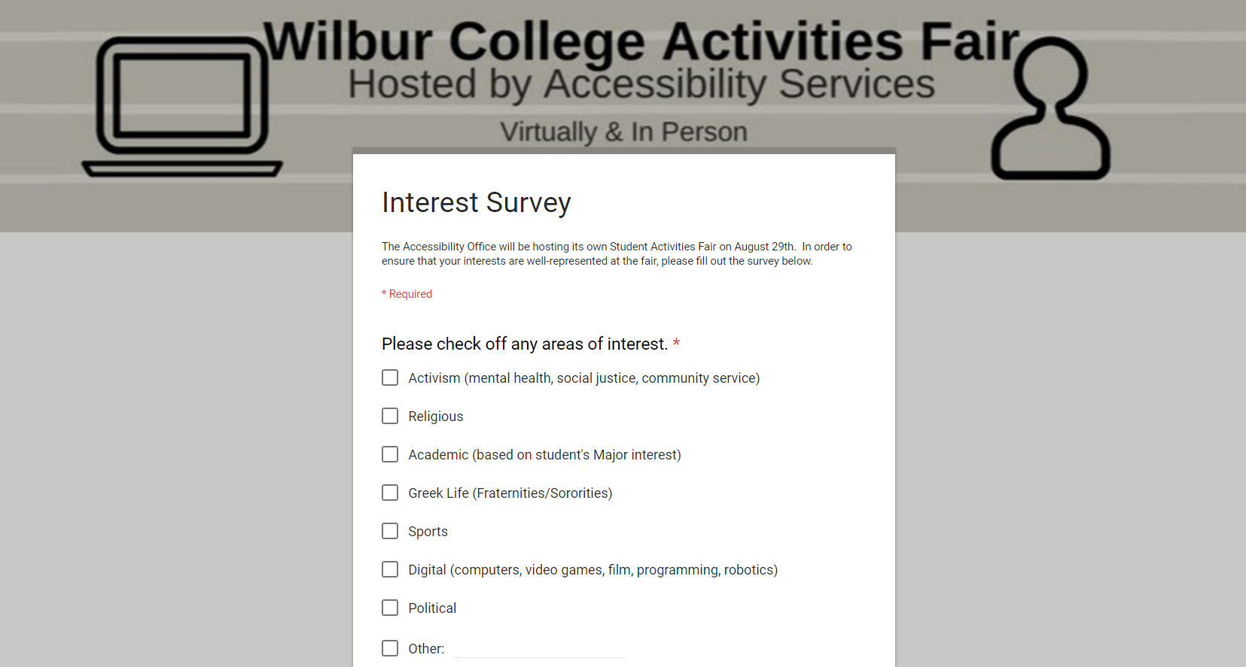
Survey Sample

Slide 13
Flier Sample
Notes:
Eliminate this slide?

Slide 14
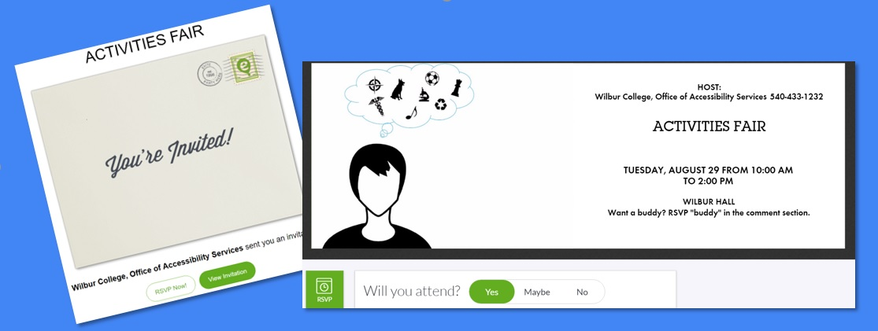
E-vite Sample

Slide 15
Outreach to Organizations
With the help of the Associate Director of Student Activities, we will:
Use database from campus-wide fair to get contact information for clubs/orgs
Include virtual fair information in campus-wide fair marketing materials
Send out two mass emails, based on our student survey results
1 targeting organizations that were popular on the surveys
“Students with ASD specifically took interest in your club”
1 targeting all other organizations
“An opportunity to engage with diverse students”

Slide 16
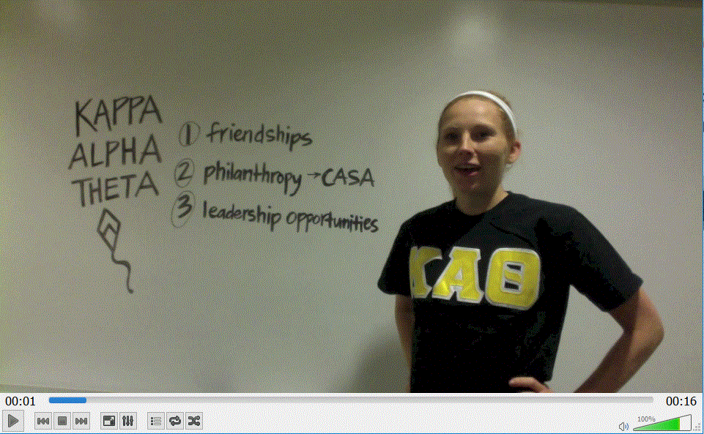
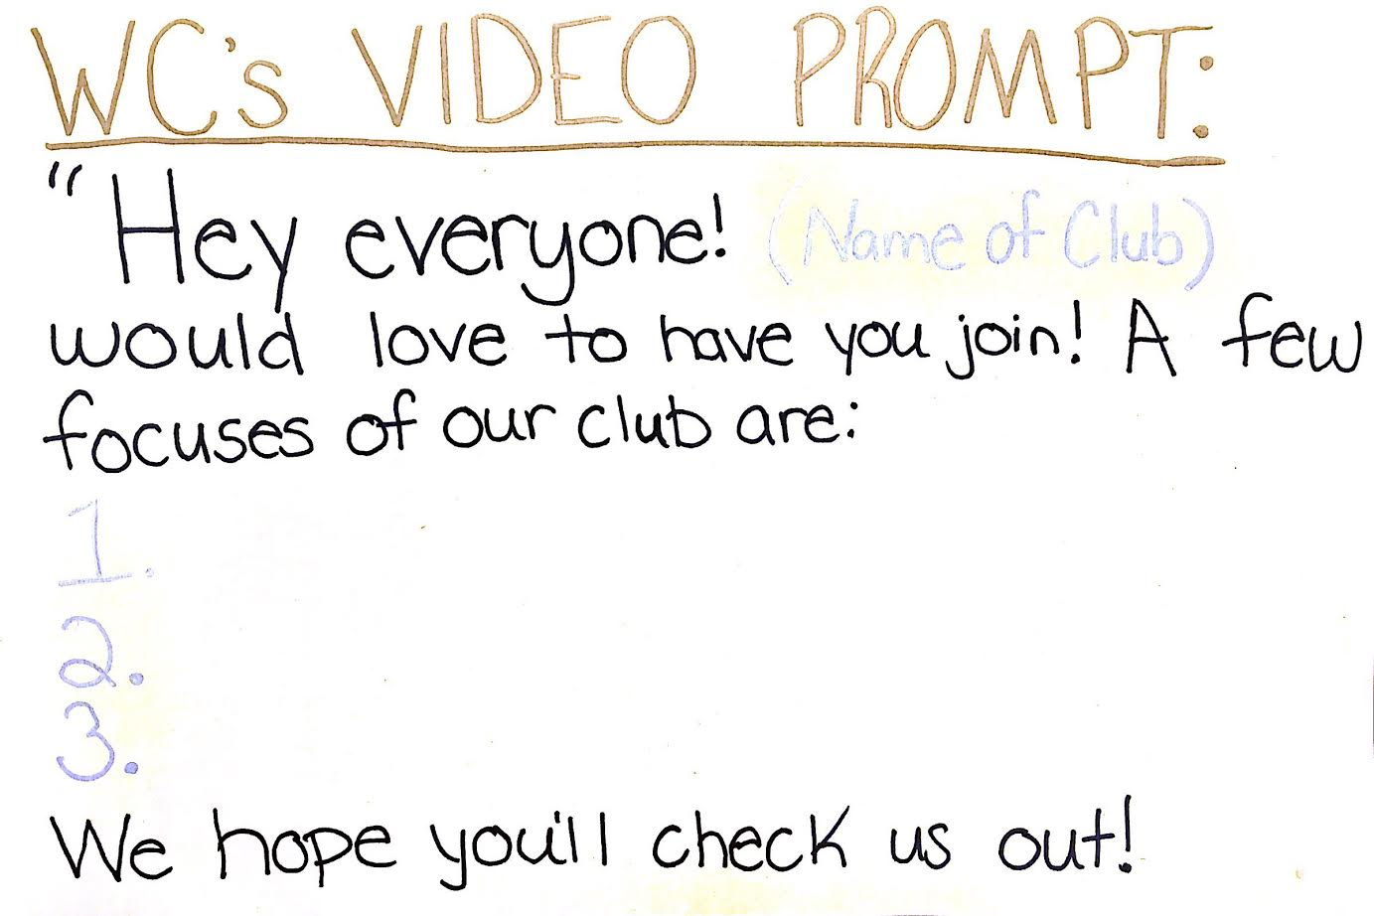
Video Sample for Virtual Fair
Snapshot of a Sample Video!

Slide 17
Buddy System
Why?
Students with ASD may want help navigating the fair
Provides a social experience, while easing the pressures of the fair
Who?
Buddies will be student volunteers from the Office of Accessibility Services
Buddies will:
-Reach out to their assigned student before the event
-Meet their assigned student at their dorm, walk to the fair, go to the fair, and walk with them to their next destination

Slide 18
The Activity Fair
Layout design allows for:
One-way movement
Decreased chance of overwhelming students
Accessibility Services tables to help facilitate the event, and provide information for our existing programming
Representation of other campus support offices
Wilbur Hall
*Not to scale
Accessibility Services

Slide 19
Follow-up with Academic Advisers
While there are some students who extensively plan, others struggle at creating a new schedule, and procrastinate before starting new tasks. This leads to students feeling overwhelmed, which inhibits their overall lives (Van Hees, Moyson, & Roeyers, 2014).
Academic Advisers will Help Students with ASD:
Determine an efficient schedule after the club fair
Plan out when they need to be at class and finish homework
Find time to attend their clubs

Slide 20
Timeline of Program Development
April
July
Mid-August
Video Campus Organizations
Send Interest Surveys to Families and Students
Mid-August
Reach Out to Student Orgs
August 28
Train Peer Buddies
May
Campus-wide Fair
Virtual Fair Goes Live
Create Collateral
May
Beginning of August
Late August
Create Website for Virtual Fair
Send E-vite to Students with ASD
Advertise Fairs at Students with ASD Orientation
Mid-August
August 29
June
Counselors/Advisors Promote Event and Buddy Option
Fair for Students with ASD
Finalize Collateral and Print

Slide 21
Budget
Necessary Budget Items:
Event Wayfinding/Signage
Estimated: $500
Marketing Materials
Estimated: $300
Total estimate: $800
Additional Budget Items:
Professional Videographer
Estimated: $1200
Total estimate: $1200
Total Requested Budget: $2000

Slide 22
Making a Difference
“It is essential that students with ASD have advanced preparation with social skills, self-advocacy skills, and organizational skills in order to transition successfully to postsecondary education settings” (Ciccantelli, 2011, p. 53).
New accessible club fair options + services already present = help these students find their passion/pursue pre-existing interests
With the largest generational population of students with ASD on the way, we need to get ahead of the curve

Slide 23
References
Ackles, L., Fields, H., & Skinner, R. (2013). A collaborative support model for students on the Autism Spectrum in college and university housing. Journal Of College & University Student Housing, 39/40(2/1), 200-212.
Center for Disease Control and Prevention. (2016). Identified prevalence of Autism Disorder [chart]. Autism Spectrum Disorder. Retrieved from https://www.cdc.gov/ncbddd/autism/data.html
Ciccantelli, L. A. (2011). College navigation for students with Autism Spectrum Disorder: The need for advanced preparation. Global Education Journal, (2), 53-63.
Davis, Kim. (n.d.). What triggers anxiety for an individual with ASD? Retrieved from https://www.iidc.indiana.edu/pages/What-Triggers-Anxiety-for-an-Individual-with-ASD
Gardiner, E., & Iarocci, G. (2014). Students with Autism Spectrum Disorder in the university context: Peer acceptance predicts intention to volunteer. Journal Of Autism & Developmental Disorders, 44(5), 1008-1017. doi:10.1007/s10803-013-1950-4
Gibbons, M. M., Cihak, D. F., Mynatt, B., & Wilhoit, B. E. (2015). Faculty and student attitudes toward postsecondary education for students with Intellectual Disabilities and Autism. Journal Of Postsecondary Education & Disability, 28(2), 149-162.

Slide 24
References
Hees, V., Moyson, T., & Roeyers, H. (2015). Higher education experiences of students with Autism Spectrum Disorder: Challenges, benefits and support needs. Journal Of Autism & Developmental Disorders, 45(6), 1673-1688. doi:10.1007/s10803-014-2324-2
Hendrickson, J. M., Carson, R., Woods-Groves, S., Mendenhall, J., & Scheidecker, B. (2013). UI REACH: A postsecondary program serving students with Autism and Intellectual Disabilities. Education & Treatment Of Children, 36(4), 169-194.
McKeon, B., Alpern, C. S., & Zager, D. (2013). Promoting academic engagement for college students with Autism Spectrum Disorder. Journal Of Postsecondary Education & Disability, 26(4), 353-366.
Shmulsky, S., Gobbo, K., & Donahue, A. (2015). Groundwork for success: A college transition program for students with ASD. Journal Of Postsecondary Education & Disability, 28(2), 235-241.
VanBergeijk, E., Klin, A., & Volkmar, F. (2008). Supporting more able students on the Autism Spectrum: College and beyond. Journal of Autism and Developmental Disorders, 38(7), 1359-1370. Retrieved from: http://link.springer.com/article/10.1007%2Fs10803-007-0524-8

