Slide 1

Case Study Presentation
Katie Frazier (Team Leader), Anna Williams, & Lydia Bullock
Western Kentucky University

Slide 2
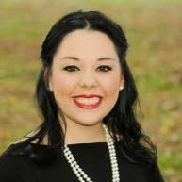
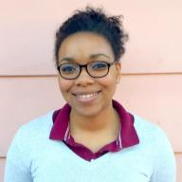
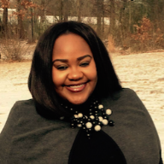
Katie Frazier
Anna Williams
Lydia Bullock
Katie is a second year graduate student in the Student Affairs in Higher Education program at WKU. Katie is a Graduate Assistant in the Office of Student Activities. Her functional areas of interest include Student Activities and Fraternity and Sorority Life.
Anna is a second year graduate student in the Student Affairs in Higher Education program at WKU. Anna is a Graduate Assistant in the Office of Study Abroad & Global Learning and hopes to continue working in international education as a Study Abroad Advisor or a Fellowship Advisor.
Lydia is a first year graduate student in the Student Affairs in Higher Education program at WKU. Lydia is a Graduate Assistant in the Office of Student Activities. Her future plan is to continue working in Student Life and Engagement after graduation.

Slide 3
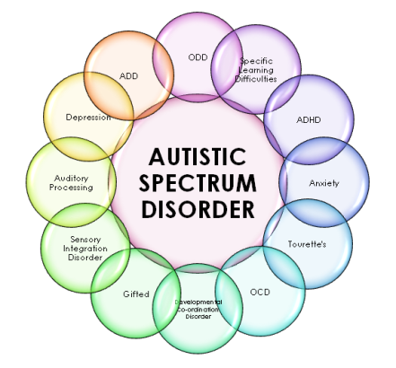
Autism Spectrum Disorder
Autism Spectrum Disorder is a class of neurodevelopmental disorders which include Asperger’s disorder, autistic disorder, pervasive development disorder, and more. ASD can affect each individual differently and those with ASD fall within a range or spectrum between mild and severe impairment. However, ASD can occur without significant intellectual disability. The prevalence of Autism Spectrum Disorder (ASD) has risen considerably in the past two decades (CDC, 2009), and we are seeing a rise in enrollment of students with ASD in higher education. According to recent data of the Centers for Disease Control and Prevention (CDC), 1 out of every 68 children (1.47 %) in the United States has ASD (2009).

Slide 4

College Students with Autism Spectrum Disorder
Students with ASD encounter unique challenges in higher education. Living independently and interacting with peers in a residential college environment can be a major adjustment for these students.
Potential Challenges for Students with ASD in Higher Education
New Situations and Unexpected Changes
Social Interactions
Time Management
Processing New Information/Sensory Overload
Doubts about Disclosing
Mental Health Issues (anxiety, stress, fatigue, depression, etc.)

Slide 5

Considerations
There is much that we can do in higher education to support students on the autism spectrum. We can begin by:
Striving to understand their disability
Complying with key legislation such as the Rehabilitation Act of 1973 and the Americans with Disabilities Act of 1990
Offer quality, consistent services for students with ASD (whether or not they choose to disclose)
Provide training and community education
Find ways to ease the transition to university life

Slide 6

Further Recommendations for Support
A study done by Hees, Moyson, and Roeyers (2014) suggested the following recommendations for services devoted to students with ASD.
Personalized approach
A safe and transparent environment with sufficient planning and clear communication
Academic accommodations
Coaching in education, student life, and daily living
Adequate psychosocial support
Leisure activities and a sufficient amount of rest

Slide 7
TRANSITIONS PROGRAM
An early arrival program to help bridge the gap for first-year students with ASD

Slide 8


Transitions Program Overview
With the previous considerations and our students’ needs in mind, we propose an early arrival program to assist students with ASD with the transition to college.
Students will move into campus housing early for a six week program which will feature extensive academic training and preparation, opportunities to develop social skills and interact with peers, staff, and faculty, and sessions detailing strategies to help students formulate their own routines and coping mechanisms for the stresses of the college environment. The staff for the program will include peer mentors who will help to support the students throughout the academic year, along with staff support from Housing and Residence Life, Disability Services, and Counseling Services. Students who participate in the Transitions Program will be able to enroll is a specially designed University Experience course as well as another regularly scheduled summer class, totaling six credit hours.
For the first year we project 20 students to attend the program.

Slide 9
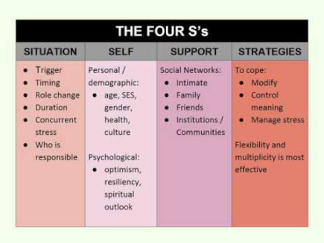
Schlossberg’s Transition Theory
This program was designed to reflect Schlossberg’s Transition Theory which establishes a transition as “any event, or non-event that results in changed relationships, routines, assumptions, and roles”. There are four major factors that influence a person’s ability to cope with a transition:
Situation
Self
Support
Strategies

Slide 10
Transition Program Timeline
August-Hire a Transition Program Coordinator
January-Announce Peer Mentor positions
March-Hire Peer Mentors and have first meeting to go over expectations
April-Meet with Peer Mentors again before the semester ends
Beginning of July-Peers Mentors and Residence Life Staff moves in to train before participants arrive
Third Week in July-Program Begins
Last week of August-Program Concludes
First week of September-Assessment Begins

Slide 11
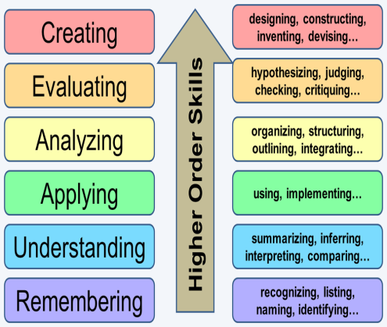
Learning Outcomes
Knowledge: Exhibits previously learned material by recalling terms and facts.
Evaluating: Defending opinions by making judgements about information based on materials.
Analysis: Breaking information into parts by identifying and making inferences and finding evidence to support principles.
Comprehending: Showing an understanding of facts by translating and interpreting informations.

Slide 12
Program Breakdown
Phase I-Orientation (Third Week in July)
Welcome to Campus & Move-in
  Participantss will move on to campus and meet their peer mentors. Each Peer Mentor is assigned two students
Participant begin orientation to program
Participants will participate in hall social opportunities, tour campus, visit with their academic advisor, and have the opportunity to meet with the counseling center
Participants will create their daily schedules with their peer mentors

Slide 13
Program Breakdown
Phase 2-Implementation (Fourth week of July to Mid August)
Participants will begin classes
Participants are expected to meet with their professors outside of class
Participants will attend a Faculty & Accessibility Office Meet & Greet Dinner
Participants will attend hall social programs, presentations about campus involvement
Participants will check-ins with staff to assess their adjustment to campus

Slide 14
Program Breakdown
Phase 3-Integration
Attend Main Campus Orientation social events
Attend Hall Meetings
Continue check ins with staff weekly for first month, biweekly for rest of semester
Discontinue pre-scheduled 1 on 1s with faculty but encourage students to schedule them on their own
Meet with peer mentor weekly for first month, biweekly for rest of semester
Mid-semester check in/social with whole program attendees

Slide 15
Budget
Salaries (1 Coordinator + 10 peer mentors) | $38,000
Training | $2,000
Activities | $ 10,00
Potential Revenues (grants, donations, fundraising) | $ 10,00
Total Proposed Budget | $40,000

Slide 16
After Transitions
After the conclusion of the Transitions
Program, students will be encouraged to remain in contact with faculty and utilize the strategies learned in their first semester.
We encourage students to meet with their peer mentor at least twice a semester.
In addition, students will be contacted to become a peer mentor for the next cohort of students.

Slide 17
Assessment
Students will undergo a pre-test post-test assessment to gage their hesitations, understanding, and readiness for the college environment.
At the conclusion of the semester, students will participate in semi-structured interviews or a focus group, depending on student preference, to reflect upon their time in the Transitions Program.

Slide 18
Conclusion
We believe that the Transition Program will aid students on the Autism Spectrum will the tools to make the transition to college easier.

Slide 19
Resources & References
A Collaborative Support Model for Students on the Autism Spectrum
College Students on the Autism Spectrum: Prevalence and Associated Problems
Higher Education Experiences of Students with Autism Spectrum Disorder: Challenges, Benefits, and Support Needs
How One College Helps Students with Learning Disabilities Find Their Way
Along the Autism Spectrum, a Path Through Campus Life
Autism Spectrum Awareness Video
Landmark College
Schlossberg's Transition Theory

