Slide 1
Supporting Students on the Autism Spectrum
University of San Diego case study team:
Linh Nguyen, Erin Fischer, David Horber

Slide 2
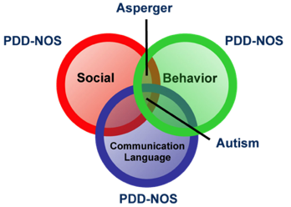
Understanding the Spectrum
People with autism spectrum disorders often…
Have ongoing social problems that include difficulty communicating
Become upset by being placed in new, stimulating environments
Have difficulty regulating and expressing emotions
Have trouble understanding another person’s point of view and actions
Have repetitive behaviors
Rely on rigid routines
Have limited and intense interests or activities

Slide 3
Disability Identity Development Model (Gibson, 2005)
Passive awareness – first part of life, but can continue into adulthood
Have no role model of disability
Taught to deny social aspects of disability
Realization – often occurs in adolescence/early adulthood
Begin to see self as having a disability
Hold self-hate and anger
Concerned with how others perceive self
Acceptance – adulthood
Starts to embrace self
Begins to incorporate others with disabilities into life
Involves self in disability advocacy
Integrates self into able-bodied world

Slide 4
Admittance of Students with ASD
CDC states that ~ 1 in 68 children have been identified with ASD
Little research/tracking on acceptance rates for students with ASD
Students meet academic standards for colleges’ admissions
Students with high-functioning ASD most common on college campuses
Colleges and universities with ASD-specific resource centers/programs take in ~ 20 to 30 new students per year
Two years ago, we admitted 12 students on the spectrum
This year, we admitted 21 students
So what can we do to support these students?

Slide 5
Admissions Tour
Without other students, so that they do not become as overwhelmed
Provide individual campus tours for students with ASD and their families
Actively seek out current students with ASD who have an interest in being a tour guide
See Disability Services Center
Ensure tour guides speak to ways students with ASD are supported throughout campus
residence life, counseling services, academics, etc.

Slide 6
Orientation Program
Building a close community amongst other students with ASD before integrating with the broader campus community
Providing orientation session just for students with ASD and their families
Staffing orientation with current students on the spectrum (orientation leaders, student panel, etc.)
Social programming
Interest-specific group activities
Dialogues social engagement and level of comfort with social activities

Slide 7
Orientation Program
Mental health counselors will meet with each student and their family
Parents can find support from each other and the institution
Parent/family-specific sessions at orientation facilitated by Residential Life, the Disability Services Center, and the Center for Health and Wellness
Opportunity to decide whether or not they would prefer to live with others
Would receive priority for single-rooms

Slide 8
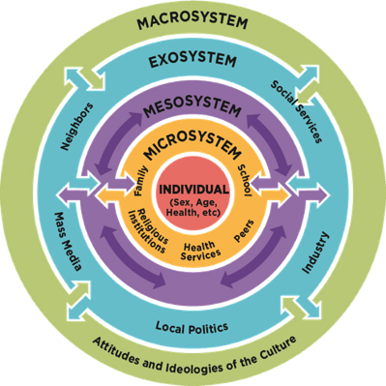
Educational Sessions
Bronfenbrenner’s Ecological Systems Theory
Intention is to introduce to faculty and staff a means of exploring the ASD experience and how it can evolve on campus

Slide 9
Educational Sessions
Ableism and Allyship
Acknowledging ableism and what we may take for granted
Explore different ways of advocating for students on the spectrum
Reflection on the language we choose to use and how it can impact students with disabilities
Learn how to be more inclusive of this community
i.e. Faculty will have the opportunity to consider how they can expand their teaching methods by providing detailed instructions and materials, finding alternatives to public speaking and group work, etc.

Slide 10
Educational Sessions
Bystander Intervention Workshops
Campus educational theatre troupe performs sketches depicting events where neurotypical students can intervene to create a safe space for students with ASD
Audience interacts with theatre sketch by “stopping” the action and providing suggesting ways students can step in to prevent harmful outcomes
Theatre troupe uses improv to show scene including audience suggestions
Gives students visual examples of practical intervention

Slide 11
Disability Awareness Week
Panel
Collaboration of faculty, staff, and students speaking about what disabilities, including ASD, are and what steps the university is taking to support students with disabilities
Exhibit
Effort to engage students across campus to create and share information and experiences
Multimedia experience in the form of art, videos, poetry, prose, etc.
Tabling
Distribute materials and engage the campus in activities (i.e. trivia games)
Address from the President
Participation through a campus-wide e-mail and DAW activities

Slide 12
Peer Mentoring Program
Recruitment is open to all students. Current students on the autism spectrum are highly encouraged to apply.
Peer mentors will receive training on how to:
Perform bi-weekly check-in’s and monitor student progress
Help students organize their academic plans
Set up tutoring appointments and suggest campus resources
Coordinate social events and activities in collaboration with other groups Including centers, departments, student organizations, etc.
Empower students with ASD to advocate for themselves

Slide 13
Tutoring
Training session for tutors interested in learning how to work with students on the spectrum
Provide an understanding of their unique academic needs
Learn how to holistically support this student population
Acknowledge that those on the spectrum have strengths and areas of growth that can be worked on at the tutoring center
Provide consistent and structured opportunities for students to receive academic support

Slide 14
Workshops for Students with ASD
Students with autism spectrum disorder may struggle with life skills and executive function.
Time Management
Students will discover useful time management strategies to help them accomplish tasks and stay organized
Study Skills
Students will learn different techniques to productively and effectively complete class assignments and prepare for exams
Self-care
Students will explore what methods of handling sensory overload and other stressors work best for them

Slide 15
Mental Health Check-In’s
Weekly check-in’s with a mental health counselor from the Center for Health and Wellness
To provide consistency, students will be asked to attend weekly meetings for their first 2 months on campus
Afterwards, they will be given the option to stop or continue the meetings
Monthly group sessions
Students on the spectrum can voice their difficulties and experiences transitioning to college to one another
Students are encouraged to advocate for themselves and schedule meetings

Slide 16
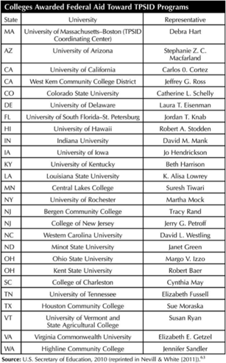
Budget
Transition Programs for Students with Intellectual Disabilities (TPSID) initiative started in 2010 by U.S. Department of Education
27 colleges and universities were given 5-year federal grants of $500,000 to create TPSID programs
In 2015, $9,800,000 was allocated for 27 new awards

Slide 17
Budget
Two-day Orientation
5 orientation leaders: $500
3 janitorial workers: $576
5 dining services workers: $720
Food: $1,890
Disability Awareness Week
Exhibit materials: $150
Tabling materials: $200
Peer Mentoring Program
4 peer mentors: $14,700
Social events: $650
Training for Tutors
Lunch for sessions: $400
Total: $19,786

Slide 18
Resources and References
Along the Autism Spectrum, A Path Through Campus Life
Cadabam's Hospitals
CDC- Data and Statistics
Disability and Clinical Competency: An Introduction
Educational Theatre Company
Emerging Practices for Supporting Students on the Autism Spectrum in Higher Education
Expanding the Paradigm: Postsecondary Education Options for Individuals with Autism Spectrum Disorder and Intellectual Disabilities
Going to College with Autism
Identifying the Unmet Needs of College Students on the Autism Spectrum
Individuals within Social Context
Kent State- Autism Spectrum Disorder Resources for Students
More Colleges Expanding Programs for Students on Autism Spectrum
NIMH - Autism Spectrum Disorder
Students with Autism in the College Classroom
Study Skills | Student Academic Success Center
Supporting Students With Asperger Syndrome on College Campuses
U.S. Department of Education

