Slide 1
Future New York office of Disability Services
By: Brittaney Cameron, Amanda Campbell, John Romano, and Shamilah Ulysse
University of Massachusetts Lowell

Slide 2
Table of Contents
What is Autism Spectrum Disorder?
Why is this topic important?
Responsibility of Students
Campus Plan
  University Police
  Training Faculty and Staff
  Career Services
  Dining Hall Staff
  Residence Life
  Student Activities
  Counseling Services
  Division of Student Affairs
  Orientation
Role of Disability Services
Scholarship/Funding
Grants
Budget
Conclusion
References

Slide 3
Why is this topic important?
Students with Autism should have the right to:
Overall access for students, faculty, staff, and visitors
Maintain accessible features
Informed use of accessible facilities and routes
Move services and classes to accessible locations with notice
Respond to individual request in a timely way
Also,
If a school receives federal funding, they have an obligation under the Americans with Disabilities Act (ADA) to ensure equal opportunity for people with disabilities
Private schools have an obligation to follow Title III of the ADA or the Department of Justice can sue the school for civil penalties and damages for individuals
There has been an increase in the diagnosis of Autism Spectrum Disorders therefore universities need to determine the needs of these students in the college setting.
“The number of children on the spectrum has risen from 1 in 150 to 1 in 88 in less than ten years, and colleges are beginning to acknowledge that these young adults are eager to receive their college degrees.” - Forbes

Slide 4
What is Autism Spectrum Disorder?
“Autism Spectrum Disorders (ASD) refer to the continuum of symptoms and specific diagnoses that are identified by impairment in thinking, feeling, language and the ability to relate to others.” –Autism Spectrum Disorder
Challenges
Difficulty interpreting nonverbal cues
Minimal expression of emotion in speech
Withdrawal from other people and difficulty sustaining conversations
Difficulty developing peer relationships
Difficulty seeing the overall picture
May be bluntly honest
Difficulty understanding figures of speech
Can be over stimulated by sounds, crowds, lights, smells
Inside feelings do not always match outside behavior
Difficulty recognizing faces out of the usual setting
Common Misconceptions
Average, or above average, intelligence
Excellent rote memory
Very detail-oriented
Often savant-like knowledge in certain areas
Works well with concrete, rather than abstract or ambiguous, information
Extensive vocabulary
Incredible gifts/talents in certain areas (arts, math, sciences, etc.)
Unique ability to perceive things in new ways, out of the box thinking

Slide 5
Responsibility of students with Disabilities:
Students are responsible for self-identification.
Students are required to provide adequate documentation to demonstrate the existence of a disability as defined under ADA guidelines.
At the beginning of each semester students are required to complete a form to request accommodations.
Students are responsible for alerting Disability Services if they experience difficulties accessing their accommodations.
Students are responsible for making arrangements to receive their extra-time accommodation, at least 7 days prior to the exam and must contact Disability Services of any scheduling conflict.
If students do not request accommodations at the start of the semester, faculty needs a minimum of one week's notification to implement accommodations.
Students must carry their Disability Identification card on them at all times in case of an emergency. Disability Identification cards do not take the place of a student ID.

Slide 6
Campus Plan

Slide 7
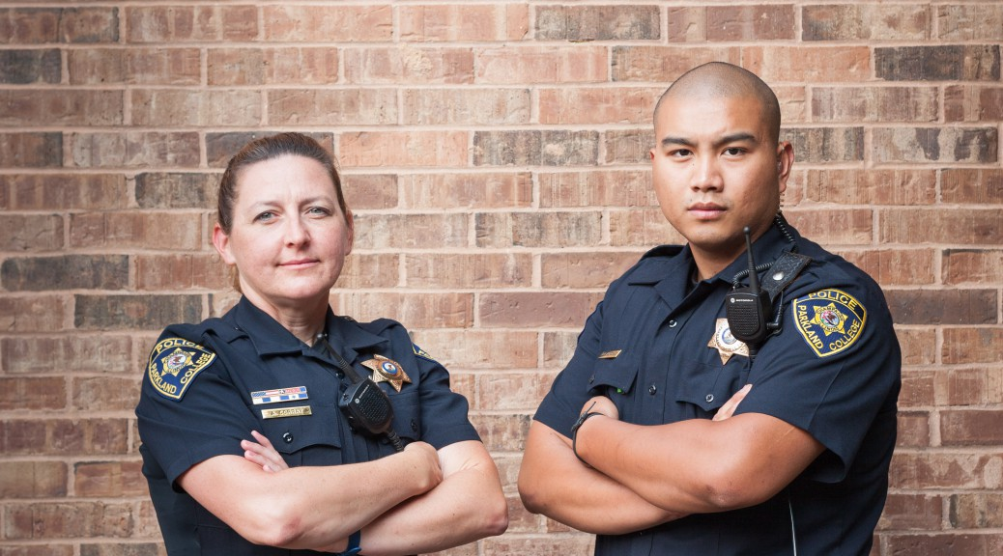
University Police
Campus Police
Individuals with Autism will have to interact with some form of law enforcement at some point in their life. It’s important that law enforcement know how to interact with them.
  Therefore,
    We think it’s important to train campus police on how to recognize signs of autism when interacting with students
    We will also train them to ask for their disability identification card so that they know they have to make accommodations for the students.

Slide 8
Training Faculty and Staff
Human Resources
As part of training and onboarding, every new employee of the university has to participate in a training on how interact with student with Autism and disability students in general.
Tutoring
The Office of Disability Services will be apart of training tutors to help them recognize and effectively tutor students with disabilities.
The Office of Disability Services will make themselves available to the tutors in case of an incident or if they need help with a student.
Faculty
All faculty members will be given access to a software that will help track and report any Autistic behavioral concerns.
The Office of Disability Services will also provide one on one coaching with faculty members, if needed, to better support students
Employees of Disability Services will have monthly meetings with faculty members to make themselves available to faculty members if they have questions or concerns
All faculty members will be trained on how to look for signs of Autism and how to interact with students

Slide 9
Employability of Students with Autism
Rochester Institute of Technology
Our Program
Rochester created a co-op school where they have students partaking in real, paid jobs before they graduate. The program specializes in job preparation and offers a 15-week program involving seminars on job interviews, networking, resume building, behavioral based interview questions, and body language tips to boost a students confidence.
This program would be high functioning students that are independent.
-Forbes
We would like to provide a program similar to Rochester’s in a shorter time frame to start and with a lower number of students. As the program and interest grows, we would like to expand the program to more students with Autism. The Office of Disability Services will work closely with Career Services to not only prepare students for work, but to help them discover their interests, and find co-ops in their desired fields. This program would also be for high functioning independent students with Autism.

Slide 10

Dining Hall Staff
Problem: Some students with Autism have difficulty expressing themselves verbally. So, doing things such as ordering food in the dining hall can be a challenge.
We want to make it easier for students to be able to pre-order their food and/or use technology to state their order.
So, that students with disabilities don’t feel singled out we will normalize the use of technology in the dining hall areas so that even students without Autism can order online/through technology.

Slide 11

Residence Life
The Office of Disabilities will facilitate trainings during Resident Advisor, Professional and Graduate Staff training to accomplish the following goals:
  Allow staff to have a conversation with those students
  Spread awareness of general information and techniques on how to interact with those individuals
  Disabilities will be added to the residential curriculum
  We would like to give students with Autism Spectrum Disorder the ability to live in a single room
  As modeled after Mercyhurst University in Forbes, we would like to dedicate a residence hall to students with disabilities or create a Living Learning Community depending on the number of students that document their disability.

Slide 12

Student Activities
The school will start a club called Disable the Label. The mission of the club is to broaden awareness on campus to the rights, challenges, and abilities of students with disabilities.
There focus will be to educate the campus community on disability issue and bridge some of the gaps between students with and without disabilities.
The students, staff, and the community will work together to be advocates for students with disabilities in oppressive systematic structures.

Slide 13
Example events
Playing for Inclusion
We will host a soccer clinic and games for children with Autism and various disabilities within the New York community. This event will include food, raffles, prizes, and some performances from talented disabled individuals during intermission
Student to Student Mentoring Panel
Past and present mentors will discuss the work they have done to support students with disabilities in New York.
March the March: Inclusion is the Solution
The New York community, Disability Services, and local organizations will be marching together to spread the awareness on disability inclusion. A brief reception will follow with a guest speaker and refreshments.
MTV True Life: I Have A Disability
With the permission of the students, a camera crew will follow students with disabilities around campus to film the challenges and struggles that face every day being a student on campus. We will them showcase these students experiences as part of an event to raise awareness.

Slide 14

Counseling Services
Counseling Services can provide:
  Group Therapy
  Individual Therapy
  Topics:
  Academics- Organization and planning of study time, utilizing classroom attendance efficiently, prioritizing assignments, preparing for exams, regular communication with instructors for progress reports and meeting regarding strengths and weakness in the classroom
    Ultimate Goal: Guide students into becoming self-advocates to ensure academic success
  Social and Daily Living- College Life , how to interact with instructors ,classmates, roommates, and dating. Regular communication with parent(s) or guardian(s) regarding progress, regular contact with residence life staff.
  Emotional and Psychological Well- identify appropriate coping strategies to manage symptoms of anxiety and/or depression, take medications as prescribed

Slide 15
The entire division of student affairs
We will require that all Student Affair professionals attend a division meeting where a representative from Disability Services will be giving a presentation about the Autism Spectrum and other disabilities.
This training is essential because every professional will have to interact with a student with Autism and it is important to know how to interact with them so that they can have the most effective conversations with them.
Lastly, knowing students with disabilities individual needs and challenges will help professionals create a more welcoming environment on campus.
  Goal:
    Challenge each department to reflect on the information that was presented to them.
    Analyze their office and buildings to see how accessible it is
    Put procedures in place so if they foresee a student with Autism having an issue within their department, they actively try to address the issue before a situation arises
    Be aware of ableism and challenge them to think about other challenges

Slide 16
Orientation- Transitions Program
In order for students with Autism to better acclimate to the campus community will we will create a program called The Brooklyn Bridge were we will do the following:
  Allow students who have registered with Disability Services to move on campus two days earlier.
  We will create an intimate two day orientation were all students with a registered disability will be asked to attend.
    This orientation will provide targeted information and name of people within offices of each department to contact in case they have any questions or come across a situation.
    The orientation will also fully disclose all of the accommodations and equipment that can be offered to students so that they can make the best decisions based on their needs at the university
    We will invite members from every department that students frequently interact with to meet the students personally and go over their rules and processes. For example, Student Conduct might review the Student Code of Conduct and Residence Life might explain the housing selection process.

Slide 17
Disability Services
The Office of Disability Services Role:
  Advise the Disable the Label Club
  Train and keep track of equipment for students
  Research further ways to assist students
  Assist in academic advising
  Find tutors (partner with tutoring center)
  Help student navigate university processes
Disability Services staff promote diversity and inclusion by partnering with the campus community. We create equal access by removing barriers, promoting diversity, employing universal design and striving for inclusion.
Assisting Devices:
Read Write Gold- Software that allows you to read on-screen text aloud, research and check written work, and create study guides
LiveScribe Smart Pen- smartpen that remembers and links everything you hear to everything you write. Tap notes with pen to replay the recording.
Dragon Naturally Speaking- ability to type papers by only your voice
There are many type of assistive devices that can be helpful during the students time at the university.

Slide 18
Scholarship/Fundraising
We suggest charging an additional $10.00 fee to every students fee to help pay for some of the resources that students with disabilities will need.
  Accompany it with Wellness fee
We will have fundraisers throughout the year to help provide resources and to make building more accessible to everyone.
If the school permits, we will ask big companies in the area to sponsor the department.
Some Fundraising Ideas:
  Create Marathon/Walk for local community
  Encourage Sororities/Fraternities to partner with the department to raise money with their organization as a philanthropy.

Slide 19
Grant Opportunities:
The Doug Flutie Jr, Foundation for Autism, Inc.
Mission:
Helping families affected by autism live life to the fullest through access to services, active lifestyles and community-based services for adult family members.
Grant Making Philosophy/Program Emphasis
The priorities of the Foundation are to meet families' needs along the way by ensuring (1) Access to Services (2) Active Lifestyles and (3) Adult Independence.
Access to Services:
Funding for community organizations and schools who are providing vital resources and actively assisting children with autism spectrum disorder and their families through education and technology*, advocacy programs, diagnostic and clinical services, direct family support, safety equipment, emergency care, respite services and other opportunities that will enhance the quality of life for those affected.
Active Lifestyle:
Support for recreational and sports programs, aquatic programs, social skills training, family events and summer camps for all individuals on the autism spectrum.
Adult Community-Based Services:
Providing opportunities for job training, vocational skills programs, employment, housing, transportation and healthcare delivery for adults on the autism spectrum.
Deadline: September 29th, 2017 @5:00 PM EST
Reward: $10,000-$20,000
Allison Keller Education Technology Program
Realizing the gains that many people with autism have achieved using the iPad, the Allison Keller Education Technology Program was created in honor of Flutie Foundation Board Member Kevin Lane Keller's daughter Allison. The goal of the program is to help fill the financial and technological gap for schools and organizations that assist individuals with autism. Over the past four years, the Flutie Foundation has granted over $270,000 to 57 schools and organizations for programs specifically serving individuals with autism that have an established technology program in place or have expressed an interest in starting a program using the iPad or other technology tools.
Applications will be considered for any technology tools and/or training that improve learning outcomes or performance. Maximum request is $5,000.00. Examples include but are not limited to:
Tablets & Accessories
Apps
Smartboards
Laptops
Technology Training
Deadline: Late January 2018
Reward: Maximum request is $5,000.00

Slide 20
Budget
Staff Time: 100 hours
Trainings: 20 hours
  Police training
  Student staff training
  Staff/faculty training
Facility/IT set up of technology: 80
  Ipad’s for the dinning hall
  Smart pens
  Read and write software integration
Non Budget expenses:
Work study students for tutoring and proctoring
Creation of the Disable the label Club
Monetary expenses:
(10) Ipads
  $2,690
(license for university) Speech software
  $10,000
(30)Smart pens
  $3,599.70
Totals:
  100 Staff hours
  $48,687

Slide 21
References
Bowen, I. (2013, June). Higher Education. Retrieved from http://ada-one.com/focus/higher-education/
Autism Spectrum Disorders. (n.d.). Retrieved from http://diversity.utexas.edu/disability/students-with-austism-spectrum-disorders/
The Doug Flutie, Jr. Foundation for Autism, Inc. (n.d.). Retrieved from http://www.flutiefoundation.org/apply-grant
Allison Keller Education Technology Program. (n.d.). Retrieved from http://www.flutiefoundation.org/allison-keller-education-technology-program
College Transitions & Support Program . (n.d.). Retrieved from https://autism-clinic.ua.edu/uaacts/UAACTSbrochure.pdf
Carlotti, P. (n.d.). More Colleges Expanding Programs For Students On Autism Spectrum. Retrieved July 31, 2014, from http://www.forbes.com/sites/paigecarlotti/2014/07/31/more-colleges-expanding-programs-for-students-on-autism-spectrum/#765b3e233661
University of Massachusetts Lowell . (n.d.). Retrieved from https://www.uml.edu/student-services/disability/

