Slide 1
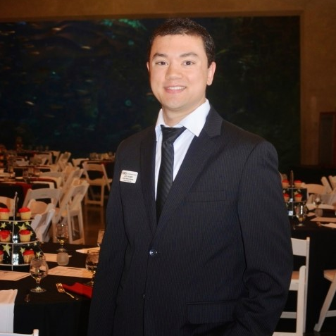
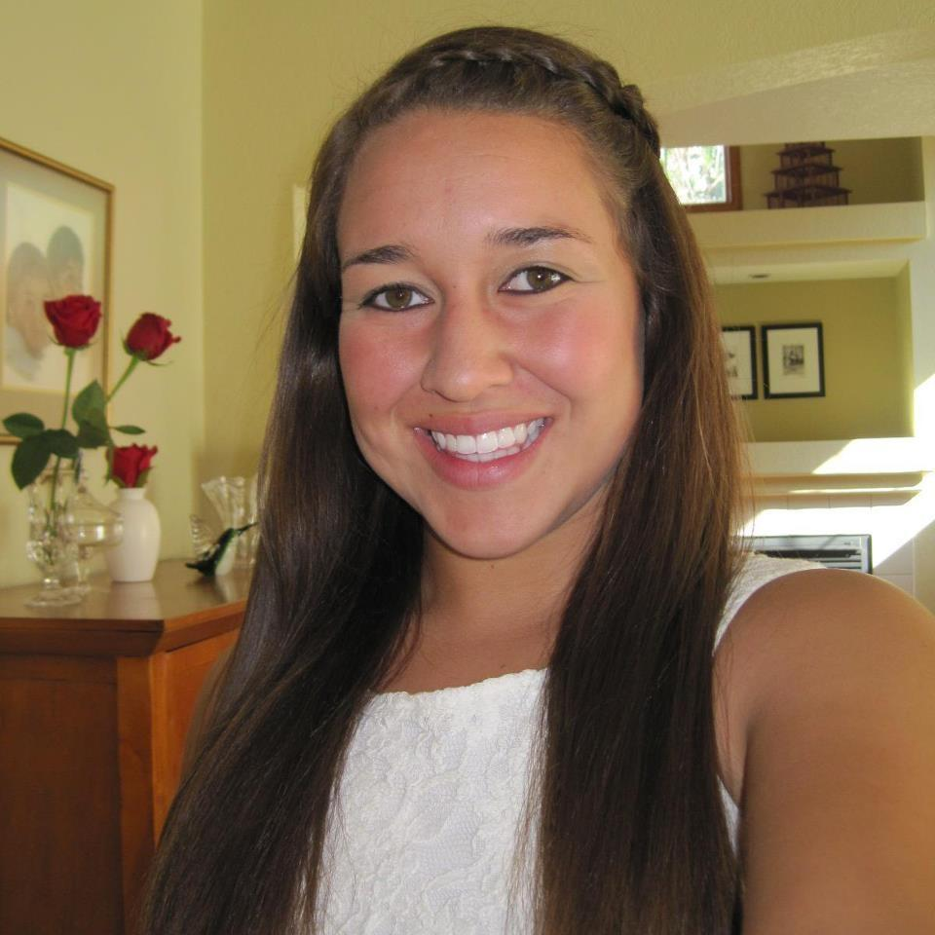
The team
“Why are we the ones to solve the problem we identified?”
Adriana Jackson
Zachary Kramer
Alejandra Sullivan
MEd Candidate, Student Development Administration
MEd Candidate, Student Development Administration
MEd Candidate, Student Development Administration
Seattle University

Slide 2
Cultivating Connections
A program based on the holistic needs of students with Autism Spectrum Disorder (ASD)
Seattle University

Slide 3
Cultivating Connections: A Program Overview
Phase One:
Phase two:
Phase three:
“Emerging practices dictate that ensuring the success of students with ASD in higher education requires two type of supports: those that indirectly impact student outcomes by creating a welcoming and supportive campus climate; and those that directly assist individuals with ASD through specific Services”
Training of ASD professional
Campus Awareness
Partnerships on campus
Implementation of the Cultivating Connections Program with first cohort accepted
Assessment and Adjustment of the Cultivating Connections Program

Slide 4
Cultivating Connections: A Model for Student Success
A program grounded in values dedicated to academic success, social integration, and independence in adulthood
Academic Success
Social Integration
Independence in Adulthood
We know students with ASD achieve academic success when given support from professional staff, peer mentors and others with similar identities. Tailored supports can increase academic success among student with ASD.
We know students with ASD do not benefit from the traditional support model in higher education. Peer mentoring and identifying with other students with ASD will allow the student to feel like they are a part of a community.
We know students with ASD succeed when adequate support is given to them. Transitioning into college can be difficult but if the students have peer and staff support the students can learn independence and self-advocacy.

Slide 5
Cultivating Connections Program: The Student Experience
4 years geared towards the success of students with ASD
August 2017
August 2019
August 2018
August 2020
Integration with campus
Self-advocacy
and internships
2017 |  |  | 2018 |  |  |  | 2019 |  |  |  | 2020
Retention and resilience
Job placement,
assessment, and revision

Slide 6
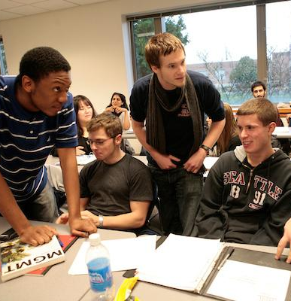
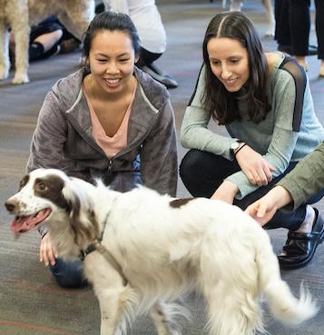
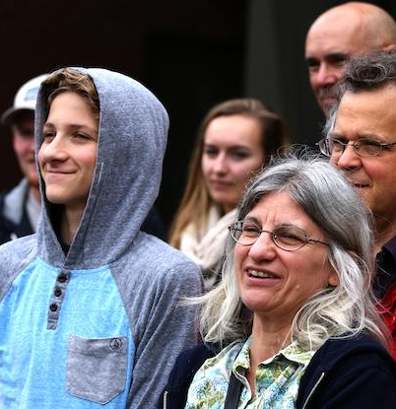
Cultivating Connections: A Model for Student Success
PHASE ONE Training, Awareness, and Partnership
Academic Success
Social Integration
Independence
Review existing admission and course materials for necessary universal design (UD) modifications, including OCR web compatibility. Provide ongoing, required UD training for all online course instructors.
Establish peer mentoring program to facilitate educational coaching, support in communication, social interactions, and organization of coursework and recreation. Implement training for orientation staff, faculty, and high-touch departments to act as designated ASD support staff.
Parent and student involvement in the creation of a transition plan from secondary to postsecondary environment.
Research supports transition component leads to higher retention, academic productivity, better problem-solving skills, and increased self-determination (Goldberg et al., 2003; Konrad et al., 2007)

Slide 7
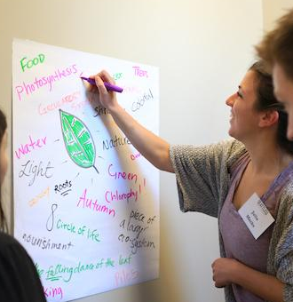
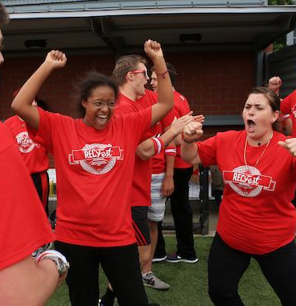
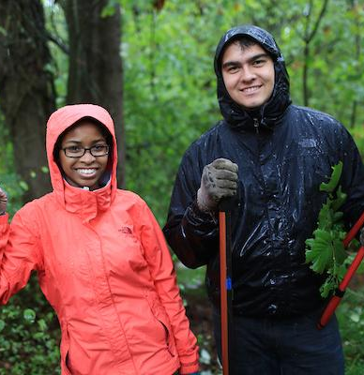
Cultivating Connections: A Model for Student Success
PHASE TWO Implementation
Academic Success
Social Integration
Independence
Implementation of a peer mentoring program so the students feel support through their academic challenges and successes. Students will meet their support team through Summer Immersion Program as well as specialized academic support and scheduling for the year.
Implementation of Summer Immersion Program: a week-long immersion program that allows students the opportunity to build community, engage with each other through mock classes, scheduling assistance, and orientation to locale through daytime excursions.
Implementation of peer mentoring program to support the students in their learning of independence and basic tasks to be successful in school and work.
Research suggests students with ASD face challenges in the college environment as it requires assertive, independent action on the part of the student (Ackles, et. al, 2014)

Slide 8
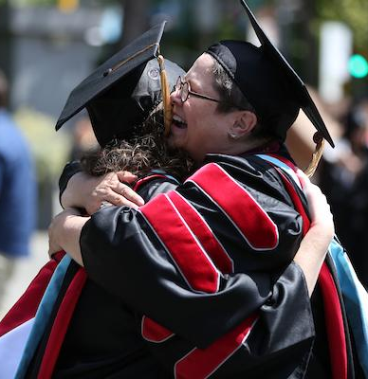
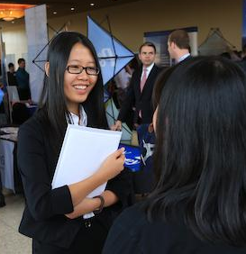
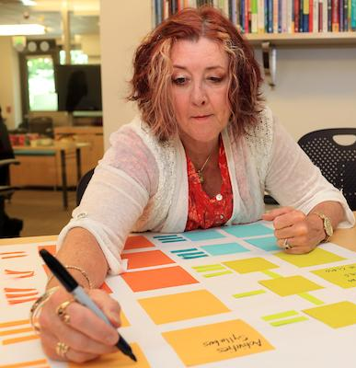
Cultivating Connections: A Model for Student Success
PHASE THREE Assessment and Revision
Academic Success
Social Integration
Independence
Assess the GPAs, retention and other levels of measurement to seek to understand the impact of the Cultivating Connections Program in regards to other students on campus.
Assess event participation, mentorship meeting attendance, and overall satisfaction with the program
Assess retention rate and self-evaluations through summer program to understand how the program can continue to be adapted to meet the needs of gaining skills focused on independence

Slide 9
The problem
“Even with a robust framework of services, students with ASD often struggle to adjust to the complexities of navigating a college system and therefore don’t benefit from the traditional support structure.” (Ackles, et. al 2014)
It is essential to keep in mind that students are facing the same challenges as all students, including identity, cognitive, and moral development while also facing distinct needs as a student with Autism.

Slide 10
Review of the Literature
Educational experiences and needs with students with ASD
90.9 % felt that if their needs were not being met, they could discuss this with institutional staff
Students recognize their preference for routine and structure
“When ASD students received appropriate and timely academic support from their college or university, their anxieties were greatly reduced” (Cai & Richdale, 2015)
Students found a lack of timely support
The Transition of Students
(Wehman et al., 2014)
Emerging Practices for Supporting Students on the Autism Spectrum
Lower enrollment than individuals with other impairments (Shattuck et al., 2012)
67.3% reported limited involvement in own transition planning (Cameto et al., 2004)
Transition-focused education improves*:
  Academic productivity
  Employment outcomes
  Problem-solving skills
Longitudinal data obtained from 2009 National Longitudinal Transition Survey
*(Goldberg et al., 2003; Konrad et al., 2007; Landmark et al., 2010; Test, Fowler, et al., 2009)
Certain skills sets are underdeveloped and negatively impact the transition into and persistence through college as well as their post-college placement in the work force
These skills are categorized into 6 domains
  Executive functioning
  Academic Skills
  Self-care
  Social Competence
  Self-Advocacy
  Career Preparation

Slide 11
What is the NLTS-2?
NLTS-2 was funded by the U.S. Department of Education
Documented the experiences of a national sample of 11,270 students age 13 to 16 between 2000-2009 as they moved from secondary school into adulthood (SRI International, 2009)
922 students identified as ASD (about 8%)
97% attended public schools
This includes individuals across the ability spectrum
National Longitudinal Transition Study

Slide 12
Support for Education and Social Mentoring
Campus Based Inclusion Model (CBIM)
Emphasize:
  Coach and support in communication
  Social interactions
  Organization of course work and recreation
  Receive intensive vocational support
  Even college- educated students with ASD struggle to gain and maintain employment commensurate with their abilities and training (C. M. Schall et al., 2012).
Peer mentor programs can help facilitate this level of networking and social acceptance (Carter & Hughes, 2013).
  Structured social skills instruction supports activities and improve social interactions

Slide 13
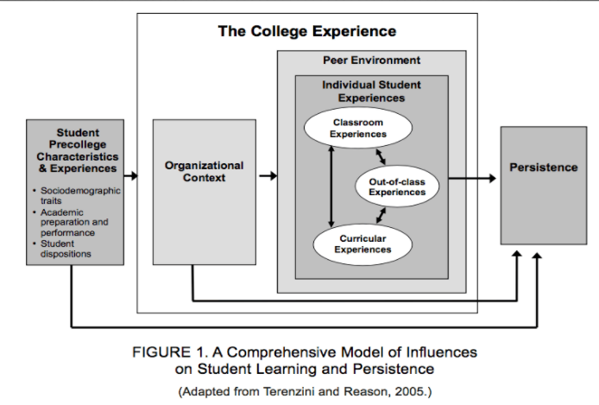
What we know about our students
Organization policy affects student outcomes
The effects of budget can influence which how many staff members there are to to help students with ASD
These are what affects student outcomes and success
  Precollege characteristics
  Experiences
  Student peer environment
  Student experience
Students with ASD can drastically be affected by outside forces when transitioning to college

Slide 14
The perspective of the student
Students face an experience full of new and varied stimuli
Students adjust to the rigor of college-level coursework
While students with ASD arrive at college with many favorable qualities, certain skills make college more difficult
ASD is a developmental disability that can cause significant social, communication, and behavioral challenges
ASD students may communicate, interact, behave and learn in different ways
Learning, thinking and problem-solving abilities can range from gifted to severely challenged.
Certain skills sets are underdeveloped and therefore negatively impact the transition into and persistence through college as well as their post-college placement in the work force
Also dependent on institutional context, income, their family, structure, race, gender, ethnicity, and other salient identities.

Slide 15
Theories: Ecological Theory (Johnstone)
Six categories of disability identities:
Externally ascribed, disempowering identities: identities are imposed from others, and can be stigmatizing terms
Overcompensating identities: have disclosed their impairment to others and are compelled to perform at high levels
Identities that shift the focus away from disability: Deaf culture especially noting its emphasis on linguistic and social bonds rather than rehabilitation.
Empowering identities: Focus on reclaiming the body and legitimizing the experience of a disabled person
Complex identities: Locating the disability within multiple identities such as race, class, gender and sexual orientation
Common identity: Feeling of a commonality or a shared experience
The ecological theory accounts for identities imposed by others and those identities that are self-ascribed.
This is not a stage model, but rather how the individual sees the world in that specific time period.

Slide 16
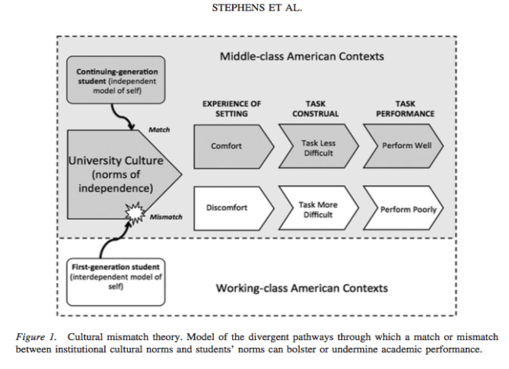
Theories: Cultural Mismatch Theory
Cultural mismatch theory refers to first generation students and the cultural mismatch they experience due to social class
  Their cultural mismatch is due to higher education valuing middle class values, such as independence, while lower class values are interdependence
Cultural mismatch theory can translate to students with disabilities
  Higher Education values students who are able-bodied and -minded
  When students with Autism enter higher education, their values and cultural norms do not align with the institutional structure, context or framework.

Slide 17
Theory into Practice
Cultural Mismatch Theory
Mismatch which leads to lower rates of academic success
Value of independence leads students with ASD to struggle when transitioning to college life
Students with disabilities are at a disadvantage due to the values of higher education
Ecological Theory
Student’s identify differently for different events in their lives
Identities are ascribed by the student and the outside forces
Theory takes into account the connections between intersecting identities
How do these theories work together to serve students?
Cultural Mismatch Theory states universities are not properly serving students with ASD, since higher education values are rooted in ableism, independence, empathy and social networking
Ecological theory accounts for identity development and the connections to outside forces related to identity development
Cultural mismatch theory and ecological theory combine to provide a power narrative about the barriers students with ASD face when entering higher education including all of their various identities

Slide 18
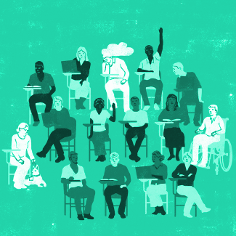
Making the difference
Based on what we know about institutions:
We know student identities and background matters
Institutional context and history matters
Student engagement matters
How does this context change with ASD Students?
Personal: support and independence matters
Social: social support and networking matters
Academic: Engagement with professors matters

Slide 19
Budgeting and Expenses
Based on a model adapted from a similar institution (University of Washington)
FY 2016, this institution allocated $700,000 for Additional operations Support for Disabled Students*
Our budget request would come from a similar, General Operating Fund (GOF) that our institution has
Program staffing will be supported by Student Affairs’ Graduate Assistants and Interns
 | Year 1 | Year 2* | Year 3* | Year 4*
Staffing | $15,000 | $15,150 | $15,301 | $15,454
Training | $2,000 | $2,200 | $2,420 | $2,662
Summer Program | $1000 | $1100 | $1210 | $1331
Additional Expenses | $500 | $550 | $605 | $665
Annual Total | $18,500 | $19,000 | $19,536 | $20,112
*Based on 10% yearly inflation
*Adapted from: https://opb.washington.edu/sites/default/files/opb/Budget/FY16_Complete_Budget-adopted.pdf

Slide 20
References
Cai, R. Y., & Richdale, A. L. (2015). Educational experiences and needs of higher education students with autism spectrum disorder. Journal of Autism and Developmental Disorders. doi:10.1007/s10803-015-2535-1
Orlando, A., Klinepeter, E., & Foster, M. (2016). Retrospectives on factors influencing inclusive opportunities for college students with extensive support needs. International Journal Of Inclusive Education, 20(12), 1239-1251. doi:10.1080/13603116.2016.1159255
Reason, R. D. (2009). An examination of persistence research through the lens of a comprehensive conceptual framework. Journal of College Student Development, 50(6), 659–682. doi:10.1353/csd.0.0098
Sinclair-Chapman, V. (2015). Leveraging diversity in political science for institutional and disciplinary change. PS: Political Science & Politics, 48(03), 454–458. doi:10.1017/s1049096515000232
Stephens, N. M., Fryberg, S. A., Markus, H. R., Johnson, C. S., & Covarrubias, R. (2012). Unseen disadvantage: How American universities’ focus on independence undermines the academic performance of first-generation college students. Journal of Personality and Social Psychology, 102(6), 1178–1197. doi:10.1037/a0027143
Wehman, P., Schall, C., Carr, S., Targett, P., West, M., & Cifu, G. (2014). Transition From School to Adulthood for Youth With Autism Spectrum Disorder: What We Know and What We Need to Know. Journal Of Disability Policy Studies, 25(1), 30-40. doi:10.1177/1044207313518071

