Slide 1
Autism Spectrum Achievement Program (ASAP)
Tony Au (Leader), Gina Garcia, Sarah Garcia, Carmen Wilson
College Student Services Administration Program | Oregon State University

Slide 2
AGENDA
Needs
Proposal
Rationale
IMPLEMENTATION
BUDGET
FUTURE POSSIBILITIES

Slide 3
NEEDS
Students on the autism spectrum need:
Greater social support
Greater educational support
Support with their transition to college
To feel safe on campus
To feel a sense of belonging on campus
Accommodations to match their unique needs

Slide 4
NEEDS
What does the current literature say?
“Student and parent report indicated that many of our students were not receiving adequate educational or social support in higher education” (Cai & Richdale, 2015, p. 10).¹
“Beyond issues of disability mandates and expectations for support services, students with ASD struggle with the increased need for independent functioning required in a college environment” (“Emerging Practices,” 2014, p. 7).²
¹ Cai, R. Y., & Richdale, A. L. (2015). Educational Experiences and Needs of HIgher Education Students with Autism Spectrum Disorder. 1-11.
² Emerging Practices for Supporting Students on the Autism Spectrum in Higher Education: A Guide for Higher Education Professionals. (2014). 1-30.

Slide 5
PROPOSAL
The Autism Spectrum Achievement Program (ASAP)
ASAP is a collaborative partnership among Disability Services, Residence Life, Academic Affairs, Office of Student Activities, and Mental Health Services to provide a free program for students who are on the autism spectrum.

Slide 6
PROPOSAL
Program Services
Buddy Program: Any student who is on the autism spectrum can apply to participate, and be partnered with another trained student on campus who may or may not also be on the autism spectrum. Students are required to meet with their buddy at least once per term for relationship building and support. (Buddies can also be online to support students with lower functioning autism/online students.)
Group Meetings: Students are required to attend approximately three meetings per term (beginning, middle, and end of term) to connect with each other, participate in fun social activities, and engage in educational workshops on a variety of topics (study strategies, time management, leadership, social justice, self-care, etc.).
Tutoring: Students in the program have access to tutors who are trained to work with students on the autism spectrum.

Slide 7
PROPOSAL
Learning Outcomes
As a result of participating in this program, students will be able to:
Describe study skills necessary for academic success
Identify other students and staff on campus who are resources for support
Demonstrate strategies for mental wellness and self-care in a college environment
Discover ways to get involved and integrate themselves in the campus community
Examine their identity (as it relates to their ability) within a social justice context
Apply their knowledge of autism and resources on campus to mentor future students in the program (for students who sign up to be buddies)

Slide 8
RATIONALE
Personal Integration: Every student is partnered with a buddy who provides similar services as a mentor, focusing on holistic student development and personal growth.
Social Integration: Students are given the opportunity to meet and connect with others who share similar experiences as they do and are on the autism spectrum through social programming.
Academic Integration: Students have access to a variety of resources to support their academic success, such as tutors, educational programs, and their buddy.

Slide 9
RATIONALE
Buddy Program: Buddies are not only beneficial for student participants, they are also an incredible professional development opportunity for other students looking to get involved (current students would also be eligible to apply to be a buddy in the future).
Group Meetings: Group meetings serve a variety of purposes, including program commitment, relationship development, and academic and social programming.
Tutoring: Student participants will benefit from trained tutors who are aware of social justice issues related to ability and the unique needs of students on the autism spectrum.

Slide 10
IMPLEMENTATION
Recruitment Plan
Students who are admitted to the university can choose to disclose ability and learn more about ASAP through the application or from referrals to Disability Services.
Advertisements will be distributed across campus to be posted in high-traffic areas. Emails will also be sent to students via student mailing lists.
Advertisements will recruit both new students to the program as well as buddies and tutors. (Buddies and tutors can receive internship credits, extra credit in relevant courses, and/or stipends.)
Recruitment will occur on a quarterly basis.

Slide 11
IMPLEMENTATION
Department Contributions and Logistics
Disability Services could provide training to students (buddies) and professional staff members who are part of the program.
Residence Life could provide meeting spaces and independent living workshops.
Academic Affairs could provide tutors via extra credit opportunities in related courses, internship credits, and/or existing jobs.
Student Activities could provide social and educational programming.
Mental Health Services could provide mental wellness programming.

Slide 12
BUDGET
Item | Estimated Annual Cost
Advertising | $500
Programming Supplies | $2,000
Optional: Buddies | $10,000 ($500 Stipend x 20 Buddies)
Optional: Tutors | $5,000 ($1,000 Stipend x 5 Tutors)
Total Cost | $2,500-$17,500

Slide 13
FUTURE POSSIBILITIES
This program could be shaped into a living-learning community in the residence halls.
This program could expand into a digital platform through a mobile application or online program, providing opportunities for online buddies and educational content for students who are enrolled in online courses and/or with lower functioning autism.
This program could grow its partnership with other on-campus departments so it continues to remain a priority and campus-wide collaborative effort.
This program could be paired with or extended to incoming students through a summer bridge program.
This program could offer scholarships for participants to incentivize participation.

Slide 14
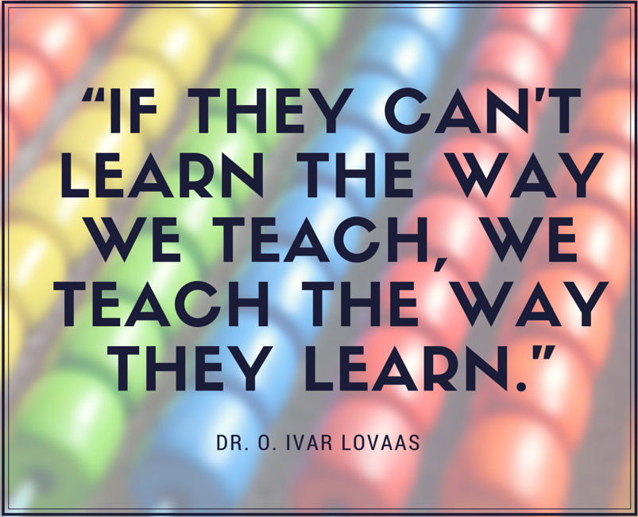
CLOSING REMARKS
ASAP is truly designed to meet the needs of students on the autism spectrum where they are at—with their particular needs—because we do not pay close enough attention to this population.
It’s time to change that.

