Slide 1
StudentAffairs.com Case Study Competition 2017
Presented by Murray State University
Team Leader: Tyler Bradley
Team Members: Eve Kotter, Paige Roach, Emily Smith
Faculty Adviser: Dr. Ben Littlepage

Slide 2
Presentation Order
Introduction of the Need
Proposed Mission
Learning Outcomes
Personal Services
Social Services
Academic Services
Organizational Chart
Position Description
Floor Plan
Budget

Slide 3
Introduction on Students with Autism
Autism or Autism Spectrum Disorder (ASD): refers to a range of conditions characterized by challenges with social skills, repetitive behaviors, speech and nonverbal communication, as well as by unique strengths and differences. There are many types of autism, caused by different combinations of genetic and environmental influences. The term “spectrum” reflects the wide variation in challenges and strengths possessed by each person with autism. (Definition from AutismSpeaks)
In the 2013-2014 academic year, nearly 13% of public school enrolled students received some sort of disability service. Of those, the highest proportion of services provided for was for students with autism. (U.S. Department of Education, National Center for Education Statistics, 2016).

Slide 4
Transitional Challenges (Cullen, 2015)
Social: “It’s just really challenging socially… kind of the feeling of not really knowing what to say and what to do and as a result of that people kind of leave me out or think I’m a little weird or quirky or more likely just shy… when that is not really true at all. I just really don’t know what to do.” (pg. 95)
Academic: “In class, every time I am placed into a group, slowly everyone starts to act distant and angry with me, leaving me to become the scapegoat and take the blame for anything that goes wrong, despite being a straight A student. When I contact instructors about my concerns, I am often told to talk it out with my group, which goes nowhere.” (pg.95)
Daily Living: “Even just things like figuring out what to eat and things like that. I mean, it seems like a simple thing and in isolation it is a simple thing, but when there are all these things that I also have to – that are otherwise really simple – they start to feel a lot more complicated or I just forget about them.” (pg. 96)

Slide 5
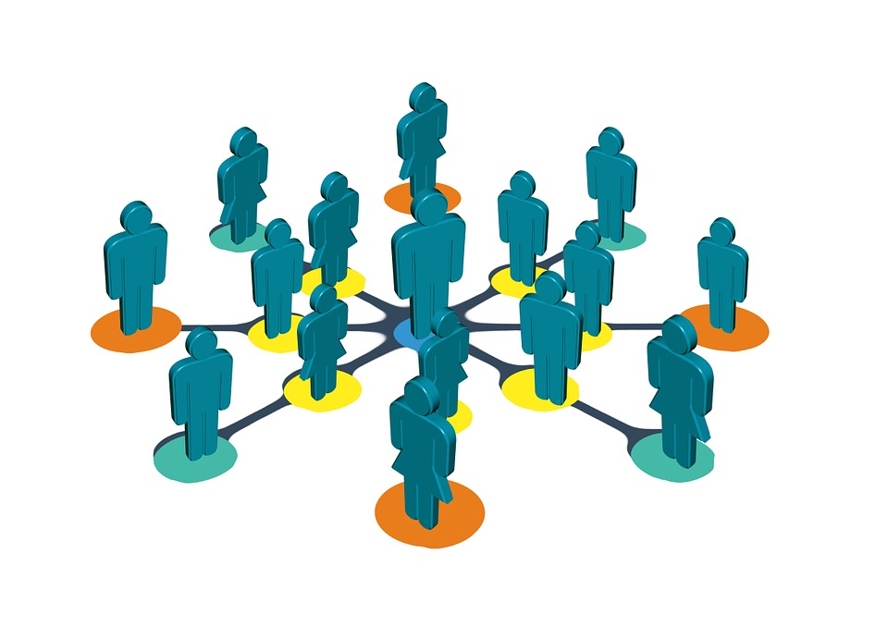
Transitional Challenges
65% of 450 children and adults with ASD report difficulties making friends. 75% of teenagers reported difficulties making friends (National Autistic Society).
“There are no clear statistics on college enrollment of students with ASD, but it is estimated that they comprise anywhere from 0.7 percent to 1.9 percent of the college population with an 80% incompletion rate,” (VanBergeijk, Klin, & Volkmar, 2008).

Slide 6
Mission: The Autism Inclusion Program aims to assist students with Autism Spectrum Disorders in gaining reasonable accommodations in accessing higher education through supporting the development of self-advocacy, life skills, academic competencies, independent living, and social integration.
*logo may be modified to reflect current visuals of institution logo

Slide 7
Autism Inclusion Program Learning Outcome Examples
Students who enroll in the Autism Inclusion Program will…
Develop executive functioning in supporting work memory, mental flexibility, and self-control as evidenced through organizing academic work and controlling emotional and behavioral impulses.
Enhance their academic writing organization, language, and perspective taking.
Identify their own needs in independence and self-care through managing stress and handling sensory overload and other stimuli.
Integrate socially through the ability to relate to others, better recognize verbal and nonverbal thoughts and feelings of others, and engaging in institutional social activities and environments.
Develop self-advocacy through knowing resources, identifying self capacity, and recognizing when to ask for help.
Utilize skills, knowledge, and experience appropriately for job search and application processes through resume-writing, interviewing, and understanding the social context of the work environment.

Slide 8
Personal Services
Vocational Training in partnership with NY’s The Bridge
Students with ASD often struggle with job retention due to memory and social issues, but with training and support, programs such as this have helped see as high as 85% retention rates after their first 90 days on the job. (Iman, 2013).
The Bridge, a $35 million program, works specifically with people with disabilities in job training, work experience for pay, competitive job placement and post-placement support services. It currently enrolls 300 clients.
Costs can be split between The Bridge and the office.
Similar to Seattle Central College’s partnership with Mainstay
Autism Spectrum Disorder Allies
Borrowing from Marshall U., the ASD Allies will be specially trained volunteers throughout the campus community.
Identifiable safe-spaces and familiar faces provide points of contact and de-escalation spaces for students on the Autism Spectrum.
Peer Allies will be assigned program participants to maintain contact with to promote social, academic, and personal support and referrals.
Notes:
Eve

Slide 9
Personal Services (cont.)
Developmental Software and Apps
Example 1: Office will promote use of free app Smart Steps Mobile
Stressful situations can hinder the decision making process for students with ASD.
This app offers easy decision making in life situations such as a lost backpack or a late ride.
Guides the user step-by-step through the decision making process.
Safety tips built in. Emergency Contacts can be stored directly in the app for quick access.
Example 2: Community Success ($39.99)
Many students coming to college with ASD may not have gone through many life experiences on their own such as riding a bus.
This app walks students through 24 important activities such as riding a bus, an activity several students may have never engaged in that can make them uncomfortable.
Includes video modeling, photo-based directions, short stories with narration and highlighted text, and clear drawings of social behaviors for each activity.
Collaboration with Residence Life
Emergency listing of students with disabilities that may need assistance or support (i.e. sensory issues), in the event of fire, tornado, or other similar situation.
Early move-in camp with peer mentors to get students better acclimated to college environment where they’ll learn common processes and resources and get a better understanding of where to find places on campus.

Slide 10
Social Services
Life Skills Course
1-credit optional course for incoming students with ASD
Curriculum modeled after Marshall University’s College Program
Social Radaring (Dialoguing v. Monologuing, Under/Oversharing)
Developing Relationships (How to end conversation, body language)
Difference in interactions between professors, admins, and friends
Stress, anxiety, and anger management (how to recognize feelings and ask for help)
1-hr interactive weekly lectures
Student Activity Sponsored Social Events
About fifty-six percent of students with ASD indicated they are lonely on campus in one study (Gelbar, Shefcyk, Reichow 2015).
Movie/Game Nights, lunches, or off-campus outings to festivals, skating, etc. can help in building friendships.
Weekly Support Group
Address behavioral goals, builds community among students with ASD
Peer Mentors
On-campus social opportunities
Student Org. Orientation: Introduce mentees to welcoming student organizations

Slide 11
Social Services (cont.)
Developmental Software & Apps
It can be difficult for students with ASD to read a person’s non-verbal expressions
Emotions Reader ($6)
Features twenty-eight video clips of real emotions being displayed. Each is accompanied by still images and a detailed description.
In completing the quizzes in the interactive ebook, students look at each video clip and think about what changes are happening in the face and body as the person shows emotions such as sadness, excitement, approval, or affection.
Available in the Disability Services Office Classroom Computer Lab
Collaboration with Residence Life
In one study, only 43 percent said it was easy to get along with their roommates, and 50 percent enjoyed living on campus (Gelbar, Shefcyk, Reichow 2015).
We will offer designated housing communities with specially trained residence life staff to recognize signs of students in need & best practices in support (social withdrawal, hygiene, roommate contracts, etc.)
We will use individual-based planning to determine access to private room residency so students can decompress and avoid overstimulating environments.

Slide 12
Academic Services
Academic Coaching
Specially trained advisor in collaboration with the Academic Advising Office
Individualized meetings with participants
Peer Tutoring
Individual tutoring sessions weekly
May be assigned additional hours based on need
Academic Success Classes
One per semester over the course of 4 semesters
One credit hour
Focus on study skills, test taking skills, career preparedness, social skills, and class participation
Supervised Study Area
Required hours weekly
Supervision to be provided by program staff

Slide 13
Academic Services
Scholarship Committee
A committee of student leaders and a AIP staff member will work to fundraise funds to create a scholarship for students at the institution with ASD.
The goal would be to give out small scholarships to start, but to plan for an endowment.
The scholarship would be a one-time award for first year students in the fall semester to assist in their transition to the college environment.
Following endowment, the committee can begin efforts to expand the scholarship to more than one award per year.
Faculty Collaboration
Students can receive an ally-trained faculty mentor to help in their studies. The faculty partnerships aid towards service that can contribute to promotion and tenure.
The AIP staff may also accommodate students in the program by accompanying the student to the faculty member’s office during their office hours to assist in social and behavioral support.
The AIP Coordinator will contact faculty members who have students from the program enrolled in their courses to inform them about best practices and possible behavioral issues they may encounter and how to handle them.

Slide 14
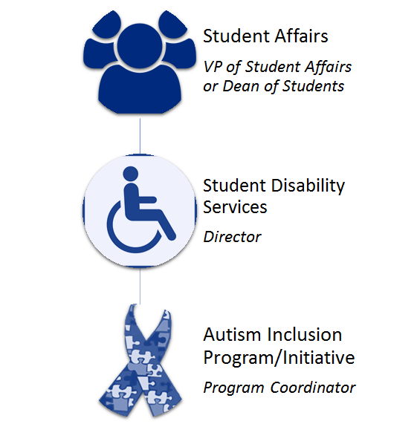
Organizational Chart

Slide 15
Human Resources Position Description
Program Coordinator: Master’s degree in Student Affairs, College Student Personnel, Social Work, Counseling, Nonprofit Management, or related field required. 1-3 years of professional experience preferred. Full-time appointment.
Recruit and retain program participants;
Review applications, accept students into the program, and orient program participants;
Maintain an annual program budget;
Renew grant funding on a bi-annual basis;
Represent the program at departmental, campus, and community meetings;
Meet one-on-one with program participants and parents to create Individualized Plans based on the participant’s goals;
Communicate closely with campus partners such as residence life and counseling services, and make referrals to appropriate resources as necessary;

Slide 16
Human Resources Position Description cntd.
Work with faculty members to help communicate program participants’ academic accommodation needs as well as provide training for faculty around how to best work with ASD students who may have behavioral issues (over sharing, etc.);
Directly supervise a graduate assistant and oversee the Peer Mentor program;
Co-instruct, create, and annually update the curriculum for the Life Skills Course;
Coordinate with Bridge to offer workshops for program participants surrounding vocational skills;
Design and provide specialized trainings for campus collaborators such academic advising, residence life, and campus police;
Perform assessment and analyze data around the program;
Recruit, train, and maintain institutional partners.

Slide 17
Human Resources Position Description
Autism Inclusion Program (AIP) Graduate Assistant: Enrolled in a Master’s degree program in Student Affairs, College Student Personnel, Social Work, Counseling, Nonprofit Management, or a related field required. Prior volunteer or work experience with individuals with disabilities preferred. Average of 20 hours per week.
Train the Autism Spectrum Disorder (ASD) Allies and Peer Mentors;
Perform administrative tasks as instructed by the Program Coordinator and Disability Services Director;
Duties may include filing paperwork, monitoring the office and program email accounts, and recording and dispersing meeting minutes;
Travel to local high schools and community centers to present information on AIP;
Provide academic support to participants by accompanying them to office hours with faculty;
Facilitate on-campus programming with participants;
Co-instruct Life Skills Course.

Slide 18
Proposed Floor Plan
Graduate Assistant Office
Where study hours, social events, Life Skills course, academic skill course, peer mentoring, and tutoring take place.
Computer lab area will have access to apps and software to aid in less supervised development.
Filing, Programming Storage
Computer Lab
Classroom/ Testing Center
AIP Program
Coordinator
Receptionist
D.S. Director Office
Renovated/New Areas of Disability Services Office (Previously additional storage)
Existing Areas of Disability Services Office

Slide 19
How are we going to pay for this?

Slide 20
Proposal Budget for Services
Expenses
Human Resources Program Coordinator Graduate Assistant Peer Mentoring (5 tutors x 5 hours weekly) | $60,296-$76,000 $45-56,000 + benefits annually $800-1000 monthly x 10 Months + tuition waivers (6 courses per academic year) 5 (9.12x5) 32 weeks = $7296 annually (12.50/hr by 2020; $10,000 annually)
Operations Software Renovations Advertising Travel/Lodging for Recruitment Contingency | $6046 $46 $3,000 $500 $2,500 $1,000
Total Initial Cost: $67,342-$80,342
Annual Cost Post-Start Up: $69,046-$80,046

Slide 21
Proposal Budget for Services
Incoming
Student Activity Fee Annually
If Student Enrollment 500-4,000 | $12.26-$120.09*/student
If Student Enrollment 4,000-10,000 | $4.90-$15.01/student
If Student Enrollment 10,000-50,000 | $0.98-$6.00/student
If Student Enrollment 50,000+ | <0.98/student - <$1.20/student
Grants
Daniel Jordan Fiddle Foundation Ignition Grant | $20,000 annually
A student activity fee was decided as the primary source of funding to address income inequalities that exist for entering college students. Many college programs charge upwards to $3,000 a semester for students wanting to receive these services. This programming office benefits all students, and better ensures students of low socioeconomic status with ASD can receive the support they need.
*If enrollment is less than 2,000, we propose making peer mentors as a volunteer position, paying the lower-end of the Coordinator salary, and striking the GA position; thus, the student activity fee would be $14.02-$56.09/student annually.

Slide 22
References
Allies Supporting Autism Spectrum Disorder Training. Retrieved from: http://www.marshall.edu/atc/asasd-training/
The Bridge: Mental Health Training and Solutions. Retrieved from: http://thebridgeny.org/programs/vocational-training-a-job-placement Cullen, J.A. (2015). The needs of college students with autism spectrum disorders and asperger’s syndrome. Retrieved from: http://files.eric.ed.gov/fulltext/EJ1066322.pdf DJ Fiddle Foundation. Retrieved from: http://djfiddlefoundation.org/ Iman, J. (2013). The reality of finding a job with autism. CNN. Retrieved from: http://www.cnn.com/2013/04/30/health/irpt-autism-in-the-workplace/ SAILS at Seattle Central College. Retrieved from: http://www.sailsforstudents.org/ Siegel, A. (2017). Scholarship for students with autism officially endowed last month. Retrieved from: http://thenews.org/2017/02/16/scholarship-for-students-with-autism-officially-endowed-last-month/ The Social Cog. Autism facts & statistics. Retrieved from: https://www.thesocialcog.org/portal/autism-facts-*-statistics The West Virginia Autism Training Center’s College Program for Students with Autism Spectrum Disorder. Retrieved from: http://www.marshall.edu/collegeprogram/files/2016-Program-Summary-and-Overview.pdf U.S. Department of Education, National Center for Education Statistics (2016). Digest of Education Statistics, 2015 (NCES 2016-014), Chapter 2.
VanBergeijk, E., Klin, A., & Volkmar, F. (2008). Supporting More Able Students on the Autism Spectrum: College and Beyond. Journal of Autism and Developmental Disorders, 38(7), 1359-1370.

