Slide 1
Phase 5
An Integrated Approach to
Supporting Students on the Autism Spectrum
Indiana University of Pennsylvania
Ashley Baksis, Julieze Benjamin & Ashley Reese (team leader)

Slide 2
Presented by
Ashley Reese
Team Leader
Dean of Students,
Office of Student Affairs
Ashley Baksis
Director of Student Engagement
Office of Student Activities
Julieze Benjamin
Director of Disability Services
Disability Services

Slide 3
“Not Every Disability is Visible”
The Phase 5 committee seeks to create a campus wide initiative that supports students on the Autism Spectrum through Academic, Personal, and Behavioral facets
(The University of Warwick, 2016; Anderson, 2015)

Slide 4
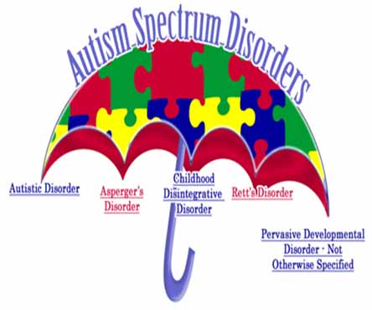
Autism Spectrum Disorders (ASD)
ASD is an umbrella term for multiple developmental disorders
Symptoms range from mild to severe
Invisible disability
Characteristics include:
Communication difficulties
Social and/or interpersonal incongruence
Repetitive and restrictive behaviors
Hypersensitive focus on objects and tasks
Developed cognitive/intellectual capabilities
(White, Ollendik & Bray, 2011; Whitman, 2000, p.22 )
https://csd.wisc.edu/slp-autism-spectrum-disorder.htm (Image)

Slide 5
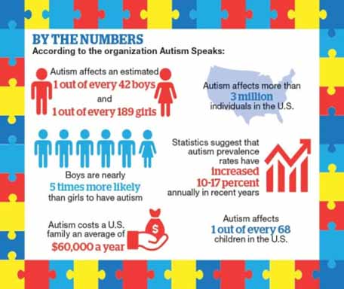
Exponential Increase
It is estimated that students with ASD comprise anywhere from 0.7 percent to 1.9 percent of the college population
Of those enrolled in higher education 80% do not persist
We recognize that the number of students who self-report a diagnosis of ASD has risen and will likely continue
With this information and our commitment to embrace diverse student populations, we propose the creation of a holistic support program
https://communityimpact.com/houston/healthcare/2016/07/13/rise-autism-prevalence-causing-demand-local-services/
(https://www.heath.gwu.edu/students-autism-college-classroom; Grogan, 2015; Zedaker, 2016)

Slide 6
Transition to College
Pre-College
Documented Disability by Guardian or Educator
Dependent Living
College
Independent Living & Decrease in Services
Self-Advocacy &
Self-Disclosure
Higher Financial Responsibility
Limited Student Responsibility
Student Conduct/Behavior
Students with ASD experience a shift within their rights, responsibilities, and services when they transition to college
“Approximately 26% of young adults on the autism spectrum receive no services”
(Grogan, 205; Roux, Shattuck, Rast, Rava, & Anderson, 2015, p.25)

Slide 7
Legislation: Shift in Rights & Responsibilities
 | Individuals with Disabilities Education Act, 1975 | Section 504 | Americans with Disabilities Act, 1990 | Higher Education Opportunity Act, 2008
Who is covered? | Students with educational disabilities from ages 3-21 (or until graduation) | Protects everyone with a disability from discrimination in educational settings | Protects everyone with a disability from discrimination within state and government entities | Protects students with intellectual disabilities
Requirements under the law | Provides free public education | Provides equal opportunity in education; prohibits discrimination based on disability | Extends section 504 to include private education; prohibits discrimination based on disability | Improves access to postsecondary education at institutions that receive Federal funding
Focus | Education focused on student success | Education focused on reasonable accommodations and equal access | Education focused on equal access | Improves access through financial aid and transition programs
(U.S. Department of Education, 2015)

Slide 8
Theory to Practice
Development
Growth
Success
Students with ASD can be successful with the support of programs that assist them in learning to manage their emotions, become interdependent, develop mature interpersonal relationships, and develop a purpose (Chickering & Reisser, 1993)
“Approximately one in four young adults with autism was socially isolated. They never saw or talked with friends, and were never invited to social activities within the past year”
(Roux, Shattuck, Rast, Rava, & Anderson, 2015, p.55)

Slide 9
What are other Universities doing?
Western Kentucky University
Kelly Autism Program
Rutgers University
College Support Program
Indiana University of Pennsylvania
Labyrinth Center
Indiana University of Bloomington
Resource Center for Autism

Slide 10
Structure Contributes to Success
Behavioral & Safety Coaching
Independent Living
Personal & Social Competence
Academic Skills & Success
Self-advocacy & support networks
Research shows that students with Autism Spectrum Disorder benefit from structured environments
As professionals, it is our responsibility to create an environment that provides structure and support to ALL students as outlined by the CAS standards
Phase 5 will be created to establish the structure that is essential to the success of Autism Spectrum Disorder students

Slide 11
Phase 5: An Integrated Approach
BEHAVIORAL &
SAFETY COACHING
SELF ADVOCACY &
SUPPORT NETWORKS
ACADEMIC SKILLS
& SUCCESS
Safety and security skills
Behavioral instruction
Self-care strategies
Conflict Resolution
Partnership with: Parents/guardians
Student Affairs
Academic Affairs
Organization skills
Career exploration
Time management
Employment skills
PERSONAL &
SOCIAL COMPETENCE
INDEPENDENT LIVING
Residential living
Medication management
Personal wellness
Financial literacy
Interpersonal communication
Relationship skills
Healthy boundaries
Campus engagement
(Wolf, Brown, & Bork, 2009)

Slide 12
Short Term Plan
Launch Phase 5 an integrated support for ASD Students
Pre-Orientation for ASD Students (1 week duration)
Engagement and Programming: 1 credit course, weekly meetings, and monthly newsletter
Create a sustainable Phase 5 structure (Student Affairs and Academic Affairs integration)
Phase 5 Application & Selection
Advertise through the Admissions Office and Disability Services (Application)
Select 25 first year residential students to participate in the Phase 5
Application and Selection Process
Host Pre-Orientation for ASD Students
Phase 5 Engagement and Programing

Slide 13
Engagement and Programing
1 Credit Course
Weekly Phase 5 Meetings
Monthly Newsletter
Cohort course
Digital newsletters will be sent to students and their support networks (parents/guardians, educators, and administration)
Facilitated by a graduate assistant accompanied by an upper class peer mentor
Designed to support ASD students successful transition, adjustment and integration from high school to college
Each week cohort members will learn about programs and engagement opportunities on campus
Designed to enhance students personal competence, social competence, independent living skills, and behavioral and coaching
Designed to promote ongoing communication and advocacy resources
Once selected, students will attend a week long pre-orientation for introduction to the Phase 5 program
(Emerging practices for supporting students on the autism spectrum in higher education: A guide for higher education professionals, 2014)

Slide 14
Program Budget
 | Purpose | Participants | Price/Each | Total
Housing | Pre-Orientation | 25 Students 1 Graduate Assistant 1 Upper-class student | Subsidized by internal funding | Subsidized by internal funding
Dining | Pre-Orientation | 25 Students 1 Faculty & 1 Staff member 1 Graduate Assistant 1 Upper-class student | $20.00 per person/ per day | $4,060.00
T-shirts | Pre-Orientation | 29 t-shirts | $3.00 per shirt | $87.00
Printing Cost (5 page handout) | Pre-Orientation | 25 | $0.50 per program | $12.50
Phase 5 Office | Office Space | N/A | FREE | FREE
Staff | Honorarium | Service and/or flex-time for faculty & staff member | N/A | N/A
Operations | Resource Materials | N/A | $1750.00 | $1750.00
Total Expected Cost |  |  |  | $5,909.50

Slide 15
Long Term Plan
Secure Funding and Operation Budget
Pre-Orientation cost
Office and meeting space
Support service resources
Staffing
Assessment and Evaluation
Direct assessment (pre-orientation and end of the year skills assessment)
Indirect assessment (semester student satisfaction survey and parent/guardian survey)
Assessment and Evaluation
Continuous Updates to the Board of Trustees on Annual Success
Secure Funding and Operational Budget

Slide 16
What Students With Autism Want You To Know…..
“Having autism doesn’t limit our abilities. Autism just changes our thought process and the way we perceive things”
-Phil Martin
“One of the biggest challenges of being autistic is not autism itself, but how other people react to it. If you to change lives, start by changing your perception of autism”
-Amy Gravino
“People with autism have a special window to the world. Our lens allows us to see depth and a perspective that many miss”
-Ann Kagarise
(Autism Speaks, 2017)

Slide 17
References
Anderson, Deanne. (2015). CT students with disabilities need to choose college wisely. Retrieved from http://ctviewpoints.org/2015/08/11/choosing-a-college/.
Evans, N. J., Forney, D. S., Guido, F. M., Patton, L. D., & Renn, K. A. (2010). Student development in college: Theory, research, and practice (2nd edition). San Francisco, CA: Jossey Bass.
Emerging practices for supporting students on the autism spectrum in higher education: A guide for higher education professionals. (2014). Retrieved from https://www.rit.edu/~w- ssp/documents/ASDinHigherEdGuide.pdf
Grogan, Gina. (2016). Supporting Students with Autism in Higher Education through Teacher
Educator Programs. Retrieved http://files.eric.ed.gov/fulltext/EJ1083126.pdf
Roux, A., Shattuck, P., Rast, J., Rava, J., and Anderson, K. National Autism Indicators Report: Transition into Young Adulthood. Philadelphia, PA: Life Course Outcomes Research Program, A.J. Drexel Autism Institute, Drexel University, 2015.
White,S.W., Ollendick, T.C., Bray, B.C. (2011). College student on the autism spectrum: Prevalence and associated problems.

Slide 18
References Continued
Whitman, Thomas. (2000). The development of autism: A self-regulatory perspective.
Wolf, L. E., Brown, J. T., & Bork, G. R. K. (2009). Students with Asperger syndrome: A guide for college personnel.
U.S Department of Education, National Center for Education Statistics. (2015). Digest of Education
Zedaker, Hannah. (2016). Rise in autism prevalence causing more demand for local services. Retrieved from https://communityimpact.com/houston/healthcare/2016/07/13/rise- autism-prevalence-causing-demand-local-services/
[“Not every disability is visible”] Retrieved from http://www2.warwick.ac.uk/services/equalops/disability/
https://www.autismspeaks.org/family-services/tool-kits/transition-tool-kit/post-secondary- educational-opportunities
https://www.autismspeaks.org/blog/2016/04/02/10-things-people-autism-want-you-know
https://www.heath.gwu.edu/students-autism-college-classroom
https://childmind.org/article/going-to-college-with-autism/

