Slide 1
Eastern Illinois university Team Leader – alexis hill
Jordan Dadez, Paul Higgerson, Porfirio Gallegos

Slide 2
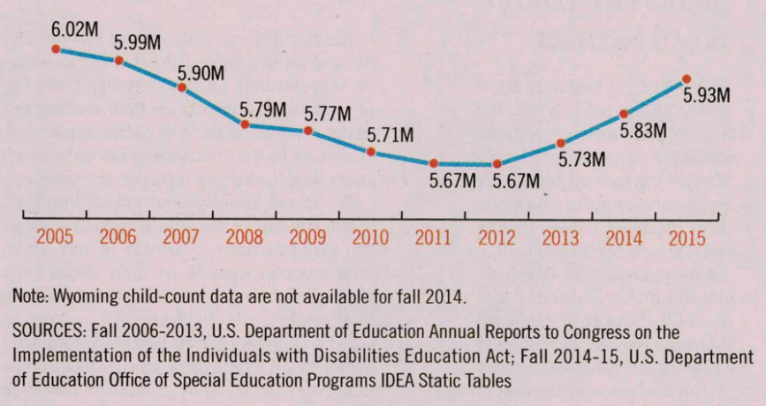
History & importance
In the Fall of 2015 with data collected from all 50 states in the United States there are currently 5.9 million enrolled in public education who live with a disability. (Samuels, 16)
Autism identification and diagnoses has increased to 144% within the last 10 years, approximately 560,000 students (Samuels, 16)
Currently not enough programs exist in public universities to handle the large increase in students with disabilities such as Autism that are seeking higher education (Samuels, 16)

Slide 3
Committee structure
Co-Chairs
Director of Disability Services
Assistant Director of Leadership Programs - Office of Residence Life
Committee Members
Director of Admissions
Live-in Associate Resident Director in the Residence Life department
Dean of Education Department
Program Coordinator from the Office of Student Activities
Director of Mental Health Services

Slide 4
Program overview
R.I.S.E
Reaching and Integrating Students with Autism into Excellence
Two-Tier Program
"Ascend"
Catered toward first-year students, course requirement, on-campus requirement, 1:1's with the Director of Disability Services bi-weekly, mandatory study hours, required meetings with mentor
"Surge"
Catered toward those who graduated from "Ascend" or transfer students, mentorship program, on-campus option, on-going until graduation
Personal, social, and academic integration through a variety of programs, resources, and opportunities

Slide 5
R.I.S.E. mission statement
The R.I.S.E. program is committed to helping students on the spectrum successfully integrate into society through learning helpful academic, social, and inter-personal skills. By participating in our program, students will be able to R.I.S.E. above the stigma associated with Autism Spectrum Disorder.

Slide 6
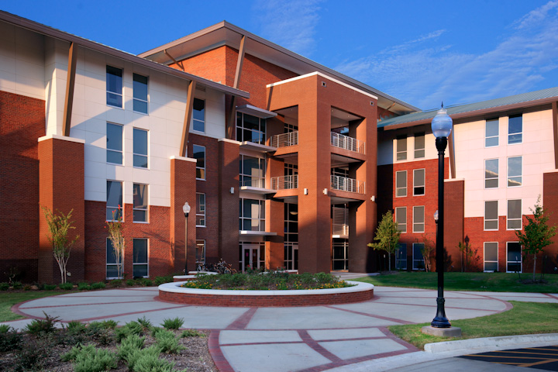
Personal integration
Work with residence life administrator to develop a Living Learning Community
Trained Resident Assistant will be on the floor
Good experience for someone who is majoring in Special Education or equivalent
Specified and unique quiet hours
Scheduled leisure activities
"Lights Out" time
Assists with routines

Slide 7
Social integration
Mentor program
Encourage them to go to on-campus events
Monthly requirement to go into a larger city with mentors to experience city living
Living Learning Community
Will help encourage social interactions with individuals in the programs as well as in the building through hall-wide and campus-wide programming

Slide 8
Academic integration
Study hours
Early alert program
"Life Skills" foundations course requirement
See next slide for course curriculum
Disability Awareness Month (October) campus program
Reduced course load for first year in program
9 hours is considered full-time for those in the program, 12 for other students
Adapted from (Hees, Moyson, & Roeyers, 2015)

Slide 9
Academic integration – life skills course curriculum
Academic:
Week 1 – Study Tips & Tricks
Week 2 – Note-Taking Strategies
Week 3 – Time Management Skills
Social:
Week 4 – Introduction to the mentorship program
Week 5 – Field trip to a local museum (and mentors come with)
Week 6 – Conversational Skills
Week 7 – Attend an on-campus event

Slide 10
Academic integration – life skills course curriculum (cont.)
Personal:
Week 8 – Developing Personal Relationships
Week 9 – Positive & Negative Habits
Week 10 – Budgeting Strategies
Week 11 - Field trip to a grocery store (to show them how to shop and budget effectively)
Emotional:
Week 12 – Self-Esteem
Week 13 – Showing Appreciation
Week 14 – Watch "The Story of Luke"
Week 15 – Reflection

Slide 11
budget

Slide 12
Committee responsibilities

Slide 13
Director of disability services
This Director is one the Co-Chairs for the R.I.S.E. Program make up. They are directly in charge of making sure of the integration of all departments for the R.I.S.E. program
Their role working with the Admissions process is the determination of the students ability to be "College Ready". Meaning their ability to function with the RISE program and work with the resources available to them
Their role working with the Housing Department in having a direct 1:1 with Associate Resident Director to gauge the community within the R.I.S.E. Learning Floor.

Slide 14
Director of Admissions
The Director of Admissions is directly in charge of the early admissions day specifically catered to students who are enrolled in the R.I.S.E. program
They are also directly in charge of overseeing the admissions councilors that are in charge of handling the R.I.S.E. student application.
They work in coordination with the Director of Disability Services to determine a students application. This includes the determine if a students "College Ready". Working hand in hand with the applicant. Collection of the applicants admissions paperwork. Making sure the perspective student has met the criteria for the university admissions standards.

Slide 15
Live-in associate resident director
The Associate Resident Director would directly supervise the specially trained Resident Assistant, and meet with them weekly.
The Associate Resident Director would serve the appropriate number of weeks on the on call schedule.
The Associate Resident Director will c0-advise the mentorship program with the Dean of Education.
The Associate Resident Director will assist with early move in of residents.
The Associate Resident Director will plan at least one building-wide program a semester for the residents.
The Associate Resident Director will work to create a safe and fun environment through university policies for the residents as well as carry out administrative duties for their building.

Slide 16
Dean of education department
Co-advise mentorship program with Live-in Associate Resident Director.
Oversees and chairs faculty instructors teaching Life Skills Foundations course.
Promotes awareness of the R.I.S.E Program, its mission, and the role of R.I.S.E on campus.
Coordinates efforts between departments to ensure that R.I.S.E. core mission and objectives are being met.
Chairs advisory committee that assesses and evaluates all aspects of R.I.S.E.

Slide 17
Director of mental health services
The Director of Mental Health Services is responsible for overseeing the mental health programs and works hand-in-hand with the R.I.S.E. Program.
This department will house the certifying officials responsible for ensuring that all applications are prepared for the social rigors and will be a good fit for the R.I.S.E. Program. They will work jointly with the Office of Admissions and Disabilities.
Advisory support and assistance in students transition to college will be functions of this department (Toor, Hanley, & Hebron, 2016).
Point of contact for students in times of confusion to assist them with questions and to help them feel safe (Hees, Moyson, & Roeyers, 2015).

Slide 18
Program coordinator - office of student activities
The program coordinator will serve as the liaison between the co-chairs of the R.I.S.E. program.
The program coordinator will serve as the liaison between the Office of Student Activities.
The program coordinator will work with the Assistant Director of Leadership Programs to plan and facilitate the off campus field trips for the Life Skills Foundations course.
The program coordinator will coordinate with organizations on campus to provide safe social outlets and spaces for R.I.S.E. participants.

Slide 19
Assistant director of leadership programs – office of residence life
Directly in charge of the coordination of the field trips within in the "Life Skills Foundations course"
Directly in charge of the campus wide program for the campus to better integrate the students involved within the R.I.S.E. with the student population. During the course of the campus wide program they are also in charge of the application of new possible Mentors into the program
Directly in charge of the Early notification system for the students enrolled in the R.I.S.E program. This program allows professors as well as campus officials the opportunity to directly let the students ARD and Resident Assistant receive notification when they are falling behind academically or when a possible incident happened on campus.
Also directly overseas the Mentor ship program application and hiring process.

Slide 20
implementation
Phase 1 (March-May)
Finalization of program
Recruitment of Resident Assistant position
Recruitment of live-in graduate assistant
Phase 2 (May-June)
Advertise the program to incoming first-year students
Recruit peer mentors
Finalize "Life Skills" curriculum and syllabus
Phase 3 (July-August)
Host early move-in dates and orientation programs for incoming R.I.S.E students
Host Q&A with faculty

Slide 21
Resources
Almendrala, A. (2014, March). More children with Autism are going to college than ever before (and 5 other key findings). The Huffington Post. Retrieved
from: http://www.huffingtonpost.com/2014/03/11/research-autism-spectrum_n_4939200.html
Autism Speaks, March 31 2016. CDC update on autism shows gap between early concerns and evaluation. Retrieved
from: https://www.autismspeaks.org/news/news-item/cdc-update-autism-shows-gap-between-early-concerns-and-evaluation.
Eastern Illinois University, N.D. Students with Autism transitional education program (STEP). Retrieved from: http://www.eiu.edu/step/.
Eastern Illinois University, N.D. 16-17 ARD job description. Retrieved from: http://www.eiu.edu/housing/pdfs/ard/16-17%20ARD%20JOB%20DESCRIPTION.pdf.
Samuels, C. A. (2017). Spec. Ed. Enrollments Rise. Education Week, 36(19), 6.
Toor, N., Hanley, T., & Hebron, J. (2016). The Facilitators, Obstacles and Needs of Individuals With Autism Spectrum Conditions Accessing Further and Higher Education: A
Systematic Review. Journal Of Psychologists & Counsellors In Schools, 26(2), 166-190. doi:10.1017/jgc.2016.21
Hees, V., Moyson, T., & Roeyers, H. (2015). Higher Education Experiences of Students with Autism Spectrum Disorder: Challenges, Benefits and Support Needs. Journal Of
Autism & Developmental Disorders, 45(6), 1673-1688. doi:10.1007/s10803-014-2324-2

