Slide 1
Student Affairs.com Case Study Competition
Team Leader: Erin Tovey
Team Members: Elizabeth Hammond, Nick Lang, Keenan Jones
Clemson University

Slide 2
CLASS
Campus Learning for Autism Spectrum Students

Slide 3
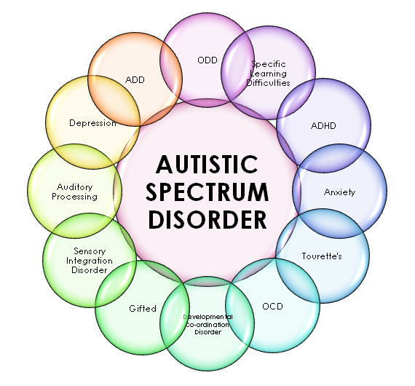
Autism Spectrum Disorder
One in every one hundred college applicants is diagnosed on the Autism Spectrum
Superior intellectual capability
Suffer from numerous personal and social issues that can impede learning in traditional environment

Slide 4
Autism Spectrum disorder
Severity level | Social communication | Restricted, repetitive behaviors
Level 3 "Requiring very substantial support” | Severe deficits in verbal and nonverbal social communication skills cause severe impairments in functioning, very limited initiation of social interactions, and minimal response to social overtures from others. | Inflexibility of behavior, extreme difficulty coping with change, or other restricted/repetitive behaviors markedly interfere with functioning in all spheres. Great distress/difficulty changing focus or action.
Level 2 "Requiring substantial support” | Marked deficits in verbal and nonverbal social communication skills; social impairments apparent even with supports in place; limited initiation of social interactions; and reduced or abnormal responses to social overtures from others. | Inflexibility of behavior, difficulty coping with change, or other restricted/repetitive behaviors appear frequently enough to be obvious to the casual observer and interfere with functioning in a variety of contexts. Distress and/or difficulty changing focus or action.
Level 1 "Requiring support” | Without supports in place, deficits in social communication cause noticeable impairments. Difficulty initiating social interactions, and clear examples of atypical or unsuccessful response to social overtures of others. May appear to have decreased interest in social interactions. | Inflexibility of behavior causes significant interference with functioning in one or more contexts. Difficulty switching between activities. Problems of organization and planning hamper independence.
https://www.autismspeaks.org/what-autism/diagnosis/dsm-5-diagnostic-criteria

Slide 5
Benchmarking
Drexel University Autism Support Program
Rutgers Developmental Disabilities Center
Mercyhurst University AIM Program
Midwestern State University
St. Joseph’s University Kinney Center for Autism
Boston University Supported Education Services
University of Alabama College Transition and Support Program
Autism Collaborative Center at Eastern Michigan University
University of Connecticut SEAD Program
Marshall University Autism Training Center

Slide 6
Program Initiative Committee
Housing and Residence Life (Provide living space and staff)
Campus Dining (provide meal plan)
Special Education Department (Encourage students to be Peer Mentors)
Campus Recreation (Fitness classes and Health & Well Being)
Career Services (Job Placement and Internships)
Financial Aid (Financial Needs assessment)
University Police (Student Safety)
Academic Success Center (Resources)
Multicultural Center (Education and Support)
Student Activities (social programming)
Counseling and Psychological Services (Mental Health)

Slide 7
Mission of CLASS
Description:
The CLASS program is a two year, fee-based program for College Town University (CTU) students on the Autism Spectrum that provides an academic curriculum along with support in academic, personal and social areas.
Mission:
The Campus Learning for Autism Spectrum Students (CLASS) program is a student-focused program for College Town University (CTU) students aiming to promote academic, personal, and social integration into the campus local, and global communities.
Highlights of the program:
  Orientation to the CLASS Program and College Town University
  Program Success Plan
  Academic Curriculum & Accommodations
  Peer Mentor Program
  Living Learning Community
  Career Guidance
  Personal Enrichment Workshops
  Social Events
  Mental Health Counseling Referrals
  Support & Advocacy
  Health and Wellness

Slide 8
Influence of Universal Design
Set of principles for curriculum development that give ALL individuals equal opportunities to learn
Flexible approaches that can be customized for individual needs
Allows students to approach learning in different ways and still be successful
CLASS curriculum will be built with principles of Universal Design to facilitate optimal function within the classroom and within society upon graduation from CLASS

Slide 9
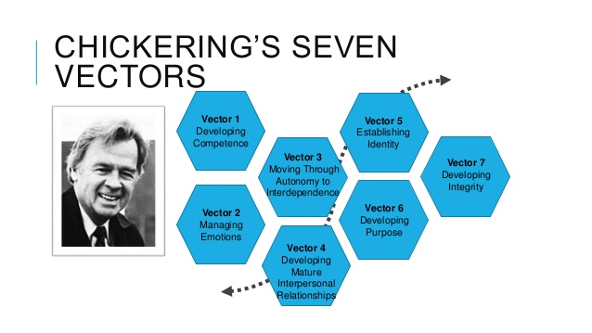
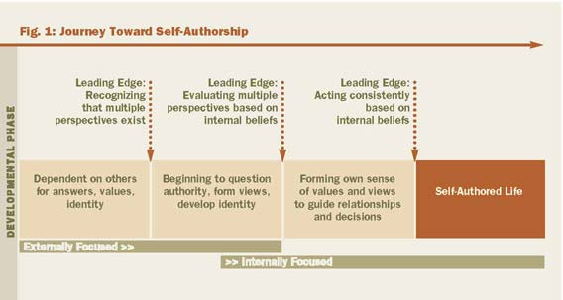
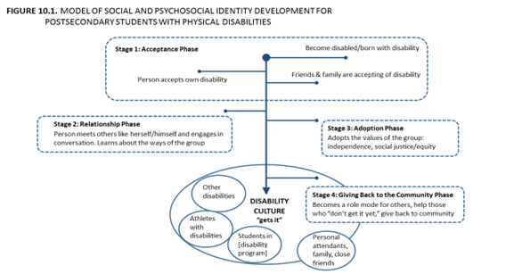
Student Development Theory

Slide 10
CLASS Pillars of Support
Personal Support
  Internship/job placement
  Housing Community
  Health and Well-Being
  Counseling referrals
Social Support
  Field Trips
  Social Events
  Dining Hall group meal times
  Peer Mentor Engagement
Academic Integration
  Specialized skill-based curriculum
  Tutoring
Familial Support
  Parent Outreach
  Open communication
    With student’s approval
Integration of all four:
  Program Success Plan
    Time Management
    Communication skills
    Personal Goal Setting
    Accommodations
    Health & Well Being goals

Slide 11
CLASS Program Orientation
For parents and students
Small groups or individual (if requested)
  Led by their Peer Mentor for the year
Orientation to University and to CLASS
Tour of campus
  Walking routes from residence halls to classrooms, CLASS Offices
Tour of housing and dining facilities
Meeting with Assistant Director for Student Support
  Creation of individual Program Success Plan

Slide 12
Director of Disability Services
Assistant Director for Program Operations
Instructor
Instructor
Assistant Director for Student Support
Graduate Assistant
Instructor
Instructor
CLASS Program Director
Dean of Students
Peer Mentors
Graduate Assistant
Housing & Residence Life
Counseling & Psychological Services
Student Activities
Development
Administrative Assistant
Peer Mentors
Career Services
CLASS Organizational Structure

Slide 13
CLASS Staff Responsibilities
Assistant Director for Program Operations
Supervise CLASS instructors
Create and implement curriculum changes
Manage on campus partnerships
Manage off campus partnerships
Program Orientation
Manage conduct and behavior concerns
Assessment of program
Assistant Director for Student Support
Manage Individual Program Success Plans
Supervise Graduate Assistants
Recruit and supervise CLASS Peer Mentors
Coordinate social activities
Collaborate with Career Center and community partners for job and internship placement
Assessment of program
CLASS Program Director
Fundraising
Coordinate with Development office
Budgeting and student fees
Applications and Acceptance
Graduate Assistants
Manage Individual Program Success Plans
Meet weekly with students
Organize Weekly Success Workshops
Assist with Orientation
Coordinate Peer Mentor Training
Instructors
Implement skill based curriculum
Provide bi-weekly progress reports
Provide program evaluations
Assess curriculum effectiveness

Slide 14
Peer Mentor Responsibilities
Hired in fall for next year
  2 week training before school starts
Help coordinate and implement orientation
Assist in recruitment of future peer Mentors
Paired with 4 CLASS students
Attend 1 dinner per week
Attend 1 social event per week
Supervise 3 tutoring hours per week
Check in weekly with supervising Graduate Assistant
  management of individual program success plans
(Receive $600/year stipend and 1 academic credit/semester)

Slide 15
Daily schedule
 | Monday | Tuesday | Wednesday | Thursday | Friday | Saturday | Sunday
9:00 AM | Internship | Group breakfast | Internship | Group Breakfast | Internship | Free Time | Free Time
10:00 AM |  | Technology |  | Technology
11:00 AM | Practical Math Skills | Communication Skills | Practical Math Skills | Communication Skills | Practical Math Skills
12:00 PM | Lunch | Lunch | Lunch | Lunch | Lunch | Lunch | Lunch
1:00 PM | Self Advocacy | Creative Expression Arts | Self Advocacy | Weekly Success Workshop | Self Advocacy | Social Activity | Peer Mentor Tutoring
2:00 PM | Computer Lab | Weekly Success Meetings/ Free Time | Independent Study | Weekly Success Meetings/ Free Time | Weekly Success Meetings/ Free Time
3:00 PM | Health & Fitness | Health & Fitness | Health & Fitness | Health & Fitness | Health & Fitness | Free Time | Social Activity
4:00 PM | Literature | Peer Mentor Tutoring | Literature | Film | Literature | Free Time
5:00 PM | Dinner | Dinner | Dinner | Dinner | Dinner | Dinner | Dinner

Slide 16
Community partners
Students are placed in local community establishments that partner with CLASS to create a supportive, educational environment for CLASS students to gain real life internship and job experience.
Jobs/Internships Partners
  On Campus Employment
  Outdoor Recreational facilities
  Public Safety
  Local Restaurants
  Religious Affiliated Organizations
  Local Grocery Stores
  Clothing/Retail Stores
  Drug Stores
  Local Community Service Organizations
  Coffee Shops
  Health and Fitness facilities

Slide 17
Budget
C.L.A.S.S. Program Annual Budget Proposal
Expected Amount of Students | 40
Anticipated Revenue | Cost | # of Item | Budget Estimates
C.L.A.S.S. Program Fees | $6,000.00 | 40 | $240,000.00
University Housing and Dining Fees | $5,600.00 | 40 | $224,000.00
Office of Disability Services | $25,000.00 | 1 | $25,000.00
Fundraising and Development | $50,000.00 | 1 | $50,000.00
Total Revenue |  |  | $539,000.00
EXPENSES
Program Staff
C.L.A.S.S. Program Director | $50,000.00 | 1 | $50,000.00
Assistant Director for Program Operations | $35,000.00 | 1 | $35,000.00
Assistant Director for Student Support | $35,000.00 | 1 | $35,000.00
Program Instructor | $30,000.00 | 4 | $120,000.00
Graduate Assistant | $10,000.00 | 2 | $20,000.00
Peer Mentor | $600.00 | 10 | $6,000.00
 |  | Total | $266,000.00
Housing and Dining Costs
University Housing/Apartment Costs | $3,600.00 | 40 | $144,000.00
University Dining Fee | $2,000.00 | 40 | $80,000.00
 |  | Total | $224,000.00
Marketing
C.L.A.S.S. Program Outreach & Launch | $10,000.00 | 1 | $10,000.00
Fundraising/Development Publications | $8,750.00 | 1 | $8,500.00
Peer Mentor Program Outreach | $250.00 | 1 | $250.00
 |  | Total | $18,750.00
Miscellaneous
Office Supplies | $5,000.00 | 1 | $5,000.00
Association of Higher Education and Diversity (AHEAD) Professional Staff Membership Fees | $265.00 | 9 | $2,385.00
Total Expenses |  |  | $516,135.00
Remaining Budget |  |  | $22,865.00

Slide 18
Assessment
Testimonials
  Participant
  Peer Mentors
  Parents
  Instructors
  Job placement supervisors
Student retention and completion rate
Job placement rate
Program evaluations
  Participants
  Parents
  Peer Mentors
  Instructors
Both quantitative and qualitative date will be utilized to assess program effectiveness and future needs and growth

Slide 19
Future Plans for CLASS
2-year plan | 4-year plan | 10-year plan
Increase participants by 10% | Increase participants by 15% | Increase participants by 20%
Increase instructors by 10% | Increase instructors by 15% | Increase instructors by 20%
Increase Career placement partnerships by 10% | Increase Career placement partnerships by 15% | Increase Career placement partnerships by 20%
Increase Peer Mentors to 1:3 ratio | Increase housing and dining options | Increase Peer Mentors 1:2 ratio
 | Create Parent and Alumni Associations | Paid professional development for staff and Graduate Assistants
 |  | Serve all students on Autism Spectrum *including level 3

Slide 20
Resources
http://www.udlcenter.org/
Forber-Pratt, A. J., & Aragon, S. R. (2013). A model of social and psychosocial identity development for postsecondary students with physical disabilities. In Emerging perspectives on disability studies (pp. 1-22). Palgrave Macmillan US.
https://www.aacu.org/publications-research/periodicals/engaged-learning-enabling-self-authorship-and-effective-practice
http://www.mercyhurst.edu/academics/autism-initiative-mercyhurst
https://www.autismspeaks.org/what-autism/diagnosis/dsm-5-diagnostic-criteria
http://www.bestcollegesonline.com/blog/10-impressive-special-college-programs-for-students-with-autism/
http://www.huffingtonpost.com/2014/03/11/research-autism-spectrum_n_4939200.html
http://www.nytimes.com/2006/11/05/education/edlife/traits.html
http://www.clemson.edu/education/culife/about/costs.html
https://www.myautism.org/wp-content/uploads/2016/01/Autism-College-Programs.pdf

