Slide 1
Beyond the Spectrum (BTS)
Clemson University
Casey Terrell (Team Leader), Abigail Beadle, Bianca Lambert, Braylon Junior

Slide 2
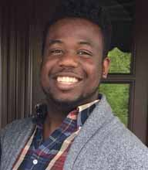
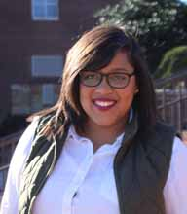
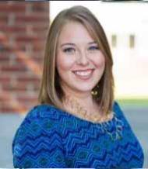
Our Team
Not Pictured: Assistant Director of Mental Health Services
Abigail Beadle
Braylon Junior
Bianca Lambert
Casey Terrell - Team Leader
Associate Director of Residence Life
Associate Professor in the Department of Psychology
Associate Director of Student Activities
Director of Accessibility Services
(Formerly known as
Disability Services)

Slide 3
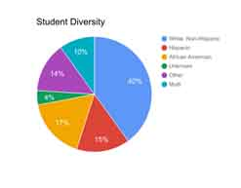
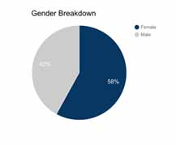
Allen State University
Public Institution
Located in Kensington, New York
Enrollment Total: 27,732
  Undergraduate: 22,498
  Graduate students: 4,380
  Law students: 854
Average ACT Score: 26
Average high school GPA: 3.5
Enrollment by school
  Lambert College of Health Sciences: 6, 489
  Beadle School of Education: 1,888
  Anthony College of Business: 4,247
  Terrell College of Arts & Sciences: 9,874

Slide 4
Understanding the Autism Spectrum
According to the DSM-5, Autism Spectrum Disorder includes the following diagnoses:
Autistic Disorder
Asperger’s Disorder
Childhood Disintegrative Disorder
Pervasive Developmental Disorder Not Otherwise Specified
Symptoms range from mild to severe and fall along the spectrum below.
Extreme ability in some areas
Above Average I.Q.
Average I.Q.
Mild Learning Disability
Moderate Learning Disability
Severe Learning Disability
Mild
Severe
(American Psychiatric Association, 2013)

Slide 5
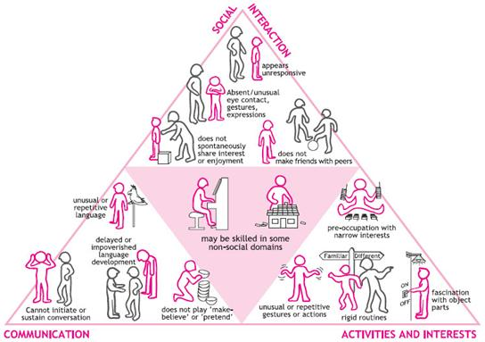
Needs of Students on the Spectrum
Individuals diagnosed with Autism Spectrum Disorder often have deficits in the following areas:
Social Interactions
Communication
Repetitive or restricted interest
Language development
The pyramid highlights what some of these challenges might look like as it relates to college students.
(International Child Development Center, 2014 )

Slide 6
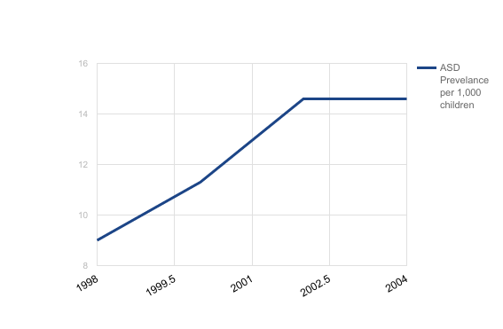
Significance
It is estimated that nearly 35% of youth with ASD attend college.
(Shattuck et. al., 2012)
Identified Prevalence of Autism Spectrum Disorder by Birth Year
On average, 10-14% of college students are diagnosed with ASD.
(Fisher, 2014)
(Centers for Disease Control and Prevention Autism and Developmental Disabilities Monitoring (ADDM) Network)

Slide 7
Our Why
Statement
We believe college is a transformational experience and should be accessible for all, regardless of ability.

Slide 8
Program Overview
Beyond the Spectrum (BTS) is a four year program that offers students with ASD opportunities to develop academic, social, and personal skills through experiential learning in the following three areas:
Mentorship
Each student will be matched with a peer mentor who acts as a support system for students as they transition into the university. They are expected to meet every other week. Students will start as a mentee their first year, but can become a mentor to incoming students in following years. Students will also be matched with an academic coach to meet with monthly.
The Residential Experience
Beyond the Spectrum students will be admitted into a Living Learning Community where they will live with and take classes alongside peers in the program. There is a Resident Assistant and two live-in counselors in the LLC to support students as they navigate integrating and being successful at Allen State University.
Internship
Students are required to complete three internship or shadowing experiences (totaling 100 hours) that enable them to explore and acquire vocational skills related to their goals. Academic coaches will help connect students with opportunities.

Slide 9
Beyond the Spectrum Learning
Outcomes
Students who complete the Beyond the Spectrum program will be able to state two vocational goals and articulate three transferrable skills that align with achieving them.
Students who complete the Beyond the Spectrum program will be able to identify and incorporate two strategies for positive social interactions.
Students who complete the Beyond the Spectrum program will be able to identify at least two approaches for independent living.
Students who complete the Beyond the Spectrum program will be able to describe the experiences had during the 100 hours of required internship experience.
Students who complete the Beyond the Spectrum program will be able to apply learned strategies to acquire and maintain a job upon leaving Allen State University.

Slide 10
Program Sequence
ACTIVATE
EXPLORE
SERVE
EXCEL

Slide 11
The First year Experience (Activitate)
Academic Goals
Students will be able to describe the outline and purpose of BTS program.
Students will be able to identify the live in and in office staff members.
Students will meet with academic coaches.
Students will work with their academic coaches to establish academic success strategies.
Students will be familiar and able to use online programs and technologies necessary for academic success.
Personal Goals
Students will be matched with a program mentor to have one-on-one interactions throughout the year.
Students will meet with the ASD counseling support group.
Social Goals
Students will be able to integrate themselves into the living learning community through the conversation club.
Students will participate in a common read to create a shared social experience.
Students will navigate healthy communication and relationship building through sharing space and adhering to the stated Living Learning Community standards.

Slide 12
The Second Year Experience (Explore)
Academic Goals
Students will be able to identify their academic goals.
Students will be able to recognize and implement productive study strategies.
Personal Goals
Students will be able to create S.M.A.R.T. goals with a program mentor.
Students will be able to identify vocational goals.
Students will be able to identify and describe their strengths and weaknesses.
Social Goals
Students will be able to identify their personal motivations.
Students will be able to identify resources on campus.
Students will be able to establish community through attending on campus social events with peers in BTS.

Slide 13
The Third Year Experience (Serve)
Academic Goals
Students will be able to articulate academic strategies for academic success.
Students will become mentors to incoming peers
Students will be able to contribute to the academic success of their mentees through one-on-one interactions.
Personal Goals
Students will be matched with a program mentee to have one-on-one interactions throughout the year.
Students will explore vocational goals through the completion of 50 internship hours at two officers over the course of the year.
Social Goals
Students will be able to invest back into the program by building community in the living learning community.
Students will be able to engage in social integration through participating in the conversation club.

Slide 14
The Fourth year Experience (Excel)
Academic Goals
Students will be able to create academic strategies for themselves and for peers.
Students will be able to create strategies to effectively utilize their degree or certificate.
Personal Goals
Students will continue vocational skill building by completing 50 internship hours at one internship site over the course of one academic year.
Students will be able to develop strategies for assisted and independent living
Social Goals
Students will be able to create welcoming spaces for other students in the program.
Students will be able to integrate students from outside the living learning community into the community.

Slide 15
Implementation Timeline
Buy- in
First Cohort
Second Cohort
Third Cohort
During the first year, we will generate student interest and recruit student and graduate staff to serve as the first group of mentors. We will also begin identifying space on campus for the LLC.
During this year, students will be introduced to the sequencing of our program goals. Graduate and student staff will serve as mentors. At the end of this first year we will assess our learning outcomes with an assessment tool.
In this year, and we will implement changes generated by the assessment. We will also continue recruiting and expanding student staff to meet the needs of our growing program.
In our third year, we celebrate successes, continue to assess our program, and expand as needed.

Slide 16
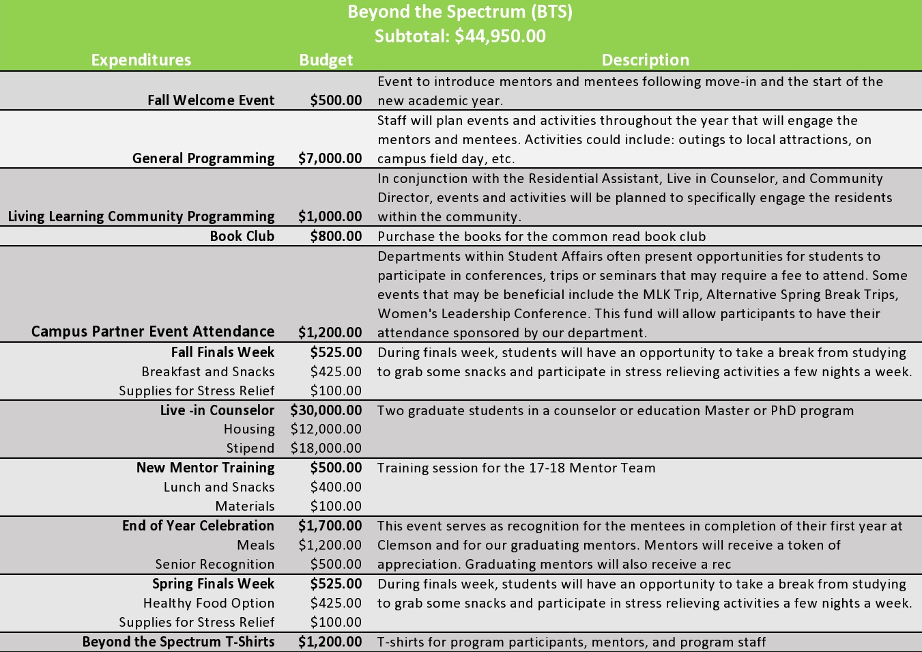
Budget

Slide 17
Application of Theory:
Developmental Ecology (Bronfenbrenner)
Microsystem
Roommates
Academic Coaches
Live-In Counselors
Office Staff
Mesosystem
Living Learning Community
Exosystem
FERPA
Classroom design
Access to resources
Macrosystem
Campus culture
Potential program stigma
Self
Microsystem
Mesosystem
Exosystem
Macrosystem
(Patton et. al.,2016)

Slide 18
Application of Theory:
Principles of Self-Authorship (Baxter Magolda)
Validating learners capacity to learn by...
Situating learning in learners experience by...
Mutually constructing meaning by...
allowing students to create their own personal, academic, social, and vocational goals
having peer mentors who have been a part of the program
making education available regardless of ability
(Patton et. al.,2016)

Slide 19
Limitations
We will be starting without mentors who have not specifically gone through the program yet, which might have an impact on the first cohort of students.
  Our goal is to set a precedence of what the mentor-mentee relationship should look like through graduate students and professional staff serving as the first mentors.
We will need more program staff to best meet the needs of the students.
We will need to ensure we are continuing to provide quality services and support while striving to reach more students as the years progress.
We recognize the most common accommodation for students on the spectrum are for residence hall single rooms
  We will need to continue to accommodate while keeping the integrity of the LLC component which is to encourage social interaction.

Slide 20
Resources
American Psychiatric Association. (2013). Diagnostic and statistical manual of mental disorders (5th ed). Washington, D.C: Author.
Centers for Disease Control and Prevention (2016). Autism and Developmental Disabilities Monitoring (ADDM) Network. Retrieved from
http://www.cdc.gov/ncbddd/autism/addm.html
Fisher, H. (2014) Disability in higher education topics: autism spectrum disorder. Retrieved from
https://www.marymount.edu/marymount.edu/media/Academic_media/Services_and_Resources/Supporting-Students-with-Autism-Spectrum-Disorder-(SEHS-ver-).pdf
International Child Development Center (2014). Diagnosis. Retrieved from http://autism.am/diagnosis/
Patton, L. D., Renn, K. A., Guido, F. M., Quaye, S. J., & Forney, D. S. (2016). Student development in college: Theory, research, and practice. John
Wiley & Sons.
Shattuck, P. T., Narendorf, S. C., Cooper, B., Sterzing, P. R., Wagner, M., & Taylor, J. L. (2012). Postsecondary education and employment among
youth with an autism spectrum disorder. Pediatrics, peds-2011.

