Slide 1

Arkansas Tech University
Hailey Canada – Anna Stark
Vince Ashford – Adam Hathcock

Slide 2
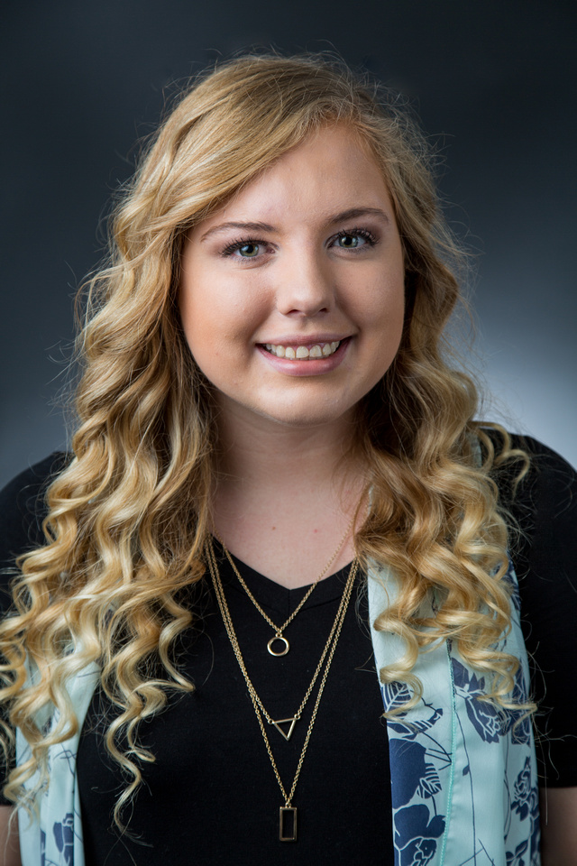
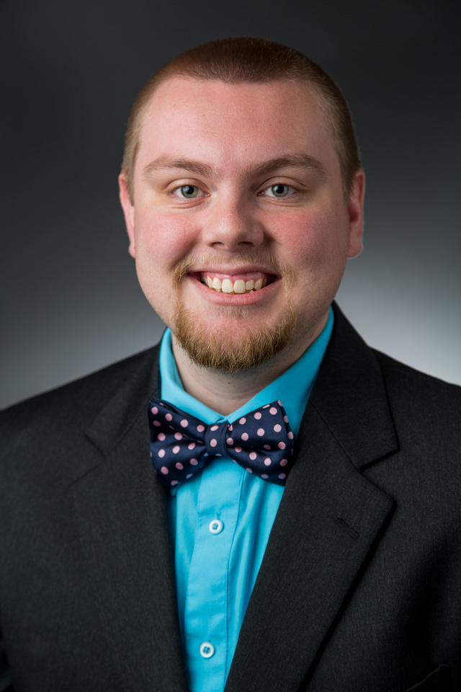
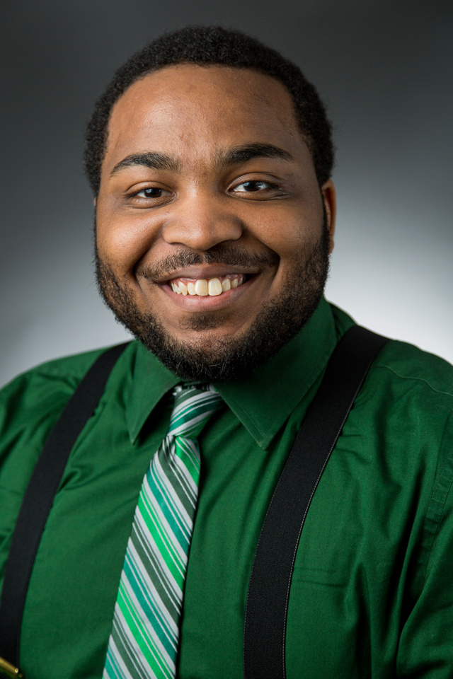
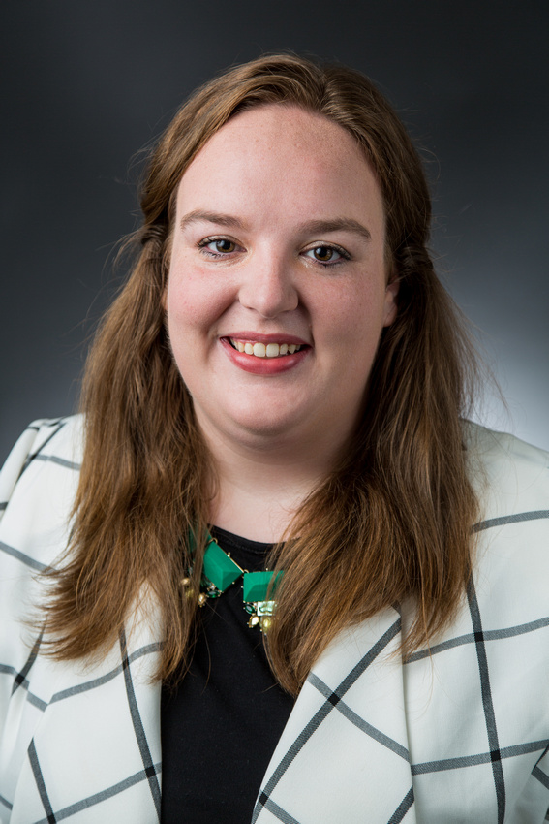
Team Members:
Hailey Canada
Team Leader
Hailey is currently the Graduate Assistant for Campus Life and completed her undergraduate degree at Arkansas Tech University.
Adam Hathcock
Adam is the Resident Director for M-Street, and completed his undergraduate degree at the University of Tennessee.
Vincent Ashford
Vincent is the Resident Director for Critz, Hughes, and Tucker, and completed his undergraduate degree at UW- Whitewater.
Anna Stark
Anna is the Graduate Assistant for Greek Life, and the Resident Director for Caraway Hall. She completed her undergraduate degree at Drury University.

Slide 3
Overview
As our university has had an increase in student enrollment along the Autism Spectrum, our committee hopes to enhance the personal, social, and academic experiences of all of our students. By creating a co-curricular programming model with the Department of Disability Services (DDS), we hope to better serve our students on the Autism Spectrum.

Slide 4
Committee Members
A committee to further research and implement strategies to better serve students on the Autism Spectrum has been created. The following staff have been appointed to this committee:
Residence Life | Mental Health Services
Derek Dorsey | Hannah Matheney
Associate Dean for Residence Life | Coordinator of Programs
Student Activities | Disability Services
Shelby Reding | Heather Gladfelter
Assistant Director of Campus Life | Director of Disability Services

Slide 5
People with Autism for Community Engagement: PACE
PACE is a co-curricular program that puts emphasis on individuals that fall within the Autism spectrum to get involved in the University community as well as educate the general population about issues facing those with Autism.
All events within this program will be selected by the co-existing student group, Spectrum.

Slide 6
Pace Steps
The program will be broken up into 4 steps. Participating students must complete one event in each step (per academic year) to be eligible for the annual spring trip. The Steps are:
Leadership | Career
Social | Awareness

Slide 7
Leadership
Professionals who are on the Autism Spectrum will expose students to different aspects of leadership styles, techniques, and presentations.
Programming example:
How to Interview with Autism
Learn professional tips for interviewing and how to connect with employers highlighting your strengths and abilities.

Slide 8
Career
Programming on the Career Step will assist students in developing skills in career readiness including resume writing, job searching, and placement while incorporating the unique aspect of living with Autism.
Programming example:
Job Searches on the Spectrum
Partnering with Career Services and the local non-profit Autism Speaks, students will gain critical information and know-how when it comes to career searching with Autism.

Slide 9
Social
With help from the campus student organization, Spectrum, social events will be facilitated to foster personal relationships for individuals with and without Autism.
Programming example:
Kate Johnson Dance
Spectrum will host an event where students will celebrate Autism Awareness in a fun social to connect students to one another.

Slide 10
Awareness
Event offerings on the Awareness Track will focus on general education about the daily lives of individuals on the Autism Spectrum.
Programming example:
Living with Autism: Different Perspectives
Executive board members of Spectrum will speak about their collegiate experience to bring awareness to life on the Spectrum.

Slide 11

If video does not load, please click here: https://youtu.be/4mh75_u0uR8

Slide 12
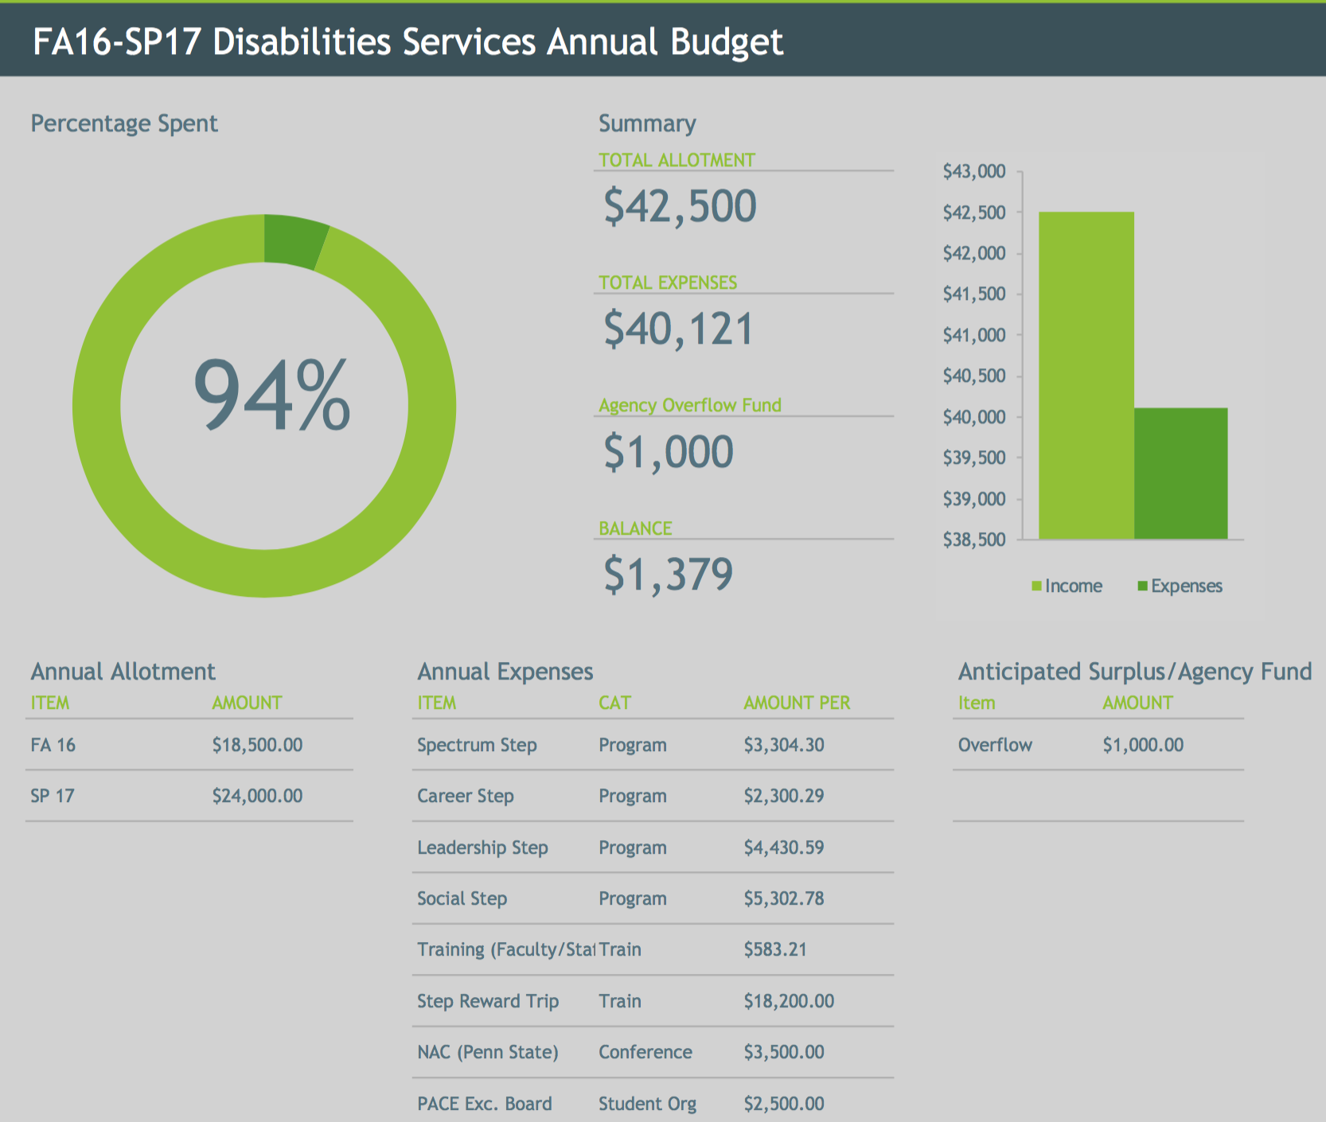

Slide 13
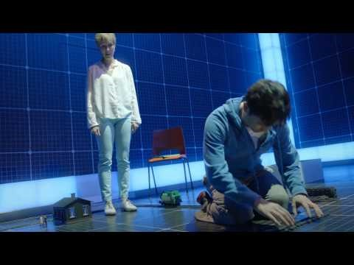
Trip
Students who complete the PACE program will be eligible to attend the annual Spring PACE trip.
This trip includes:
Travel to and from New York City
Meet and greet with a professional with autism spectrum disorder
Dinner in the city
A showing of "The Curious Incident of the Dog in the Night-Time" on Broadway
Trailer:
If video does not load, please click here: https://youtu.be/UVrOsXhG61Q

Slide 14
Promotion and Marketing:
Getting the Word Out about PACE
This new program will rely heavily on faculty, staff, and Spectrum members to spread the word and get students involved.
Share with Greek organizations, asking members to set example and get involved
Classroom presentations
Mass email to student’s University email accounts
Promote all-expense paid trip to New York City

Slide 15
Behind the Scenes
There will be work that needs to be done behind the scenes that many students will never know about. These tasks will be assigned to Department of Disability Services staff, committee members, and Spectrum executive board members.
Use sign-in sheets at events to keep track of attendance
Track student involvement using Microsoft Excel
  If program is successful after first year, invest in attendance tracking software
Social media efforts
Email students when
  their attendance log is updated
  they are eligible for the Spring PACE Trip
Answer student questions and troubleshoot issues

Slide 16
Applied Theory
Alexander Astin’s Student Involvement Theory:
“The amount of student learning and personal development associated with any educational program is directly proportional to the quality and quantity of student involvement in that program.” (Astin, 1984)
The PACE program will encourage students to get involved in events that teach leadership traits, career preparation, and interpersonal skills while spreading awareness about Autism (quality). Participants who complete the program will be required to attend at least four events on campus (quantity).

Slide 17
Conclusion
This program will directly affect all students on campus, but will give those students that do fall within the Autism Spectrum special tools to excel socially and academically at the university as well as into the future.
Personal
Enhance leadership and career skills through developmental programs
Opportunity to gain presentation and public speaking experience
Develop interpersonal skills by socializing with other students, faculty, and staff who partake in the program
Social
Meet students from different areas on campus, including those on the Autism Spectrum
Attend events planned specifically for socialization and experiencing new things
Academic
Develop skills that will directly impact success in class, including leadership traits and professionalism
Bridge the gap between student affairs staff and faculty members, giving both opportunities to get involved
*This program is inspired by the On Track program that currently exists at Arkansas Tech University.

Slide 18
references
Patton, Lori D., Kristen A. Renn, Florence Guido-DiBrito, and Stephen John Quaye. Student Development in College Theory, Research, and Practice. 3rd ed. San Francisco, CA: Jossey-Bass, A Wiley Brand, 2016. Print.
[London Theatre Bookings]. (2015, Aug 15). The curious incident of the dog in the night-time - official trailer. [Video File]. Retrieved from https://www.youtube.com/watch?v=UVrOsXhG61Q&feature=youtu.be
[Fixers UK]. (2013, Jul 29). What is autism?. [Video File]. Retrieved from https://www.youtube.com/watch?v=4mh75_u0uR8&feature=youtu.be

