Slide 1
Case Study: Welcoming Trans* Individuals to Centrist College
Wright State University -
Lindsey Steller, Jessica Baker, Kate Bumhoffer, Katie McGrath

Slide 2
Agenda
Thank you for taking the time to invest in our students! Today will be wonderful for us all!
Introductions
Icebreaker
Learning Objectives
Trans* Terminology
Gender Schema Theory
Challenges Facing Trans* Groups
Campus Resources
Title IX
Action Plan(s)

Slide 3
Introductions: name, pronouns, affiliation/Office

Slide 4
Icebreaker: 4 Corners
Participants will split into 4 groups and each group will take 2 minutes per topic to discuss privileged groups within US context. Groups will share their main points in a large group discussion.
Ask yourself these questions: What does this group do? How do they act? What do they have access to?
1. Heterosexual or Cisgender people 2. Religion/Faith 3. White Privilege 4. Socio-Economic Status

Slide 5
Learning Objectives
Participants will be able to:
Define basic trans* concepts
Identify at least three challenges trans* individuals face
Refer trans* students or staff to appropriate helpful campus resources
Develop individual department action plans for creating a welcoming environment

Slide 6
Terminology
Sex: objective biological characteristics, binary (male or female)
Intersex: a general term used for a person born with anatomy that is non-binary
Gender: culturally shaped expression of sexual differences
Gender Identity: one's innermost concept of self as male, female, or other
Gender Expression: how one chooses to openly demonstrate their gender
Cisgender: a person whose sex assigned at birth aligns with their gender identity
Trans*: an umbrella term for people whose gender identity and/or expression is different from cultural expectations based on the sex they were assigned at birth

Slide 7
Let’s take a look
This short film
will provide a
deeper understanding
for us all

Slide 9
Bem’s Gender Schema Theory
A developing child learns his or her society’s cultural definitions of maleness and femaleness
Anatomy, family roles, emotional characteristics
The child learns to recognize and organize incoming information in gender-based categories
Filters perceptions before child is even aware of this process
Gender becomes a sorting mechanism
Children construct and experience themselves within these gender-based categories
Leave behind elements that “don’t fit”
Evaluate themselves according to how well they conform to these gender schemas

Slide 10
Bem’s
Sex Role Inventory
Measures how much individuals view themselves as fitting into masculine and feminine stereotypes
Masculinity and femininity as orthogonal - not binary
Not on opposite ends of one scale
Cross each other within a matrix
Androgynous: high on both masculinity and femininity
Undifferentiated: low on both masculinity and femininity
Masculine: High on masculinity, low on femininity
Feminine: High on femininity, low on masculinity

Slide 11
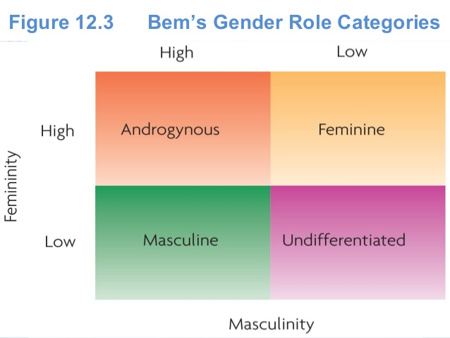

Slide 12
Discussion
How did your childhood shape
your gender identity?

Slide 13
Challenges Trans* Individuals Face
Students:
Typical gender roles and norms can often be reinforced on campus (ex: sports teams, Housing assignments)
Students may feel pressured to act in ways that conform to gender norms
Cisgender peers may not be accepting or understanding of trans* individuals
Difficulty finding a niche
Employees:
Equal Employee Benefits
Partner Benefits
Restroom Access (Universal or Single-stall restrooms are not always available)
Misuse or no use of correct pronouns
Fear of safety within the workplace

Slide 14
Campus Resources
Office of LGBTQA Affairs
“Rainbow Alliance” (student organization)
“Allies” (faculty and staff organization)
Counseling & Wellness Services
Ombudsperson
The Office of Equity & Inclusion

Slide 15
Title IX
“Title IX of the Educational Amendments of 1972 and 34 C.F.R. Part 106, is a comprehensive federal law that prohibits discrimination on the basis of sex in any federally funded education program or activity. The principal objective of Title IX is to avoid the use of federal money to support sex discrimination in education programs and to provide individual citizens effective protection against those practices.”
(https://www.wright.edu/equity-and-inclusion/title-ix-gender-based-violence)

Slide 16
Title IX Rights
Title IX:
1. Is a landmark federal civil right that prohibits sex discrimination in education. 2. Does NOT apply to female students only.
Our Institution: 3. Must be proactive in ensuring that our campus is free of sex discrimination. 4. Must have an established procedure for handling complaints of sex discrimination, sexual harassment or sexual violence. 5. Must take immediate action to ensure a victim can continue their education free of ongoing sex discrimination, sexual harassment or sexual violence. 6. May not retaliate against someone filing a complaint and must keep a victim safe from other retaliatory harassment or behavior. 7. Can issue a no contact directive under Title IX to prevent the accused student from approaching or interacting with you. 8. In cases of sexual violence, we are prohibited from encouraging or allowing mediation (rather than a formal hearing) of the complaint. 9. We should not make any student pay the costs of certain accommodations that they require in order to continue their education after experiencing violence.
See more at http://knowyourix.org/title-ix/title-ix-the-basics/

Slide 17
Universal Design For Inclusivity
Universal Design: a process that can be applied to any product or environment to be certain it can be used universally by all people without the need for adaptation
Creating space for universal/all access restrooms and locker rooms helps trans* individuals feel comfortable on campus without fearing they will be ridiculed, outed, or retaliated against
As simple as changing the signage on the restroom and/or locker room that will represent that this space will now be universally used.
Both gender specific as well as universal restrooms and locker rooms would be available on campus - freedom of choice for all

Slide 18
Takeaways & Tips
Don’t get flustered over terminology
Mirror the language individuals use for themselves
Allow yourself to mess up - apologize, and try better next time
Choose universal terms, such as “significant other or partner” instead of “boyfriend” or “girlfriend”
You don’t have to be part of a community to be an ally to that community
Empathy goes a long way!
Each person has a different experience

Slide 19
University Action Plan
Provide additional options other than “male” and “female” on Admissions application, Financial Aid forms, Housing contracts, etc.
Campus-wide remodeling to establish at least one gender-neutral restroom in high-traffic area of each building
Offer gender-neutral Housing options on campus
Redesign faculty training on using preferred student pronouns
Re-evaluate student and staff health insurance plans
Consider a diversity general education requirement, with an LGBTQ+ course as one option
Add LGBTQ+ topics to new employee training

Slide 20
Your Action Plan
Develop an action plan including at least 3 steps for how your department will begin creating a more inclusive and supportive environment for trans* individuals.
Your action plan is due a week from today via email to the Director of Student Services. A consultation meeting will follow shortly after.

Slide 21
For Further Education...
Ally Training
Through the Office of LGBTQA Affairs, learn more about the entire LGBTQ+ community
ProjectImplicit.com
Online quiz, discover what implicit associations you hold towards diverse groups
Growing Up Trans
PBS documentary available online
Trans Student Educational Resources
www.transstudent.org

