Slide 1
Transgender Students at Centrist College
Part of the Employee Professional Development Series
Case Study Analysis by Alexis Austin, Gracielle Horta, Jason Homan, & Jessica Girdler

Slide 2
Our Student Population
Secular, private institution
Located in capitol city of state
12,000 students enrolled
8,000 live on campus
Liberal Arts college
Strong Women’s Studies, Political Science, and Pre-Law undergraduate programs
42% are Students of Color
70% of students are religiously affiliated

Slide 3
What Does Our Campus Have?
LGBTQA Resource Center
Safe Space training for students and employees
Beginning to look into Living Learning Communities
Survey given to get understanding of campus senior staff of Transgender issues
14% of bathrooms on campus are gender-inclusive

Slide 4
Survey Results
Anonymous online survey completed by Senior Staff
62% identified understanding of Transgender identity
5% identified having worked directly with a Transgender individual previously
21% could comfortably discuss Transgender issues
80% believe campus could be more inclusive of Transgender employees and students
57% believe staff should undergo comprehensive training on Transgender issues

Slide 5
What Can We Improve?
Living Learning Community for Gender-Inclusive Living
Employment training
Write policy for inclusive workplace
Want 50% gender-inclusive bathrooms in the next 5 years
Counseling Center – group therapy
Specific counselor with more experience with Transgender students
Self-identification
Name on diplomas, ID cards
Intramural athletics
Locker rooms
Community partnerships
Notes:
Religious intolerance concerns
What policies will we put in place
Transgender inclusion policies on the rise

Slide 6
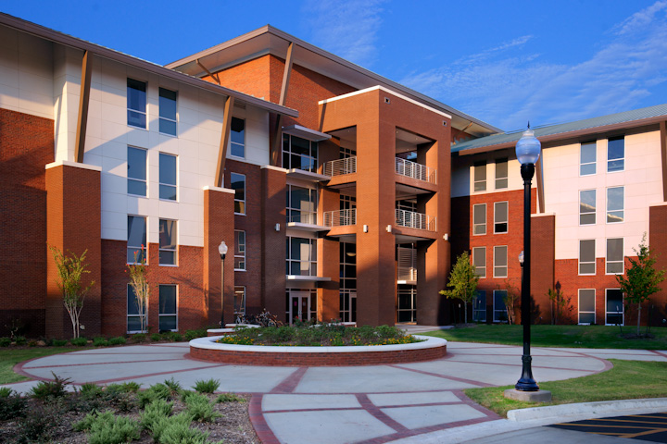
Living Learning Community
Creating a living environment for students to opt into
Work with faculty partners in various departments to develop intentional and educational programming for the floors
Connecting with already-established courses and enrolling LLC students into a specific course so that they have at least one class together
Provide social programming in connection with programs that are already offered on campus
LGBT socials, study nights, conference trips, and other initiatives
Gender-inclusive bathrooms available on the floor(s)
Specific selection and training of RA for the floor
Provide funding from Housing for partnering with all above initiatives

Slide 7
50% Gender-Inclusive Bathrooms by 2021
Also called Gender-Neutral, All-Gender, Inclusive, etc.
Recognize that bathrooms are for ALL genders, not just men and women
Many campus bathrooms are already structured for use by all genders
Cost of switching to gender-inclusive bathrooms is the cost of new signs
To begin transition, start with most easily renovated/adjusted bathrooms
Provide passive and active programming campus-wide to educate about the history of and reason why gender-inclusive bathrooms
Posters and bulletin boards
Including training for faculty and staff for them to inform students
Work to ensure that each building has proportional amount of gender-inclusive bathrooms to non-inclusive bathrooms

Slide 8
Employment Training--For students and staff
It is our effort at Centrist College to make not only the campus more Trans* inclusive for students, but other campus community members as well. This means that we will implement a more Trans* friendly workplace by:
Ensuring our health insurance policy includes coverage for Trans* health needs including transition-related care.
Ensuring that all non-discrimination policies protect identities including Trans*, gender non-conforming, gender identity, and gender expression.
Developing procedures and policies for when any employee transitions while in their position. This will include clear communication to all staff of support for the individual, and will be conducted how the person transitioning is most comfortable.
We are committed to the use of all individual’s preferred gender pronouns and during a newly implemented all staff training, we will ensure the concept is being discussed across all departments.
Dress codes have been updated to ensure that no dress policy is exclusionary or limited based on an employee’s gender.
Similar to students, employees have the right and opportunity to change their name and gender in their official record at any time. This will be consistently communicated to them through training.
Notes:
http://transgenderlawcenter.org/wp-content/uploads/2013/12/model-workplace-employment-policy-Updated.pdf

Slide 9
Counseling Center
Provide a counselor who has training in supporting trans* students to better serve them
Will help both the counselor and student build a relationship on trust
Be able to understand the importance of using appropriate language
Ex: correct name and pronouns
Give the students an opportunity to be called what they identify as
Offer a support group for students
Students are able to address their identities and share their experiences
Notes:
http://www.lgbtcampus.org/assets/consortium%20suggested%20trans%20policy%20recommendations-compressed.pdf
https://www.counseling.org/docs/default-source/competencies/algbtic_competencies.pdf?sfvrsn=8

Slide 10
Self-Identification policies
Add “Gender Identity and Expression” to Centrist College nondiscriminatory policy
Enable students to indicate the name and pronouns they wish to use
Fosters relationships of inclusion across campus
Enable students to self-identify their gender
Have offices across campus change the gender category on their standardized forms
Work with the Registrar’s Office so students can change their name and/or gender
Ex: class lists, student ID cards, advisee lists, diplomas, etc.
Aware that legal names need to appear on
official transcripts, financial aid records, student accounts, enrollment verification
Offer more inclusive language across campus
Notes:
http://www.umass.edu/stonewall/uploads/listWidget/8764/improve%20trans%20inclusiveness.pdf
http://www.mills.edu/diversity/Final-Report-on-Transgender-Inclusion-4-25-13.pdf

Slide 11
Intramural Athletics
Intramural athletics has a history of a gender based policy. We have done away with the policy. At no point will any individual be asked to disclose gender to participate in intramural sports.
Locker rooms: Any Trans* identified individual is free to use whatever locker room they identify with. Single stall locker rooms are available at the request of the individual, but no person will be required or even encouraged to use them.
Each team will be required to attend an introductory meeting where we will provide education on Trans* related issues and discuss concepts with them such as preferred gender pronouns. Hopefully we can use this as yet another educational opportunity for our students.
Notes:
http://athletics.bates.edu/transgender-inclusion-policies

Slide 12
Community Partnerships
Local hospital for health support of Transgender students
We already have strong partnerships for other health concerns, so focusing on this
Safe Space training available to community members
Meet with local lawmakers to discuss laws
We are politically-active institution
Notes:
-Good relationship with other presidents
Ability to address issues with on and off campus constituents

Slide 13
Local Hospital Partnerships
Direct lines of support to three local hospitals with Transgender specific services
Services include:
Evaluation of readiness for cross-gender hormones
Physicians experiences in cross-gender psychotherapy
Organized support groups made up of members of the community
Specifically tailored sexual health education
Hospitals provide specific Transgender programming on campus as well
Could partner with LLC’s in the future
Notes:
http://www.mountsinai.org/patient-care/service-areas/adolescent-health-center/services/lgbtq-support-services

Slide 14
Safe Space Training for Community Members
In an effort to create a space where our campus community feel welcome both on campus and off, we are implementing a community outreach and education program to help educate community members on trans* related issues. Through this training community members will be able to:
Define common trans* related terminologies
Understand a basic history of Trans* related issues
Educate community members on resources available to get more information and support Trans* students
This training will be led by students who are trained through the LGBTQA center on campus
Eventually, we will invite campus members to become trained to facilitate as well
We are partnering with the community LGBTQ resource center as well to help cover cost and staff trainings

Slide 15
Lawmakers
College is located in capitol city of state; access to local and state lawmakers
Encourage student organizations, like Student Government Association and LGBTQA-related organizations to help lobby lawmakers
Utilize college’s government liaisons to meet with lawmakers to urge the adoption of legislation supporting Transgender individuals
Overall goal: advocate for the passing of legislation that calls for supporting the success of transgender students
California Senate passed similar legislation
Notes:
http://transgenderlawcenter.org/archives/8550

Slide 16
Any Questions?

