Slide 1

StudentAffairs.com
Case Study 2016
The University of West Georgia - College Student Affairs Program
Team Leader - Courtney Campbell
Team - Courtney Campbell, Alyssa Mitchell, Shayna Sandbank, Sarah Scheel

Slide 2
Beyond the Binary:
Gender Inclusivity On Campus
Centrist College
Spring 2016 Senior Staff Professional Development

Slide 3

Eli is an incoming freshman to Centrist College.
They checked “female” on their housing application.
On move-in day, you see this student moving into a room on the female hall.
What do you do? What are your thoughts? Discuss with your table.
Notes:
Photo from: http://www.xojane.com/terms/transgender
Opening this presentation is a thought piece on a real situation that could occur on Centrist’s campus. Eli, a transgender student, is moving into a female-designated room. Though born a male, Eli identifies as female and portrays herself as such. This opening activity is meant to open the room to a discussion on general thoughts of transgender students and their inclusion on our campus. Maybe Eli would not cause concern for some senior staff members. For others, Eli may raise some questions about safety and inclusion. This opening activity will set the floor for our learning objectives for this quick professional development.

Slide 4
Learning Objectives
Utilize respectful presentation guidelines including
  Keep an open mind
  Keep what is best for our students in mind. The focus will be on their wants and needs without imposing personal assumptions
Define inclusive key terms
Become knowledgeable of Camps Pride and their Campus Pride Index
Identify action steps to make our campus more welcoming to transgender students
Notes:
It will be imperative that our participants keep our students in mind during this training process. Personal judgements need to stay aside of the intentional conversation based in student safety and inclusion. Respectful presentation guidelines must be addressed and followed throughout the session in order to keep the training informative and effective.

Slide 5
Sex vs. Gender vs. Gender Identity
Define on your own
Sex refers to the classification of people as male or female. At birth infants are assigned a sex, usually based on the appearance of their external anatomy (GLAAD, 2014).
Gender refers to the socially constructed expression of the differences between the sexes of being male or female (Bilodeau, 2009).
Gender Identity refers to an individual’s internal sense of self as male, female, or an identity between or outside of that binary (Wilchins, 2002).
Biologically male (sex) students, who society assumes are men (gender), can identify as men or women (gender identity)
Biologically female (sex) students, who society assumes are women (gender), can identify as women or men (gender identity)
Notes:
A breakdown of key terms that will be utilized in the presentation will be addressed here. This slide is incredibly important due to the ever-changing nature of voabulary within society. Gender does not mean sex as many may believe.
Prior to the literature definitions being presented, tables of senior administrators will be asked to define each of these terms on their own. This engaging activity will allow each individual to determine what their understanding of these key terms is.
After the activity, we will explain the key term definitions as found in recent literature on transgender individuals.

Slide 6
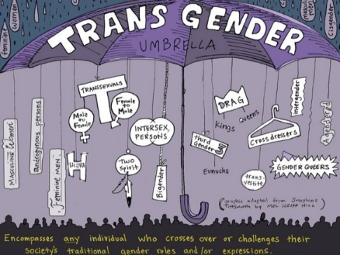
What is “transgender”?
Lev (2004) defines transgender as those whose gender identity does not align with their biological sex.
2010 State of Higher Education for
LGBT People found that more than
a third of students who identified
as transgender or gender
non-conforming seriously considered
leaving their institution because of
the campus climate.
Notes:
http://www.campuspride.org/wp-content/uploads/campuspride2010lgbtreportssummary.pdf
http://prideandjoycampaign.com/wp-content/uploads/2014/10/transgender-umbrella.jpg

Slide 7
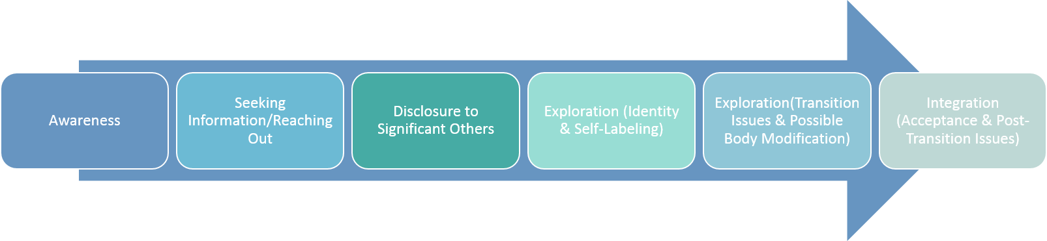
Gender Schema and Trans Identity Development
Sandra Bem (1983) presented a gender schema that focused on the social and cognitive development of the student
  Transgender students struggle due to their identity and gender role not aligning according to social standards
    Coincides with Lev’s stage of Awareness, when students are likely distressed
A.I. Lev’s (2004) Transgender Emergence Model
  Stage-based Model (linear)
  How trans students come to understand their identity
Notes:
Gender schemas present multiple dimensions in which a gender identity is developed.
Gender schemas are applied to transgender (trans) students through separate identities as assigned through sex.
Lev, through a counseling-based model, explains transgender emergence through stages. Here we would briefly outline key components of each stage in terms of typical actions college-aged students would be exhibiting.
Questions would be posed to participants: How are trans students at Centrist College identifying themselves through the culture on campus? How can we create an inclusive environment that will allow them to defeat the negative mindset society has placed on them due to transphobia?

Slide 8
Transgender Students and Higher Education
Transgender students can be in any of these stages while pursuing higher education.
Not all transgender students decide to externalize their gender identities.
Support must be provided during all stages of this model for successful integration into the campus culture.
Discuss by table number matched by stage (Awareness = 1, etc.)
Notes:
Tables will discuss, designated by table number matching to a stage of the model, what supports could be put into place for that particular stage. Senior leaders will potentially identify actions already in place for support, while others may bring up concerns for a need in order to support their particular stage of development.

Slide 9
“The first question is: Can learning take place if it in fact silences the voices of the people it supposed to teach? And the answer is: Yes. People learn that they don’t count.”
-Henry Giroux, Border Crossings: Cultural Workers and the Politics of Education

Slide 10
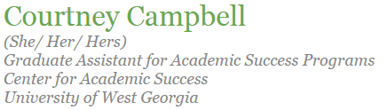
Gender Pronouns
A quick, easy, and free way to promote a more inclusive environment for transgender students is to add your own preferred pronouns to your email signature.
Add your preferred pronouns to your email signatures before the next professional development meeting to be included in an “I’m Inclusive” raffle drawing!

Slide 11









Centrist’s Current Campus Climate - Unknown
Campus Pride website does NOT have Centrist College listed on their Campus Pride Index (CPI) national listing of LGBTQ-friendly colleges and universities
No formal or informal assessment has been completed at Centrist
The Campus Pride Index provides a “Report Card” checklist that can be used for assessment here at Centrist prior to requesting a listing on Campus Pride website
*See Printed Report Card for Five-Star-Rated Ithaca College and discuss with your table*
Notes:
At this point we do not know what Centrist is doing well or poorly on when it comes to the campus climate for transgender students.
Campus Pride serves as an increasingly popular resource for transgender students researching institutions of higher education. This non-profit has collected assessment data from multiple institutions looking to become more aware of their campus climate for LGBTQ students. Because Centrist is not listed, this student population is left to assume that Centrist may not be a comfortable place for them to seek a degree.
Table discussions will be held while looking over Ithaca College’s CPI Report Card. By looking at a five-star-rated institution, groups may begin to discuss some things that Centrist is currently doing, what may be missing, and what the college is potentially working on.
https://www.campusprideindex.org

Slide 12
Assessment Plan
Roundtable with department directors to discuss CPI checklist
Directors have 6 weeks to compile data and research
  While directors do research, senior staff hold 3 Town Halls (one every 2 weeks) to invite community and campus members to discuss creating a more welcoming environment for transgender students.
Directors present research to senior staff members during sixth week
Apply to be listed on Campus Pride, share findings, compile strengths and weaknesses, create action plan to improve campus environment based on Campus Pride recommendations
Notes:
We would ask our senior staff to meet with the department directors they supervise. There would be a discussion on how welcoming their departments and our campus are to transgender students. These directors would have a 6 week timeline to gather information noted on the Campus Pride Index Report Cards. At the end of the 6 weeks, the directors of each department would come together and present their findings to the senior staff members. Campus Pride requires a senior administrator initiate the listing on Campus Pride, who tabulates scores and sends a final report including strengths and weaknesses of the university.
Following discussions and actions would be decided based upon the Campus Pride Index results.

Slide 13
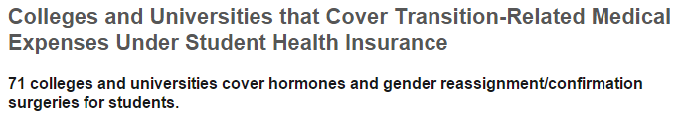
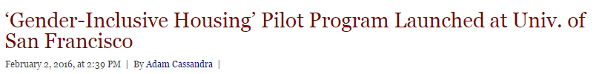
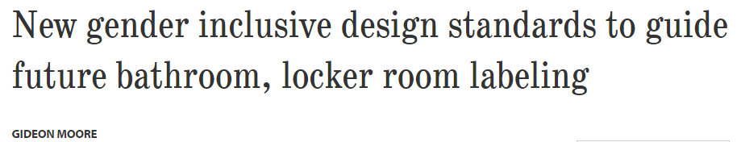
National News
https://www.campuspride.org/tpc/student-health-insurance/
http://www.cardinalnewmansociety.org/CatholicEducationDaily/DetailsPage/tabid/102/ArticleID/4659/%E2%80%98Gender-Inclusive-Housing%E2%80%99-Pilot-Program-Launched-at-Univ-of-San-Francisco.aspx
Retention
Safety and Inclusion
Academic success
Physical and mental well-being What else have you heard about?
http://bowdoinorient.com/article/10985
Notes:
Students are coming out as transgender on campuses across the country. As student affairs professionals, we should be effectively addressing transgender students needs in areas of campus life. If we are committed to working with all students and helping their personal development and academic success, we can not ignore transgender students in the student population.
Current headlines, like the ones listed, show the ever-growing inclusivity of higher education to transgender students. Other popular topics in national news include retention, safety and inclusion, academic success, and physical and mental well-being of transgender students.

Slide 14
Title IX, FERPA, and Transgender Students
On April 29, 2014 The Department of Education clarified that transgender students are protected from discrimination under Title IX. *exemptions can be claimed
Sex discrimination encompasses gender identity.
Students must be treated in accordance with their gender identity for all purposes, not their biological sex.
FERPA protects the privacy of student educational records and students have the right to amend those records.
Transgender students are protected and should be treated as such.
Notes:
Title IX has reiterated multiple times that gender identity, including transgenderism, is a protected class and therefore cannot be discriminated against unless approved for exemption. This, and FERPA, ensure that transgender students are not outed by their institution of higher education as well as feel safe and included.

Slide 15
Admissions
To be more inclusive, Admissions can use the following format, asking for gender identity rather than sex:
Gender Identity (select all that apply):
__ Woman
__ Man
__ Transgender (please specify______________)
__ Another identity (please specify______________)
These four options allow the institution to collect data efficiently while promoting an inclusive environment. This change in application will not affect the way we or any institution reports national data.
Adapted from: The Consortium of Higher Education
Recruiters should not assume a prospective student’s gender. Use neutral pronouns or give them an opportunity to let you know.
Notes:
http://www.nacacnet.org/research/PublicationsResources/bulletin/2014Bulletin/04-23-2014/Pages/Supporting-Transgender-Students-on-Admission-Materials.aspx

Slide 16
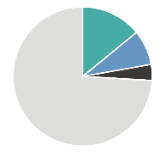
Housing and Residence Life
Sex-defined markers on housing applications are non-inclusive of transgender students.
Transgender students have a right to be placed in campus housing according to their gender identity as per Title IX.
Formal written policies should be in place to respect gender identity placement rather than biological sex placement.
Regular trainings and workshops for professionals and paraprofessionals will be essential for serving these students.
19% of transgender students were refused gender appropriate housing
11% were evicted because of their gender identity expression
5% were refused campus housing altogether
http://www.thetaskforce.org/static_html/downloads/reports/reports/ntds_summary.pdf
Notes:
Housing is an increasingly popular functional area that must dedicate time and attention to serving the needs of transgender individuals. Because not all transgender students externally promote their gender identity, institutions of higher education must be willing to work with these students in making sure they are comfortable and safe in the housing environment.

Slide 17
Orientation
Orientation programs should give the students opportunity to use their gender pronouns on name tags.
Give the option of “Gender-Identity:_______” in the registration process rather than just Male and Female.
Provide gender neutral bathrooms as well as a map of campus that points out where there are single-stall and gender neutral bathrooms in each building.
If we provide overnight programing, offering a gender neutral hall and or single room options for students who would rather not have a roommate.
Notes:
Orientation is the first time a student might experience our campus. The tone of the setting has a great impact on if a student feels welcomed, accepted, and valued. These action steps can make a transgender students experience more enjoyable and avoids students feeling excluded, rejected, and ignored.

Slide 18
Counseling
Transgender students may experience intense stress as a result of family rejection, harassment, violence, and isolation. This may lead to anxiety, adjustment disorders, depression, post traumatic stress, substance abuse, suicide ideation, and self-harm. This population needs quality interactions with campus counselors (Beemyn et al., 2005).
In a 2005 survey of 75 transgender participants, only four respondents reported positive interactions with campus counselors (Beemyn et al., 2005).
Campus counselors should ensure they are educated on the spectrum of issues transgender students face in order to provide quality services to them.
Notes:
Counselors must be educated on transgender issues and be trained to help students moving through Lev’s Model. This may take financial and timely resources, but will be ever-so important in making sure this student population is well-served.

Slide 19

Diversity and Inclusion
CAS Standards
  Serve underserved populations...such as students of color; lesbian, gay, bisexual, and transgender students; and disability students
Create transparency across campus that this office is applicable to transgender students
Publicize programming that can be utilized for students discovering their gender identity
Safe Zone Training - 2hr LGBTQ Inclusion Training
Please place on your calendar for two Thursdays
from today

Slide 20
Health Services and Insurance
FTM Alliance of Los Angeles (2004) found slightly more than half of its respondents had been denied medical services because of their transgender status and two-thirds of those who had received care were dissatisfied with their service
Centrist should:
Provide a list of trans-competent health care providers who are located in the community
Offer regular trainings and continuing education to staff and health care providers on working with transgender and gender nonconforming individuals
Advocate for expanded coverage of transition-related services (hormones, surgeries) if not already included on student health insurance plans
Notes:
Some campus health insurance plans exclude transition-related services. If this is the case, student health personnel should advocate for expanded coverage and help students find alternate, off-campus care. This is important because the absence of appropriate health care may have negative effects on the retention, academic success, and physical and mental well-being of transgender students (DeBerard, Spielmans, and Julka, 2004; Lombardi and Davis, forthcoming).

Slide 21
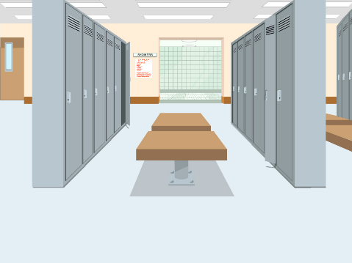
Recreation
Separate sex-based workout areas create environments for the student to feel ostracized.
Male and female restrooms and locker rooms can be some of the greatest dangers for transgender students. This creates a greater possibility for them to be bullied or assaulted (Beemyn et al., 2005).
Create gender inclusive showers with doors rather than curtains that will allow for privacy.
The open showers and changing space typical of traditional locker rooms are non-inclusive of transgender students
Notes:
Create an environment within recreational centers that encourage students to utilize facilities in an inclusive environment
Creating a healthy lifestyle will encourage student to establish a healthy personal, physical, and mental well being
Recreation staff need to facilitate a “safe space” environment for all students. No gymtimidation

Slide 22
Career Services
The greatest role is for a career counselor to become an ally for the student’s rights in a professional and collegiate workplace.
Career Services must educate students on politics and social dynamics of a workforce.
Career counseling should expose students gender inclusive career options (military, for example)
Currently there is no federal law that universally and explicitly provides protection for transgender employees, and fewer than half of states have laws that protect workers based on sexual orientations and gender identity/expression.

Slide 23

Registrar and Documentation Offices
Seelman (2014) suggests simplifying processes for requesting record changes, more options beyond binary male/female, and allowing students to record preferred names alongside legal names
Being addressed by the incorrect name, pronoun, or title (Mr./Ms.) can result in ‘outing’
A student should never be asked to “prove” their biological sex for paperwork purposes
“They kept looking at their records back at me, just trying to figure me out. I felt like I was naked.”
Landon “LJ” Woolston
lambalegal.org

Slide 24
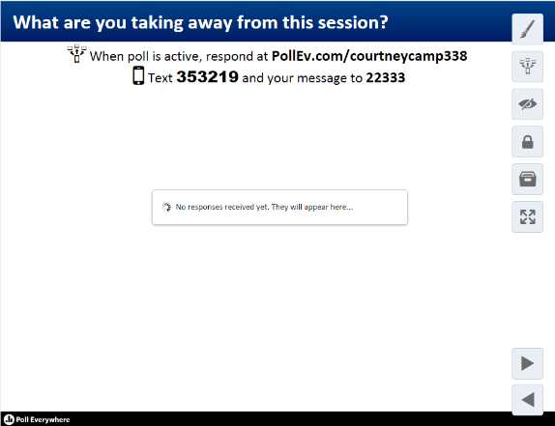

Conclusion
In order to better serve the transgender student community, Centrist must take action in assessing the current culture as well as take actions focused on legal protection and environmental inclusivity.
While you complete the poll, please enjoy the closing video.
Notes:
http://chronicle.com/article/Ask-Me-What-LGBTQ-Students/232797

Slide 25
References
Beemyn, B., Curtis, B., Davis, M., & Tubbs, N. J. (2005). Transgender Issues on a College Campus.New Directions for Student Services, (11), 49-60.
Bem, S. L. (1983). Gender schema theory and its implications for child development: Raising gender-aschematic children in a gender-schematic society. Signs, 8(4), 598–616.
Bilodeau, B.L. (2009). Genderism: Transgender students, binary systems, and higher education. Saarbrucken, Germany: Verlag.
DeBerard, M.S., Spielmans, G., and Julka, D. “Predictors of Academic Achievements and Retention Among College Freshmen: A Longitudinal Study.” College Student Journal, 2004, 38(1), 66.
Evans, N., Forney, D., Guido, F., Patton, L., & Renn, K. (2010). Student development in college: Theory, research, and practice (2nd ed.). San Francisco, CA: Jossey-Bass.
Giroux, H. A. (1992). Border crossings: Cultural workers and the politics of education. Psychology Press.Lev, A.I. (2004). Transgender Emergence: Therapeutic guidelines for working with gender-variant people and their families. Binghamton, NY: Haworth Press
Lev, A.I. (2004). Transgender Emergence: Therapeutic guidelines for working with gender-variant people and their families. Binghamton, NY: Haworth Press
Multicultural Student Programs and Services. (2011). CAS Professional Standards for Higher Education (pp. 361-371).
Seelman, K. L., Walls, N. E., Costello, K., Steffens, K., Inselman, K., Montague-Asp, H., & Colorado Trans on Campus Coalition. (2012). Invisibilities, uncertainties, and unexpected surprises: The experiences of transgender and gender non-conforming students, staff, and faculty at universities & colleges in Colorado (Executive Summary). Denver, CO: Authora.
Seelman, K. L. (2014). Recommendations of transgender students, staff, and faculty in the USA for improving college campuses. Gender & Education, 26(6), 618-635. doi:10.1080/09540253.2014.935300
Wilchins, R.A. (2002) Queerer bodies. In Nestle, J., Howell, C., and Wilchins, R.A (eds.), Genderqueer: Voices from beyond the sexual binary. Los Angeles, CA: Alyson.

