Slide 1
Transforming Awareness
Submitted by: Aracelis Figueroa, Jacque Jankiewicz, Jennifer Fazal, Chris Allen from University of Wisconsin-Whitewater

Slide 2
Learning Objectives
This professional development series will help you gain a better understanding of the transgender students on our campus and how to better serve their needs. Some goals this presentation include:
To bring awareness to the issues that effect transgender college students
To combat stereotypes against the transgender community
To benchmark with other institutions on the practices implemented on their campus
To foster change through assessment of current practices and the execution of an action plan

Slide 3
L
E
S
B
I
A
N
G
A
Y
B
I
S
E
X
U
A
L
T
R
A
N
S
G
E
N
D
E
R
Definition:
Someone born with male or female anatomies but feels like they belong to the opposite gender.

Slide 5
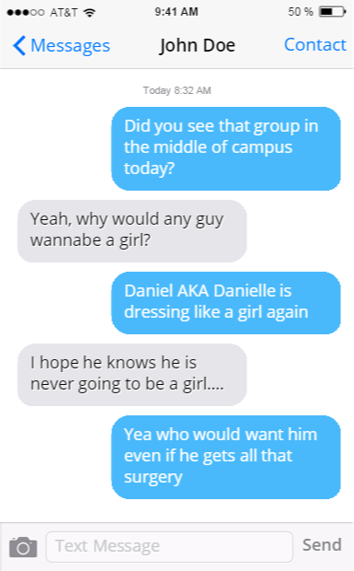

Slide 6
Stereotypes to believe unfairly that all people or things with a particular characteristic are the same
They are all confused
They are mentally disturbed
They are gay
They hate their bodies
They perform in drag shows
They are weird
They are obsessed with surgery
They are molesters

Slide 7
“I don’t know who to talk to…”
“I was born into the wrong body”
“I am in the wrong skin”
“Don’t ask me what my birth is…” name
“Why won’t they use the pronouns I use for myself?”

Slide 8
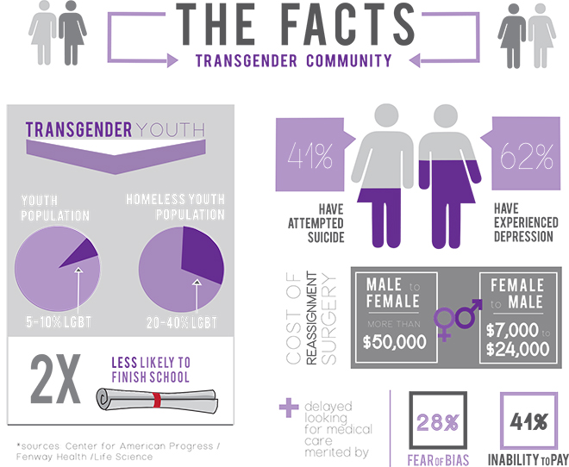
Transgender students:
At least 21 transgender women were murdered in 2015
“Most studies reveal that approximately 50% of transgender people experience sexual violence at some point in their lifetime”

Slide 9
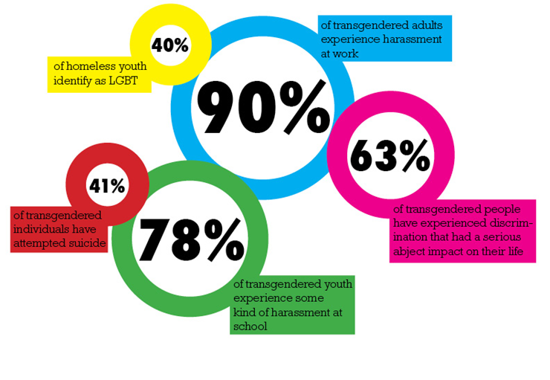
NATIONAL DATA
Transgender students:
At least 21 transgender women were murdered in 2015
“Most studies reveal that approximately 50% of transgender people experience sexual violence at some point in their lifetime”

Slide 10
Institutional facts
Total Number of Students (FTE) = 12,000
A campus climate survey was conducted in April 2015 (for 2014-2015 academic year) to evaluate student impressions on campus.
1,700 total responses
4% or 68 students self-identified as transgender on the survey
15% of transgender respondents reported feeling unsupported on campus due to interactions with faculty and staff
5% of transgender respondents reported at least one instance of harassment on campus that was directly correlated to their gender identity within the past year

Slide 11
Institutional Facts
Under Federal Law:
Title IX of the 1964 Civil Rights Act prohibits discrimination on the basis of sex.
The U.S. Department of Education (ED) has stated that Title IX also applies to gender identity.
The U.S. Department of Justice (DOJ) and the ED affirmed that transgender students should not be singled out to use a separate, designated restroom or made to room separately

Slide 12
Case Study
Linus, a male-presenting transsexual student, wants to change the female name and gender status on his records. However, he is told by the school’s registrar’s office that they won’t alter his records unless he receives a court-ordered name change and brings in a letter from his doctor indicating that he has completed gender confirmation surgery. Linus states that he cannot afford these procedures and hasn’t decided for sure that he even wants surgery. He comes to you as the director of the campus LGBT center. How do you intervene in this situation?

Slide 13
How do you intervene in this situation?
Investigate requirements under state law
Research how many transsexual students are affected by the policy
Consider how other campuses handle the issue
Recognize that a student's gender expression and their campus records and identification have to be consistent for their safety and to help protect them from discrimination
Recognize that a student shouldn’t be pushed into SRS
Make sure that Student Affairs offices like the registrar and human resources, which are often overlooked by Safe Zone or Ally Program trainings, are included

Slide 14
Other schools
Duke/UCLA
Offering health care insurance for gender confirmation surgery for transgender students
UMass Amherst
Created a policy to allow transgender students to participate in single-sex sports
Ithaca College
Has an LGBT residence hall community and gender-inclusive housing
New York University
Offers programming through Trans Awareness Week

Slide 15
Currently doing
IMPACT
Student Organization that educates interested parties on the LGBT community
PRIDE Center
LGBT Coordinator-Graduate Assistant position
Gender neutral bathrooms in academic buildings
Safe Zone Training
Optional training to learn how to be an ally to the LGBT community
Coming Out Day
Program to give the campus community an opportunity to share their coming out story

Slide 16
Improvements
Safe zone training is optional
LGBT Coordinator role is not a full time position

Slide 17
Action Plan
Gender Inclusive Housing on specific floors in 3 residence halls
Add gender neutral bathrooms on these floors as well
Revise the university's mission statement to address sexual orientation and gender identity inclusivity on campus.
Formalized, mandatory training for faculty, staff, and student-employees
Asking and using preferred pronouns and names of students
Boxes & Walls Programming efforts
Week long oppression experience designed to educate students on diversity and inclusion
Allow students to self-identity on applications and departmental forms
Gender and preferred name

Slide 18
REFERENCES
Beemyn G. & Windmeyer S. (2012) The top 10 trans-friendly colleges and universities. Retrieved from: http://www.advocate.com/politics/transgender/2012/08/15/top-10-trans-friendly-colleges-and-universities
Case Study Developed by Genny Beemyn Director, The Stonewall Center, University of Massachusetts, Amherst, Retrieved from http://www.umass.edu/stonewall/uploads/listWidget/8756/trans%20case%20studies.pdf
Infographic on Transgender Facts. (2010). Retrieved from http://ballbearingsmag.com/2015/02/23/safezone-offers-haven-for-lgbtqa-community/
Infographic on Transgender Statistics. (2013). Retrieved from http://www.brownpoliticalreview.org/tag/lgbt-rights/
Infographic. Retrieved from http://24.media.tumblr.com/d22de238080c3bebc566cea9f4d9c298/tumblr_monxia4Hho1s77xzko2_500.jpg
Intersex Society of North America. (2015) What's the difference between being transgender or transsexual and having an intersex condition? ISNA.com. http://www.isna.org/faq/transgender.
Kellaway & Brydum, 2016, Retrieved from http://www.advocate.com/transgender/2015/07/27/these-are-trans-women-killed-so-far-us-2015
Lambda Legal. Best practices for supporting transgender students. Retrieved from: http://www.lambdalegal.org/know-your-rights/transgender/supporting-trans-students
Rape Response Services, National Statistics, Retrieved from http://www.rrsonline.org/?page_id=944) (Original Publication: Stotzer, R. (2009). Violence against transgender people: A review of United States data. Aggression and Violent Behavior, 14, 170-179.

