Slide 1

Creating a More Inclusive College:
Welcoming Transgender Students
Team Leader: Paton Roden
Team Members: Kaci Carter, Jen Kau, and Yena Kim

Slide 2
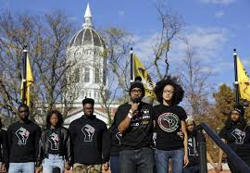
Review of Current Events
2015 Brought College Campus Tensions
  University of Missouri
  Yale University
  Many Others
Transgender Student Inclusion
  Policies
  Increased Attention
A Need to be Inclusive
Notes:
2015 was a big year in terms of student voice on college campuses. The University of Missouri is where the racial tension led to students taking a stance at the University and calling for change. Yale joined in the conversation and supported the University of Missouri’s lead. Students held the University accountable and caused change to happen.
Recently, there has been a rising concern for the needs of transgender students on college campuses. Many policies are being developed and there has been a rising transgender population in higher education as a whole.
Due to the tensions on campuses across the US and the rising concern to ensure transgender students are welcomed on campuses, action is needed at Centrist College. President Fogg has decided to be more proactive in the approach to ensure Centrist is inclusive for transgender students.

Slide 3
Transgender Definitions
Transgender: Umbrella term that encompasses a wide range of gender identities, appearances, and behavior that blur and/or cross normal gender lines
Transsexuals: Individuals who live all or some of the time as a sex that is different from their biological sex
Crossdressers: Individuals who wear clothing generally associated with the opposite biological gender
Drag kings & queens - crossdressers within a performance context
Genderqueers: Individuals identifying outside of a binary sex system
Gender Identity: One’s sense of one’s own gender. The felt sense that one is man, woman, both, neither, etc.
Gender Oppression: The verbal, physical, legal, emotional, and sexual violence and legal discrimination against people who do not conform to socially acceptable gender roles.

Slide 4
Traditional Binary Gender Model
Biological Sex
Hormones,
Genitalia
Secondary sex characteristics
Male
Female
Gender Expression
Dress, Posture,
Roles, Identity
Masculine
Feminine
Attracted
to Women
Attracted
to Men
Sexual Orientation
Notes:
Most societies view gender as a binary concept. This idea splits individuals into male and female categories. These lead to expectations for behavior of a person who is perceived as male or female which includes attitudes, actions, and personality traits associated with a particular gender within society.
This binary concept fails to see the variation that exists. It prevents any third or subsequent genders from being identified. Instead, it places roles into one of two categories: Male and Female, depending on biological sex.
This model narrowly defines gender and presents many challenges for individuals who exist outside of these “norms.”
As a college, we need to move away from this cut and dry male/female model towards a more inclusive one.

Slide 5
Revolutionary Inclusive Gender Model
Biological Sex
Hormones,
Genitalia
Secondary sex characteristics
Male
Intersexual
Female
Gender Expression
Dress, Posture,
Roles, Identity
Masculine
Androgynous
Feminine
Sexual Orientation
Women
Men
Both
Neither
Other
Notes:
This new model holds:
Gender is not anatomical.
Gender is fluid.
It does not assume gender based on appearance, mannerisms, and cues.
This model includes those who do not fit in the binary model shown previously. If we want to move towards being an inclusive college, we need to focus on the array of paths people take with relation to biological sex, gender expression, and sexual orientation.

Slide 6
Transgender Issues on College Campuses
Gender Identity & Higher Education
The LGBT issues and concerns have risen to the surface within higher education
Problem: many programs and resources are focused on the LGB issues but very little work has been done within higher education for individuals who identify as transgender
Many faculty, staff, and students (including LGB identified and professionals who work with LBGT population) have minimal knowledge and understanding of transgender students and their experiences

Slide 7
Professional Development Series
Informative Lecture Series
What other institutions are doing
Challenges facing transgender students
Current events regarding LGBTQ
Sensitivity Training Modules
Safe Space Certification
Anti-Discrimination Policy
Open Discussions
Notes:
This presentation is only the beginning of an upcoming professional development series regarding LGBTQ issues, particularly involving transgender students. The series will include the following elements:
Informative Lectures: Periodically lectures will be offered in order to keep a well-informed faculty and staff regarding LGBTQ topics. Potential lecture topics will include: what other schools are doing, challenges of transgender students, and current events of LGBTQ issues.
Sensitivity Training Modules: There will be mandatory training modules for faculty and staff in order to create a more welcoming environment for transgender students. These modules will include Safe Space certification, a training that works to enhance the institutional environment to be culturally competent and supportive to LGBTQ. It will allow students to easily recognize faculty and staff that are welcoming to all students with the display of the Safe Space symbol on office and class doors. Training modules will also include review of the institution’s anti-discrimination policy and how it applies to transgender students and employees.
Open Discussions: We will invite faculty and staff to come together in open discussions to discuss any issues or personal experiences that are of importance or that participants see fit. This will create a more inclusive and understanding environment.

Slide 8
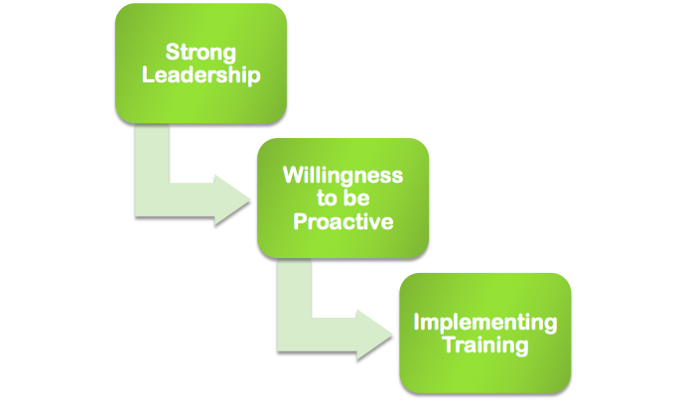
What is Centrist College doing well?
Notes:
Centrist College’s President Fogg is well-respected and has led Centrist well for 8 years. Leadership starts at the top. Fogg taking action sets the stage for other leaders at Centrist to take action as well.
There has not been a major uprising at Centrist, but the campus is being proactive instead of reactive. Thus, we will be prepared for any future occurrences. It is better to have knowledge before any major uprising.
Implementing a training for staff is a smart approach because this will set the stage for what type of college we want to become.We want to be a college of choice for all students and we want to lead others in the field. Staff need to develop their skills and approaches model the way for students. It is important for staff to be continuously learning and adding to their knowledge base to ensure the college is a welcoming place for all students.

Slide 9
Areas for Improvement
Support Services | Current services are geared towards LGB students whose issues issues are generally related to sexual orientation not gender identity issues
Inclusive Policies | Campus nondiscrimination policies typically protect students based upon sex and sexual orientation, but the rights of transgender students are not necessarily covered under these policies
Counseling | Counseling support can be essential due to challenges with being TG that lead to violence, stress, depression, substance abuse, and self-harm.
Health Care | Health insurance coverage is frequently insufficient and more services and providers need additional training and resources on TG related health issues.
Notes:
Support Services - Transgender students are generally lumped in services for LGB students → Problem: LGB identity issues are generally related to sexual orientation, as opposed to gender identity, the support in place may be insufficiently prepared to address the issues they frequently encounter.
Inclusive Policies - Similarly, campus nondiscrimination policies typically protect students based upon sex and sexual orientation, but the rights of TG students are not necessarily covered under these policies. Language to include gender identity in nondiscrimination policies would assist in protecting the TG population.
Counseling and Health Care – Among the barriers for TG students seeking these services are professionals that are unable to provide the support or to adequately address the needs.
Counseling (for support, not mental illness) – can be essential due to challenges with being TG that lead to violence, stress, depression, substance abuse, and self-harm.
Health Care – TG students interviewed felt that they often had to educate providers on their health related issues and coverage is frequently insufficient. Providers must realize that a patient’s biological makeup and not physical appearance will dictate the services needed. Health insurance plans must be more inclusive to include more services and providers need additional training and resources on TG related health issues.
College Records and Documents – Students who decide to transition to the opposite gender usually desire to have their name changed on official records and documents. Procedures and policies for doing so vary greatly from institution to institution and state to state, and are sometimes altogether non-existent. Accurate records may also prevent discrimination when applying for a job, graduate school, or any other time a college document must be provided.
Campus Housing – Traditional procedures for assigning rooms based upon gender fail to take into account the complexities and issues that are faced by the TG population, especially those students that are transitioning.
Bathrooms & Locker Rooms – Anecdotal and research evidence suggests that TG people are often faced with verbal and physical assaults, and at times arrested by police, when using gender specific facilities. As a result, some TG’s travel long distances out of the way for gender neutral facilities. In the case of locker rooms, this may discourage TG’s from engaging in physical activity, at a detriment to their health and well-being. Creating private and secure gender-neutral bathrooms and locker rooms that are readily accessible is the best way to address this issue.

Slide 10
Areas for Improvement
College Records and Documents | Procedures to change name and their gender can be very difficult and sometimes non-existent. Accurate records may also prevent discrimination when applying for a job, graduate school, or any other time a college document must be provided.
Campus Housing | Traditional procedures for assigning rooms based on gender fail to take into account the complexities and issues that are faced by the transgender populations, especially those students that are transitioning.
Bathrooms & Locker Rooms | Transgender students are often faced with verbal and physical assaults, and at times arrested by police, when using gender specific facilities
Notes:
Support Services - Transgender students are generally lumped in services for LGB students → Problem: LGB identity issues are generally related to sexual orientation, as opposed to gender identity, the support in place may be insufficiently prepared to address the issues they frequently encounter.
Inclusive Policies - Similarly, campus nondiscrimination policies typically protect students based upon sex and sexual orientation, but the rights of TG students are not necessarily covered under these policies. Language to include gender identity in nondiscrimination policies would assist in protecting the TG population.
Counseling and Health Care – Among the barriers for TG students seeking these services are professionals that are unable to provide the support or to adequately address the needs.
Counseling (for support, not mental illness) – can be essential due to challenges with being TG that lead to violence, stress, depression, substance abuse, and self-harm.
Health Care – TG students interviewed felt that they often had to educate providers on their health related issues and coverage is frequently insufficient. Providers must realize that a patient’s biological makeup and not physical appearance will dictate the services needed. Health insurance plans must be more inclusive to include more services and providers need additional training and resources on TG related health issues.
College Records and Documents – Students who decide to transition to the opposite gender usually desire to have their name changed on official records and documents. Procedures and policies for doing so vary greatly from institution to institution and state to state, and are sometimes altogether non-existent. Accurate records may also prevent discrimination when applying for a job, graduate school, or any other time a college document must be provided.
Campus Housing – Traditional procedures for assigning rooms based upon gender fail to take into account the complexities and issues that are faced by the TG population, especially those students that are transitioning.
Bathrooms & Locker Rooms – Anecdotal and research evidence suggests that TG people are often faced with verbal and physical assaults, and at times arrested by police, when using gender specific facilities. As a result, some TG’s travel long distances out of the way for gender neutral facilities. In the case of locker rooms, this may discourage TG’s from engaging in physical activity, at a detriment to their health and well-being. Creating private and secure gender-neutral bathrooms and locker rooms that are readily accessible is the best way to address this issue.

Slide 11
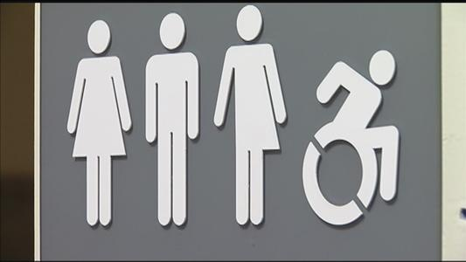
Colleges and Transgender Students | NYS Exposed Education
Please follow link to watch video:
https://youtu.be/0XXL33Z4vts
Notes:
Colleges across the nation have recognized that accommodating transgender students needs to be addressed. Many already have accommodations for transgender students in place. Others are coming up with plans that would work on their campus. The video follows SUNY SA and its efforts to create an transgender-student-friendly environment.

Slide 12
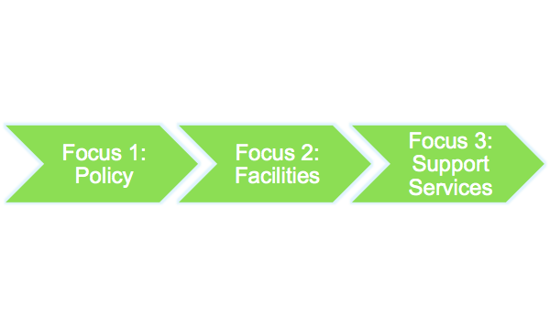

Action Plan
Notes:
Policy includes any official policies and procedures within the college’s administration, including nondiscrimination policy, name and gender change procedures, and institution form policy.
Gender Neutral Accommodations include gender neutral bathrooms, locker rooms, and housing options. The end goal will be to have at least one gender neutral bathroom in every building on campus, to provide a gender neutral locker room, and have the option of gender neutral housing options.
Advocacy is a public way of showing that the college truly cares about being inclusive to all students. We will sponsor regular transgender-specific programs and include transgender-related events during LGBT pride weeks and awareness months. We will also work with Student Activities, Greek Life, Athletics, and other campus departments to develop policies that ensure that transgender students can be part of gender-specific student groups, fraternities and sororities, and sports teams.
We are truly committed to changing the campus culture to be a culture of inclusivity and acceptance. At Centrist College, we believe that all students should have the opportunity to express themselves and feel safe in this learning environment. We believe that taking action now can cultivate and expand an already great campus community!

Slide 13
Action Plan - Policy
Nondiscrimination Policy
Add gender identity to let students know that the institutions accepts all people
Address acts of harassment and discrimination (including anti-trans acts)
Work with different campus departments (Student Activities, Greek Life, Athletics, etc.) to ensure that transgender students can participate in gender-specific activities
Notes:
Adding gender identity to the college’s nondiscrimination policy lets students know that the institution accepts all people regardless of how they identify on applications and other documents submitted to the college.
work with Student Activities, Greek Life, Athletics, and other campus departments to develop policies that ensure that transgender students can be part of gender-specific student groups, fraternities and sororities, and sports teams.

Slide 14
Action Plan - Policy
Campus records and documents
Allow students to use name other than their legal name on records
Enable students to change the gender marker on their records upon request
Include student’s pronoun preferences on rosters to keep faculty informed
Official institution surveys and forms
Offer inclusive options for gender identity
Notes:
Software should allow students to use a name other than their legal name on their campus records, including campus ID cards and diploma, if possible. Students should also be able to change the gender marker on their records at their request. This should also include student’s pronoun preferences for course rosters in order to keep faculty informed. The information about these processes of changing names and gender should be easily accessible to students.
Any official college survey or form distributed to students and employees should have very inclusive options for gender identity. Preferably, students would be able to self-identify on forms. Additionally, any form or survey that does not necessarily need to know sex or gender identity should not ask about it.

Slide 15
Action Plan - Accommodating Facilities
Housing
Adapt our housing intake forms to request additional information regarding special needs.
Establish an option for gender neutral housing where roommates are assigned regardless of biological gender, allowing residents to request roommates of any gender
Locker Rooms & Bathrooms
Offer lockable, single user changing and shower rooms in campus recreations centers and athletic facilities
Aim to have at least one gender-neutral restroom in every building
Create an online map listing all gender-neutral restrooms on campus

Slide 16
Action Plan - Support Services
Safe Space Campaigns
Offer Safe Space training to students, faculties, and staffs to cultivate a more inclusive and accepting campus climate through education.
Health services
Hire, train, and maintain trans-knowledgeable staffs members and have them easily identified so a transgender student can request these providers
Cover hormones and gender-affirming surgeries for transitions students under student health insurance
Notes:
Safe Space was created to develop, enhance and maintain environments in workplaces, schools and other social settings that are culturally competent and supportive to LGBTQ (lesbian, gay, bisexual, transgender and queer/questioning) individuals, as well as straight, cisgender people who care about diversity, equality and inclusion. Utilizing this training Centrist College could start cultivating a more inclusive and accepting campus climate through educational programming. It also allows students to easily recognize faculty and staff that are welcoming to all students with the display of the Safe Space symbol on office and class doors.

Slide 17
Action Plan - Support Services
Counseling services
Hire, train, and maintain trans-knowledgeable staffs members
Offer a support group for tran and gender-nonconforming students
Cover the requisite therapy for students who are transitioning under student health insurance
Advocacy in Action
Sponsor regular transgender-specific programs and events
Celebrate LGBT Pride Week and awareness month
Notes:
Advocacy is a public way of showing that the college truly cares about being inclusive to all students. We will sponsor regular transgender-specific programs and include transgender-related events during LGBT pride weeks and awareness months. We will also work with Student Activities, Greek Life, Athletics, and other campus departments to develop policies that ensure that transgender students can be part of gender-specific student groups, fraternities and sororities, and sports teams.

Slide 18
Works Cited
Beemyn, B., Curtis, B., Davis, M., & Tubbs, N. J. (2005). Transgender issues on college campuses. New directions for student services, 111, 49-60.
Consortium’s Trans* Policy Work Group. (2014). Suggested best practices for supporting trans* students. Retrieved from http://www.lgbtcampus.org/suggested-best-practices-for-supporting-trans--students
Gender Models [Digital image]. (n.d.). Retrieved February 26, 2016, from www.massresistance.org
Schneider, F. (2015). Where do we belong? Addressing the needs of transgender students in higher education. The Vermont Connection, 31(1), 11.

