Slide 1
Supporting Transgender Students
Emily Horton, Alaina Desalvo, and Addy Irvine
University of Minnesota - Twin Cities
Notes:
Photo: http://inthereddest.com/?p=3015

Slide 2
Why is this important at Centrist College?
Diverse student body of over 7,000 students located in a vibrant urban area
Leader among our peers in diversity and equity
Historic commitment to social justice
Centrist College mission statement: “The mission of Centrist College is to provide an exceptional undergraduate education. In pursuit of this, the College is devoted to academic excellence, extensive international engagements, and fostering an engaged community that is committed to intentional diversity and social justice”¹
Notes:
¹Mission statement created by combining mission statements from two mid-sized institutions. Colleges used: Augsburg College (http://www.augsburg.edu/about/mission/) and Carleton College (https://apps.carleton.edu/visitors/mission/)

Slide 3
Who are transgender students?
“Transgender” is generally used by students who identify as a gender other than the one they were given at birth
Transgender people:
are more likely to be harassed, isolated and drop out of school¹
are more likely to suffer from depression, anxiety and eating disorders²
are more likely to be sexually assaulted³
Transgender students
report being denied on-campus housing and scholarships¹
feel that faculty and staff are not meeting their needs⁴
are less likely to use campus resources⁴
Notes:
¹http://www.huffingtonpost.com/2015/05/18/trans-friendly-colleges_n_7287702.html
²http://www.activeminds.org/transgender-college-student-mental-health
³http://forge-forward.org/wp-content/docs/FAQ-10-2012-rates-of-violence.pdf
⁴http://www.iamsafezone.com/resources/Ally_Handouts_Article_On_the_margins_McKinney.pdf

Slide 4
What is Centrist College doing well?
Commitment to transgender inclusivity by senior staff
Because YOU are here!
Some gender inclusive restrooms available
3 single stall, lockable bathrooms without gendered signage are available on campus
LGBT Resource Center offers Transgender Ally 101 training
LGBT Resource Center distributes information on community resources for transgender students

Slide 5
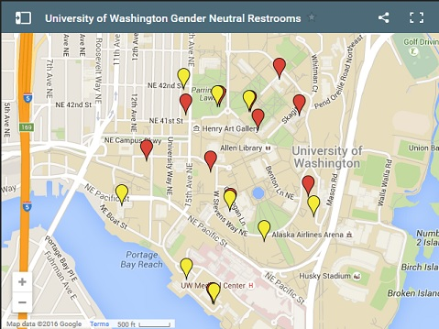
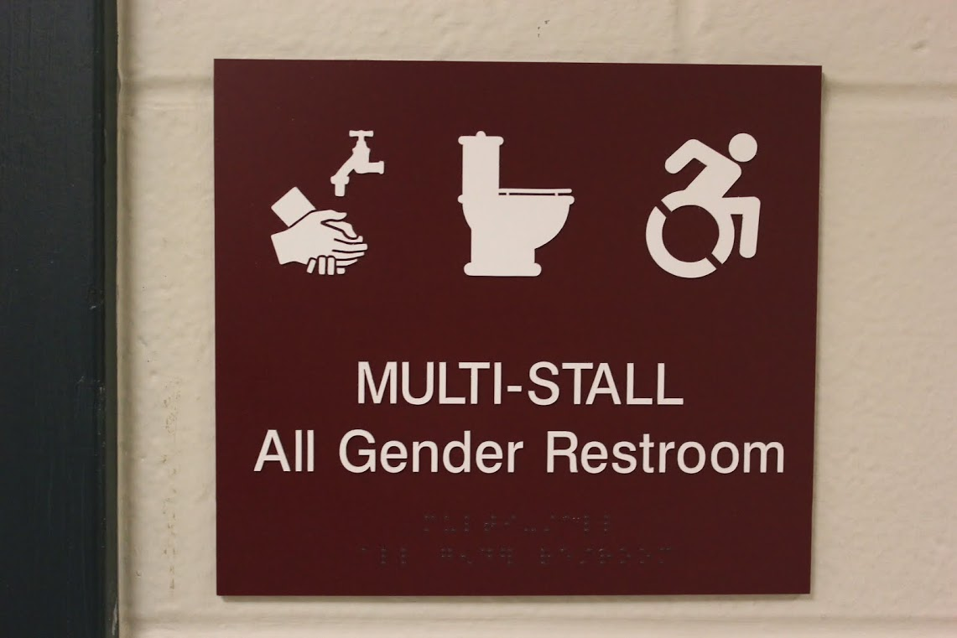
Campus-Wide Best Practices
Mandatory for all staff to complete trans ally training
Clearly publicize all information that would be helpful, supportive or relevant to trans students on the university website¹
Create gender-inclusive bathrooms in every building and dormitory on campus
Avoid using stick-figures to depict gender on bathroom door
Create an accessible map and list of gender-neutral bathroom locations on campus both available on print and on university website²
Notes:
Photo: http://www.infostormer.com/wp-content/uploads/2015/04/gender-neutral-bathrooms.jpg
¹UMass Amherst Transguide (website): http://www.umass.edu/stonewall/transguide/
²University of Washington Gender Neutral Restroom map: https://depts.washington.edu/qcenter/wordpress/frequently-used-resources/gender-neutral-bathrooms/
Further information on gender-inclusive bathrooms: http://amplifyyourvoice.org/youthresource/youthresource-genderneutralfaq

Slide 6
Best Practices: Campus Records
Allow students to use chosen name on registration documents, campus ID card, diplomas, etc.
Critically examine all campus records to determine whether asking for sex and/or gender markers are necessary on all forms
Allow students to change gender marker on all records and documents by request
Enable students to self-identify gender on forms (i.e. Gender Identity: _____ )
Enable registration options to indicate pronoun use as reported by student (i.e. Pronouns: ________)
Pronouns should appear on course and grade rosters in addition to advisor lists
Notes:
Best practices taken from: http://www.lgbtcampus.org/

Slide 7
Best Practices: Campus Housing
Create a fair and equitable hiring, training and retainment process for trans-identified Residential Life staff
Develop trans-supportive housing policies, including but not limited to:
Recognize and respect the stated gender identity of the student
Trans students are safely and comfortably housed in keeping with their gender identity
Include “gender-identity” in general housing nondiscriminatory policy
Establish gender-inclusive housing¹
For all students, including first-year and returning students
Separate from LGBTQ housing for transgender student who may not be ‘out’ to parents and/or want to live in housing different area²
Establish gender-neutral bathrooms and private showers
Notes:
Best practices taken from: http://www.lgbtcampus.org/
¹https://www.campuspride.org/tpc/gender-inclusive-housing/ ² For example, see: University of Illinois at Urbana Champaign, gender-inclusive housing options: http://housing.illinois.edu/living-options/special-options/gender-inclusive

Slide 8
Best Practices: Athletics & Locker Rooms
Develop a policy for trans students to compete in intramural sports
UMASS Amherst policy: “When an activity makes a gender designation, an individual who has transitioned to a different gender can participate in the division of the individual’s current gender. If an individual is in the process of transitioning to a different gender, participation in a particular gender-designated activity will be handled on a case-by-case basis.”¹
Offer lockable single-user changing rooms and showers²
Make an online list of locker room privacy options³
Notes:
Best practices taken from: http://www.lgbtcampus.org/
¹http://www.umass.edu/campusrec/intramurals/participantsguide/index.html#III
²For example, see: http://web.mit.edu/trans/lockerroom.html
³For example, see: http://web.mit.edu/trans/lockerprivacy.html

Slide 9
Best Practices: Fraternities and Sororities
Enable all students to self-identify their gender on fraternity and sorority recruitment applications/paperwork (i.e. Gender Identity ________)
Develop and publicize trans-supportive fraternity and sorority policy which includes that the college will always respect and recognize the stated gender identity of students
Include “gender identity” in fraternity/sorority nondiscrimination policy
Include policy that addresses acts of harassment, discrimination, and violence towards trans students
Title IX and fraternity/sorority policies: “Because Title IX preserves their ability to define their membership, fraternal organizations are empowered to address the inclusion of transgender members. For most, membership in a fraternity or sorority begins at initiation, the requirements of which are set forth in an organization’s inter/national bylaws and governing documents. These documents also control an organization’s single-sex status. Fraternal organizations should use these governing documents to clarify how transgender persons may participate in all levels of membership.”¹
Encourage fraternities and sororities to hold trans awareness programs with their membership²
Notes:
Best practices taken from: http://www.lgbtcampus.org/
¹https://www.campuspride.org/resources/transgender-membership-in-fraternities-sororities-and-title-ix/
²News article: Missouri State University’s Xi Omicron Iota sorority opens doors to transgender students- http://www.news-leader.com/story/news/education/2015/09/08/msu-sorority-opens-doors-transgender-women/71902506/

Slide 10
Best Practices: Campus Conduct Offices
Accessible web page that explains the college’s policies related to gender identity
Provides contact information for an official who is the designated point person on these policies
Develop and publicize trans-supportive policy
Include policy that addresses acts of harassment, discrimination, and violence towards trans students in accordance with campus judicial policies
University of Pittsburgh’s University Statement (on Campus Conduct site): “ ...the University prohibits and will not engage in discrimination or harassment on the basis of race, color, religion, national origin, ancestry, sex, age, marital status, familial status, sexual orientation, gender identity and expression [emphasis added], genetic information, disability, or status as a veteran.”¹
Encourage Student Life staff to hold trans awareness and education programs
Notes:
Best practices taken from: http://www.lgbtcampus.org/
¹http://www.studentaffairs.pitt.edu/lgbtqia/transgender

Slide 11
Best Practices: Campus Health Centers
Equitable process for hiring and retaining trans-identified and trans-knowledgeable staff
Clearly identify trans-inclusive health care providers
Allow students to self-identify their gender on all healthcare forms (i.e. Gender Identity _______)
Allow students to indicate their chosen name on the Health Center’s intake form
Prescriptions and referrals are to be written using the student’s chosen name
Cover hormones and gender-affirming surgeries under student health insurance
Train practitioners so that they can assist in hormone treatment, write prescriptions for hormones, and monitor hormone levels for transitioning students
Publicize information on trans health on the Health Center webpage¹
Appoint patient advocate to Health Center to assist trans students and/or provide support for trans students
Patient advocate will walk students through reporting process if they feel mistreated or have any concerns
Notes:
Best practices taken from:http://www.lgbtcampus.org/
¹For example, see University of Arizona’s Transgender Health Benefits website: https://www.health.arizona.edu/transgender-benefits
For more information, see The Center of Excellence for Transgender Health: http://transhealth.ucsf.edu/trans?page=home-00-00

Slide 12
Best Practices: Campus Counseling Centers
Equitable process for hiring and retaining trans identified and trans-knowledgeable Campus Counseling staff members
All counseling staff members must attend a trans ally training
Allow students to indicate their chosen name on the Counseling Center’s intake form
Develop and publicize a list of area therapists who can provide trans-supportive gender therapy for students who are transitioning or struggling with their gender identity
Cover all required therapy sessions for students who are transitioning under student health insurance¹
Have at least one therapist at the Counseling Center who specializes in supporting trans students
Make sure they have proper training and can assist in writing letters for transitioning students to access hormones
Create a trans-led peer support group for trans and gender-nonconforming students
Notes:
Best practices taken from: http://www.lgbtcampus.org/
¹For more information on this process, see: http://www.wpath.org/

Slide 13
Next Steps
How can Centrist College realistically implement these best practices?
Identify areas where you can affect change
Include key stakeholders and allies in making the change
Recruit trans students who can provide insight to the culture and needs of the students for whom these initiatives would affect
Include transgender students in every step of planning and implementation
Set a defined plan for implementation that includes specific, measureable, attainable, relevant, and timely goals
One example: By the start of the next fall semester, 75% incoming students will receive trans ally 101 training as part of their orientation.
Educate and encourage buy-in from the campus community

Slide 14
Identifying Stakeholders
You’ll need to include key stakeholders on the planning and implementation of any best practices that impact other areas of campus.
Stakeholders may include:
Faculty
Office of General Counsel
Registrar
Cisgender students
Other departments in student/academic affairs
Alumni
Community members
Trans Student Advisory Group

Slide 15
Recommendation: Trans Student Advisory Group
With the help of the LGBT Resource Center, recruit students for a transgender student advisory committee.
They will be crucial members of the team in identifying what they want to see on campus to support them.
Call on the advisory group often during conceptualization, planning, and implementation of any of the best practices.
Ensure alignment of the policy with their needs.

Slide 16
Recommendation: Create Working Groups
Once you’ve identified an area for change and key stakeholders and allies, recruit members for a working group that will propose and implement the change.
Membership may include you, your departmental staff, stakeholders, and students.
Their charge will be to set the specific goals of the project, propose the change to the President, and implement the change
They will also be responsible for:
Seeking out evaluation and assessment resources and developing the evaluation plan
Setting the timeline
Educating the campus community
Implementation
Assessment and evaluation

Slide 17
Assessment, Evaluation, and Follow-Up
Assessment, evaluation, and follow-up are KEY to success.
Consider assessment and evaluation from the beginning of the conceptualization phase.
If assessment and evaluation is underdeveloped in your department, seek assistance across departments, from community members, or from consultants
Example: Susan Rankin, a well-known researcher in LGBT issues on college campuses, with other associates has a consulting firm, Rankin & Associates Consulting, that can assist in developing comprehensive institutional assessments¹
Follow-up: Senior staff should meet with the working group bi-monthly (recommended) to get updates on progress to report to the President.
Report to stakeholders and the campus community the results of implementation (from assessment and evaluation data)
Notes:
¹Rankin & Associates rankin-consulting.com/

Slide 18
Remember...
In order to stay true to our institutional mission and values, we MUST work towards creating an inclusive environment for transgender students.
Thank you!
Notes:
Photo taken from: http://www.warnerpacific.edu/about/diversity/

