Slide 1
StudentAffairs.com
Case Study Competition
Charlotte Brown - CharlotteBrown@uga.edu
Natalie Emerson - NEmerson@uga.edu
Reggie Gacad - Renaldo.Gacad@uga.edu
Nyya Jones (Team Leader) - Nyya.Jones25@uga.edu
From The University of Georgia - M.Ed. College Student Affairs Administration Program
Please review the notes section on each slide for further information.

Slide 2
Creating Trans*formational Spaces
Centrist College
Student Services
Notes:
Facilitation guidelines are in the notes section of this presentation.
Presentation created by Charlotte Brown, Natalie Emerson, Reggie Gacad, & Nyya Jones, from the University of Georgia College Student Affairs Administration Program
(175 minutes total; ~ 3 hour workshop)

Slide 3
Introductions
Charlotte Brown (she/her/hers), Coordinator of Student Services
Natalie Emerson (she/her/hers), Coordinator of Student Services
Reggie Gacad (he/him/his), Graduate Assistant of Student Services
Nyya Jones (she/her/hers), Assistant Director of Student Services
Introduce yourself!
Name
Pronouns
Department/Job Title
Notes:
(5 minutes)
Facilitator Guide:
Participants are encouraged to introduce themselves with their name, pronouns, and department.

Slide 4
Pronouns
What kind of pronouns can be used?
She, Her, Hers and He, Him, His
  Most commonly used. Traditionally referred to as masculine or feminine pronouns
  Some prefer to avoid these labels, as they may allow for unwanted stereotypes.
They, Them, and Their
  Replaces she/he and is gender inclusive
Ze and Hir
  Replaces all of the above and is gender inclusive
Name Preference
  Some people prefer for their names to be used instead of pronouns
And More!
  More variations of pronouns exist, and people have the option to self-identify
Notes:
(7 minutes)
Facilitator Guide:
Why do we use pronouns?
How does pronoun usage connect to equity and social justice?

Slide 5
Agenda
Community Standards
Terminology & Social Justice Language
Campus Climate
What are we doing well?
  Root Causes
What can we do better?
  Action Plans
  Accountability and Implementation
  Future Workshops
References
Notes:
(2 minutes)

Slide 6
Community Standards
Assume everyone has positive intent
Use “I” statements (speak only for yourself)
Yes, and…
Step up in speaking. Step up in listening.
Ask questions from a place of curiosity (rather than debate)
Try on new ideas
What’s shared here stays here; what’s learned here leaves here
Safe Space, Grace Space, Brave Space
What else do you need from the rest of us?
Notes:
(10 minutes)
Facilitator Guide:
Go through the standards with the group
Ask if they need anything else they need to be successful in the space

Slide 7
Examining Our Positionality
Our positionality as four cisgender workshop facilitators
Five minute free-writing exercise
  What are your assumptions about the TGNC population on campus, their needs, and what the university is currently doing?
Notes:
(10 minutes)
Facilitator Guide:
Who is our audience and what is useful for them to know? Senior level administrators
How does our positionality effect this presentation and the work we do as student affairs professionals?
Note: Facilitators should provide the definition for TGNC before the free-writing (shown again on Slide 9)
Justification:
The free-writing exercise will help the facilitators gauge participants’ understanding of this topic and provide information accordingly. Providing the space for participants to reflect on their positionality and thoughts about the TGNC population will allow the facilitators to cater portions of the workshop to this audience.
Facilitator Pedagogy:
Facilitating Intergroup Dialogues (Maxwell, Nagda, & Thompson, 2011)
Critical Race Theory

Slide 8
Why We’re Here
Increase mattering, support, and inclusion for TGNC (Transgender & Gender Nonconforming) students
Educate ourselves and increase accountability to our students
Amplify students’ narratives and counterstories
Re-commit to advocating for full and equitable participation for each student
Promote a safe and secure campus environment for each student
Everyone has the right to be themselves
Notes:
(3 minutes)
The slide is a non-academic version of our intended learning outcomes.
Intended Learning Outcomes:
As a result of this workshop, Senior Student Affairs Officers will be able to...
Develop a personal definition of social justice
Articulate the importance of considering TGNC experiences
Identify two new concepts relating to the TGNC population
Formulate three strategies for making Centrist University more inclusive of the TGNC population
...as evidenced by a post-workshop assessment

Slide 9
Distinguishing Definitions
Sex: biological classification of male or female (based on genetic or physiological features); as opposed to gender
Gender: the socially constructed concepts of masculinity and femininity; the ‘appropriate’ qualities accompanying biological sex
Gender identity: an individual’s inner sense of being male or female. Gender identity is not necessarily the same as assigned or presumed sex at birth
Gender expression: the way a person expresses gender through dress, mannerisms, and other characteristics
Cisgender: refers to people whose gender identity is the same as their assigned or presumed sex at birth
TGNC: Transgender refers to people whose gender identity, one’s inner sense of being male, female, or something else, differs from their assigned or presumed sex at birth. Gender-non conforming (GNC) people don’t meet society’s expectations of gender roles
Notes:
(10 minutes)
Facilitator Guide:
Do we have 6 volunteers to each read 1 of the definitions on this slide?
What questions do people have after hearing and/or seeing these definitions?

Slide 10
Words on the Wall Activity
We want to acknowledge the collection of experiences and knowledge in the room. As such, we want to take the time to engage in a silent dialogue activity in order to co-construct knowledge of social justice terms and concepts.
Notes:
(20 minutes)
Facilitator Guide:
This activity allows participants to examine their personal definitions and reactions to words surrounding issues of social justice.
Facilitator must understand concepts:
Social identities
Privileged Identity Development Exploration Model
Schlossberg’s Mattering vs. Marginality
Mattering
Importance
Dependence
Ego Extension
Appreciation
Attention
Instructions:
Write the four words/terms on 4 separate sheets of large, butcher paper : Privilege, Oppression, Intersectionality, and Social Equity
Tape these papers up on 4 different walls around the room (Privilege should be on the wall parallel to Oppression).
Give each participant a marker, pen, etc. and a set of sticky notes.
Ask participants to take the time to silently write their definitions, reactions, and concerns regarding each word on the corresponding butcher paper sheet. Those who prefer to respond from their seat may have their sticky notes posted on the butcher paper for them, so their voices are still heard.
As participants finish writing their own words, they should revisit each word, highlighting things they thought about and reactions to the phrases written on the walls.
Encourage everyone to continue moving around the room to read what is written on the sheets, even when they’re done writing.
Debrief Questions:
What was this process like?
What was difficult?
How did this make you feel?
Reactions?

Slide 11
The Language of Social Justice
Privilege refers to the benefits people receive based on who they are, not because of anything they have done or accomplished.
Oppression refers to the benefits people are denied based on who they are, not because of anything they have done or accomplished.
Intersectionality refers to the influence of our unique constellation of social identities on how we perceive each of the identities we simultaneously have.
Social equity refers to various social-identity groups’ fair access to resources and opportunities.
Notes:
(10 minutes)
Facilitator Guide:
Can we have 4 volunteers to read these definitions?
What thoughts or phrases come to mind from these words?
Do you have any examples? Any specific from our campus?

Slide 12
What is Social Justice?
Adams, Bell and Griffin (2007) define social justice as both a process and a goal. "The goal of social justice education is full and equal participation of all groups in a society that is mutually shaped to meet their needs. Social justice includes a vision of society that is equitable and all members are physically and psychologically safe and secure."
Pair & Share: What does this mean to your work as a senior level administrator? How does this apply to the experiences of TGNC students on campus?
Notes:
(15 minutes)
Facilitator Guide:
Before the Pair and Share
1. Would anyone like to volunteer to read this definition?
2. What words or phrases resonate with you, and why?
After the Pair and Share
After reflecting through the pair and share, how does social justice influence your work?

Slide 13
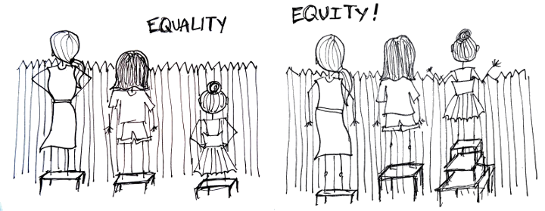
Equality vs. Equity
Notes:
(5 minutes)
Facilitator Guide:
Equality is giving everyone the same resources.
Equity is giving everyone access to the resources they need to learn and thrive.
Examples: All-gender restrooms, training and education for healthcare providers, on-campus housing accommodations.

Slide 14
Campus Climate Survey Results
More than half (57%) of all respondents were comfortable or very comfortable with the overall climate of Centrist College
55% of cisgender men and 58% of cisgender women were comfortable or very comfortable with the overall climate
TGNC respondents were much less comfortable with the campus climate at 38% responding with comfortable or very comfortable
25% of TGNC respondents have considered leaving the institution because of the cis-genderist climate
38% of TGNC respondents believed they had experienced harassment
Check-in: What are your thoughts and feelings after hearing these students’ experiences on campus?
These survey results are from the Michigan State University LGBTQ Climate Project Report (2010)
Notes:
(10 minutes)
Facilitator Guide:
As a review, the survey indicated that students who identify as TGNC...
Are tired of correcting people’s usage of pronouns
Feel burdened having to educate the campus about the TGNC community
Censor their feelings and hide their identity to ensure their safety
Express concerns regarding their safety on campus
Want to see their experiences centered (eg. transgender women of color, first-generation students who are TGNC)
Explore these issues using a Critical Pedagogy Lens (as described through Critical Race Theory) with participants
Counterstorytelling - including the narratives of Centrist College students who are not part of the dominant story at our institution
Intersectionality - considering what other identities TGNC students bring as part of who they are, and how those connect to their experiences on campus in the context of power, privilege and oppression

Slide 15
Student
Narratives
“Ever since, it's been a game of "I'm actually a man" or "It's "he," please." I'm still pre-testosterone with the lack of a job and a license to get it. Still, I keep my chin up and press on with countering assumptions because I have to. It's on me for people to know how I identify because how does one know unless they ask or I tell them? I've had varied responses, most of them confusion, some cold neutrality. Some don't have any idea what transgender means. So I teach until I'm blue in the face, whatever the reaction.” – L., First year student
“For most of my life until I hit about 21 I didn't know any trans people of color. I was very isolated and didn't know I was. It hit me hard and it was becoming harder to navigate the LGBT spaces I was in at my previous institution and hometown. I left to start a new and I am able to thrive as a strong Black Trans Queer Activist….my identity has taken me on a lot of different paths. I know that all I want to do is to give people a voice that speaks louder than mine.” – T., Fourth year student
“I hope that my generation will be a generation that makes progress to normalize gender neutral and genderless bathrooms, a generation that accepts people no matter their names or pronouns.” – E., Third year student
Notes:
(5 minutes)
Facilitator Guide:
Ask for three volunteers, and hand them each a slip of paper with the one of the quotes shown on the slide typed on them. Ask the volunteers to read the quotes on the slide aloud as the remaining participants read along from the slide. Give participants a moment at the end to process what they have listened to.

Slide 16
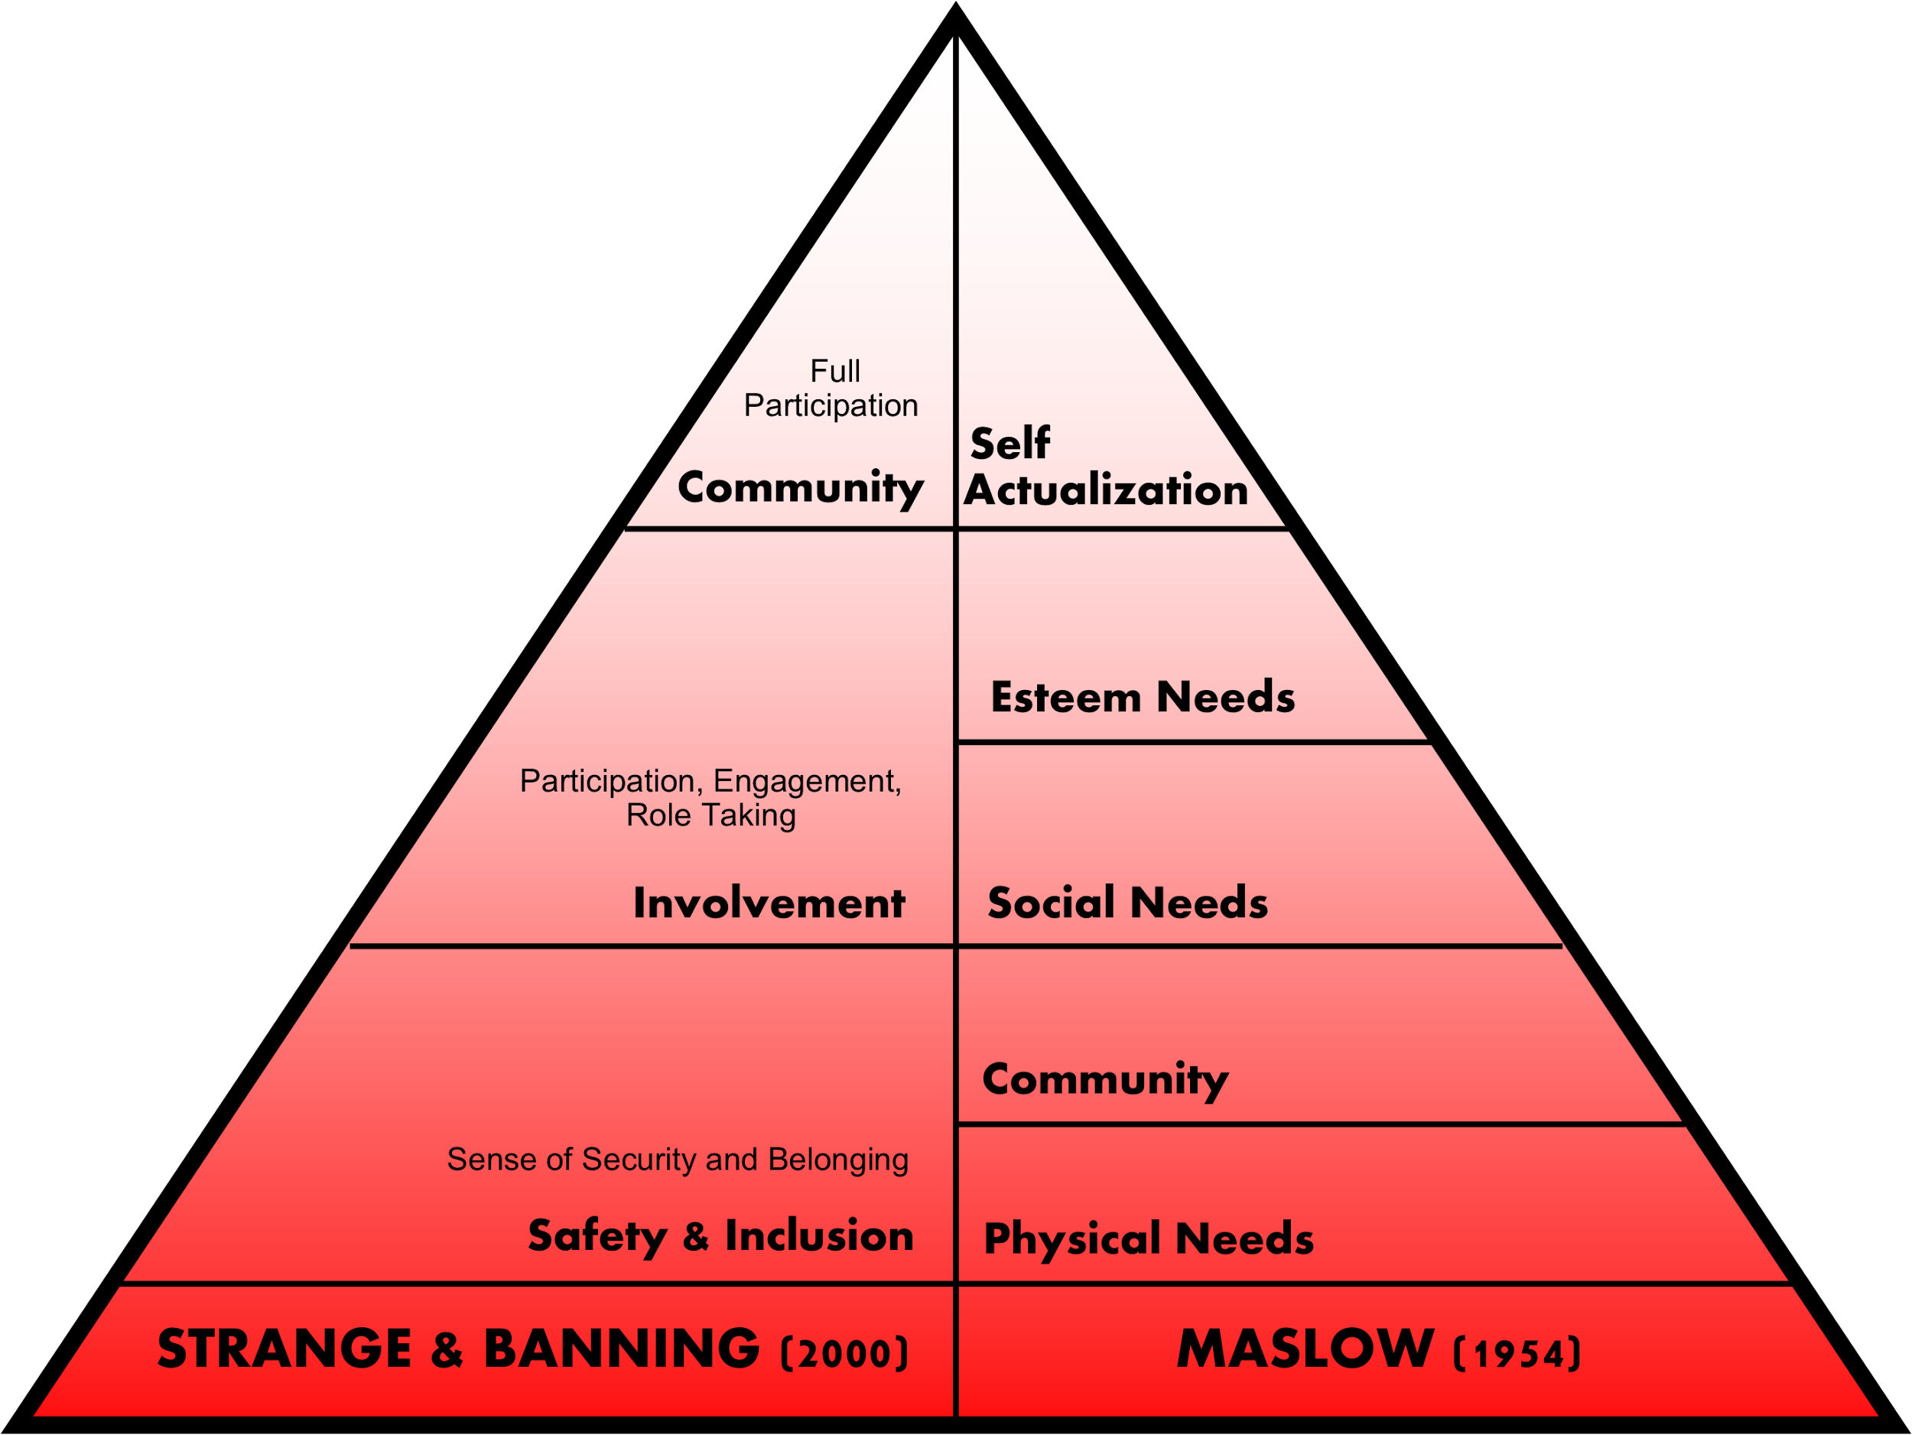
What are their needs?
Creating a community of learners in our campus environment
Physical environment - restrooms, housing, health/counseling clinics
  Aspects of safety
  Sense of belonging
Notes:
(5 minutes)
Facilitator Guide:
How are we providing a safe and secure foundation for students? (physical environment)
Restrooms - minimal all-gender restrooms on campus
Housing - students grouped by gender, visitation policies based on cisgenderism and heteronormativity
Counseling Services - counselors are not formally trained by the College about TGNC students’ experiences
Safety - equity in campus safety because TGNC students may have different needs and concerns that might not be fully understood by all campus safety officers
References:
Maslow’s Hierarchy of Needs (1954)
Strange & Banning (2001)

Slide 17
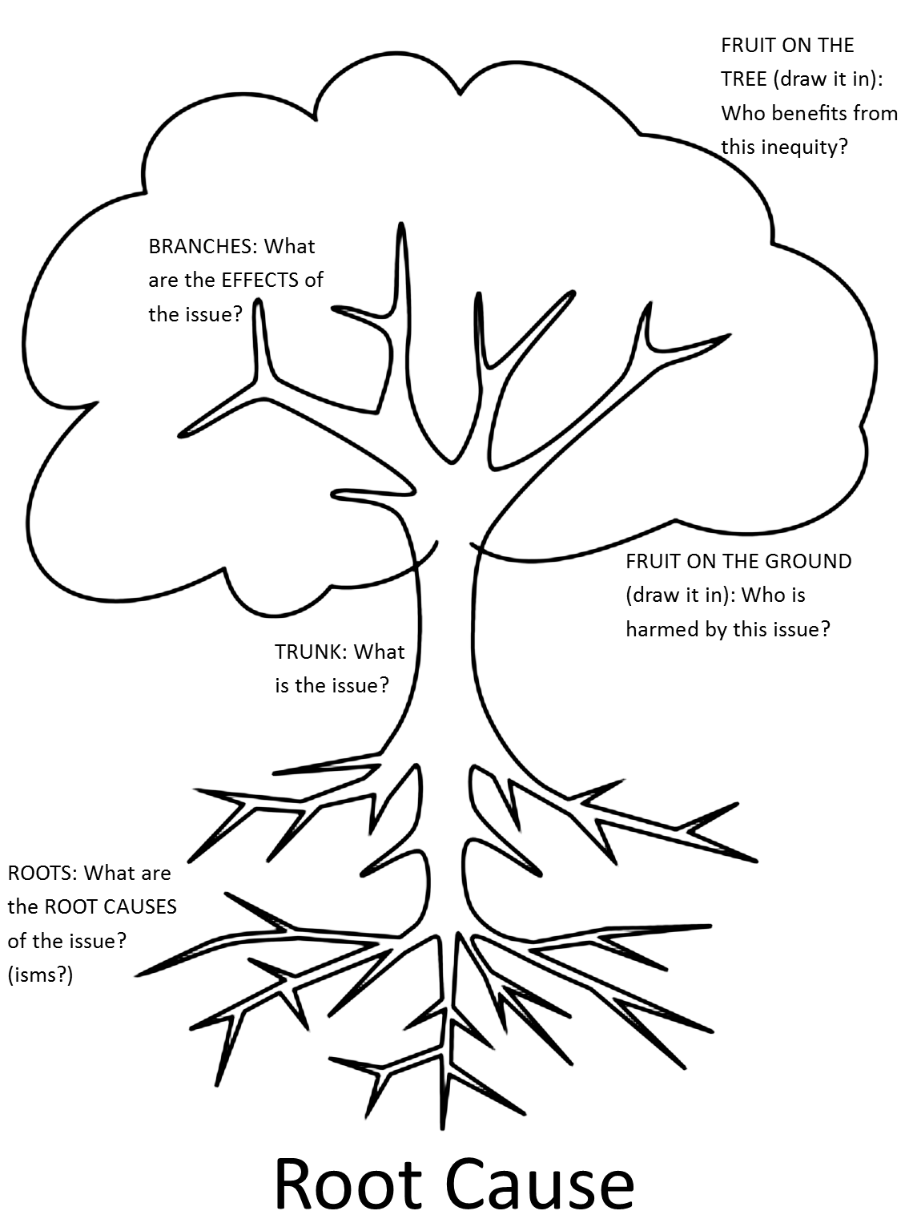
Root Causes
Cisgenderism: a form of prejudice that denies, ignores, denigrates, or stigmatizes non-cisgender forms of expression, sexual activity, behavior, relationship, or community
Notes:
(20 minutes)
Facilitator Guide:
Using Cisgenderism as the “Roots” of the worksheet, participants will examine the following questions in small groups:
Trunk: What are the issues and concerns that TGNC students face during the campus climate survey
Branches: What are the effects of cisgenderism
Fruit on Tree: Who benefits from inequity caused by cisgenderism
Fruit on Ground: Who is harmed by cisgenderism
Justification
Turpin (2008) expresses the importance of teaching individuals analysis skills as a way to focus conversation not on solutions but on root causes. The temptation to move directly to solutions inhibits them from deeply connecting with or examining structures that contribute to inequity and the humanizing piece of justice work. This activity allow people to look inwardly in order to think about positive change work as more of a transformation towards societal justice rather than an opportunity to fix a problem.

Slide 18
What are we doing well?
Anti-discrimination and anti-harassment policies distinguish between gender, gender identity, and gender expression
Forms distinguish between sex and gender
We have some all-gender restrooms on campus
Students are able to change their name on their collegiate email addresses
Students can change their names on transcripts
What is your department doing? Other campus departments? What are you doing, personally?
Notes:
(10 minutes)
Facilitator Guide:
Review the bullet points with the large group. (Based on the campus climate survey results, these are things students think we do well.)
Ask if anyone has questions about any of these points.
Ask participants to turn to the person next to them and take 3 minutes to discuss the questions listed at the bottom of the slide.
Bring everyone back together in the large group and initiate a discussion based on people’s small group discussions.
Acknowledge the positive actions Centrist College has made for the TGNC population AND challenge participants to do more (Transition to what we can do better)

Slide 19
What could we do better?
Realize and leverage the power of counternarratives
Get TGNC students at the table
Don’t assume: Asking and providing pronouns as a standard and norm for everyone
TGNC Ally training
Notes:
(5 minutes)
Facilitator Guide:
Based on the campus climate survey results, these are things students think we could do better.
Benchmarking: ask audience if there are other institutions that are implementing similar initiatives around inclusion for TGNC students, and if there are, if they could share how those initiatives have gone/are going

Slide 20
Action: What can we do moving forward?
We’ve identified four categories of small and large changes that can make a huge difference for TGNC students and the campus climate.
What are some things you can think of that fall under these categories?
Physical Spaces
Processes and Procedures
Learning Spaces
Elevating Voices and Healing Spaces
Notes:
(10 minutes)
Facilitator Guide:
In addition to thinking about what we as practitioners can do better, we need to think about what we as a university can do moving forward.
Prompt group to answer the question and write down answers on a butcher sheet as people call them out. In addition, make sure to add everything below to the list and explain each of those pieces.
We want to think about ways that we can implement change through tangible action steps and focus on areas
Physical Spaces
Convert single stall restrooms to be all-gender spaces
Improve the housing process from registration to assignments
Processes and Procedures
Surveys should ask for pronouns and preferred name
Assessment and Staff Development requires offices to collect preferred names and pronouns
Faculty and staff use students’ preferred names, rather than legal names on roster
Review places that pronouns could be listed without prompt - they can set an example by listing pronouns in their email signature
Learning Spaces
TGNC-specific resources
Elevating Voices and Healing Spaces
Create affinity and caucus spaces for students to discuss and explore their intersectional identity
Anonymize the system that we use for students to file grievances with the Division

Slide 21
Increasing Accountability
Pair & Share: What are three changes that you will implement in your role as an administrator to better support TGNC students?
Identify an accountability partner that you will touch base with at least three times this semester to evaluate your progress.
Notes:
(7 minutes)
Facilitator Guide:
Pair and Share
Think about all the information we’ve covered today! How are students feeling? Why are they feeling this way? What are things they need to feel safe on campus?
Make sure your changes are specific, measurable, attainable, realistic, and timely (SMART)
If you do not have direct contact with students, how can you help them feel like they matter to the campus community?
Can you make any logistical or policy changes?
Accountability Partner
How will you keep in touch with your partner? Will you connect in person, via e-mail, or otherwise?
What motivates you? What motivates your partner?
What does success look like to you? To your partner?

Slide 22
Future Workshops
March Workshop: Tuesday, March 15th, 2:00-5:00pm
  Uncoiling the Tension around Race
April Workshop: Monday, April 18th, 1:00-3:00pm
  Reconciling Religion: The Impact of Intolerance
May Workshop: Thursday, May 12th, 9:00-12:00pm
  Probing into Politics: Presidential Election Year
All workshops will be held in the Multipurpose Room.
Thank you!
Notes:
(5 minutes)
Facilitator Guide:
Facilitators explain future workshops and take any additional questions at this time.

Slide 23
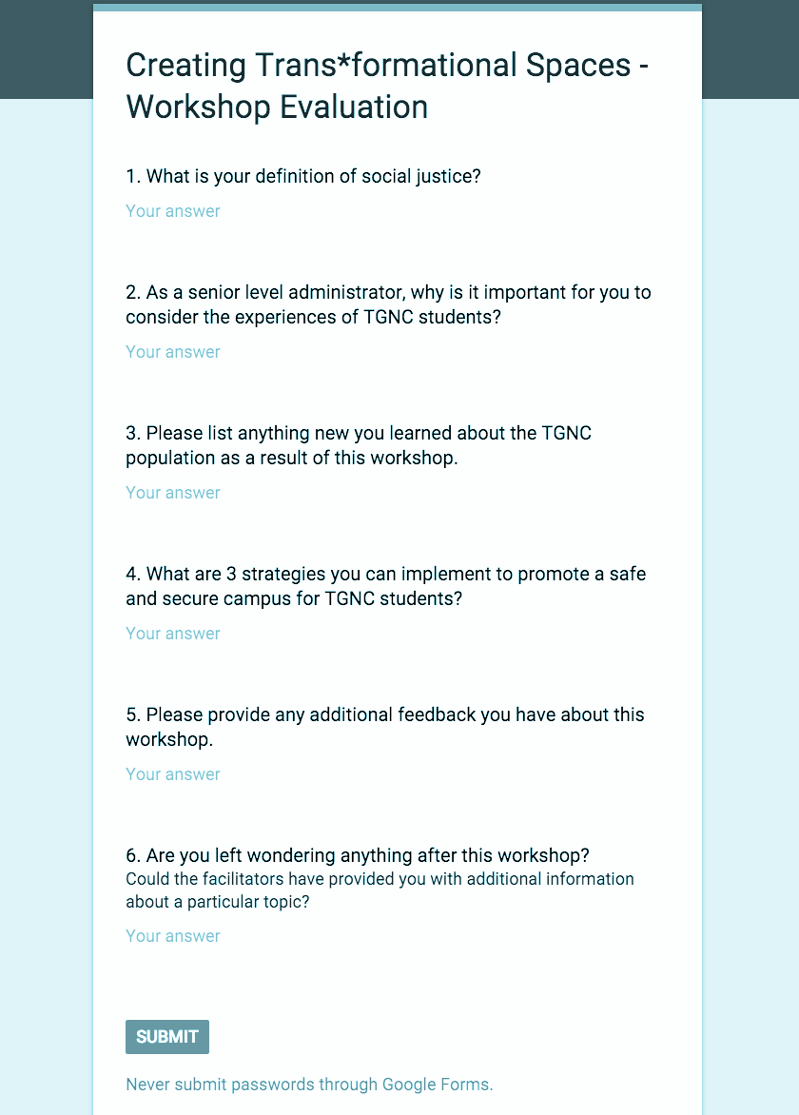
Please complete this workshop evaluation: http://tinyurl.com/CentristEval
Notes:
(2 minutes)
Facilitator Guide:
Allow participants time to write down the URL if they would prefer to take the evaluation later or in private, or stay and complete the evaluation if they have a device to use in front of them.

Slide 24
References
Adams, F. (2015 October 18). Transgender students deserve equal access. The Chronicle of Higher Education. Retrieved from http://chronicle.com/article/Transgender%C2%ADStudents%C2%ADDeserve/233755?cid=cp11
Anderson, W. (2015 February 20). Pronoun round etiquette. The body is not an apology. Retrieved from http://thebodyisnotanapology.com/magazine/pronounOroundOetiquette/
Beemyn, G. (2015) Leaving no trans college student behind. The Chronicle of Higher Education. Retrieved from http://chronicle.com/article/Leaving­No­Trans­College/233754?cid=cp11
Biemiller, L. (2015). A guide to gender-inclusive facilities starts with a survey of restrooms. The Chronicle of Higher Education. Retrieved from http://chronicle.com/article/A­Guide­to­Gender­Inclusive/233756?cid=cp11
Crossroads (n.d.). Racial identity caucusing: A strategy for building anti-racist collectives. Retrieved from http://www.crossroadsantiracism.org/wp-content/themes/crossroads/PDFs/Racial%20Identiy%20Caucusing%20Strategy.pdf
Dill, B. T., & Zambrana, R. E. (2009). Critical thinking about inequality: An emerging lens. In Emerging intersections: Race, class, and gender in theory, policy, and practice (pp.1-21). New Brunswick, NJ: Rutgers University Press.
Grant, J. M., Mottet, L., Tanis, J. E., Harrison, J., Herman, J., & Keisling, M. (2011). Injustice at every turn: A report of the national transgender discrimination survey. National Center for Transgender Equality.
Hill, R. J., Childers, J., Childs, A. P., Cowie, G., Hatton, A., Lewis, J. B., & Valentine, T. (2002). In the shadow of the arch: Safety and acceptance of lesbian, gay, bisexual, transgender and queer students at the University of Georgia.
McCoy, D. L., & Rodricks, D. L. (2015). Critical race theory in higher education: 20 years of theoretical and research innovations. ASHE Higher Education Report, 41(3), 1-33. doi: 10.1002/aehe.20021
Notes:
Additional Resources:
Beemyn, B. G., & Rankin, S. (2011). The lives of transgender people. Columbia University Press.
Center, T. L. (2005). Peeing in peace: A resource guide for transgender activists and allies. Transgender Law Center.
Levy, D. L., & Lo, J. R. (2013). Transgender, transsexual, and gender queer individuals with a Christian upbringing: The process of resolving conflict between gender identity and faith. Journal of Religion & Spirituality in Social Work: Social Thought, 32(1), 60-83.

Slide 25
References (cont.)
Safir, Shane. (2016). Equity vs. Equality: 6 Steps Towards Equity. Edutopia. Retrieved from http://www.edutopia.org/blog/equity-vs-equality-shane-safir
Seelman, K. L. (2014). Transgender individuals’ access to college housing and bathrooms: Findings from the National Transgender Discrimination Survey. Journal of Gay & Lesbian Social Services, 26(2), 186-206.
Strange, C. C. & Banning, J. H. (2001). Educating by design: Creating campus learning environments that work. San Francisco, CA: Jossey-Bass.
Suk, J. (2016 January 25). Who’s afraid of gender-neutral bathrooms? The New Yorker. Retrieved from http://www.newyorker.com/news/news-desk/whos-afraid-of-same-sex-bathrooms
Talusan, M. (2015 November 6). Here’s what actually happens when trans people use public restrooms. Buzzfeed. Retrieved from http://www.buzzfeed.com/meredithtalusan/we­just­need­to­pee#.haNKy78mP
Transgender lives: Your stories. The New York Times. Retrieved from: http://www.nytimes.com/interactive/projects/storywall/transgender-today
Tharp, D. S. (2012). The language of social justice. Change, 44(3), 21O23.
Turpin, K. (2008). Disrupting the luxury of despair: Justice and peace education in contexts of relative privilege. Teaching Theology & Religion, 11(3), 141-152.
Watt, S. K. (2007). Difficult dialogues, privilege, and social justice: Uses of the Privileged Identity Exploration model in student affairs. College Student Affairs Journal, 26(2), 114O126.
Notes:
That’s all, folks!

