Slide 1
Trans*
Shanon Davis
Victoria Heithaus
Devin Walker
University of Dayton

Slide 2
agenda
Presentation Outline
Trans* Care Team: Pre-Assessment Survey
Climate Survey Results
Student Interest
Student Voices
Statistics / Data
Pronouns
Intersectionality
Negative impacts
Fixed / Growth Mindset Video
Trans* Care Team (TCT) Action plan
How to get involved
Resources
References
Learning Objectives
Perceive our campus climate as it relates to the acceptance and support of our transgender students;
Appropriately use preferred gender pronouns;
Discern the needs of transgender students in higher education;
Recognize the role of intersectionality in the support, or lack thereof, of transgender students;
Articulate their role and action plan to proactively design a supportive environment for transgender students;
Shift perspectives from a fixed mindset to a growth mindset if one exists and for those who have a growth mindset, reinvigorate their expertise.

Slide 3
Trans* care team pre-assessment
In order to develop an effective and intentional action plan the Trans* Care Team (TCT) would administer a Transgender Awareness survey to campus faculty and staff. The TCT would expect the survey results to reveal what is going well on campus, what is not going well, and why students are interested in Centrist College. These results would be incorporated in the creation of new systems and further utilized to strengthen existing programs and supports.

Slide 4
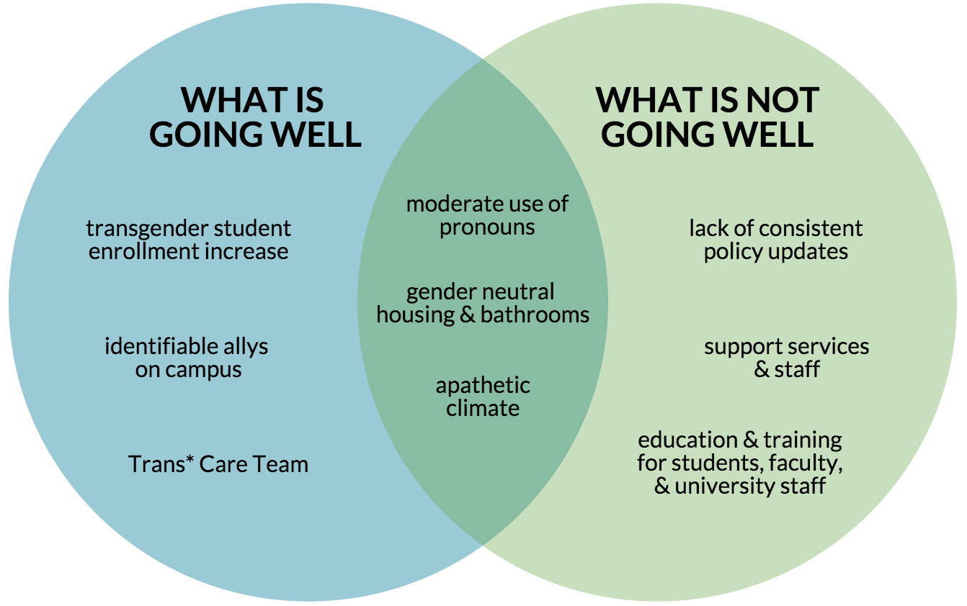
Summary of results (expected)

Slide 5
Summary of results (expected)
Centrist College has a small population of students who identify as LGB, and an even smaller, but growing, number who openly identify as “T” - Transgender. These students have noted that while their peers, campus administrators, and faculty are not unfriendly, there is a need for some overall education.
According to the results of the climate survey, here are some things that are going well:
the university president has acknowledged the need for professional development and continued education around transgender students
transgender student enrollment continues to increase
there are allies on campus interested in supporting the transgender community
The following are items that are not going well:
transgender students are having to explain what it means to identify who they are on a daily and/or weekly basis
on the admissions application, there is no way to indicate gender identity other than “male” or “female” and it must comply with the biological sex assigned at birth, which causes some issues for admissions, registering for housing, and insurance
the policies regarding entrance to the university, housing, bathrooms, insurance, etc. have not been updated to reflect the changing campus population
The Trans* Care Committee, and the climate report administrators, have devised the following growth areas:
while there is a gender neutral special interest residence hall on campus, the remaining dorms do not have gender neutral bathrooms, and there are limited academic buildings with gender neutral bathrooms
Centrist College has physical resource offices for multicultural and international students, as well as a women’s center, but there is no physical space or professional staff dedicated specifically to serve the LGBT community

Slide 6
Trans* student interest
Let’s examine why trans* students continue to enroll at increasing rates at Centrist College:
Our institution has been consistently ranked highest in our region in several areas, including
cost (overall value of education)
undergraduate program offerings
community engagement
faculty recognition at the national level
opportunities for student-faculty research partnerships
The student body at Centrist is progressive and accepting overall
few bias-related incident reports in residence halls and classrooms
gender-neutral housing is available
support from student organizations, including SGA, to be inclusive
Finally, our alumni have played an important role in connecting students to campus
they offer competitive internships
networking opportunities
job placement rates are highest among alumni

Slide 7
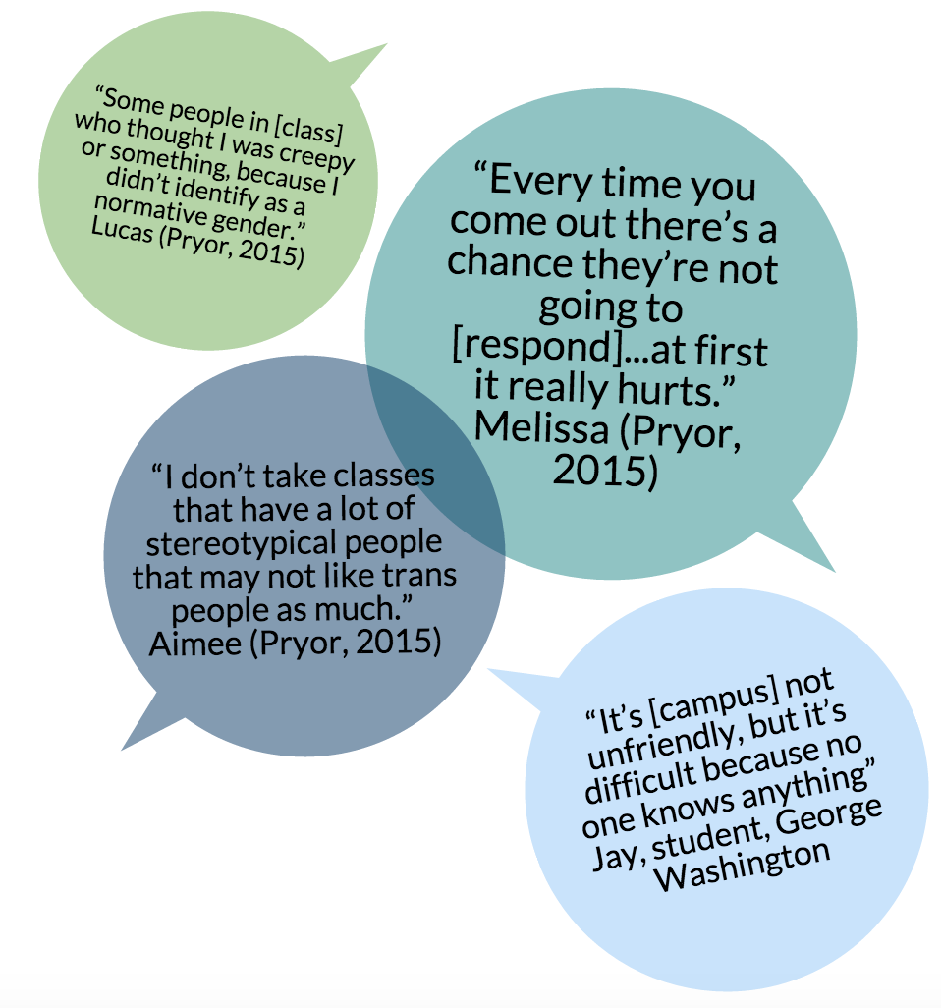
Student voices
Why is it important to capture the trans* student voice? The Centrist campus has been quiet, but there are still needs that have not been met for our community. The TCT recognizes that in order to continue to be proactive, there must be an intentional effort to understand the student experience.
Here are some examples of what students have been saying at other institutions:

Slide 8
Notes:
Please listen to the following spoken word poem as an inspiration for our continued work.

Slide 9
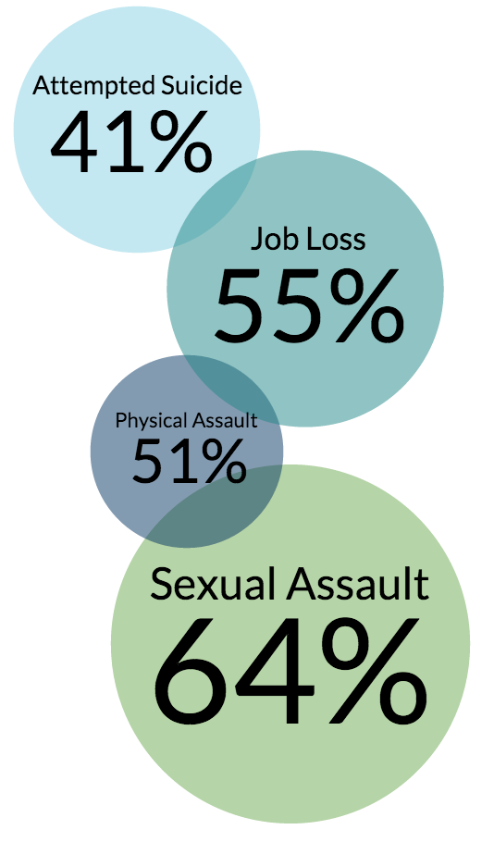
Voices in numbers
According to the National Gay and Lesbian Task Force, a staggering (41%) of respondents reported attempting suicide compared to (1.6%) of the population
Percentage rates raised even higher for those who:
lost a job due to bias (55%)
Low household income or victim of physical assault (51%)
Sexual assault, (64%)

Slide 10
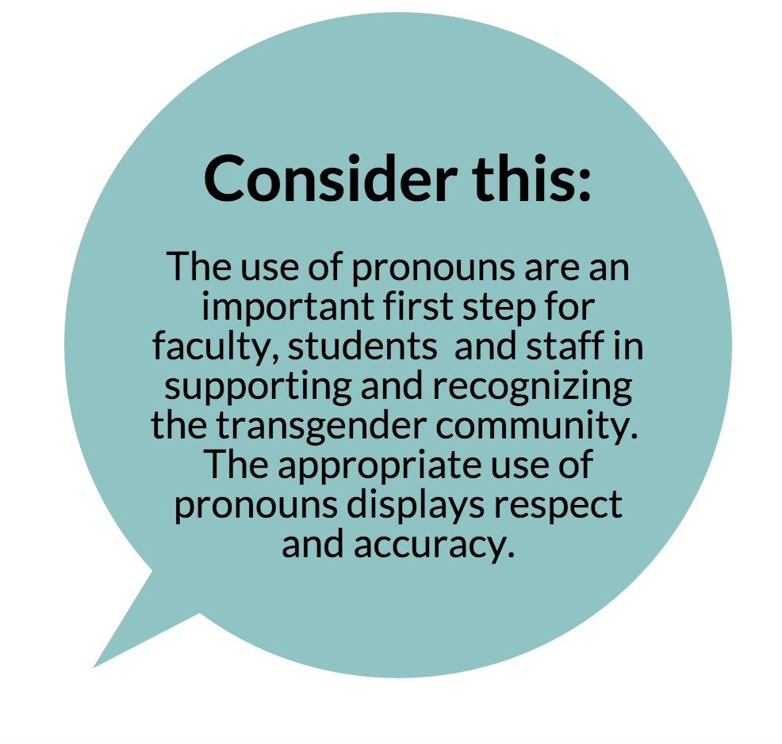
terminology
Trans: Anyone whose gender identity and/or gender expression differs significantly from what is expected of them in their culture based on their sex assigned at birth, including people who are transgender, transsexual, genderqueer, etc.
Cisgender: Non-trans
Genderqueer: One of many labels used by trans* people whose gender identity does not fit into either of the two most widely recognized gender categories (men and women)

Slide 11
pronouns
Traditional (Binary) Pronouns:
He/Him/His/Himself
She/Her/Herself
Gender Neutral (Non-Binary) Pronouns:
They/Them/Their/Themself
Ze/Hir/Hirself

Slide 12
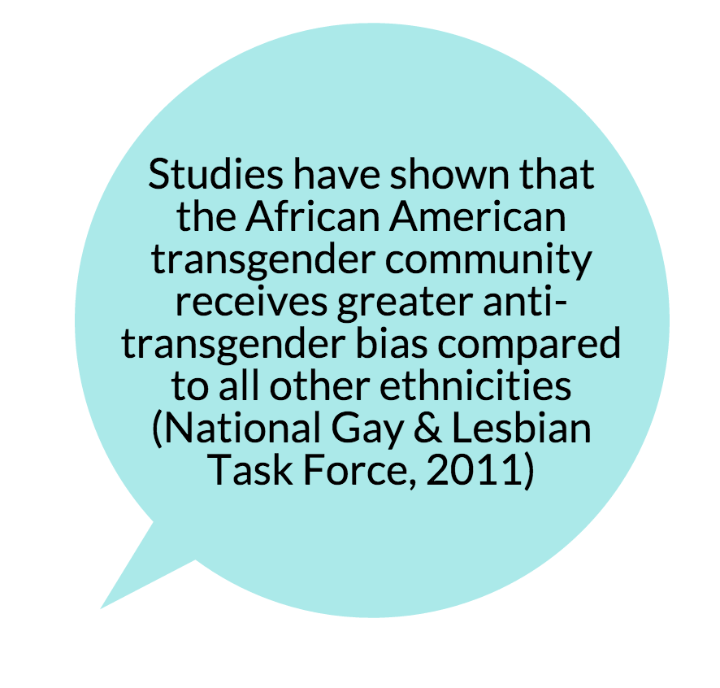
intersectionality
When supporting our Trans students, we must be mindful of how the intersection of an individual’s identities makes the discernment of needs a unique and multi-layered discussion.
Intersecting identities of the individual can be impacted positively or negatively by external forces; such as the campus community, family members, and society’s views on the Trans community (Russell, 2012).

Slide 13
Negative impacts
Sense of Belonging: The feeling of being apart and included in an environment
Self Efficacy: Refers to beliefs in one’s capabilities to execute the course of action in order to produce (Bandura, 1997, p.3)
Student Experience: The experiences that students are having that give implicit examples that they are welcomed but not fully supported. This can show up in passive and aggressive ways.
Self Authorship: : “Socialization to rely on external authority toward establishing their (students) internal authority depends on the dynamic interaction of their personal characteristics, experiences, their interpretation of those experiences, and their underlying constructions of knowledge, identity, and social relations” (Baxter Magolda, 2014, p. 27).

Slide 14
Fixed / growth mindset
In order to assess where faculty and staff are with their beliefs, attitudes, and awareness of the transgender community, identifying your mental framework is essential. This video explores and reiterates the influence and power of fixed and growth mindsets. This sets the foundation for professional development and opens up the viewer to prepare to learn and develop strategies to support transgender students on campus.

Slide 15
Trans* care team action plan
Faculty, staff, and student steering committee
Benchmarking partner institutions
Review of current research and literature
Campus climate survey to determine students’ experiences and perceptions
Assessment of needs
wellness
financial
personnel
physical space
education & training
Proposal for full time professional staff, graduate assistant

Slide 16
Trans* care team action plan
The TCT has created a proposed action plan. Providing a professional development series will be most beneficial though setting up a formal committee, conducting research of our campus climate and our partner institutions, and assessing the needs that are evident on campus based on student, faculty, and staff experiences. This thorough and informed approach (we hope) will ultimately result in the hiring of staff to take the responsibility of educating the campus community. While our campus community is open to the LGBT* community, the TCT feels that education, resources, and support should be on-going. These needs will not be going away anytime soon. We have a duty to serve ALL and it is time that we bring our institutional trends and initiatives to present day standards to meet those lifelong needs.

Slide 17
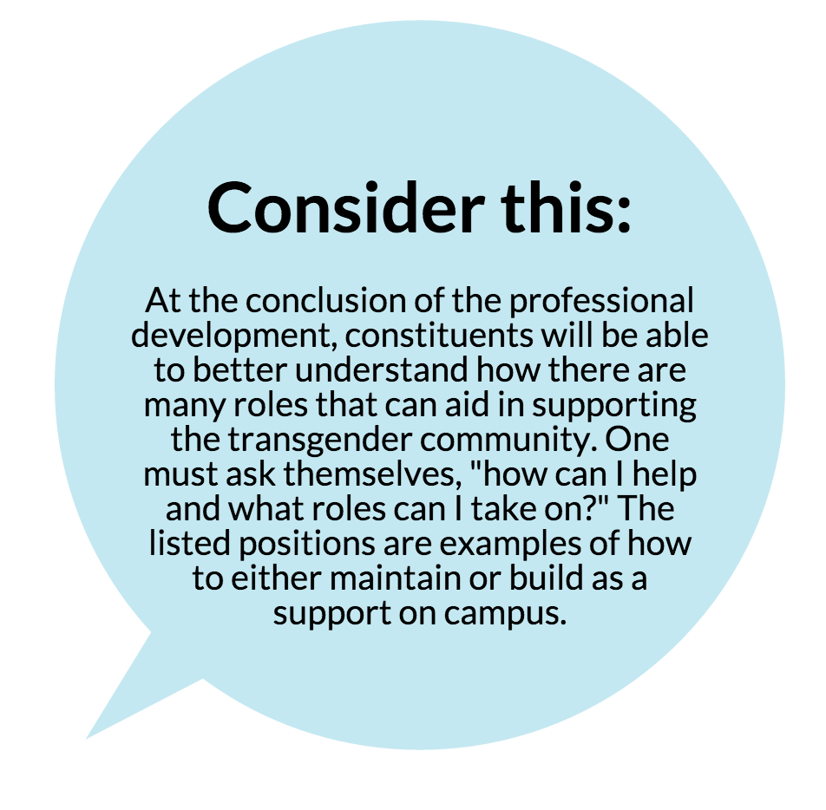
Identify your role
Mentor / Ally / Programmer / Mandatory Reporter ?
Have you acknowledged where you stand on this topic?
Have you assessed your comfortability levels with having a role in the transgender awareness and community building?
You must know where you stand in order to select roles that best suite your knowledge, skill sets, awareness and readiness to take on a specific role.

Slide 18
What can you do now?
For personal and professional ongoing development, one would need to do the following steps:
If a Fixed Mindset exists, set goals to learn general knowledge on the transgender community
This will start the shift to a Growth Mindset
Be aware and knowledgeable of current trends
Actively seek out professional development
Take ownership of the learning experience

Slide 19
Future professional development
Future sessions in the professional development series will involve students, faculty and staff.
These sessions will include:
Roleplay scenarios
A forum to discuss gender neutral restrooms on campus
A workshop on supporting Trans students in Residence Halls
Case Studies
Nationally recognized speakers
Social Media’s role
LGBT* Panel

Slide 20
Additional resource
The TCT has identified the Trans* Ally Workbook as a valuable resource. Understanding and learning how to use appropriate pronouns with trans* students, staff, and faculty is just one way to take ownership of your learning experience, in addition to recognizing the need to use more inclusive language.
This workbook will supplement the professional development seminar.

Slide 21
Questions?
Thank you!

Slide 22
references
Bandura, A. (1997). Self-efficacy. The exercise of control. NY: W. H Freeman and Company.
Baxter Magolda, M. B. (2014). Self-Authorship. New Directions for Higher Education, 2014(166), 25-33.
Fixed and Growth Mindsets Video: https://video.search.yahoo.com/video/play;_ylt=A2KLqISvwqtWUTcAOc4snIlQ;_ylu=X3oDMTByZWc0dGJtBHNlYwNzcgRzbGsDdmlkBHZ0aWQDBGdwb3MDMQ--?p=Growth+Mindset+Vs+Fixed+Mindset&vid=298a8e776dd81e1f2fe5dd7da1895044&turl=http%3A%2F%2Ftse1.mm.bing.net%2Fth%3Fid%3DOVP.V1680ab37bb525a98ef50a1d547b66a5b%26pid%3D15.1%26h%3D168%26w%3D300%26c%3D7%26rs%3D1&rurl=https%3A%2F%2Fwww.youtube.com%2Fwatch%3Fv%3DbrpkjT9m2Oo&tit=Growth+vs+Fixed+Mindset&c=0&h=168&w=300&l=76&sigr=11bbvmj3j&sigt=10n8grvnc&sigi=1315djf5l&age=1411087850&fr2=p%3As%2Cv%3Av&fr=yhs-mozilla-004&hsimp=yhs-004&hspart=mozilla&tt=b
Grant, J.M., Mottet, L. A., Tanis, J. (2011) Injustice at Every Turn: A report of the National Transgender Discrimination Survey
Pryor, J. T. (2015). Out in the classroom: Transgender student experiences at a large public university. Journal of college student development, 56(5), 440-455.
Russell, E. I. (2012). Voices unheard: Using intersectionality to understand identity among sexually marginalized undergraduate college students of color (Doctoral dissertation). Retrieved from ProQuest.
Shlasko, D. ( 2014). Trans* Ally Workbook: Getting pronouns right & what it teaches us about gender.

