Slide 1

Welcoming Transgender Students at Centrist College
Team Leader: Alfredo Oliveira
Team Members: James Bradley, Amanda Larson, and Kristopher Oliveira
February 26, 2016
St. Cloud State University
Notes:
Team Leader: Alfredo Oliveira
Team Leader email: olal1101@stcloudstate.edu
Team Leader phone number: (651)604-7113
Team Members: James Bradley, Amanda Larson, and Kristopher Oliveira

Slide 2
Welcome!
Introductions
  Preferred Name
  Preferred Pronoun
    i.e.: she/her/hers, he/him/his, they/them/theirs
  Department/Office and Position
Ground Rules
  Let’s turn this into a Brave Space, not just Safe Space
  Be respectful
  Expand your mind set to absorb the information
  Ask questions!
  "An open mind leaves a chance for someone to drop a worthwhile thought in it" - Unknown
Notes:
RULES
Safe Space – one where we can talk openly and honestly about issues. This is a sensitive subject so we want all participants to feel encouraged and welcomes to voice their opinion. We recognize that it is not always easy to talk about these issues, and that is why we have also designated this space as a “Brave Space,” because we know it takes a lot of courage to talk about things that make us uncomfortable and we therefore ask everyone to be brave by using their voice to speak up. Similarly – members should feel comfortable to speak up if they feel uncomfortable about something that we, the participants, have stated – or your fellow participants. That way we can positively correct or explain our positions so that everyone can learn in this environment. With this in mind, we ask that everyone be respectful, but also open yourself up to expand your mindset so that you can absorb the maximum amount of information.

Slide 3
Overview of the Trans* Community
Trans* is an umbrella term that encompasses those who identify as transgender, transsexual, cross-dressers, drag queens/kings, gender radicals, and gender-queers to name a few. This list of identities is not exhaustive and many college students identify in different terms, especially within and between cultures.
Transgender is a term used to describe people whose gender identity differs from the sex the doctor marked on their birth certificate (GLAAD, 2016).
Gender identity is a person's internal, personal sense of being a man or a woman (or someone outside of that gender binary) (GLAAD, 2016).
Sex is the classification of people as male or female. At birth infants are assigned a sex, usually based on the appearance of their external anatomy (GLAAD, 2016).
According to Stryker’s theory (2008) gender is historical, temporal, geographical, cultural, contingent, and contextual, whereas sex is considered scientifically immutable and fixed.
It’s also important to note that gender identity and sexual orientation are not the same, and do not predict each other.
Notes:
For those that may have questions about the identities listed on the page, please refer to these definitions. It may be important to make yourself more aware of other identities in case questions arise about their meaning and employment:
Transsexual: An older term that originated in the medical and psychological communities. Still preferred by some people who have permanently changed - or seek to change - their bodies through medical interventions (including but not limited to hormones and/or surgeries). Unlike transgender, transsexual is not an umbrella term. Many transgender people do not identify as transsexual and prefer the word transgender. It is best to ask which term an individual prefers (GLAAD, 2016).
Cross-Dresser: While anyone may wear clothes associated with a different sex, the term cross-dresser is typically used to refer to heterosexual men who occasionally wear clothes, makeup, and accessories culturally associated with women. This activity is a form of gender expression, and not done for entertainment purposes. Cross-dressers do not wish to permanently change their sex or live full-time as women or men (GLAAD, 2016).
Gender Queers: A term used by some people who experience their gender identity and/or gender expression as falling outside the categories of man and woman. They may define their gender as falling somewhere in between man and woman, or they may define it as wholly different from these terms. The term is not a synonym for transgender or transsexual and should only be used if someone self-identifies as genderqueer (GLAAD, 2016).

Slide 4
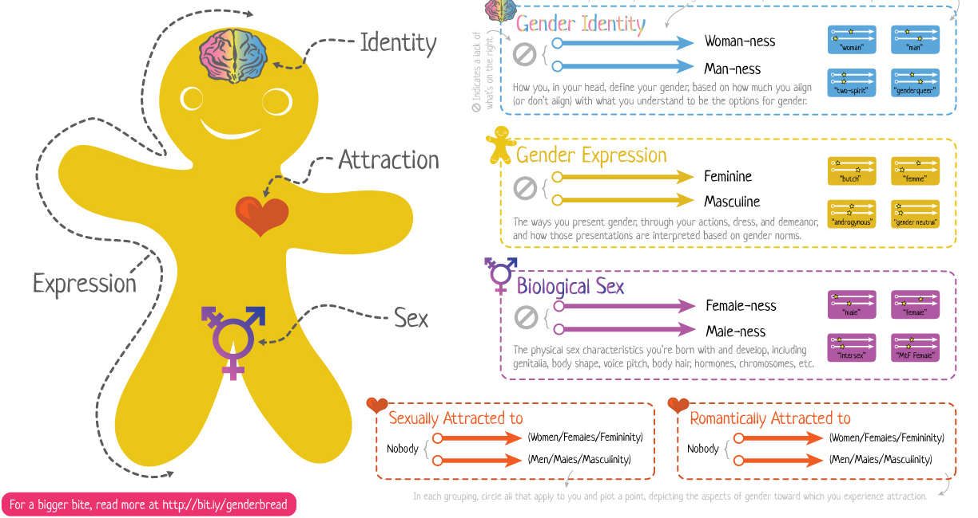
Overview of the Trans* Community
Gender Identity exists on a continuum. Gender Identity is historical, temporal, geographical, contingent and contextual (Stryker, 2008).
Killermann, S. (n.d.). The Genderbread Person v3 | It's Pronounced Metrosexual. Retrieved February 18, 2016, from http://itspronouncedmetrosexual.com/2015/03/the-genderbread-person-v3/
Notes:
It is understood that gender (as well as sexual orientation and biological sex) exist on a continuum.
This graphic (from ItsPronouncedMetrosexual.com) shows that identity is not black and white; rather most people’s gender identity is somewhere in the middle.
There is not set formula to establish a person’s gender identity. This easiest way to determine a person’s gender identity is to simply ask.
Understanding the difference between gender identity, gender expression, and biological sex is the first step to helping trans* students feel safe on our campus.
There are many other activities that professionals can explore to help to understand gender identity.

Slide 5
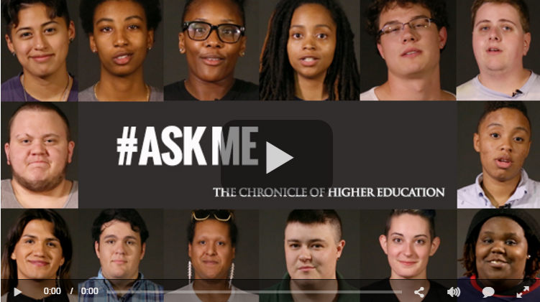
Barriers and Challenges
Notes:
http://chronicle.com/article/Ask-Me-What-LGBTQ-Students/232797

Slide 6
Barriers and Challenges
These are just a few common issues the Trans* students face on campus:
A national survey, conducted by McKinney (2005), showed that trans* students have the following negative experiences in college: minimal faculty and staff education and training on trans* issues, minimal programming about the trans* community, a lack of campus resources for trans* students, poor counseling services, and the inability for healthcare to meet the needs of trans* students.
Sex-segregated living space, locker rooms, and bathrooms.
Sex-segregated language on applications/forms, records, and pronouns.
Lack of healthcare & insurance coverage (i.e. sex reassignment & hormones).
Isolation, rejection, discrimination from others. (Clark, Ellis, Peel, and Riggs, 2010).
Notes:
Trans students face:
minimal faculty and staff education and training on trans* issues,
minimal programming about the trans* community,
a lack of campus resources for trans* students,
poor counseling services
inability for healthcare to meet the needs of trans* students.
Sex-segregated living spaces, locker rooms, and bathrooms that oppose or reject their gender identities
Sex-segregated documents
Lack of health insurance and healthcare
Isolation, prejudice, rejection, and discrimination from others.

Slide 7
Best Practices for Trans* Inclusivity on College Campuses
Required Staff Training Sessions
Preferred Name Policy
LGBT Resource Center
Gender-neutral Housing and Restroom
Pride Living Community
Inclusive Language on Forms
Notes:
Reference: Beemyn, B. G., Domingue, A., Pettitt, J., & Smith, T. (2005). Suggested Steps to Make Campuses More Trans-Inclusive. Journal of Gay & Lesbian Issues in Education, 3(1), 89-94.

Slide 8
Centrist College’s Current Practices
LGBT Resource Center
  Great visibility in the student union; easily accessible
  Safe space trainings for students, faculty, and staff
Preferred name policy
  Affects class rosters, e-mails, and online platform (D2L Brightspace).
  Preferred name on student and staff IDs.
Inclusive language on college forms
Pride Living Community
Notes:
WHAT DO WE DO WELL?
Centrist College has a LGBT Resource Center housed in the student union, that is very visible and easily accessible to any and all students and allies.
The LGBT Resource Center offers and provides safe space trainings for students, faculty and staff throughout the academic year. This helps to build awareness and support for this population of students.
Centrist College implemented the Preferred Name Policy, which allows students the option to choose a preferred name to be put on their academic records and documents.
All college forms exhibit inclusive language related to gender preference and identity. Examples: Gender: Male, Female, Transgender, MTF, FTM, Other.
One of the on-campus living communities is the Pride Living Community, which offers a space for LGBT students and allies to co-habitat residential hall rooms and suites.

Slide 9
Centrist College’s Growth Opportunities
Preferred pronouns on class rosters
All-gender restrooms
Guest speaker(s) to campus
Single room priority
Workshops on transgender issues
Updating non-discrimination policies
Notes:
WHAT CAN WE DO BETTER?
Preferred pronouns would allow students to identify how they would like to be addressed by their professors and other students within their classes (i.e. he/him/his, she/her/hers, or they/them/theirs).
All gender restrooms would allow for more comfortable access within all areas of campus.
Guest speakers would be brought to campus through a partnership between the Residence Hall Association (RHA) Social Justice Committee and the University Programming Board (UPB) to raise awareness and foster understanding of transgender students and their college experience.
The Department of Residential Life in partnerships with the LGBT Resource Center would provide a single room preference and priority option to any and all transgender student to promote a safe and comfortable living environment.
This committee/team would continue to focus on developing workshops to offer university staff and student leaders and staff to raise awareness of issues faced by transgender students in an effort to create a more welcoming atmosphere for these students.
Centrist College would update all non-discrimination policies to include gender identity and expression.

Slide 10
Strategic Action Plan 2016-2020
Support Services
Project: Promoting Advocacy and Creating Support Groups
Campus Partners: LGBT Resource Center, University Program Board, Department of Campus Involvement, Counseling and Psychological Services, Student Health Services, Residence Hall Association, and Student Government.
Action Steps
Training for faculty, staff, administrators, and counselors.
  Increase the number of faculty and staff who complete Safe Space trainings.
  Add a Transgender 101 workshop starting Spring 2017.
Programming efforts to increase awareness
  Bring a Transgender speaker Ryan Sallans – FTM to campus next Freshmen Orientation.
Develop a student support group through the LGBT Resource Center by Fall 2017.

Slide 11
Strategic Action Plan 2016-2020
Administrative
Project: Updating College Forms and Policies.
Campus Partners: LGBT Resource Center, Records and Registration, Information Technology Services, and Student Government.
Completion Goal: Implementation Fall 2017
Action Steps
Inclusive language on forms, records, etc.
  Give students the opportunity to choose “Other” as Gender. There is a difference between “Biological Sex” and “Gender”.
  Preferred pronoun on student and staff IDs.
Updating non-discrimination policies to include gender identity and expression.

Slide 12
Strategic Action Plan 2016-2020
Student Life & Development
Project: Gender-neutral housing, bathrooms, and locker rooms.
Campus Partners: LGBT Resource Center, Department of Residential Life, Finance and Facilities Management Team, Strategic Planning & Steering Committees, and Student Government.
Action Steps
  Add gender-neutral housing, restrooms, and locker rooms to the Campus Comprehensive Facilities Plan.
    Gender-neutral housing within each residence hall
  Gender-neutral locker room in the campus fitness center completed by 2018.
  Gender-neutral restrooms in all academic and other student buildings completed by 2020.

Slide 13
Outcomes, Implications & Considerations
Budget limitations
  for all-gender restrooms
  Events
Enrollment and capacity considerations for a single room priority
  Students falsely identifying
Workshop/program attendance
Campus cultural shift
  Student, faculty, and staff backlash

Slide 14
Outcomes, Implications & Considerations
Retention
  Students who feel connected and supported by our institution will be more likely to stay (Tinto, 1993).
Identity Development
  Bilodeau & Renn (2005) found that identity development is a continual process and our role as student affairs professionals is to support trans students “in ongoing self-work surrounding personal identity.”
Notes:
Into Tinto’s Theory of retention he states that effective retention programs are committed to the development of supportive social and educational communities in which all students are integrated as competent members.
By implementing our action plan trans* students can feel not only safe and secure, but supported and looked after on our campus.
Further, Bilodeau & Renn note that as student affairs professionals we are not only helping students adjust through their student development, but other forms of identity development. Specifically, LGBT students are often more likely to explore and be comfortable with their gender identity. Our role is to create a safe campus environment that promotes identity development, and allows students to live their lives as authentically as possible.

Slide 15
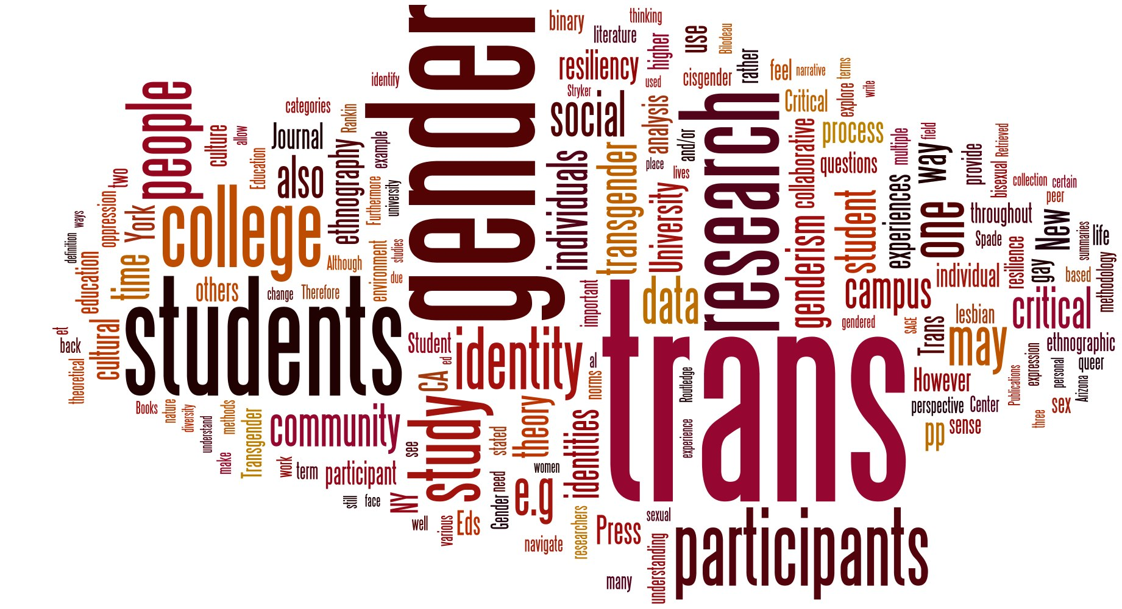
Thank you. Questions?
Centrist College
Lesbian, Gay, Bisexual, and Transgender Center
Atwood Student Union, 112
E: lgbt@centrist.edu
O: (651)604-7112
Notes:
Image source: http://higheredlive.com/wp-content/uploads/2014/11/Trans-Wordl.jpg

Slide 16
References
Beemyn, B. G., Domingue, A., Pettitt, J., & Smith, T. (2005). Suggested Steps to Make Campuses More Trans-Inclusive. Journal of Gay & Lesbian Issues in Education, 3(1), 89-94.
Beemyn, B., Curtis, B., Davis, M., & Tubbs, N. J. (2005). Transgender issues on college campuses. New Directions For Student Services, (111), 49-60.
Bilodeau, B. L., & Renn, K. A. (2005). Analysis of LGBT identity development models and implications for practice.New Directions For Student Services, (111), 25-39.
Clarke, V., Ellis, S.J., Peel, E., & Riggs, D.W. (2010). Lesbian Gay Bisexual Trans & Queer Psychology: An Introduction (pp. 88-90). New York: Cambridge University Press
Killermann, S. (n.d.). The Genderbread Person v3 | It's Pronounced Metrosexual. Retrieved February 18, 2016, from http://itspronouncedmetrosexual.com/2015/03/the-genderbread-person-v3/
Marine, S.B., & Catalano, D.C.J (2015). Engaging trans* students on college and university campuses. In Quaye, S.J., & Harper, S.R. (Eds.), Student engagement in higher education: theoretical perspectives and practical approaches for diverse populations (pp. 135-145). New York: Taylor & Francis.
McKinney, J. (2005). On the margins: a study of the experiences of transgender college students. Journal Of Gay & Lesbian Issues In Education, 3(1), 63-76 14p.
Schneider, W. (2010). Where Do We Belong? Addressing the Needs of Transgender Students in Higher Education. Vermont Connection, 3196.
Stryker, S. (2008). Transgender history. Berkeley, CA : Seal Press : Distributed by Publishers Group West, c2008.
Tinto, V. (1993). Leaving College: Rethinking the Causes and Cures of Student Attrition. (2nd ed.). Chicago: University of Chicago Press.
Transgender FAQ. (2013). Retrieved February 18, 2016, from http://www.glaad.org/transgender/transfaq
Notes:
All

