Slide 1
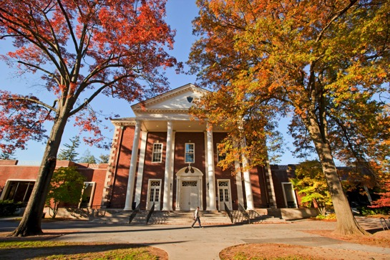
Centrist college professional development series
ACTIVELY Serving our transgender student population
Sam Benson
Amy Gooch
Katie Schmitt
Southern Illinois University Carbondale

Slide 2
Today’s session
Introduction to Transgender Identities
Learning Outcomes and Expectations
Concepts and Terminology
Reflection on Our Current Practices
Resources and Systems We Have
Resources and Systems We Lack
Short Term & Long Term Action Plan
Where Do We Go From Here?
What Can the Institution Do?
What Can Individual Practitioners Do?
Introduction to Transgender Identities
Reflection on Our Current Practices
Short Term & Long Term Action Plan

Slide 3
LEARNING OUTCOMES
Basic understanding of terms and concepts related to transgender identities
Ability to articulate currents trends in higher education regarding transgender students
Ability to articulate things that Centrist College is doing well
Ability to articulate things that Centrist College can work on in the future to better support transgender students
Knowledge of Centrist College’s current action plan
Access to additional resources useful in understanding transgender identities and issues facing transgender students on campus
Current Trends in Higher Education
Terms and Concepts
What Are We Doing Well?
What Can We Work On?
Additional Resources
What is Our Action Plan?

Slide 4
GROUND RULES FOR DISCUSSION
Listen Actively: We will use a variety of resources today including articles, statistics, educational materials, and graphics, so it is important to remain engaged in the content.
Listen with Empathy: The experiences of transgender students we discuss today may or may not match your own experiences. Regardless of your own lived experiences, it is important that you listen with a willingness to learn something new or expand your current knowledge of transgender students’ experiences.
Ask Thoughtful Questions: When constructing questions, ask yourself what information you are seeking to know and whether or not that information will assist you in better serving our transgender population.
Respect Confidentiality: Any experiences shared by attendees during this session should not be shared with those outside of the session. If you feel that sharing a story about someone else would be relevant to the conversation, be sure to eliminate any distinguishing features (department, role on campus, name, age, etc.).
Keep the Discussion Going: This session will be one step of many by Centrist College to advocate for transgender students. Continue to think about ways we can strive to be a more inclusive institution.

Slide 5
TERMINOLOGY
Assigned Sex: The sex a person is legally assigned at birth
Cisgender: A person whose gender identity and biological sex assigned at birth align
FTM and MTF: Abbreviations used by many female-to-male transgender persons (also known as transmen) and male-to-female transgender persons (also known as transwomen)
Gender Non-Conforming: Possessing characteristics or behaviors not aligning with gendered expectations. This could include an individual with a mix characteristics or behaviors that are traditionally labeled as both masculine and feminine
Gender Pronouns: The pronouns one wants to be referred to by. For example, she/her/hers, he/him/is, their/theirs, ze/zir/zirs, ze/hir/hirs
LGBTIQQAA: Acronym standing for Lesbian, Gay, Bisexual, Transgender, Intersex, Queer, Questioning, Asexual & Ally
Preferred Name: The name that a transgender person identifies with and wants others to use when referring to them. This may or may not be their legal name
Transgender: (1) An umbrella term covering a range of identities that transgress socially defined gender norms (2) A person who lives as a member of a gender other than that expected based on sex assigned at birth
Transition: The process that a transgender person might go through in order to live as the gender they identify as. This may include changing one’s physical appearance using clothing or medical procedures, hormone replacement therapy, or adjusting legal documents to represent one’s preferred name and gender. It is important to note that being transgender does not necessitate any formal transition
Transphobia: The fear of, discrimination against, or hatred of transgender people, the transgender community, or gender ambiguity

Slide 6
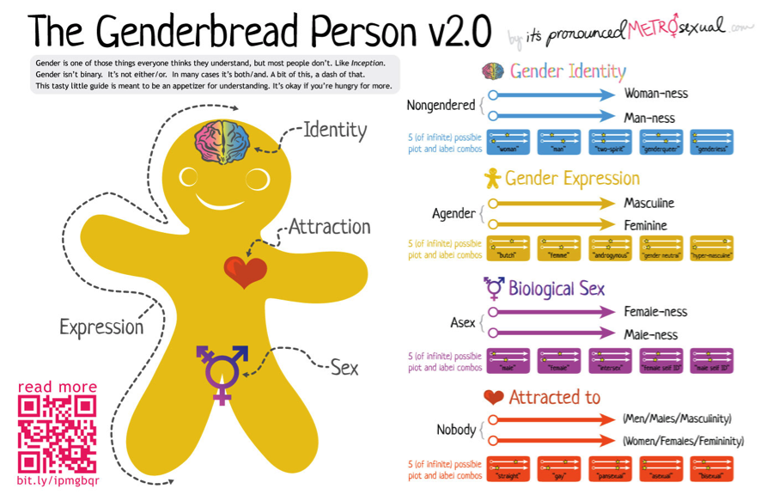
UNDERSTANDING SEX AND GENDER
Gender is a mix of various factors including:
Gender Identity: Someone’s perception of their own gender
Gender Expression: External display of one’s gender through means such as physical appearance or behavior
Biological Sex: A medical term for chromosomes and hormonal and anatomical characteristics used to classify sex at birth
Attraction: Whom one is romantically or sexuality attracted to
Transgender students have a gender identity that differs from the sex they were assigned at birth
Because of this, some of our institutional practices and procedures may not be inclusive of transgender students
Being transgender is not a choice or a medical condition but rather an identity that many of our students share

Slide 7
ASSESSING OUR RESOURCES FOR TRANSGENDER STUDENTS
In order to assess the resources we already have and identify those we are lacking, we have used the following resources:
The Campus Pride Index
“Best Practices for Serving Transgender Students and Gender Non-Conforming Students in Schools” compiled by the Massachusetts Transgender Political Coalition Policy Committee
Stories from other institutions around the country
Journal articles addressing the needs of transgender students in higher education

Slide 8
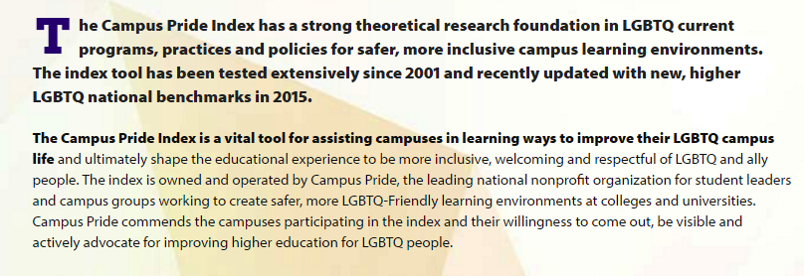
THE CAMPUS PRIDE INDEX
Campus Pride Index
Database containing information on an institution’s inclusion of LGBTQ students
Institutions receive a report card that contains basic information (student population, tuition, location, etc.) and an assessment based on 7 categories:
LGBTQ Policy Inclusion
LGBTQ Support and Institutional Commitment
LGBTQ Academic Life
LGBTQ Student Life
LGBTQ Campus Safety
Excellent resource for gaining an outside perspective on inclusion of students of varying genders and sexualities

Slide 9
CENTRIST COLLEGE’S CAMPUS INDEX REPORT CARD
What We Currently Have
What We Currently Lack
Non-discrimination statement inclusive of gender identity/expression
Ally programs or Safe Space/Safe Zone trainings
Resource center/office with responsibilities for LGBTQ students
LGBTQ studies program
Procedure for reporting LGBTQ related bias incidents and hate crimes
Trans-inclusive trained counseling staff
LGBTQ student scholarships
Accessible, simple process for students to change their name on university records and documents
Accessible, simple process for students to change their gender identity on university records and documents
Students have options to self-identify gender identity/expression on admission application or post-enrollment forms
New faculty/staff training opportunities on gender issues
Regularly plans educational events on transgender issues
Trains campus police on gender identity/expression issues
Annually participates in LGBTQ admission fairs

Slide 10
Best practices for serving transgender and gender non-conforming students in schools
This 2012 report outlines numerous things that institutions can do to be more inclusive of transgender and gender non-conforming students. These suggestions include:
Names and Pronouns: Transgender students should be referred to by their preferred names and should not have to obtain any outside permission to change their name on university documents. Refusal to accept a student’s name or pronouns should not be tolerated. Opportunities for students to express their pronouns should be provided. The name a student uses should be on their records and diploma.
Restroom Accessibility: Transgender students should have access to restrooms consistent with their gender identity. Single stall bathrooms should be widely available on campus.
Bullying and Harassment: Policies should exist that address the use of physical, verbal, or written harassment that targets an individual based on gender identity.
Training: Training should be available for university faculty and staff focused on the rights of transgender students and additional resources for learning about transgender identities.

Slide 11
CENTRIST COLLEGE’S ACTION PLAN
Starting right now
Student focus groups
Starting conversations within functional areas
Completed by May 2017
Trainings for Campus Police, Student Health Center employees, faculty, and residence life staff
LGBTIQQAA Resource Center funding
Completed by May 2018
LGBTIQAA Resource Center funded and relocated
Housing policies updated to be more inclusive
Student Rec Center has new inclusive spaces
Attendance at LGBTIQQAA Admissions Fairs
Completed by May 2019
Ability for students to change official records
New Greek life presence and policies
Completed by May 2020
Student health insurance updated for more inclusive services
Completed by May 2021
Have reached a 4 star or 5 star rating on Campus Pride Index

Slide 12
CENTRIST COLLEGE’S ACTION PLAN - Timeline
Beginning Immediately
Organize student focus groups
Collaborate with Centrist College’s LGBTIQQAA Resource Center to invite transgender students to closed focus groups
Propose and elicit feedback about current five year action plan
Welcome new student-driven ideas for further development
Begin initial conversations with functional areas on campus regarding specific changes to their departments
Create framework for committee focused on implementing action plan consisting of at least one self-appointed representative from each functional area

Slide 13
CENTRIST COLLEGE’S ACTION PLAN - timeline
Completed by May 2017
Trainings
Work with campus police to coordinate transgender inclusive bias incident training
Coordinate training for Student Health Center employees focused on addressing the specific needs of transgender students
Revise training for residence hall staff for gender inclusivity and hate and bias response
Faculty/staff Safe Zone mandatory 1 year within 1st year on payroll
LBGTIQQAA Resource Center
Provide additional funding for LGBTIQQAA Resource Center
Determine a more adequate location for center
Current center is located in the basement of the Student Center and most spaces have large windows, which hinders students’ privacy
New location should be accessible to students but have additional private spaces within the center

Slide 14
CENTRIST COLLEGE’S ACTION PLAN - Timeline
Completed May 2018
Resource Center is in new location and fully staffed
Housing
Gender Inclusive policies have taken effect in all University Housing spaces
The LGBTIQQAA Living Learning Community has grown to an entire floor and there are one faculty and one professional staff member that are invested in the support of this community
University Housing has created a webpage outlining the accommodations and support available for trans students
Student Rec Center
Gender Inclusive restrooms and locker rooms have been designated
Admission Fairs
Centrist College has participated in several LGBTIQQAA Admission Fairs nationwide to recruit students as well as share ideas with other like-minded institutions

Slide 15
CENTRIST COLLEGE’S ACTION PLAN - Timeline
Completed May 2019
Official Records
Process for student name and gender identity changes on university records has been streamlined to require only one online form that syncs with all other university software and databases
Students now have the option to self-identify their gender identity/expression on admission applications or post-enrollment forms
Greek Life
Gamma Rho Lambda, a gender and sexual orientation inclusive sorority, has chartered a colony on campus
Other Greek organizations have been charged by the Office of Greek Life to make their recruitment processes more inclusive of gender and sexual orientation

Slide 16
CENTRIST COLLEGE’S ACTION PLAN - Timeline
Completed May 2020
Student Health Insurance
Policies have been updated to include transgender student health services, such as hormone replacement therapy
Completed May 2021
Centrist College has reached a 4 star or 5 star rating by the Campus Pride Rating
After May 2021…
Centrist College will continue their commitment to inclusivity by regularly facilitating focus groups and opportunities for student, staff, and faculty feedback
Student affairs professionals will stay up to date on current research, trends, and changing transgender student needs

Slide 17
SMALL CHANGES WITH BIG IMPACT
While many of the changes proposed in our plan involve large steps toward becoming more inclusive, there are plenty of things that can be done on an individual or department-wide basis to better support transgender students:
Eliminate unnecessary gendered language from pamphlets, newsletters, and forms
Work on eliminating gendered language from your own vocabulary. Take a day and tally how many times you assume someone’s gender, by addressing them as “sir” or “ma'am” or addressing a group as “men and women”
Participate in Centrist College’s Safe Zone trainings, held throughout the academic year
Take time to personally learn more about transgender identities
Address transphobic jokes or comments with peers and students
Follow transgender activists and activist groups on social media platforms

Slide 18
RESOURCES
http://itspronouncedmetrosexual.com
http://www.transequality.org
http://www.transstudent.org
http://www.glaad.org/transgender
http://www.transequality.org/sites/default/files/docs/resources/NTDS_Report.pdf
https://www.campuspride.org/about/staff-directory/
http://www.masstpc.org/wp-content/uploads/2013/02/MTPC-2013-K-12-Best-Practices.pdf

