Slide 1
Rising Beyond Neutrality to Inclusivity at
Centrist College
Amber Danku, Jillian Webber, Mia-Kay Fuller (Team Leader), & Rob Zarrella Salem State University
Notes:
Introduce Presentation and presenters

Slide 2
Questions this
Professional Development Series Addresses:
What do you know about “Transgender”?
Gender: A binary or is it?
How does gender expression and identity impact students here?
Who are Trans students and what do they want us to know?
What Student Development Theories should we brush up on?
What does Centrist College do well?
What can Centrist College do better?
How can we commit ourselves to actively changing our campus to be more inclusive to the Trans community?
Notes:
We are hoping to gain some clarity through this presentation as well as understand where Centrist is at currently, where we can do better, and go through an example Action Plan to be implemented over the next three years.
The goal is to create a more welcoming environment for students at Centrist College, and Dr. Fogg would like that to start with this professional development series!
Questions this Professional Development Series Addresses:
What do you know about “Transgender”?
Gender: A binary or is it?
How does gender expression and identity impact students here?
Who are Trans students and what do they want us to know?
What Student Development Theories should we brush up on?
What does Centrist College do well?
What can Centrist College do better?
How can we commit ourselves to actively changing our campus to be more inclusive to the Trans community?
It may seem overwhelming at first but we have some guiding learning outcomes to center and guide everyone during the presentation.

Slide 3
Learning Outcomes:
As a result of this professional development series, senior staff
will be able to:
Know the definitions of binary, gender, and transgender
List (3) ways that Centrist College can change now to be more inclusive of transgender students
Create a list of (5) goals that senior staff would ideally like Centrist College to meet before 2019
Understand the (3) ways the Commitment Statement can be used
Notes:
Review Learning Outcomes and ask if anyone has any questions that will not be explained during the following presentation

Slide 4
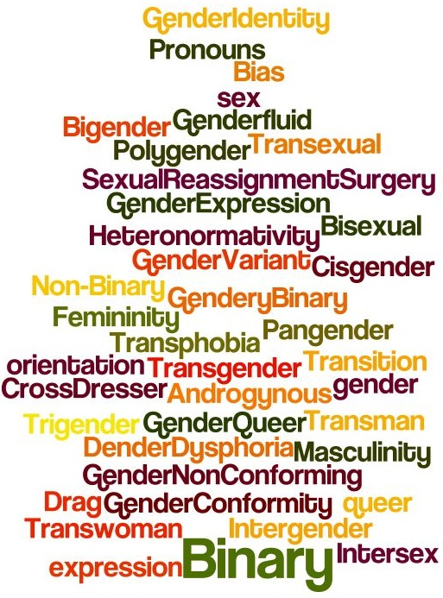
Quiz Time
Can you match a words from the word bank with the
following definitions?
Describes someone who is comfortable with the gender identity & gender expression assigned to them based on their physical sex
Either the male or the female division of species differentiated by social and cultural roles and behavior
Something that is made of two pieces or parts
A person’s sense of being masculine, feminine or other gendered
A person who lives as a member of a gender other than that expected of them based on anatomical sex
The irrational fear of those who are gender variant and/or the inability to deal with a gender ambiguity
Notes:
Quiz Answers:
Cisgender (term for those who are heterosexual & gender-conforming)
Gender (notice social and cultural roles and behavior)
Binary (Important when discussing those who do not fall within the binary of Male & Female identities)
Gender Identity (Starts conversation of gender as a spectrum, no one is totally masculine and no one is totally feminine)
Transgender (It’s why we’re here, we must know what the term means in order to educate ourselves and impact the campus community)
Transphobia (A barrier preventing change, let’s address it. Note *Irrational fear*-- Why does it bother us? Understand potential biases to work against it & bring about change)
Things to consider individually:
Q. How many did you all get right?
Q. Any terms on the board you don’t understand?
Q. What can we do, together, to bring about an inclusive environment for all our students?

Slide 5
Gender: A Binary or is it?
Gender Binary Rules of Thumb:
Must identify as either “Male” or Female”
Only two gender options
Societal Institutions reinforce this binary (e.g. education, government, consumerism)
Non-Gender Binary Rules of Thumb:
Can identify within the gender spectrum
Multiple gender options
Supported through policies and deconstruction of gendered institutions (e.g., gender inclusive restrooms, gender inclusive housing, gender neutral language)
The Gender Spectrum
*Not just “Male” or “Female”
(image from csrspreadscience.files.wordpress.com/2015/03/gender.jpg)
Notes:
Gender: A Binary or is it?
Just learned that binary is limited to two parts and that gender is a division between male and female defined by social and cultural roles and behavior.
Important to reflect that the gender binary has some “rules of thumb” to it or common attributes.
A Gender binary only gives two options and those are predefined and reinforced by society.
A non-gender binary (or spectrum) has “rules of thumb” to it too.
Being non-gender (or outside of the) binary gives a myriad of gender options, allows the person to self identify, and can be supported through policies and the deconstruction of gendered institution
The graphic shows the spectrum of identity that one can be placed on .
Note it does not have to be only one of two options

Slide 6
Do you know someone who identifies outside of the gender binary?
Do you know someone who is trans*?
How does this impact the students at Centrist?
Click on image to go to Prezi
(Clifford, 2015)
Notes:
Trans* with an asterisk is often used as an umbrella term for folks who are a part of the transgender community, but may not identify specifically within the community (e.g., may identify as gender neutral, non-gender binary, intersex, etc).
While a brief overview of the gender binary was introduced, going through the attached presentation will allow for some deeper exploration of gender identity and expression for those who are exploring this topic for the first time.
We will also take the time to review some questions with you to see where you are at in this process.
This process is a journey and not a destination, so please be mindful that everyone is going to be in a different place in their own journey. This is a no judgement zone.
Questions:
Do you know someone who identifies outside of the gender binary?
Do you know someone who is trans*?
How does this impact the students at Centrist?
It is important that we make connections throughout the presentation to our students here as they are the ones that are going to need our support during their journey at our institution. If you make any connections that you would like to share, please feel free to at any point during the presentation.

Slide 7
Who are trans* students?
Transgender students may be of any age, ethnicity, race, class, or sexual orientation.
Some enter higher education open about being transgender, while others come out during college or graduate school.
Still others may never use the term transgender, but will strongly identify themselves as male, female, transsexual, or another (or no) gender.
Some students may choose to transition; that is, to live as a gender different from the one assigned to them at birth.
(Beemyn et al., 2005, p. 50)
Notes:
Before we dive into helping trans students at our institution, we must review who trans* students are.
Here are some basic guidelines:
Transgender students may be of any age, ethnicity, race, class, or sexual orientation
Some enter higher education open about being transgender, while others come out during college or graduate school
Still others may never use the term transgender, but will strongly identify themselves as male, female, transsxual or another (or no) gender
Some students may choose to transition; that is, to live as a gender different from the one assigned to them at birth
What is something you folks notice about this?
Trans* students can be anyone!
It is important to never make assumptions of our students because they are all in different places in their identity development!
Does anyone have any questions before we move forward?

Slide 8
Where are our students at?
In 2014, “the U.S. Education Department issued guidance that made clear that transgender students are protected from discrimination by the federal civil-rights law Title IX” regardless of discrimination policies at institutions (Gardner, 2015)
this includes housing!
As there are no documentation measures in place, we cannot support our trans students properly (e.g., housing, counseling, medical care)
Lack of gender inclusive restrooms so students are forced to choose an identity
Lack of gender inclusive athletic facilities for trans* athletes
Registration and personal-data collection systems do not typically use gender inclusive language (chosen names and pronouns included)
No System for Inclusion in place
Gender identity is not included in nondiscrimination or inclusion policies at institutions
Gender inclusive housing is either non existent or inclusive to certain extents (e.g., apartments gender inclusive but rooms still assigned by biological sex)
Facing constant misgendering through societal assumptions
Feeling a general lack of awareness of their lives from faculty, staff, and admin
(The Chronicle of Higher Education, 2015)
Notes:
So, where are our trans* students at?
We put “our” here because, although we do not yet have the numbers to document how many trans* students, they exist at our institution and we need to have a starting point to understand where we are at.
What is the most recent update to trans* inclusion is that, as of 2014, our transgender students are protected from discrimination by Title IX. I am sure you all have already been to Title IX training, but it is always good to be aware of this, especially when it comes to the housing we provide our students.
With no documentation measures for our students, we are unable to support our students accurately as we do not know what services to provide.
Trans* students often find that spaces are not created for them to exist in. For example, these students have to chose an identity that they might not feel comfortable with in order to feel comfortable using a public restroom, as there are limited gender inclusive options. This includes the lack of gender inclusive athletic facilities for our trans* athletes.
When students are registered at our institution or when we collect personal data regarding them, we do not have gender inclusive language on our forms so students are yet again forced to choose an identity that may not be salient for them.
There is no System of Inclusion put in place for our students currently. That is what we hope to change starting here today. Our Action Plan will aid us in actively thinking about trans* students in every facet of our institution, with the hope to create a System of Inclusion at Centrist College.
Gender identity is not included in our nondiscrimination or inclusion policies and gender inclusive housing is nonexistent. On top of that, these students face constant misgendering at our institution and throughout their lives due to assumptions.
Because of all of this, trans* students feel a general lack of awareness of their lives from faculty, staff, and administration. You are the first step in changing this.

Slide 9
What LGBTQIA+ Students Want Their Professors to Know
Click on image to go to video
(Schmalz, 2015)
Notes:
Chronicle did a special on What LGBTQIA+ Students Want Their Professors to Know that we wanted to share with you so you may receive an insight from the students themselves.
After video, ask staff if they have any questions or if they need any information reviewed. Has anyone made connections to our students at Centrist and what we’ve talked about thus far?

Slide 10
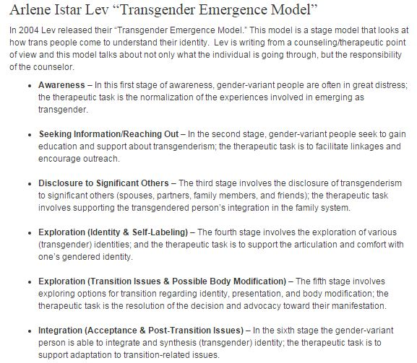
Student Development Theory to know:
Gender + Gender Identity Development:
Gender Binary Construct
Male or Female
Bem’s Sex-Role Inventory
Masculinity, Femininity, Androgyny
Transgender Identity Development
Arlene Istar Lev’s, “Transgender Emergence Model” (to the left)
(Safe Zone, n.d.)
Notes:
Some theory to know includes the “Gender Binary Construct” mentioned previously in this presentation. It’s the belief that gender is either male or female, where in reality no one is complete feminine and no one is completely masculine. Gender lies on a spectrum.
Bem’s Sex-Role Inventory (http://garote.bdmonkeys.net/bsri.html) is an online resource/quiz that asks individuals a series of questions to show them how Masculine, Feminine and Androgynous they are based on their quiz answers. It’s not a hard and true test of your identity, but it draws home the point that no one is completely whatever “gender” they identify, instead it’s all a spectrum.
Transgender Emergency Model-- Laid out above is the entire student development model. It ranges from an individual becoming aware that they do not fall within the gender binary set up by society, to complete acceptance through integration into society.

Slide 11
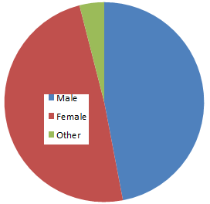
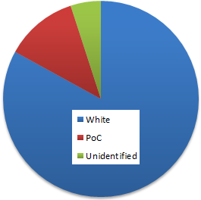
Centrist College- background & pop.
47% male
49% female
4% Unidentified
Mid-size institution (8-9k)
Demographics:
No demographics about
non-binary students or
sexual orientation
LGBTQ+ resources limited to what state mandates
Basic safezone training
“Multicultural Center”
83% white
12% PoC
5% Unidentified
Notes:
The team came together and broke down what we saw Centrist College being demographically. The graphs are important because it shows that on the gender binary, 4% of respondents responded “other” which shows the possibility of there being a high trans*/LGBTQ+ population that may or may not be having their needs met at the Institution.

Slide 12
What is Centrist doing well?
Serving Trans students on campus who are *openly* identified
Knowing where these students can go on campus to receive counseling when needed
Incorporating some educational training to staff on the Trans* community, usually within LGBTQA+ programming
Tolerance
Offering initial and ongoing support for the Trans* community with the Diversity Office and Health Services
We have the basics down, but more is needed to continue our journey of becoming a more inclusive institution.
Notes:
Before we can make changes, we must first recognize where we are in the present state.
Serving Trans students on campus who are *openly* identified
Knowing where these students can go on campus to receive counseling when needed
Incorporating some educational training to staff on the Trans* community, usually within LGBTQA+ programming
Tolerance
Offering initial and ongoing support for the Trans* community with the Diversity Office and Health Services
Is there anything else that you can think of that we currently do and do well?

Slide 13
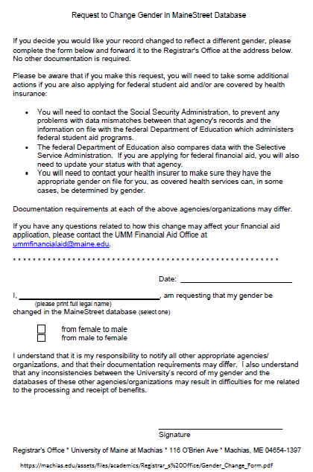
Changes we can make now
Example of an Institution’s “Change of Gender form”
Preferred name policy
Change of Name forms
Will impact all students, not just transgender students.
Change of Gender form availability (e.g. left)
Gender neutral bathrooms (designated by signs)
Inclusive housing options
(Request to Change Gender in MainStreet Database. n.d.)
https://upload.wikimedia.org/wikipedia/commons/c/c3/Whitehead-link-alternative-sexuality-symbol.svg
Notes:
Here are a list of simple changes that could be made at Centrist in order to start the process of becoming a more inclusive institution.
Something big that impacts all students on campus, not just the Trans* population is the preferred name policy. Many professors already ask students at the beginning of the year what name they prefer to go by, why streamline the process and already have a process in place so that students will be addressed by their preferred name right out of the gate.
Change of Gender Form-- More complicated, but it helps facilitate the changes individuals on campus already want to make. This process gets the proverbial ball rolling for individuals who want to make this change. If using the example above, the bullet points outline the steps individuals need to take in order to actually change their registered gender at any institution. This includes contacting the Social Security Administration, the Department of Education and your healthcare provider. It’s a long process, but we should be doing our part in helping these individuals find their paths.
Gender neutral bathrooms can be as simple as changing signs to be more welcoming and inclusive to anyone who identifies as any gender. This might be a tricky transition that requires the limited availability of neutral bathrooms, but it’s the beginning stages of a longer and more important process.
Another change we can make now, or at least start the processes is including gender neutral housing options for individuals who identify as non-binary. If we are unable to implement the changes right away, we can at least open the floor for consideration.

Slide 14
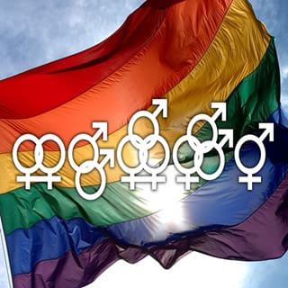
Long term changes to becoming more inclusive
Medical needs covered under institutional insurance (hormones, surgery)
Inclusive athletics policies (no gender based discrimination)
Inclusive admission policies (language used/vocab terms, definitions)
Creation & implementation of an LGBTQ resource center
(Admission of Transgender Students, 2014)
Notes:
Long term changes will still include the “short term changes” from the previous slide, but this list contains items that will likely take longer to implement seemingly more in-depth and require more planning and conversation.
Insurance coverage for hormones and surgery-- many schools are making this switch, it will go a long way in helping Trans* students getting the resources they need to become who they are inside/how they identify
Inclusive athletics policies--Work to pen a mission statement or policy that shows that individuals who want to participate in athletics or intramurals will not be discriminated due to their gender
Inclusive admission policies-- Here we need to be more mindful of the language used, vocab terms and our updated definitions of terms impacting the population. Example above is from Mount Holyoke College in Western Massachusetts-- How they’ve embraced the population and provided inclusion within their admissions policies
LGBTQ+ Resource Center/office-- The creation of an office or space for individuals to go to for help that doesn’t bring them to the multicultural office, or the health services.

Slide 15
Action Plan- 3 year “Strategic Plan” outlining changes to be more inclusive with Transgender folks
From 2016 to 2019, Centrist College will see a more inclusive campus between both academic and student life on campus. We will do this through a series of attainable and realistic goals.
Please work together and brainstorm a list of goals you’d (individually, office-wide, institutionally) like to meet by 2019
Adapted from Emory University’s Strategic Plan
Notes:
Now that we’ve outlined where we are and what we can improve on, let’s make a 3 year strategic plan that outlines changes to be more inclusive with Transgender folks.
We should follow a 3-year plan that is modeled for improving our inclusiveness and constantly assessing the effectiveness of that. In this plan, we should only list goals that we feel are realistic and may be accomplished.
During this time, the audience should work together and brainstorm a list of manageable goals that can be met by 2019.
Adapted from Emory University’s Strategic Plan - Emory University. (2012). Office of lesbian, gay, bisexual, and transgender life strategic plan. Retrieved February 25, 2016, from
http://www.lgbt.emory.edu/docs/strategic_plan.pdf

Slide 16
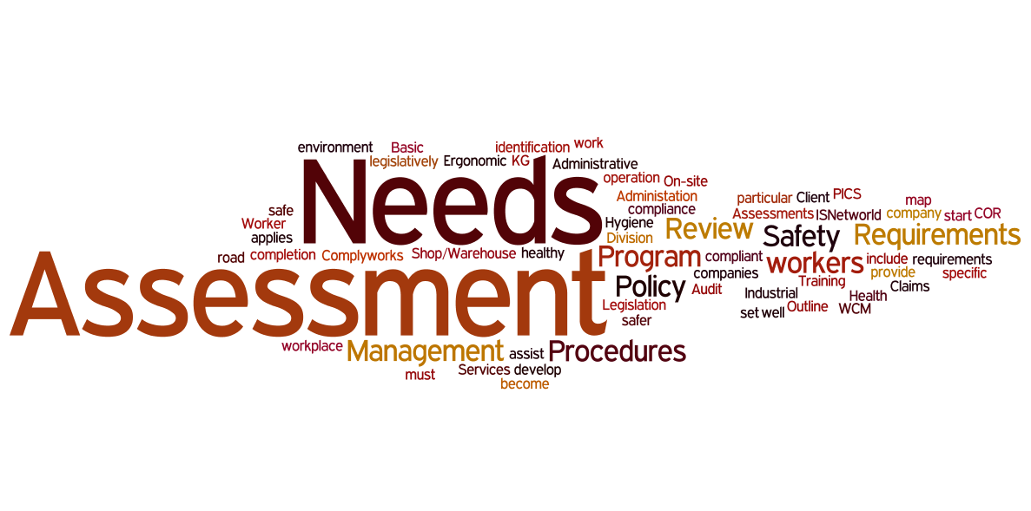
Action Plan: Year 1- Information Collection
Develop institutional needs-assessments and focus groups in order to gather a pulse on the current campus climate of the Trans* community. These will allow Centrist College to better understand the size of the Trans* community and their needs.
Adapted from Emory University’s Strategic Plan
Notes:
In the 1st year of the action plan, mostly student-related information will be collected. Needs-assessments and focus groups must be conducted in order to get a sense of the size of the Trans* community and what can be improved upon. Does the college need to provide more academic resources for Trans* folks? This is the year that assesses where the college is truly at and provides a solid basis of information that can be used to make informed decisions.

Slide 17
Action Plan: Year 2 - Implementation Upon Evidence
After a year of collecting valuable information on the Trans* community and its needs, Centrist College will use that information to establish new programs/services and further develop existing programs/services.
For example, there is a Trans* community at Centrist College. With the information that we gathered, creating an LGBT center in order to serve student needs and support students will be vital.
Adapted from Emory University’s Strategic Plan
Notes:
In the 2nd year, after collecting information, Centrist college will be able to make informed decisions that will impact Trans* folks in a positive way. Since Centrist College doesn’t have a LGBT center, and after collecting information the students suggested there is a need for one, we should establish one. By creating an LGBT center, we will be more supportive of Trans* folks and further educate our campus community.

Slide 18
Action Plan: Year 3 - Assessment of Implementation
In order to ensure that the programs and services that we’ve implemented are effective and frequented, we must conduct another assessment.
A great question to ask in our assessment is: “Are we meeting the needs of the Trans* community?”
If our programs and/or services could be changed to better suit the needs of the Trans* community, we must be receptive and adaptive to those changes
Adapted from Emory University’s Strategic Plan
Notes:
In the final year of our 3-year action plan, we will be evaluating our programs in order to see if they have been effective. We want to know if the programs that we put in place have been fully serving students in a positive way. By polling students and holding focus groups, we will be able to determine if we are meeting the needs of the Trans* community.

Slide 19
Statement of Commitment to the Centrist College Trans* Community
We have drafted a statement, which we believe all administrators and staff should commit to in order to benefit the Trans* community on campus, and create accountability.
“As leaders in higher education at Centrist College, we have the responsibility to commit ourselves to better serving the population of Trans* persons within our community through improving our offices, services, resources and campus environments. This includes first educating ourselves and others in recognizing the unique and current issues that persons who identify as Trans* may face, and a knowledge on intersectionality. We will ensure Trans* voices are heard and visible on Centrist’s campus through intentional programming and respectful dialogue. Our responsibility includes speaking out and acting with a zero tolerance policy against prejudice, harassment, and violence. Through this commitment, we hope to make our campus a welcoming space for everyone, which allows our community to thrive and foster a sense of pride in individuality, equality, trust, and acceptance for Trans* identifying students, faculty, and staff .”
(Mission, vision, and values, n.d., Mission, Vision & Values, n.d., Mission Statement - Gay, Lesbian, Bisexual, Transgender, Queer, Questioning, and Ally Resource Center, n.d.)
Notes:
See the Statement of Commitment to the Centrist College Trans* Community that has been drafted.

Slide 20
How to use this commitment statement:
Introduce this statement to those within your department and your supervisees by placing it on your door, hanging it in your office, or placing it in a prominent place that makes sense for you and your department.
Incorporate this statement as a starting point for employee training, professional development, and conversations on inclusion.
Use or revise the following sample wording for introduction emails or in-person meetings or trainings:
“We are models of the commitment to our trans* students’ development and experience at Centrist College. We are also modeling a commitment to the values and basic standards determined by the Council for the Advancement of Standards within the profession of higher education regarding promoting commonalities and differences, respecting sexual orientation, gender identity, and expression, and fostering a welcoming and inclusive environment. This statement of our commitment is important to the entire campus community that we serve.”
From here, another suggestion would be to give each employee a physical copy of the statement for their own use, and sign it using their preferred name and pronouns. This is just the starting point.
(CAS Standards, 2014)

Slide 21
Future of Centrist College -- What 2019 might look like
Goals by 2019 including:
Increased awareness of needs of Trans* community
Throught the implementation of LGBTQ+ Resource Center
Student, Faculty and Staff acceptance of Trans* community
A more welcomed and comfortable Trans* student body
Welcoming Admissions & Athletics policies
Gender Neutral housing & bathrooms
Greater retention and graduation rates
Generally more diverse campus community
Notes:
General goals we at Centrist should aim to get to by 2019, along with our goals we brainstormed above.

Slide 22
Question? Concerns? Qualms? Queries? Inquisitions?
Ask now, or come find us later!

Slide 23
References
Admission of Transgender Students. (2014). Retrieved February 22, 2016, from
https://www.mtholyoke.edu/policies/admission-transgender-students
Beemyn, B., Curtis, B., Davis, M., & Tubbs, N. J. (2005). Transgender issues on college campuses. New Directions for Student Services, 2005(111), 49-60. Retrieved from http://vp.studentlife.uiowa.edu/assets/Transgender-Issues-on-College-Campuses.pdf
Clifford, A. (2015). Gender Identity & Expression Map [Prezi Presentation]. Retrieved from https://prezi.com/yvqu4hrcexig/gender-identity-expression-map/.
Emory University. (2012). Office of lesbian, gay, bisexual, and transgender life strategic plan. Retrieved February 25, 2016, from
http://www.lgbt.emory.edu/docs/strategic_plan.pdf
Gardner, L. (2015, October 18). Dilemmas from day 1. Retrieved February 25, 2016, from
http://chronicle.com/article/Dilemmas-From-Day-1/233760?cid=cp11
Mission Statement - Gay, Lesbian, Bisexual, Transgender, Queer, Questioning, and Ally Resource Center. (n.d.). Retrieved February 15, 2016, from
http://www.glbtrc.colostate.edu/mission-statement
Mission, Vision & Values (n.d.). Retrieved February 15, 2016, from https://www.campuspride.org/about/mission/
Mission, vision, and values. (n.d.). Retrieved February 15th, 2016, from http://transgenderlawcenter.org/about/mission
Park, P. (2013, April).Transgendering the Academy: Ensuring Transgender Inclusion in Higher Education. Symposium conducted at the Spring Colloquium Of the Institute for Research on Women’s Trans Politics: Scholarship and Strategies for Social Change, Rutgers University, New Brunswick, NJ.
Request to Change Gender in MainStreet Database. (n.d.). Retrieved February 22, 2016, from
https://machias.edu/assets/files/academics/Registrar_s Office/Gender_Change_Form.pdf
Standards. (n.d.). Retrieved February 15, 2016, from http://www.cas.edu/index.php/standards/
Safe Zone. (n.d.). Retrieved February 22, 2016, from https://safezone.uncc.edu/allies/theories#Arlene_Istar_Lev
Schmalz, J. (2015, September 03). 'Ask me': What LGBTQ students want their professors to know. Retrieved February 25, 2016,
from http://chronicle.com/article/Ask-Me-What-LGBTQ-Students/232797

