Slide 1
Transgender Basics and Creating a Trans-Inclusive Campus Training Session
Grand Valley State University
Jakia Fuller (Team Captain), Tiffany Steele, Care McLean, & Scott Burden

Slide 2
Objectives
Provide a deeper understanding of what it means to be Transgender
Introduce recent literature that is relevant to the experience of Transgender students
Understand where our institution stands and how we can improve in supporting Transgender students
Provide the beginning tools needed to create better intersectional allies
Notes:
Our objectives for you today are to provide you with a deeper understanding of Transgender students, issues they face, recent and relevant literature that can inform our practices, understand what our university is currently doing to be inclusive of Transgender students and what we can do better in order to be more inclusive and increase allyship for our Transgender student population.

Slide 3
Agenda
Terminology
Gender Unicorn
Video
Trans Issues Today
Supporting/Confronting Oppression
What We Are Doing Well
Areas of Improvement
University Action Plan
Tips for Allies
Notes:
Our agenda for this presentation includes exploring current terminology to help be more sensitive of our language usage, a fun and visual way of understanding gender, a quick video, exploring issues of trans students today, how to support and confront oppressive behavior, explore hat our university is doing well, identify where we can improve, tips for becoming an ally and action plan for the university moving towards the future.

Slide 4
Terminology
LESBIAN
GAY
BISEXUAL
TRANSGENDER
QUEER
INTERSEX
ASEXUAL
LGBTQIA
Notes:
Here are the terms represented under the LGBTQIA umbrella.

Slide 5
Terminology
Transgender- An umbrella term for anyone who does not identify as cisgender
Cisgender- An individual who identifies with the gender that they were assigned at birth
Other Important Terms
Gender- Refers to social and cultural behaviors and characteristics, typically associated with sex- roles, identity, perception, and expression
Gendering- The act of assigning a gender to other people based on personal perception
Misgendering- Referring to someone as the wrong gender, using the wrong pronouns, or insisting on an old name
Notes:
Here are important terms we want you all to know in order to create a frame of reference for our training session.

Slide 6
Notes:
For our visual learners, here is a fun, creative and simplistic way of exploring what it means to create a gender identity, express gender, the difference between sex and gender, sexual orientation and romantic interest.

Slide 7
Trans Issues Today
Notes:
Now we will dive into current theory and facts around transgender students and the issues they face.

Slide 8
Trans Student Research
Collegiate institutions offer little to no services to their transgender populations which causes feelings of marginalization and contempt from their peers and other staff.
Safer spaces like gender neutral housing and bathrooms would make students feel more safe.
- McKinney, J. F. (2005)
Students that identified as non-heterosexual in any capacity were found to have suicidal ideations at a rate of 2.5 times more than their heterosexual counterparts.
- Kisch, J., Leino, V. E., & Silverman, M. M. (2005)
Transgender students reported more frequent encounters with harassment and discrimination as well as a significantly lower sense of belonging within the campus community. In addition, transgender students reported lower rates of self-confidence/self-efficacy.
- Dugan, J. P., Kusel, M. L., & Simounet, D. M. (2012)
Transgender students were shown to have higher rates of psychological distress in comparison to their cisgender counterparts and also higher rates of suicidal ideations.
- Effrig, J. C., Bieschke, K. J., & Locke, B. D. (2011)
Notes:
Here are some of the leading facts and information we currently know about transgender students on college campus in the U.S.

Slide 9
Minority Stress Theory
The lived experiences of Transgender college students can be examined through a theoretical framework of Minority Stress:
Minority Stress can be defined as the excess stress to which individuals from a stigmatized social categorized are exposed as a result of their social, often a minority, position (Meyers, 2003, p. 675).
Minority Stress is categorized as: unique, chronic and socially based (Meyers, 2003).
The Transgender college student population is at a higher risk of experiencing distal stressors such as violence and discrimination and proximal stressors of internalizing negative experiences in society (Effrig et al., 2011).
Notes:
The minority stress theory can be used to help us create a framework for the need we have in helping transgender students.

Slide 10
Minority Stress Theory continued...
A study by Effrig (2011) showed that instances of both distal and proximal stress can lead to negative psychological effects for Transgender students.
Feelings of discrimination from your campus community can lead to feelings of alienation and being unwelcomed:
How can we collectively eliminate these feelings for our population of Transgender students?
Notes:
The question remains: How can we collectively eliminate these feelings for our population of Transgender students?

Slide 11
A Sense of Belonging
Sense of belonging refers to student’s perceived social support on campus, a feeling or sensation of connectedness, the experience of mattering or being cared about, accepted, respected, valued by and important to the group or others on campus (Strayhorn, 2012, p.3).
Sense of belonging positively affects :
academic achievement
retention
persistence
Without a sense of belonging students can experience:
decreased interest
lack of engagement
decrease in academic performance
Notes:
One thing we need to foster in our campus climates for our Transgender students is a sense of belonging. This notion of belonging can also relate to other minority groups across campus.

Slide 12
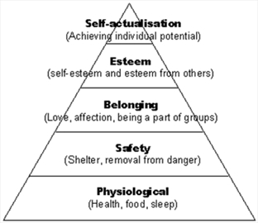
A Sense of Belonging continued...
What we know is that social identities intersect and affect college students’ sense of belonging (Strayhorn, 2012, p. 22).
Therefore, as faculty, staff, and administrators, we need to provide all students, including our Transgender students, a sense of support and security in the identities and in the following areas:
http://www.yorkregion.com/opinion-story/1445503-a-sense-of-belonging-is-essential-to-your-fulfillment/
Notes:
So not only do we need to focus on supporting their identities but also making sure that we are functioning to accommodate their basic human needs.

Slide 13
“If some day we read about the discovery of a trans* gene, we must remember how elements of both nature and nurture determine who we are. We should ask questions of the science, form our own opinions about its claims, and remember that—regardless of what is found—we are always the experts on our own identities.”
Dr. Rachel Levin
Trans Bodies, Trans Selves
Notes:
This quote sums up the importance we emphasize on the ownership of identities.

Slide 14
Reflective Activity
Think of an experience you have had that made you want to be supportive or affirming of people with a LGBTQIA identity.
Notes:
We will now ask you to reflect on your own experience with identifying, empathizing with and supporting an individual with a LGBTQIA identity. We come back together and reflect on our experiences.

Slide 15
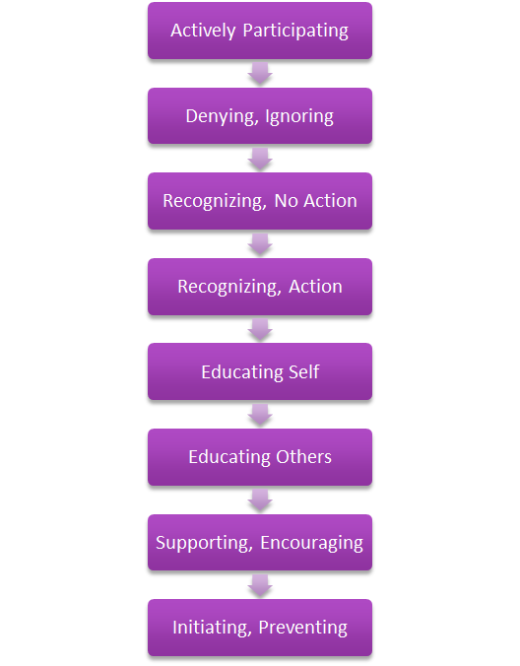
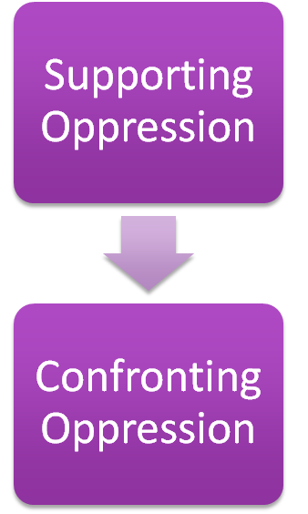
Created by P. Griffin and B. Harro, 1982
Notes:
After reflecting on those identities, lets dive into how these identities experience oppression and what we do consciously or unconsciously to support or confront that oppression.

Slide 16
“‘Ally’ cannot be a label that someone stamps onto you or, god forbid, that you stamp on to yourself—so you can then go around claiming it as some kind of identity. It’s not an identity. It’s a practice. It’s an active thing that must be done over and over again, in the largest and smallest ways, every day.”
Mia McKenzie
No More ‘Allies’
Notes:
Essentially we are asking you all to become allies for this community of students and support them holistically.

Slide 17
What We Are Doing Well
LGBTQ Center
Campus Events
Ally training for faculty/staff
Notes:
Our institution has made a number of initiatives to create an inclusive environment. This includes the opening of our LGBTQ Center that provides a safe space for students of the LGBTQ community and allies. We also have campus events that are sponsored by the LGBTQ Center, student organizations, and other offices to bring awareness about the LGBTQ community here on campus and globally. These events are a great way to education the community as a whole and have a fun, inclusive environment for learning. Last, we have ally training for faculty and staff members that is offered once each academic year. These initiatives that our institution have are are great start, but there is more work to be done.

Slide 18
Best Practices for a Trans-Inclusive Community
Use preferred names
Respect Pronouns
Correct mistakes (yours and others)
Don’t out people
Check your curiosity
Educate Yourself
Notes:
So with all of this information and knowledge accumulated about Transgender students and inclusion, we would like to provide you with some tips in order to continuously build an inclusive environment.

Slide 19
Best Practices
Use Preferred Names
There are many financial, social, and legal barriers to changing names on state and federal documents. Regardless of where people are in that process, use the name that they ask you to use. If you knew the person before they started using a new name, stop using the old name immediately.
2. Respect Pronouns
Don’t assume gender or sexuality. State your own pronouns. If you aren’t sure or don’t remember a person’s pronouns, ask them. When a person tells you their pronouns, use them.
Use a person’s current pronouns even when they are not present. Use a person’s current pronouns even when referring to them in the past when they may have used different pronouns.

Slide 20
Why Pronouns Matter for Trans People
https://www.youtube.com/watch?v=N_yBGQqg7kM

Slide 21
Best Practices
3. Correct mistakes (yours and others)
What should you do if you accidentally use the wrong name or pronoun?
Acknowledge the mistake
Apologize (if you are with the person you misgendered/misnamed)
Move on
Try very very hard not to do it again
Correct mistakes even if the person is not present. Don’t ask the person who was misgendered to take care of you.
4. Don’t Out People
Don’t disclose a person’s trans* status to anyone who does not have a legitimate medical or legal need to know. A person may be “out” as trans in one context but not in another.
Notes:
Respect the person’s privacy and don’t put them in harm’s way unnecessarily.

Slide 22
Best Practices
5. Check Your Curiosity
Don’t ask trans* people questions you would not ask other people.
6. Educate Yourself
Become aware of and sensitive to the way that gender norms and gender-segregated spaces make life difficult or even dangerous for trans and non-binary people. When possible, advocate for accessibility and inclusion.
Notes:
Be sensitive to the way that society and the media tends tends to sensationalize trans people and focuses on aspects of their lives and bodies that for other people are considered off-limits—genitals, how they have sex, what surgical procedures they have had or will have.
Pay special attention to the needs and issues of trans people of color.

Slide 23
What We Need To Improve
More training for faculty, staff, and students
Gender neutral bathrooms
Campus programs
More funding for our support center (the LGBT Center has the lowest amount of allocated funds compared to similar centers on campus)
Notes:
After understanding best practices, we, as an institution, can make more efforts to ensure we are servicing all of our students. We need more more training for faculty, staff, and students. Offering one optional opportunity just for faculty and staff is minimal. We need gender neutral bathrooms and more campus programs We also need more funding for our support center. The LGBT Center has the lowest amount of allocated funds compared to similar centers on campus.

Slide 24
University Action Plan
Mandatory Intersectionality Training for New Faculty
Mandatory Intersectionality Training for Every Division and Academic Department
Intersectionality Training to be Offered for Entire Campus During Both Fall and Spring Semester
Increased Funding for LGBT Center
Implement Gender Neutral Restrooms (will start with student center and expand)
Amend Student Conduct Code and University Policy to include bias based on gender identity and expression
Notes:
We will accomplish our goals by making 6 initial changes. They will include: a mandatory intersectionality training for new faculty and a mandatory intersectionality training for every division and academic department. We will also offer intersectionality training to be offered for entire campus during the fall and spring semester. We will work with our Board of Directors and Provost to increased funding for the LGBT Center. We will also implement gender neutral restrooms at the student center with the intention to expand through out institution. Finally, we will amend Student Conduct Code and University Policy to include bias based on gender identity and expression.

Slide 25
References
Dugan, J. P., Kusel, M. L., & Simounet, D. M. (2012). Transgender college students: An exploratory study of perceptions, engagement, and educational outcomes. Journal of College Student Development, 53(5), 719-736.
Effrig, J. C., Bieschke, K. J., & Locke, B. D. (2011). Examining victimization and psychological distress in transgender college students. Journal of College Counseling, 14(2), 143.
McKinney, J. F. (2005). On the margins: A study of the experiences of transgender college students. Journal of Gay and Lesbian Issues in Education, 3(1), 63-75.
Meyer, I. H. (2003). Prejudice, social stress, and mental health in lesbian, gay, and bisexual populations: Conceptual issues and research evidence. Psychological Bulletin,129(5), 674-697.
Kisch, J., Leino, V. E., & Silverman, M. M. (2005) Aspects of suicidal behavior, depression, and treatment in college students: Results from the spring 2000 National College Health Assessment Survey. Suicide and Life-Threatening Behavior, 35(1), 3-13.
Strayhorn, T. L., & Ebooks Corporation. (2012). College students' sense of belonging: A key to educational success for all students. New York, NY: Routledge.

