Slide 1
Florida State University
Team Leader: Kate Morales
Case Study Members:
Amanda Mintz, Emily Oswalt, Kaileen Paige

Slide 2
Transgender Resource Training
Workshop 1: Introduction to Trans Issues at Centrist College

Slide 3
Training Overview
Brave Space Guidelines
Significance of Transgender Issues in Higher Education
Key Terms and Definitions
The Genderbread Person: Understanding Trans Identity
Using Proper Pronouns
Inclusive Language Activity
Group Discussion and Future Action Plan for Promoting Inclusion on Campus

Slide 4
Creating a Brave Space for Learning
Listen with an attempt to understand - not to respond
Don’t make assumptions - ask for clarification when necessary
Be respectful of one another’s perspectives and identities
Use “I” statements when sharing
Lean into discomfort
Accept constructive feedback when sharing thoughts and ideas
What’s shared here, stays here. What’s learned here, leaves here.
Notes:
Facilitator should have an open conversation with workshop participants on what the expectations of conversation are through the experience. Brave Space is meant to be a safe, but challenging environment where the participants are fully engaged in their own and their peer’s learning. Above are the minimal guidelines for Brave Space. Facilitators will ask group members what set of expectations they would like to add to ensure they are comfortable and committed to engaging in a Brave Space.

Slide 5
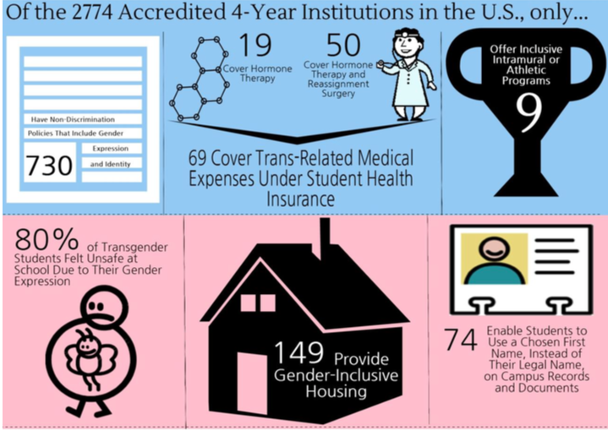
Why does this matter?
Tripsas et al. (2014)
Notes:
The concern for the support and well being of transgender students on college campuses is increasing as we do not currently provide them with the resources to be successful as students in higher education. Transgender students are continually facing more forms of discrimination than cisgendered students. In the infographic above outlines some of the discrimination encountered by transgender students on college campuses.
Maurer-Starks, Clemons, and Whalen, (2008) highlight the problems of heteronormativity in the athletic training programs working with student athletes. Sports programs are designed off the premises of heteronormativity, and do not allow for transgender students to thrive in collegiate sports. There is a call for programs to be more considerate and inclusive to better serve the trans-community.
Maurer-Starks, S. S., Clemons, H. L., & Whalen, S. L. (2008). Managing Heteronormativity and Homonegativity in Athletic Training: In and Beyond the Classroom. Journal of Athletic Training, 43(3), 326–336.

Slide 6
Key Terms:
Gender (n): expressed in terms of masculinity or femininity. Largely cultural and/or socially determined, it is how people perceived themselves and expect others to behave. Gender involves assigned genders (genders designated at birth), gender roles (how one is expected to behave based on gender), gender attribution (how others perceive someone’s gender) and gender identity (how an individual defines their gender).
Notes:
Facilitators will give the definition of gender highlighting the difference between gender and biological sex. Gender will be expanded on later is an activity with participants so it is important for participants to begin thinking about gender and the social constructs involved

Slide 7
Key Terms Continued:
Cisgender: a person who by nature or by choice conforms to gender and sex based expectations of society (also referred to as gender conforming).
Trans: an abbreviation that is sometimes used to refer to a gender variant person. This use allows a person to state a gender variant identity without having to disclose hormonal or surgical status/intentions. This term is sometimes used to refer to the gender variant community as a whole.
https://www.campuspride.org/resources/transgender-allyship-and-advocacy/
http://sga.fsu.edu/safe_zone/PDF/Trans_Allies_Handout.pdf

Slide 8
Key Terms Continued:
Heteronormativity: the belief or assumption that all people are heterosexual, or that heterosexuality is the default or "normal" state of human being.
Transphobia: the irrational fear of those who are gender variant and/or the inability to deal with gender ambiguity.
http://queerdictionary.blogspot.com/2014/09/definition-of-heteronormativity.html
http://sga.fsu.edu/safe_zone/PDF/Trans_Allies_Handout.pdf
Notes:
Heteronormativity is perpetuated in society as we assume people are attracted to the opposite sex. How is this seen at an individual level? Institutional level? Cultural level?
Transphobia stems from the idea that cidgender individuals are normal and “right” whereas individuals that do not fit in the male/female binary are scary. How can we assuage these fears?

Slide 9
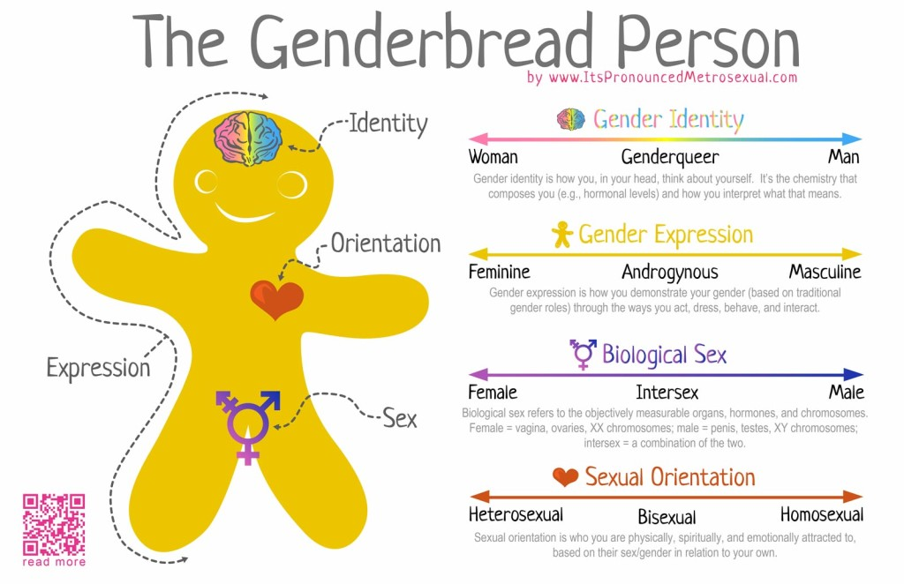
http://itspronouncedmetrosexual.com/
Notes:
Each individual would receive a handout that allows them to represent their identity so as to understand the differences between gender, gender expression, biological sex, and sexual orientation as those are regularly misapplied terms. Facilitators would discuss the importance of the spectrum in identifying the above terms.

Slide 10
Microaggression
Sexual or Gender Microaggression
Whether intentional or unintentional - verbal, nonverbal, behavioral, or environmental indignities that communicate hostile, derogatory, or negative connotations about a particular culture. Term that originated in 1970’s regarding racial microaggressions.
Sexual or Gender Microaggression is a subtle negative attitude conveying that one’s sexual or gender identity is less-valuable than dominant culture’s defining identities resulting in missed screening, late interventions, and avoidance of the healthcare system. Using improper terminology is one form of a sexual or gender microaggression.
http://medicine.missouri.edu/policy/docs/mohec/The-Impact-of-Sexual-and-Gender-Microaggressions.pdf
Notes:
On the screen is terminology regarding Microaggressions and Sexual or Gender Microaggressions. Later in the program we will identify some potential microaggressions our students are going through as transgender students.
Nadal, Rivera, and Corpus (2010) state there is a lack of information and education on transgender microaggressions. Students, staff, and psychologists have a hard time identifying and understanding the complex microaggressions impacting transgender students.

Slide 11
Pronoun Activity
Find a partner
Get to know your partner
  Name
  Reason for attending the training
  Fun fact
Introduce your partner to the group without using any pronouns i.e. no use of “she”, “he”, “they”, “ze”
Notes:
When introducing partners, the introducer can use their partner’s name in lieu of pronouns. For example, “This is Taylor. Taylor is here because __________. Taylor’s fun fact is _________.”
Reflection Questions to ask participants:
What are your initial reactions to this activity?
Was it difficult to refrain from using pronouns?
What does this tell us about how our society is socialized?

Slide 12
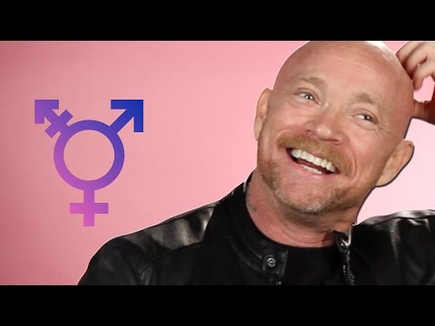
Pronouns
https://www.youtube.com/watch?v=N_yBGQqg7kM
Notes:
This video is a good representation of why pronouns are important for trans individuals. Another good way that facilitators can give the audience some context would be comparing the use of incorrect pronouns to someone calling you the wrong name. For example, someone continuously calls you Bob when your name is James. How would that make you feel over time?

Slide 13
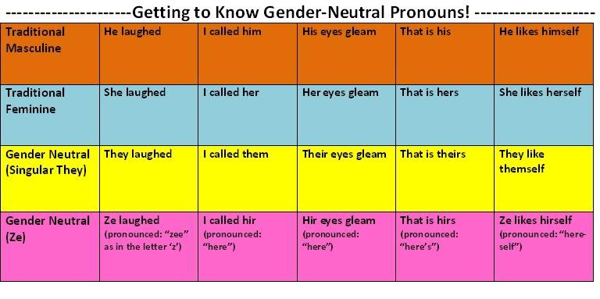
Pronoun Chart
https://apps.carleton.edu/student/orgs/saga/pronouns/
Notes:
After the video, facilitators will discuss the different possible pronouns one might use to identify themself. Please note that the use of the singular “they” is grammatically correct.
Here you can challenge participants to introduce themselves by adding in which pronouns they use so that trans individuals feel comfortable identifying their own pronouns without making others feel uncomfortable. This practice allows trans students to show up as their authentic self rather than asking for accommodations.

Slide 14
ACTIVITY: Inclusive Language and Microagressions
Match each statement on the left to one or more potential interpretations of the statement on the right.
Oh, you’re trans? But you look so good!
I’ve never met a trans person before.
I would date a trans person.
You look just like a real woman.
I’m glad you’re being honest with me about being trans.
I love trans people.
It’s so hard to switch pronouns.
I don’t have a problem with trans people.
Adapted from http://www.buzzfeed.com/meredithtalusan/cissexist-bullshit-translator#.soWw6e6m8
Nadal, K. L., Rivera, D. P., & Corpus, J. H. (2010). Sexual orientation and transgender microaggressions. Microaggressions and marginality: Manifestation, dynamics, and impact, 217-240.
Trans people are an inconvenience to me.
I have a problem with trans people.
I deserve a prize.
Trans women aren’t really women.
Trans people who don’t tell me they’re trans are deceivers and liars.
Trans people are ugly.
I am incapable of hetrosexism
I assume I can identify any trans person.
I fetishize trans people.
Most people have a problem with trans people.
Trans people are usually undateable.
Notes:
To illustrate the importance of utilizing inclusive language, avoiding microaggressions, and avoiding a deficit-approach to the transgender populations, our senior staff members will take part in this activity. Participants will match the statements on the left to any implicit or explicit meaning or impact that statement might have when spoken to someone who identifies as transgender. Statements on the left can be matched to more than one statement on the right. The activity is designed to spark conversation and understanding of how one’s intent can be different from the impact of one’s statement. The statements were adapted from a popular Buzzfeed article written by a news writer who identifies as LGBT and an article from a peer-reviewed article.

Slide 15
As Senior Staff at Central College, what are we doing well?
Moving Forward as a Senior Staff Member...
Do our office environment promote inclusivity of transgender students? How can we make our office environment even more inclusive?
Do our current policies (including forms, applications, scholarships, etc.) allow students to self-identify as transgender?
Do we currently promote any trainings, programs, or events that could potentially create a hostile or unwelcoming environment for our transgender students?
How can we as a staff hold each other accountable to remaining current on policies, issues, and trends regarding our trans and LGBTQIAA students?
We ask that you gather with your staff and discuss the following questions at your next staff meeting. In order to create a truly inclusive campus, we must all be willing to investigate our own current practices and challenge ourselves to improve.
Notes:
This slide of the presentation is meant to serve as a basis for discussion among senior staff members. These questions will help staff members answer the questions “What are we currently doing well” and “What could we be doing better?” Facilitators should also emphasize the importance of senior staff members bringing these questions to their local offices and investigating current practices as a staff team.
Note: A presenter will take notes on the content shared for senior staff members to bring back to their department to continue training.

Slide 16
An Action Plan for Centrist College - Short Term
Don’t make assumptions. You can never assume you know how a student identifies or how supported or unsupported they feel in your office space.
Use inclusive language - utilize proper gender pronouns, avoid micro and macro aggressions!
Allow space for students to self-identify on any forms your office produces for events or programs.
Advocate for your students by attending meetings, programs, and events concerning the rights of transgender students.
Continue educated yourself and your staff on issues surrounding the transgender population locally, regionally, and globally.
Be a present, available, and supportive figure and always respect confidentiality of students who may self-identify to you.
http://sga.fsu.edu/safe_zone/PDF/Trans_Allies_Handout.pdf
Notes:
After the group discussion, the facilitators of the training will provide short term and long term action plans for senior staff members. The short term action plan items are meant to be items that can be applied immediately by individual staff members. While these ideas will not change the culture of the campus overnight, they certainly will support an overall more inclusive campus if individual staff members are striving to uphold these practices.

Slide 17
An Action Plan for Centrist College - Long Term
Advocate for safe spaces for transgender students in your department, e.g. gender neutral housing or bathrooms.
Allow students to change their preferred name or gender identity on official and unofficial university documents.
Provide opportunities for staff to attend and facilitate trainings on supporting students of the LGBTQIAA population.
Assist in the creation and/or development of trans-centered student support groups - registered student organization or university sponsored space.
Create a 5-year strategic plan for increasing student awareness of trans issues.
Notes:
These items reflect a long-term plan of action for Centrist College to be more inclusive of its transgender students. These items require collaboration, communication, and support from professionals at varying levels. In order for Centrist College to be a place that advocates for and supports students who identify as transgender while providing them the most optimal environment for learning and growth, we recommend these long-term steps be taken by the institution.

Slide 18
Resources
Beemyn, G. Best Practices to Support Transgender and Other Nonconforming Students. Campus Pride. (February 14, 2014). http://www.campuspride.org/tools/best-practices-to-support-transgender-and-other-gender-nonconforming-students/
Ideas for Allies of Transgender and Intersex Communities. (2015). Florida State University Trans Allies Workshop.
Maurer-Starks, S. S., Clemons, H. L., & Whalen, S. L. (2008). Managing heteronormativity and homonegativity in athletic training: In and beyond the classroom. Journal of Athletic Training, 43(3), 326–336.
Nadal, K. L., Rivera, D. P., & Corpus, J. H. (2010). Sexual orientation and transgender microaggressions. Microaggressions and marginality: Manifestation, dynamics, and impact, 217-240.
Talusan, M. & Midhani, R. (2016). What cis people say to trans people and what we hear. Buzzfeed. Retrieved from http://www.buzzfeed.com/meredithtalusan/cissexist-bullshit-translator#.wdd2RvRM3
Tripsas, M., Berkey, S., & Maggard, A. (2014). Heteronormativity: The impact of heterosexism on transgender students. Workshop presented at Florida State University in Tallahassee, FL.

