Slide 1
A WELCOMING ENVIRONMENT FOR ALL
A case study competition submission by Concordia University Ann Arbor
Team: Julie Edler (c), Beth Bodiya, Kristen Thornton

Slide 2
Student Services Mission
Following NASPA guidelines, Centrist College works “to make our campus safe, affirming, and inclusive for all students, staff, faculty.”¹
Advocacy – Community – Inclusion – Openness
This includes our transgender students.
Notes:
1. History of NASPA | Student Affairs Professionals. (n.d.). Retrieved from https://www.naspa.org/constituent-groups/kcs/gay-lesbian-bisexual-and-transgender/history

Slide 3
Centrist College aims to:
Make all students feel welcome
Support student success
“Ensure LGBT programs and services address the needs of LGBT students regardless of their race, gender, religion, age, socioeconomic status, disability, and degree of enrollment status.” (CAS Standard)
How can we support our transgender community?
Notes:
https://www.naspa.org/images/uploads/main/Lesbian,_Gay,_Bisexual,_Transgender_Programs_and_Services_SAG.pdf

Slide 4
Importance
Last fall, racial tensions escalated at the University of Missouri and other campuses. Some trainings were put in place and the events recognized by administration, but on Sept. 24, students protested, “saying university officials had done nothing to address to Head’s [Student Government President] concerns.”
Centrist College plans to evaluate campus climate and implement a strategic plan to ensure plans are in place before student complaints are not heard and issues are addressed before, or as they happen.
With increasing needs of students for access and support, we must take steps now to create a more welcoming environment for transgender students.
Notes:
http://www.cnn.com/2015/11/09/us/missouri-protest-timeline/

Slide 5
Transgender
Transgender refers to individuals whose gender identity, expression or behavior is different from what is associated with their assigned sex at birth (National Center for Transgender Equality)¹
2% - 5% of the world’s population currently classifies themselves as transgender²
Campuses are facing criticism in meeting the demands of the university and the needs of transgender students³
Transgender students are facing high levels of sexual harassment, physical and emotional abuse⁴
Notes:
Lindenberg, M. (2012).Transgender Students: Seven Recommendations for Academic Advisors. Retrieved from the NACADA Clearinghouse of Academic Advising Resources Web site: http://www.nacada.ksu.edu/Resources/Clearinghouse/View-Articles/Advising-issues-for-transgender-students.aspx
Lindenberg, M. (2012)
Erbentraut, J. (2015, May 18). College Campuses Are More Trans-Inclusive Than Ever, But Still Have A Long Way To Go. Retrieved from http://www.huffingtonpost.com/2015/05/18/trans-friendly-colleges_n_7287702.html
Erbentraut, J. (2015, May 18)

Slide 6
Successes So Far
LGBTQ Campus Student Center
  Offers support services, programs, training, and overall knowledge about transgender individuals for Centrist students and staff
  Goal: Develop a supportive and inclusive environment for student diversity, including gender identity and sexual orientation
An active and growing Campus Pride chapter
  Host of Summer LGBTQ Leadership Academy
  Campus programming and webinar opportunities, specifically focused on transgender students
Inclusive, non-discrimination policy
  Working to include gender identity/expression
(https://www.campuspride.org/about/)

Slide 7

Centrist College Celebrates with the LGBTQ Campus Student Center for their successful communication and connection/social media platforms already in place.
Congratulations, LGBTQ office!
Notes:
Social Media Icons Imaged Retrieved from: http://www.graphicsfuel.com/2013/03/popular-social-media-icons-psd-png/

Slide 8
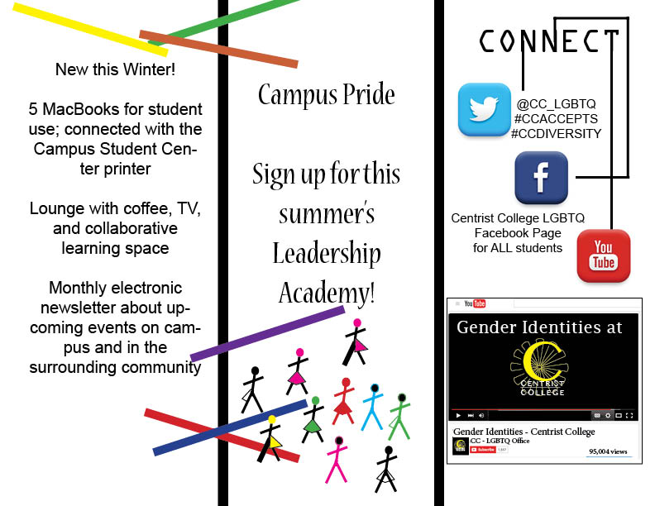
Examples of some successful initiatives evaluated with high
student satisfaction rates. Brochure interior is below.
Notes:
Social Media Icons Imaged Retrieved from: http://www.graphicsfuel.com/2013/03/popular-social-media-icons-psd-png/

Slide 9
Areas to Improve
Regardless of our collaboration and success with welcoming our transgender students, there are many areas we can work to improve. The goal of our professional development series is to consider where our campus is at, how we can meet students where they are at, and how we can expand our Centrist College focus on ALL students!
  Increase campus safety, residence life options, counseling, recruitment and retention of transgender students
  Fully utilize the resources and staff at the LGBTQ Student Center
  Increase educational programming to educate students and staff

Slide 10
Action Plan
Action Plan
Internal Training and Awareness
Transgender Curriculum Incorporated Naturally
Policies and Physical Space
Campus Climate Attitudes and Beliefs
Community Outreach

Slide 11
Internal Training and Awareness
  Raise staff awareness on policies to combat transgender barriers and how to communicate effectively with all students
  Train student leaders to recognize transgender bullying
Here’s why:
  Research done by McKinney (2005) shows that most faculty are unaware of transgender students or what difficulties they may face on campus.¹ According to Schlossberg’s Theory on Mattering (1989), guaranteeing that students do not feel marginalized and that they matter to the campus community will create a more positive and successful college experience.²
  Beemyn, Curtis, Davis & Tubbs (2005) indicate that for staff to be successful supporting and including all students, a better understanding of transgender students is required.³
Notes:
1. McKinney, J. S. (2005). On the margins: A study of the experiences of transgender college students.Journal of Gay and Lesbian Issues in Education, 3, 63-75. Retrieved from
http://www.informaworld.com/smpp/content~db=all~content=a904561863~tab=content
2. Schlossberg, N. K. (1989). Marginality and mattering: Key issues in building community. New Directions for Student Services, 1989(48), 5-15.
3. Beemyn, B., Curtis, B., Davis, M., & Tubbs, N. J. (2005). Transgender issues on college campuses. Retrieved from http://secure.gvsu.edu/cms3/assets/3B8FF455-E590-0E6C3ED0F895A6FBB287/Transgender%20issues%20on%20college%20campuses-Beemyn-New%20Directions%20ch%205.pdf

Slide 12

This is a priority goal. Deadline: June, 2016
Goal
Ensure confidence and care in working with all students
Educate all staff in Sexual Orientation and Gender Identity Diversity Training¹
Develop student leaders to support transgender students
Plan
Email transgender educational resources and training program to all faculty
Organize Safe Zone Ally Training to develop visible allies among staff²
Develop an Outspoken Peer Education Program³ – interview potential peer educators by April 2016
Responsible Office
Office for Equity and Diversity
LGBTQ Student Center
Notes:
1. Human Rights Campaign. (n.d.). Diversity Training on Gender Identity and Gender Expression. Retrieved from http://www.hrc.org/resources/diversity-training-on-gender-identity-and-gender-expression
2. Office of Web Communications. (n.d.). Top 11 Things Faculty and Staff Should Know About LGBTQ Life at NYU. Retrieved February 26, 2016, from http://www.nyu.edu/life/student-life/student-diversity/lesbian-gay-bisexual-transgender-and-queer-student-center/faculty-and-staff.html
3. Outspoken Peer Education Program. (n.d.). Retrieved from https://www.nyu.edu/life/student-life/student-diversity/lesbian-gay-bisexual-transgender-and-queer-student-center/outspoken-peer-education-program.html

Slide 13
Policies and Physical Space
  Address students by preferred name instead of given name
  Omit pronouns in campus correspondence
  Create more facilities for transgender students
  Incorporate transgender students into marketing and campus communications
  Create safe spaces throughout campus¹
Here’s Why:
  By utilizing a student’s preferred name, and not using pronouns, we can ensure Centrist College creates a gender inclusive environment from the first contact a student has with the college²
  Centrist College can demonstrate the commitment we have for all students by creating gender neutral facilities and showcasing these facilities on campus communities; including maps, brochures, and in marketing materials³
Notes:
1. Rullman, L., & Harrington, K. (2014). College unions, learning, and community building. In New Directions for Student Services (145, pp. 39-47). Wiley Periodicals.
2. Beemyn, B. G. (2006). Ten Strategies to Improve Trans Inclusiveness on Campus. Best of the Best: An Official Queer Guide to Higher Education, 1-5.
3. Lindenberg, M. (2012). Transgender Students: Seven Recommendations for Academic Advisors. Retrieved from the NACADA Clearinghouse of Academic Advising Resources Website: http://www.nacada.ksu.edu/Resources/Clearinghouse/View-Articles/Advising-issues-for-transgender-students.aspx
Image retrieved from: http://www.hrc.org/resources/establishing-an-allies-safe-zone-program

Slide 14
Goal
Address students by preferred name
Showcase gender neutral facilities on campus communications
Expand health care options and insurance for transgender students
Plan
Add additional field on application for preferred name within 30 days of today. Preferred name will be utilized for all communications with student
Designate one gender neutral restroom per building by June 30, 2016. List the bathrooms on all campus maps printed after July 1, 2016
Revise current healthcare insurance to include transitioning services for transgender students
Responsible Office
Admissions
All campus offices
Office for Equity and Diversity
Maintenance in partnership with Marketing
Office of Admissions
Office of Health Education and Centrist College Health System (CCHS)

Slide 15
Campus Climate Attitudes and Beliefs
Beginning at freshman orientation, create an inclusive campus climate to recognize the value of diverse personalities and identities
Develop opportunities for the student population to interact with one another outside of the classroom environment
Here’s Why:
  Research shows that when students have opportunities to interact with diverse peers outside of the classroom, they show more active thinking, motivation, and intellectual engagement
  When students perceive their campus climate as inclusive, they also show greater willingness to accept intellectual changes
Notes:
Gurin, 1999; 2002; Pascarella et al., 1996 (http://diversity.arizona.edu/benefits-diversity-and-inclusion-students)
Pascarella et al., 1996

Slide 16
This is a priority goal. Deadline: Evaluate ASAP and continue through next year
Goal
Ensure dorm R.A.s support all students
Foster an inclusive environment for all beginning at Freshman Orientation
Invite students to “Together as One” events.
Together as One will be intertwined throughout the classroom and campus community
Have Learning Lunches each month to bring up new issues of what it means to be “Together as One”
Plan
Provide RAs with proper training, LGBTQ literature, and event promotions information
Identify student leaders from each class by July 1, 2016 to lead orientation in September; ensure these leaders are trained in diversity and inclusiveness
Highlight programs and remind students of events, especially commuter students to may not see dorm posters
Host seminars to encourage campus community engagement throughout the year
Responsible Office
Residence Life
Office of Student Life
Office of Student Life
Marketing Department
Residence Life
Office of Student Life in conjunction with campus community

Slide 17

Campus Climate Event
Notes:
Glass Mosaic Art Party! (n.d.). Image retrieved from http://www.eventbrite.com/e/glass-mosaic-art-party-tickets-11489197499

Slide 18
Transgender Curriculum Incorporated Naturally
Integrate transgender curriculum into coursework
Here’s Why:
  As Case, Stewart, and Tittsworth (2009) noted, the invisibility of transgender people within coursework allows for perpetuation of myths, stereotypes, and oppression of this particular population. Transgender inclusion requires efforts to eliminate bias in the classroom.¹
Notes:
1. Case, K. A., Stewart, B., & Tittsworth, J. (2009). Transgender Across the Curriculum: A Psychology for Inclusion. Teaching of Psychology, 36(2), 117-121.

Slide 19
Academic Affairs,
Please set a day to discuss future plans and measurement steps.
Goal
Integrate transgender information into the curriculum to enable all students to understand and respect those who identify as transgender
Plan
Encourage professors to incorporate transgender discussions into the classroom and for students to research transgender topics
Responsible Office
Dean of Academic Affairs with partnership of professors
Curriculum developers

Slide 20
Community Outreach
  Create a peer support group for Centrist College transgender students to meet with community members questioning their gender identity to offer support
  LGBTQ Campus Student Center will provide resources and information for community members seeking additional information and guidance on gender identities
Here’s Why:
  By providing outreach to the community, Centrist College will be able to connect students with the local community. This will create partnerships to raise awareness on gender identity, further creating a culture of inclusion within the campus and surrounding community.

Slide 21
This is a priority goal. Deadline: May, 2016
Goal
Provide transgender literature and resources for community members
Connect transgender students with community members seeking support in their identity search
Support LGBTQ community on campus and throughout the community with our actions and words
Plan
Ensure relevant and current information is always on file within the LGBTQ Campus Student Center
Create a Peer Support group for transgender students to share their experience with community members
Lead by example and encourage individuality
Responsible Office
Office of Student Life
Outreach Department
LGBTQ Student Center
Office of Student Life
Outreach Department
LGBTQ Student Center
Campus Leadership Staff and Campus Deans

Slide 22
Next Steps
Provide summary of presentation to each department on campus for review and input.
Campus wide evaluation meeting scheduled for May 1, 2017.
As the senior staff, it is our responsibility to encourage commitment, conversation, and community at Centrist College to include all students.

Slide 23
Sources
All sources are listed in the notes section.
The policy suggestions for this case study may not be reflective of Concordia University, a private religious university.
Notes:
Thank you!!

