Slide 1
Don't Forget The "T's"
Arkansas Tech University
Jenna Bradley, Morgan Bradley, and Xuelin "Shirley" Shao

Slide 2
Diversity: What is it?
The concept of diversity encompasses acceptance and respect.
It means understanding that each individual is unique, and recognizing our individual differences.
These can be along the dimensions of race, ethnicity, gender, sexual orientation, socio-economic status, age, physical abilities, religious beliefs, political beliefs, or other ideologies.

Slide 3
Implementing Diversity in College
Department of Diversity and Inclusion (DDI)
This department focuses on enhancing the experiences of students within the underrepresented population.
While creating a campus environment and culture that celebrates inclusiveness and multiculturalism, DDI aims to impact students from their first year to graduation.

Slide 4
What is the "T"?
LGBTQ: Lesbian, Gay, Bisexual, Transgender, and Queer
Transgender serves as an umbrella term for individuals whose self-identified as gender does not match their assigned sex, representing individuals who may identify as transsexual, transgender, genderqueer, among several other self-identities that may fall under the transgender umbrella.

Slide 5
History of Hate
History of the LGBTQ community (specifically transgender) is limited
"Queerness has instead existed as innuendo, gossip, fleeting moments, and performances that are meant to be interacted with by those within its epistemological sphere, while evaporating at the touch of those who would eliminate queer possibility."
Bits and pieces of evidence survive to recognize the distaste for the LGBTQ community
Example: Gay Pride Week at California State University in 1975: flyers were torn down and replaced with others that read "Gays are the scum of the earth."
Example: San Jose State College: “People threw rocks, garbage at us, and called us names..."
Students in the LGBTQ community were often stressed over becoming public or keeping their identity private. Many students were unwilling to publicly associate with the student groups that formed for fear of repercussions.

Slide 6
#ASKME
http://chronicle.com/article/Ask-Me-What-LGBTQ-Students/232797

Slide 7
Major Breakthroughs
1960s and 1970s- Gay politics moved onto the agendas of many student activists
1965-1967-The Mattachine Society was established at Columbia University, which is the first student gay rights organization.
1969- The Stonewall riots in NYC were a response to police raiding gay bars. This was the first time that queer people fought back against the state. These riots were also the "main catalyst for the rise of a new era in the struggle for LGBTQ rights."
1970s-The American Psychological Association (APA) removed "homosexuality" from the Diagnostic & Statistical Manual of Mental Disorders (DSM). Homosexuality was therefore no longer a disease.
1971- Cornell University's Gay Liberation Front was joined by more than 175 colleges in the nation, among those Columbia and Cornell in NYC.
1973-The Gay Student Coalition (GSU) was organized at UCLA in San Francisco.

Slide 8
In Today's World
As we look at the history, we see universities focusing more on the gay and lesbian student subculture. Transgender students are often left behind.
As student affairs professionals, we cannot forget the "T". Today, more and more students are identifying with the transgender orientation. This diverse population of students we serve proves that we must be more open-minded and inclusive than ever before.

Slide 9
Our Responsibility as Staff and Faculty
It is the responsibility of student affairs faculty and staff at all universities to create an inclusive environment on campus for the diverse population of students we encounter every day.
Faculty and staff must stay up-to-date and aware of current issues in higher education and in the country as a whole.
We must acknowledge and respect our differences while creating an inclusive environment.

Slide 10
Positive Steps Integrating Transgender Students
What is Centrist College doing correctly?
Inclusivity and support is an important aspect for transgender students at the university.
Proactive steps have been made in relation to these variables.
DDI (slide 2), housing, and admissions applications have made positive strides toward the inclusion of transgender students on campus.

Slide 11
The Selection Process: Residence Halls
Gender-neutral housing can be critical to transgender students.
Our university provides some gender-neutral housing.
This housing option is designed for students to be paired with a roommate or roommates based on compatibility rather than gender identity.
Newly admitted students may choose this option on their Housing Profile Form that is given to them prior to move-in day on campus.

Slide 12
Inclusion on Applications
Transgender students should be incorporated into all facets of college life.
Centrist has taken steps toward this in regards to the admission process.
We ask whether enrolling students identify with the LGBTQ community.
This allows transgender students to avoid exclusion in the admissions process.

Slide 13
How Can We Move Forward?
Although Centrist College has taken positive strides toward implementing trans-friendly accommodations, there is always room for improvement.

Slide 14
Transgender Friendly Recruiting
Centrist College could recruit LGBTQ students through advertising LGBTQ-friendly policies, services and atmospheres on the Admissions web site and the recruitment materials.
Our institution can use results of the Campus Climate Index (assessed by Campus Pride) to set themselves above their peer institutions.
Campus Pride is an organization with a mission in part to support programs and services to create safer, more inclusive LGBTQ friendly colleges and universities. Since 2001, Campus Pride has developed and published The LBGTQ Campus Climate Index, which assesses how LGBTQ friendly a campus may be.

Slide 15
Transgender Friendly Recruiting
Centrist College could send staff and faculty to college fairs targeting the LGBTQ prospective students through Campus Pride.
Example: In University of Pennsylvania (PA) students who apply to the University of Pennsylvania and self-disclose a LGBTQ identity will receive outreach from a current LGBTQ student.
LGBTQ and College Bound
Our college could hold a special session for high school LGBTQ students to answer their questions and concerns related to attending college as a transgender student.

Slide 16
Update Centrist's Policy
Centrist College should update our nondiscrimination policies, specifically mentioning the rights that transgender students have.
One of the misconceptions about protection for transgender students is that policies and laws against discrimination based on sex apply to them. In fact, inclusive language in policy would be the best way to protect transgender students. The language can help students feel more included.

Slide 17
Customer Service
It is important to prepare staff for the inevitable. We need to have a system in place for when a student identifies either as transgender, as transitioning, or as planning to do so in the future.
It may seem unrealistic for all staff and faculty to be knowledgeable about transgender issues. Some situations may come up that are not easily solved. However, Centrist College could train the staff who come into contact with transitioning students most frequently.
The staff in the Admissions, Financial Aid, Registrar, and Student Accounts offices, etc. could go through mandatory information and training courses. These courses would focus on transgender students.
Ally Training
Centrist College could promote Ally Training for the LGBTQ community. Faculty, staff, and students would be encouraged to participate.This would serve as encouragement and support for all transgender students.

Slide 18
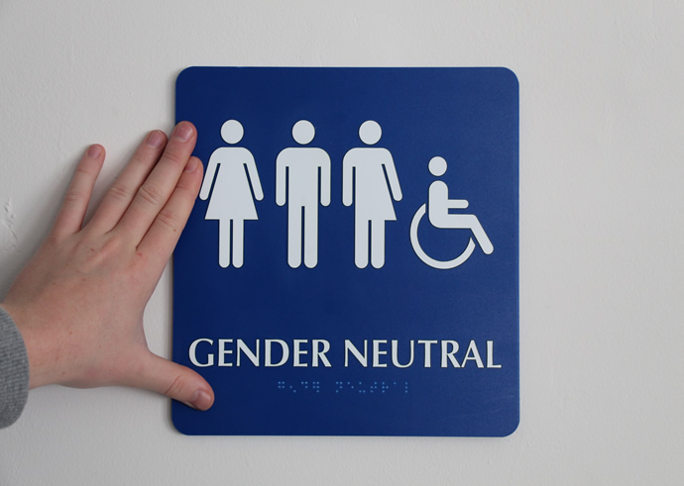
Facilities
Gender Neutral Restrooms
An emerging area of inclusion for transgender students is the addition of "transgender friendly" restrooms in campus buildings at Centrist College. Instead of considering a private single stall restroom, the restrooms could be smaller with a traditional family style layout.
Restrooms on campus could also double as family restrooms and restrooms for people with disabilities. This simple no or low cost gesture can go a long way toward making transgender students, as well as other students, feel welcomed and safe on campus.

Slide 19
Campus Housing
The university should also provide a diversity program within residence halls where students could choose to live on particular floors in particular buildings based on their acceptance of a variety of issues.
Example: The university of Southern California created a "rainbow floor" for LGBTQ students and supportive allies to live.

Slide 20
Name and Gender Changes
Name and gender changes are the most frequent requests that staff and faculty get from transgender students on a college campus.
Example: At the University of Vermont, they created a software patch for the student-information system that puts students’ preferred names and pronouns on class rosters.
Our institution could borrow this idea to create our own software, or use their software for our students. The advantage of using this software is to avoid forcing transgender students to "come out" on the first day and in front of the class.
Students will be able to let others know the correct name and/or pronoun(s) they identify with. This lessons the likelihood of an uncomfortable and awkward situation in front of classmates.

Slide 21
Action Plan: Are These Changes Realistic?
If Centrist College finds the importance of what we have discussed today, the appropriate changes need to come into effect.
As student affairs practitioners, we need to place an emphasis that all lives matter. Taking steps toward the issues presented will lead us to a diversified university, allowing inclusion for those who do not always feel included. Safety is also a top priority for these students, and that is an issue that cannot be overlooked.
This can't happen overnight, but while we are working on the necessary steps and discuss the matter further, remember, "Don't forget the "T"!"

Slide 22
References
Arkansas Tech University. (2015). Office of Diversity and Inclusion. Retrieved from https://www.atu.edu/diversity/
Bard College. (n.d.). Frequently asked questions about gender neutral housing. Retrieved from http://www.bard.edu/reslife/housing/index.php?action=getfile&id=9998985
Barack, L. (2015). LGBTQ and college bound. School Library Journal, 61(6), n/a.
Beemyn, B. (2003). The silence is broken: A history of the first lesbian, gay, and bisexual college student groups. Journal of the History of Sexuality, 12(2), 205-223.
Brown, E. C. (2015, January 27). What steps can campuses take to be more trans-inclusive? Retrieved from http://kinseyconfidential.org/steps-campuses-transinclusive/
Cegler, T. (2012). Targeted recruitment of GLBT students by colleges and universities. Journal of College Admission, 215, 18-23.
Clawson, J. (2014). Coming out of the campus closet: The emerging visibility of queer students at the University of Florida, 1970–1982. Educational studies: Journal of the American Educational Studies Association, 50(3), 209-230.
Definition of diversity. (n.d.). Retrieved from http://gladstone.uoregon.edu/~asuomca/diversityinit/definition.html
Miner, J. (2009). How to make your office and institution more transgender friendly. College and University, 84(4), 69-72, 74.
Pryor, J. T. (2015). Out in the classroom: Transgender student experiences at a large public university. Journal of College Student Development, 56(5), 440-455.
Reichard, D. A. (2012). Animating ephemera through oral history: Interpreting visual traces of California gay college student organizing from the 1970s. Oral history review: Journal of the Oral History Association, 39(1), 37-60.
Schmalz, J. (2015). Ask me: What LGBTQ students want their professors to know. Retrieved from http://chronicle.com/article/Ask-Me-What-LGBTQ-Students/232797
.

