Slide 1
Virtual Case Study
By Kaew Preamchuen
Laurel Spurgeon
Katie Zhu
Jay Anderson

Slide 2
1st Part-Crowd Chaos
For part one main issue that we see here is that there was a chaos in the crowd. Depending on the student organization and the topics that they were talking about there was conflict the resonated within some of the members of the crowd. Members of the crowd became upset then out burs began. The members of the student organization were using their first Amendment rights of freedom of speech. However, there was also in violation of a for Hecklers Veto.

Slide 3
2nd Part-Problem Solving
What is the problem
Identify the problem
Implement a plan to stop the problem from occurring again
Research and resources
Putting the plan into action
Find guidelines on how to handle the situation
Be prepare with an unexpected situation that might occur
Discuss with the faculty member on how to deal with the situation

Slide 4
Creating a Speaker’s Community
The speaker's committee would be a committee made up of student staff and faculty members who will formulate a way to created a way to protect the students from outburst that have happened at this institution. For things like this not to happen again have a designated area on campus known as the “freedom” of speech area on campus where members that are invited or what to speak that are from the outside community, famous speakers or on campus organization will be able to talk about whatever topic they would like to talk about.
If the campus does not like the speakers who want to talk about the topic that is not what the campus is asked for then the campus will NOT say “no we don’t want you to come to our campus,” but instead we can delay the speaking of the student group or invited persons to the institution.

Slide 5
What would the committee be doing?
The Committee will be reviewing organizations and speakers who want to speak on campus to the students
Ensuring proper campus police department coverage/ security
Allowing and exiting plan to insure the protection of the speaker/presenter if things were to get out of hand
Allowing security to split into sections to divide the audience
There will be parking lot patrol to ensure that there will not be fights/ arguments in the parking lot/ sidewalks/ exterior routes that students or audience members take to ensure they get “home” or they next destination safely
The campus police department will patrol the surround areas and routes heavily taken by students and community members to ensure there are no riots later after the event

Slide 6
Type of faculty members would be best to formulate a plan for this and why
Committee Members: Student Government Representatives, Staff and Faculty from throughout the campus, the Dean of students, and the Vice President of the University. Committee Members will be able to talk amongst pro-staff, deliberate, and discuss about the past events that haven't taken place on campus

Slide 7
Type of faculty members would be best to formulate a plan for this and why
Look at past actions
Talk with surround schools and schools in different regions
Talk will the student government groups to ensure to put together a manual or something for protocol when having groups speak but this honor their first amendment rights
Speak to the student activities board about their policies and procedures
Conduct leader
Judicial board
Committee members will be able/ needing to come up with sanctions/disciplinary actions for the student population for the member who began the riot and for those involved that followed.

Slide 8
Pros and Cons of “Free Speech”
Pros:
Allows for more academic diversity
Allows for discussion surrounding controversial issues
Regulation unfortunately won’t stop hate
Often used to dismiss campus activists and detract from issues of pervasive racism and inequality
Faculty, staff, and students should be prohibited from violating the rights of other members of the University community
Cons:
Welcomes hate speech
Universities might be liable for damages
Restrictions represent a step down the slippery slope toward censorship, ultimately and totalitarianism
The toleration of speech is the price to be paid for individual liberty
The university’s role was not being to protect student when victimized by hate speech that are overly sensitive and self-conscious

Slide 9
The “Freedom” of speech area on campus
During the last several years, freedom of speech has come under attack while demonstrations against guest speakers on campus have not been controlled. Students and faculty have witnessed campus unrest at four-year universities and private liberal arts colleges that have not been seen since the 1960s and early 1970s when the Vietnam War divided public opinion.
Guest speakers at four-year colleges and universities have become threatened by actions of students and faculty. The big debate is over the First Amendment of the United States Constitution and Bill of Rights, which includes freedom of speech.

Slide 10
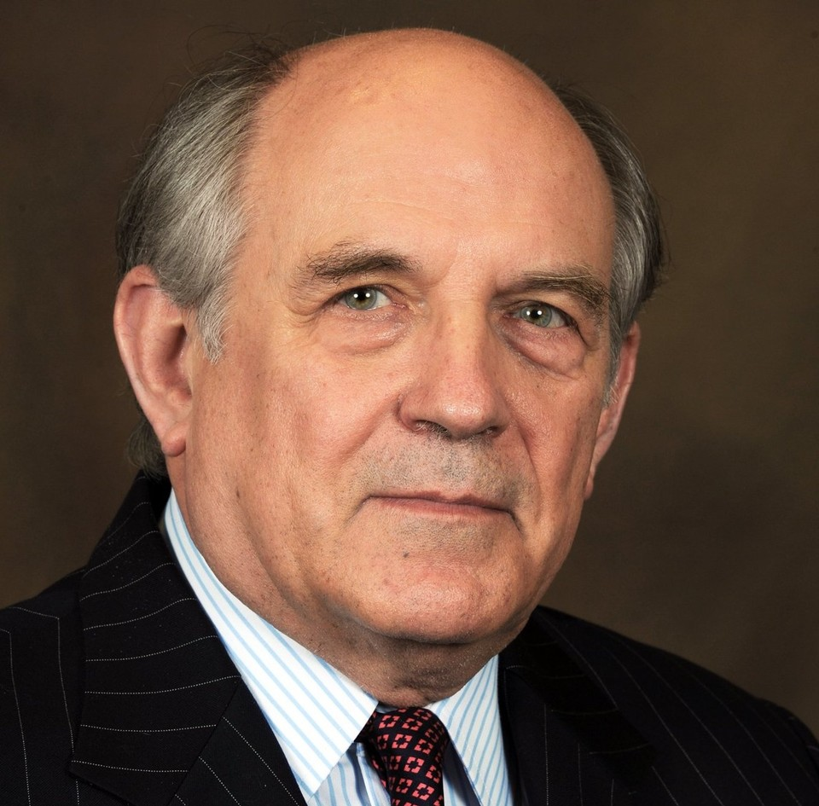
The Debate of Freedom of Speech
Guest speakers have been the subject of violent protests and outbursts by student organizations and have been mishandled by student affairs organizations, administrators, and campus security or police guards. According to Gerstmann, nobody has the right to block people from seeing a guest speaker and use violence against a speaker; furthermore, they do not have a right to shout them down when the speech is occurring (Gerstmann, 2018, p. 7). The first amendment protects controversial speakers just the same as it does the students and faculty protesters. In 2016 and 2017, disorder turned into riots and student unrest. For instance, libertarian conservative political scientist and intellectual Charles Murray was physically attacked by students and faculty at Middlebury College in Vermont (Gerstmann, 2018, p. 7). Also, a protest almost turned into a riot at Indiana University when Dr. Murray spoke at this Big Ten research university.
Dr. Charles Murray

Slide 11
The Debate over Freedom of Speech
Students also have the right of the First Amendment guaranteeing freedom of speech to protest a speaker for his or her views outside the place where the speaking event is taking place; furthermore, they have the right to attend and challenge them with questions.

Slide 12
The Charles Murray Protests in Vermont, Indiana, and Pennsylvania

Slide 13
Other Disruptions
Texas A&M University had a disruption in 2016 when a white supremacist, Richard Spencer, was paid to speak by a private supporter at the university auditorium. Texas A&M has a history of being one of the most conservative campuses in the country. It has a proud military ROTC tradition graduating the highest number of military officers second to the Army, Naval, and Air Force Academies. Texas A&M officials denounced Spencer and the private person who sponsored the event.

Slide 14
Featured Speaker-The President of the University of Oregon Run Out By His Own Students while University of Utah student protesters block Ben Shapiro’s Speech
University of Oregon students disrupted President Michael Schill’s State of the University address and University of Utah protesters blocked entrance to Ben Shapiro’s Speech at Salt Lake City in one of the most Mormon, Conservative, and Republican states in the Union. These students are threatening attendees. The other video is a protest against Shapiro at UCLA with protesters threatening attendees, too.

Slide 15
Possible Committee Solutions for Free Speech
Set the limitations for free speech
The committee should have the Dean or Provost of Student Affairs and Vice President Albert Longbottom on the committee to support the other division heads within the Department of Student Affairs. Administrative Assistant Minerva Lockhart should apply her secretarial skills to type and record all of the procedures on which the committee agrees for the next major guest speaker. The Dean or Provost of Academic Affairs should be in touch with the committee along with the university administration. The solution is to set up a designated area for students to speak near the auditorium guarded by the campus police and city police protecting all students and faculty. In addition, the campus and city police will sit on this committee and will be in close contact with the Division of Student Affairs and Division of Academic Affairs. Also, the campus police and city police will be in contact with the county sheriff's office. The three local law enforcement agencies will do background checks on any groups that promote terrorizing of attendees at special speaking events.

Slide 16
Possible Committee Solutions for Free Speech
Protect the right of free speech
According to Dean Vikram Amar of the University of Illinois School of Law (2017), free speech is protected under the First Amendment; at the same time, there is no legal definition for hate speech. The universities and colleges have an obligation to educate the costs on all sides of promoting hate speech. It is the role of universities to call out hate speech from the political right or left and educate students on how it harms people. Academic freedom and freedom of speech have to be protected at universities. This situation does not keep the federal government, state government, and universities from trying to punish people that promote threats, verbal harassment, physical harassment, and violence (Amar, 2017, pp. 1-3).

Slide 17
Possible Committee Solutions for Free Speech
Education as the method
The student affairs divisions as well as academic departments have the role to educate students in accepting diverse points of view as they learn to form their own views and mature into young adults. This responsibility belongs to all divisions within student affairs whether it be student organizations, academic advising, disability resource centers, honor societies, or residence life officials.
Respect each other
Students must be taught to respect each others views and respect each other as human beings. Dr. Martin Luther King, JR., stated that he wanted young men and women to be judged by their character instead of by their race or ethnicity. College students whether liberal or conservative have to respect each others views. The student affairs organizations must promote tolerance. In addition, these committees along with the administration should meet to discuss the costs and benefits about bringing in a speaker from the right or left politically.

Slide 18
Possible Committee Solutions to Freedom of Speech
Choice of different groups
Guest speakers right or left should be inspected by the committee with the support of the student affairs and academic affairs associations. People such as Charles Murray, Ben Shapiro, Milo Yilannopolis are not going to imply physical threats and hate to a group of people. These are conservative people in the intellectual world, the academic field, and journalism field, who do not promote violence. This committee should think hard about inviting people that are supporters of “white nationalism”; furthermore, these groups should never be invited to speak that might have ties to race hating groups like neo-nazis or the KKK. Other groups promoting other controversial causes like Antifa, who have threatened people attending speaking events, should not be invited to speak to students and faculty.

Slide 19
Possible Committee Solutions to Freedom of Speech
Campus police and social media
This embarrassing incident could have been avoided that turned into a brawl with two arrests by the campus police, city police, and county sheriff’s office. They could monitor the emails and social media actions on Facebook, YouTube, Linkedin.com, and Twitter. In addition, the local law enforcement officials should also have officers that can decipher any codes these groups put on social media to hide their true intentions of threatening public safety. This committee within the student affairs division of the university should work with law enforcement.

Slide 20
Bibliography-Source
“Berkeley students protest conservative speaker”. (2017, September 25). Annenberg Media. YouTube.
Retrieved from
https://youtu.be/jOoclw0CbB8
Cicora, P. and Akram, V. (2017, August 20). “How should universities handle controversial
speech”?
I-Illinois News Bureau-News Blog
Retrieved from
https://news.illinois.edu/view/6367/549565
Fleccas talk. (2017, November 16). “Free speech protesters can't compete with Ben Shapiro supporters at UCLA”.
YouTube. Retrieved from
https://www.youtube.com/watch?v=6ePMGIsp_Ew
Gerstmann, E. (2018). “Protests, free expression, and college campuses”. Social Education.
(pp. 6-9). Retrieved from
https://www.socialstudies.org/system/files/publications/articles/se_820106.pdf

Slide 21
Bibliography (Sources)
Gutenberg (2017, February 2). “UC Berkeley riots - Milo - Antifa - explosions”. YouTube.
Retrieved from
https://www.youtube.com/watch?time_continue=10&v=Pi_vX0tknJM
“Handling controversial speakers and protests-Blogs”. (January 2012). Blogs. (pp. 1-2). Retrieved from
https://www.edurisksolutions.org/Templates/template-blogs.aspx?pageid=47&id=260&blogid=100
“Hundreds of Middlebury students protest school speaker”. YouTube-
WPTZ Newschannel 5
Retrieved from
https://youtu.be/KmvHtY3fKgc
“IU students, staff protest controversial speaker”. (2017, April 11). RTVChannel6 The Indy Channel-YouTube
Retrieved from
https://youtu.be/_tl7d41F3FQ
Newhouse, A. (2017, March 7). “Middlebury Charles Murray protests”.
Retrieved from
https://youtu.be/92lAJHjci80

