Slide 1
Accio First Amendment:
Calling Upon Freedom of Speech
Committee of Legal Counsel and Student Organizations:
Dominique Overman, Eric Kang, Rae Chaloult, & Marissa King

Slide 2
First Amendment 101
Let’s get some background information on free speech and bringing speakers to campus...
Notes:
Notes: to situate staff about the basics of First Amendment before going into full presentation about campus speaker procedures

Slide 3
Congress shall make no law respecting an establishment of religion, or prohibiting the free exercise thereof; or abridging the freedom of speech, or of the press; or the right of the people peaceably to assemble, and to petition the Government for a redress of grievances.
- United States Constitution-
Notes:
Notes: Explain history of First Amendment and what it outlines

Slide 4
You can also split your content
Does the First Amendment Apply to MSU?
YES IT DOES!
Magicgan State University (MSU) is a large, public, M1 magical research institution and must abide to the Constitution and its protections.
As a public university, the Constitution, specifically the First Amendment, must be upheld at MSU when working with campus speakers

Slide 5
General Overview of Freedom of Speech
Cannot prohibit speech because of disagreement or dislike of the content
Subject to reasonable regulations
“Clear and present danger”
Elicits violent overthrow of the government of the United States/state/political subdivisions
Willful destruction or seizure of the institution’s buildings or other property
Disruption by force of regularly scheduled classes
Physical harm, coercion, intimidation, or other invasion of lawful rights
Campus disorder of violent nature
Notes:
Notes: a person’s right of free speech cannot be limited because of the audience’s reaction to their presence, but only based on what the speaker does or says. A simple dislike

Slide 6
General Overview of Freedom of Speech Pt 2.
Subject to reasonable regulations
“Time , place, manner restrictions”
Can place (1) content-neutral, (2) narrowly tailored to serve a “significant government interest,” and (3) provide room for open and ample alternative channels of communication
“Material and substantial disruption”
Must be able to forecast/predict material and substantial disruption
“Subject to forum analysis”
Conditions of which government/state/institution can restrict speech dependent on the type of forum or location of speech delivery
Notes:
Notes: a person’s right of free speech cannot be limited because of the audience’s reaction to their presence, but only based on what the speaker does or says. A simple dislike. Additional reasonable regulations.

Slide 7
In two or three columns
Understanding Your Spaces for Speakers
Traditional Public Forums
-places that have been by long tradition, designated as a location for the purpose of assembly and communication of thought to citizens and the public. Can have time/place/manner restrictions
-Example: Magicgan State’s “Town Square”
Limited Public Forums
-spaces that institution has opened up for activities related to speech and expression. Still cannot discriminate by content. Can have time/place/manner restrictions.
-Example: Magicgan State’s Grand Speaker Hall
Non-Public Forums
-public property that has not by tradition or designation a place for the exercise of speech and expression. The state may limit or reserve this type of forum for specific purposes as long as regulation on speech is reasonable and not an effort to suppress
-Example: Magicgan State’s classrooms
Notes:
Notes: Explanation of the places available for speakers and the differences in ability to place regulations.

Slide 8
Summary of Old Procedure
Our old, existing procedure for bringing campus speakers.
Notes:
Notes: discussion of old procedure

Slide 9
Summary of Old Procedure
Campus Speaker Form must be filled out and turned in at least 4 weeks prior to event date.
Completed Campus Speaker Form must be turned into the Events Office
Events Office (in charge of events in public campus venues) reviews all event-related forms every Friday afternoon at 1pm.
Events Office provides decisions every Friday by 5:00pm.
Registered Student Organization responsible for organizing campus security requests and food orders.
Notes:
Notes: outlines the existing, procedure

Slide 10
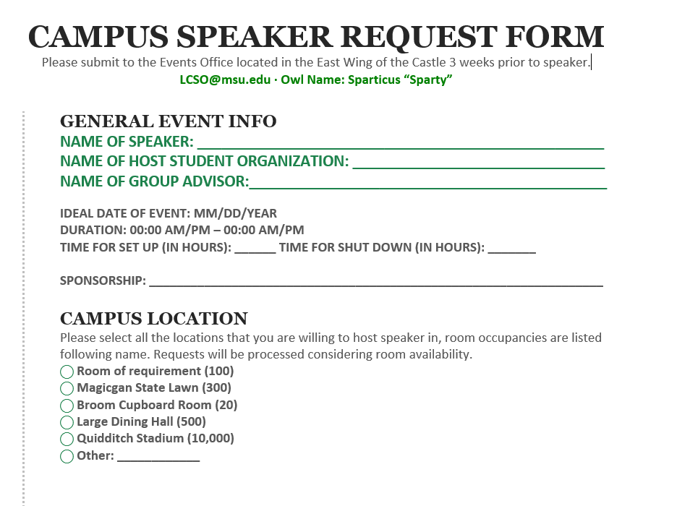
Inadequate Campus Speaker Form
Notes:
Notes: Speaker form lacks critical information

Slide 11
In two or three columns
Three Main Issues from Old Procedure
Insufficient Campus Speaker Form
-previous form was missing critical information related to the event. Missing advisor information
-lacked additional signatories from Executive Board of organization
-form turned into Events Office, which is not familiar with handling speakers
Speaker Guidelines Not Upheld
-Campus security policy states that professional security must be hired and approved in accordance to the security-attendance ratio.
-Lack of campus security in previous event led to difficult security management.
Lacked Communication with Legal Counsel and Student Organizations Office
-procedure not in place for event organizer to explicitly communicate with Legal Counsel and Student Organization
Notes:
Notes: Explanation of the places available for speakers and the differences in ability to place regulations.

Slide 12
Summary of New Procedure
Crafted by the Legal Counsel and Student Organizations Committee, the new process keeps in mind where our old process failed to be student centered and ensure the safety and security of all students

Slide 13
In two or three columns
Additional Requirements in New Procedure
Must meet with advisor prior to submitting form
-by providing signature at bottom of form, we will know that your organization has received guidance and approval from advisor
All executive board members signatures
-This signature form can be found on the MSU.edu/LCSO/GuestSpeakerRequest
Legal Counsel and Student Organizations Office will review form and be in communication with student group
LCSO will ensure that safety and security personnel are available to staff event
Notes:
Notes: Guidelines for how many safety personnel needed depends on location because of attendance

Slide 14
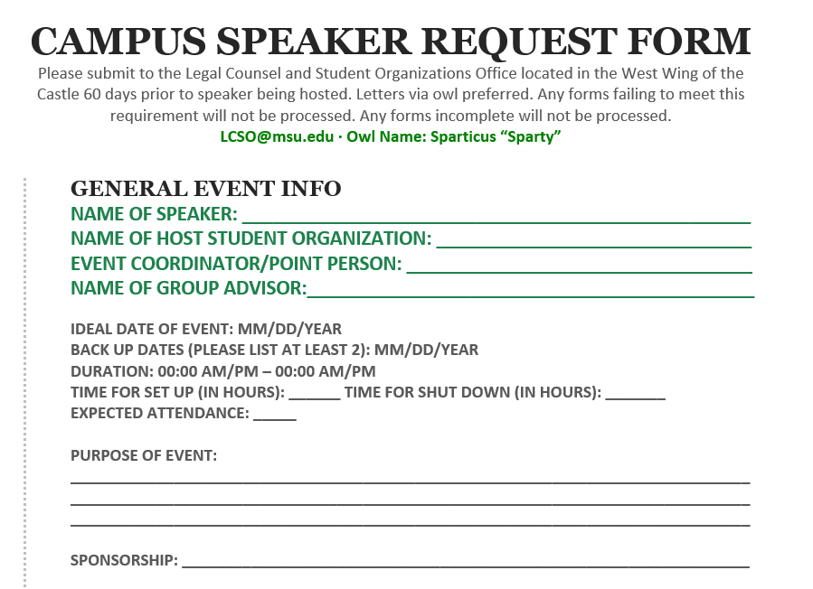
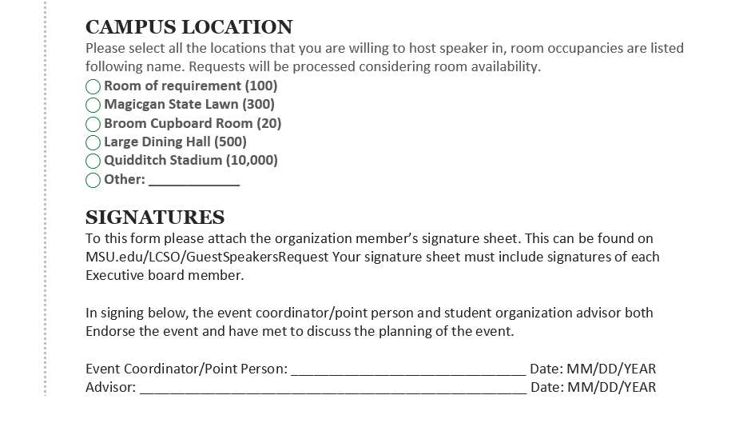
All groups must submit a Guest Speaker Request form 60 days prior to event to ensure that proper safety and security staff can be present and prepared
What’s new:
Extended deadline
Identify point person
Suggest back-up dates
Share purpose of event
Identify expected attendance
Have advisors signature
Now must include signatures of all executive board members

Slide 15
Students’ Rights
An overview of what is allowed to occur at events

Slide 16
Let’s review some concepts
What students can do!
Avoid
Students can choose to not attend an event/not support event by attendance
Leave at any Time
Students cannot be forced to stay at the event. All exits must be open and accessible
Host Alternative Event
Other student organizations are allowed to host an event at the same time at a different location
Protest Peacefully
Heckler’s Veto is in place: protests may not cut off/interrupt speaker (see video to right)
Host a debate
Students can host an event in opposition to your event
Notes:
VIDEO LINK (ALSO HYPERLINKED ON IMAGE): https://www.youtube.com/watch?v=DBa8uRM5fcI

Slide 17
What is Not Protected
Promoting or inciting actual violence or harm
Fighting words
True threats
Defamation or slander
Severe [illegal] harassment
False advertising
Use of public resources for partisan politics
Notes:
Notes: on this slide the definition of each statement will be given as it is outlined by the Supreme Court
True threats- non-hyperbole, non-joke threats
Fighting words- words indicating a fight or challenge
False Advertising- saying the speaker stands for x but they actually stand for y

Slide 18
What else is new?!
MSU will be implementing Brave Space training into all student organization orientations

Slide 19
You can also split your content
Brave Space Orientation
Goal
Educate student organizations on how to facilitate difficult conversations and process through controversy with civility
Provide overview of how to bring speakers to campus through the new method
Notes:
VIDEO LINK: https://www.youtube.com/watch?v=DBa8uRM5fcI

Slide 20
In two or three columns
Brave Space Orientation Program
When?
Will take place at the beginning of the school year before the student involvement fair takes place
Who is facilitating?
Members of the Legal Counsel and Student Organizations Office
Students
Interns
Will be a paid position with funding through the Brave Space Grant
Got to MSU.edu/LCSO for student employee opportunities
What will I learn?
facilitation techniques
Identifying aspects of a brave space
Working with diverse student populations
Understanding intent vs. impact

Slide 21
References
Alexander, K. W., & Alexander, K. (2017). Higher education law: Policy and perspectives (2nd ed.). New York: Routledge.
Bird, L. E., Mackin, M. B., & Schuster, S. K. (Eds.). (2006).
The First Amendment on campus: A handbook for college and university administrators. Washington, DC: NASPA.

Slide 22
Thanks!
ANY QUESTIONS?
Email:
legalcounselso@magicgan.edu

