Slide 1
SUPPORTING STUDENTS WITH AUTISM SPECTRUM DISORDERS
StudentAffairs.com
2017 Graduate Case Study Competition
Michigan State University
Krystle Forbes, Morgan Bauman, & Luke Jeffery

Slide 2
CONTEXT SETTING

Slide 3
WHAT IS AUTISM SPECTRUM DISORDER (ADS)?
(Marshall, 2016)

Slide 4
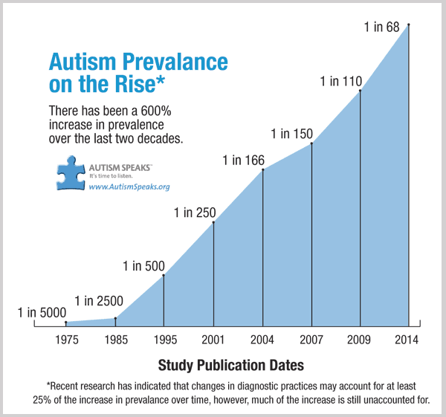
WHY THIS IS IMPORTANT?
Nationally, ASD diagnosis are exponentially on the rise.
New Jersey (one of 11 participating states) has these highest prevalences of cases, nationwide (Roux et al, 2015)
(U.S. Centers for Disease Control [CDC], 2016)

Slide 5
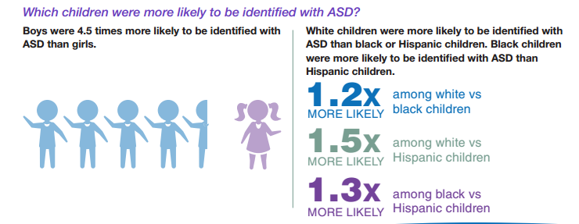
WHY THIS IS IMPORTANT?
Underrepresented students are diagnosed at a decreased rate, this is most likely due to other contributing factors such as socioeconomic status (access to healthcare) or parents’ education level
(American Speech Language and Hearing Association [ASLHA], n.d; CDC,2016)

Slide 6
WHY THIS IS IMPORTANT?
People in the U.S. who continue education beyond high school can expect to earn more, be healthier, and live longer lives.
75% of youth in the general population attend some type of postsecondary education
Only 36% of students with autism attend any type of postsecondary education
Less than any other disability or learning disability or speech-language impairment
Beyond being good stewards of our mission and dedication to student support, limited research around support and success strategies for students with ASD provides opportunities (Gelbar, Smith, & Reichow, 2014) for our institution to be on the cutting edge of student development and support.
(Roux et al, 2015, p.41)

Slide 7
PROGRAM PROPOSAL

Slide 8
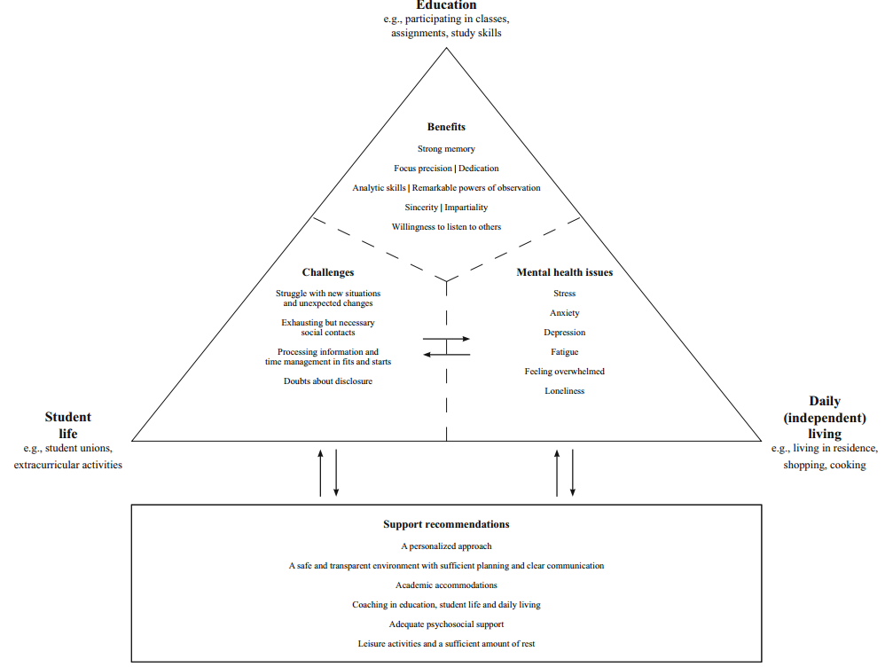
PROGRAM CONSIDERATIONS
Shifting the conversation to a strengths based approach (Hart, Grigal & Weir, 2010), and focusing on what is unique about people with ASD’s learning styles, improves student performance (Van Hees, Moyson & Roeyers, 2015)
According to a 2015 study by Van Hees, V., Moyson, T. & Roeyers, H. J (2015) “the challenge [to students with ASD transitioning to university] consisted precisely in the simultaneous combination of tasks and challenges in the three domains, resulting in major mental health issues.” (p. 1677)
While Van Heese, Moyson & Roeyers (2015) had a number of recommendations, we will be framing ours around the domains of personal achievement and academic success, in line with other university initiatives.
Illustration from Van Hees, Moyson & Roeyers, 2015, p. 1677

Slide 9
RECOMMENDATIONS
PERSONAL INTEGRATION
SOCIAL INTEGRATION
ACADEMIC INTEGRATION
Based on a review of the literature we recommend a three-pronged Disability Service program focusing on:
Challenge: Growing Self-Advocacy Skills
Challenge: Addressing Campus Culture
Challenge: Breaking with the Familiar
We have started the process of creating a committee consisting of:
Director of Disability Services
Representatives (1 each) from residence life, faculty & the office of student activities
Mental health services administrator or counselor
Committee’s purpose: serve as a regular touchpoint for collaboration, resource planning and assessment data to ensure comprehensive, wrap-around support

Slide 10
PERSONAL INTEGRATION
Challenge: Growing Self-Advocacy Skills
Difficulties with planning, personal flexibility, and social communication, make it hard for students with ASD to recognize how and when to ask for help, often resulting in a failure to access adequate and timely support.
(Rochester Institute of Technology, 2014)
Recognizing and Communicating Need
In the k-12 system, most advocacy for services and support comes from the parent and students are not involved in planning and development conversations for their accommodations.
(Hart et al., 2010; Rochester Institute of Technology, 2014)
Receiving Accommodations

Slide 11
PERSONAL INTEGRATION
Start the Process with Orientation
Mullendor and Banahan (2005) suggest “orientation can be the defining moment in the transition to college for the student – a time in which basic habits are formed that influence students’ academic success and personal growth – and marks the beginning of a new educational experience” (p. 319). (as cited in Grogan, 2015, pp. 9-10)
Specialized Pre-orientation process where environment can be controlled for more optimal conditions
Explain the process clearly and without inferences or idioms (Grandin & Panek, 2013)
Allows time for students to familiarize themselves with campus (addressing the need for time to anticipate and process change) (Van Hees, Moyson & Roeyers, 2015)
Begins the process of relationship development to create a supportive peer-network and sense of belonging on campus

Slide 12
PERSONAL INTEGRATION
Utilizing Orientation
Making systems of support
Individual introductions and relationship building with key staff members and administration
Making options clear and available (to allow processing time)
Take-away resource to add to orientation materials
Normalizing help-seeking behaviors (especially among peers)
Rochester Institute of Technolog, 2014)
Recognizing and Communicating Need
Tiered system of responsibility release
Ideally students will start to be involved in planning process in K-12
Involving parents in the initial planning phases provides an added level of comfort for student
(Hart et al., 2010; Rochester Institute of Technology, 2014)
Receiving Accommodations

Slide 13
SOCIAL INTEGRATION
Challenge: Addressing Campus Culture
Former understandings are based on ableist worldviews rooted in medical models. As such, students with ASD’s potential is limited without contextual understandings of differences in mode of communication or environment needs. They are limited by what people think they can achieve.
(Peña, Stapleton, and Schaffer, 2016)
Identifying Social Constructs
“Challenges with initiating conversations and the inability to read social cues leads to failed attempts to connect with peers and ultimately contributes to isolation and loneliness.”
Isolation and lack of a sense of belonging is a warning indicator for both retention and persistence, therefore of worthy consideration of administrators and faculty.
(Rochester Institute of Technology, 2014, p. 5)
Creating a Sense of Community

Slide 14
SOCIAL INTEGRATION
Education, Reflection, & Community
When considering an institutional response, practitioners should consider “thinking outside the box on programming when working with and supporting students in all of their complexities”
(Peña, Stapleton, & Schaffer, 2016, p. 93)
Develop an awareness campaign on ASD
Cultivate a deeper understanding of what ASD is within campus community
Nurture a campus climate of inclusivity by highlighting the diverse student population
Focus on strengths of students with ASD and shift away from deficit-based assumptions about students with ASD (Grandin & Panek, 2014)
Create programming aimed at building community
Establishing peer groups with others who hold similar identities allows students with ASD to feel a sense of belonging
Future directions could include a peer mentoring program aimed at coaching students with ASD through social situations that may be difficult to navigate
(Nevill & White, 2011)

Slide 15
SOCIAL INTEGRATION
Engaging in Education, Reflection, & Community
Collective community response informed by the awareness campaign aims to shift understanding in what valid knowledge looks like, challenging ideas of ‘normalcy’
Henry et al. (2010) stated, “institutions must move beyond legislation about accommodations for students with disabilities and start to embrace the spirit of the ADA”
(as cited in Peña, Stapleton, & Schaffer, 2016, p. 93)
Identifying Social Constructs
Opportunities for students to interact in “typical ways” with peers “provides a powerfully positive social experience for those students. When college students with ASD...talk about their experiences in college, they often mention that ... gives them a sense of esteem and belonging; less of a sense of “other-ness” than they had experienced previously.” (Hart et al., 2010, p. 136)
Creating a Sense of Community

Slide 16
ACADEMIC INTEGRATION
Challenge: Breaking with the Familiar
For students with ASD, K-12 success is often the result of rudimentary academic strategies. However, in college, students struggle to adapt learning methods to respond to various teaching styles and disciplines.
(Rochester Institute of Technology, 2014)
Applying New Strategies
In post-secondary education, students with ASD may struggle due to the abstract nature and perspective- taking foundational to some disciplines and assignments.
(Grandin & Panek, 2013; Rochester Institute of Technology, 2014)
Interpreting the Abstract

Slide 17
ACADEMIC INTEGRATION
Universal Design for Learning (UDL)
Grandin and Panek (2013) noted “if you really want to prepare [people] to participate in mainstream life, then you have to do more than accommodate their deficits. You have to figure out ways to exploit their strengths” (p. 184). Operating under this deficit perspective, higher education often fails to recognize the great diversity in students with ASD and the success they can achieve in the college learning environment (Grogan, 2015).
UDL acknowledges the diversity of strengths students with ASD bring to college.
Move from passive learning via lecture to active learning via visual, auditory, and tactile methods (Grogan, 2015)
Play to strengths by allowing students to choose assignments and break down barriers to traditional written assessment (Grogan, 2015)
Recognizing faculty members are not experts in teaching, but in discipline, a concentrated effort to educate and train faculty and staff on the need for inclusive teaching and learning methods to engage both students with ASD and neurotypical students will be necessary.

Slide 18
ACADEMIC INTEGRATION
Employing Universal Design for Learning
Sufficient planning and clear communication
Allow time to adapt to schedule, expectations, and changes
Disclose teaching methods to students in advance
(Van Hees, Moyson, & Roeyers, 2015)
Applying New Strategies
Varied assessment methods
Allow students to demonstrate learning in ways that align with their strengths
Use an array of techniques
Play to students’ strengths as visual, auditory, or tactile learners to give a concrete method to abstract concepts
(Grogan, 2015; Grandin & Panek, 2013)
Interpreting the Abstract

Slide 19
BUDGET
Item | Cost
Specialized Pre-Orientation Program
Facilities usage & staff compensation | Recommend applying for grants from Autism Speaks Family Services Similar programs funded by participant fees ¹
Resources Awareness (printed materials) | Utilize existing program promotion materials
Awareness Campaign²
Marketing Materials (print) | $2,000
Guest Speaker | $5,000
Faculty and Administration Training³
Workshop Materials ³ | $1,500
Guest Speaker | $5,000
Peer Support Group
Program Funding ($100 per facilitator) | $1,000
Total Proposed Costs
$ 14,500
¹ Rochester Institute of Technology, 2014
² Figures are approximate and determined based on similar awareness campaigns implemented at R1 institution serving approximately 40,000 students.
³ This is an approximate cost based on 2 workshops with a projected attendance of 100 participants. The cost includes the assumed need for materials that may include flipchart paper, writing utensils, etc.

Slide 20
REFERENCES
American Speech Language and Hearing Association (ASLHA). (n.d.) Autism. Retrieved from
http://www.asha.org/PRPSpecificTopic.aspx?folderid=8589935303&section=Incidence_and_Prevalence
Gelbar, N. W., Smith, I., & Reichow, B. (2014). Systematic review of articles describing experience and
supports of individuals with autism enrolled in college and university programs. Journal of Autism and Developmental Disorders, 44(10), 2593-2601. Retrieved from http://link.springer.com.proxy2.cl.msu.edu/article/10.1007%2Fs10803-014-2135-5
Grandin, T., & Panek, R. (2013). The autistic brain: Helping different kinds of minds succeed. New
York, NY: First Mariner Books
Hart, D., Grigal, M., & Weir, C. (2010). Expanding the paradigm: Postsecondary education options for individuals
with autism spectrum disorder and intellectual disabilities. Focus on Autism and Other Developmental Disabilities, 25(3), 134-150. Retrieved from http://journals.sagepub.com/doi/pdf/10.1177/1088357610373759
Marshall, T. (2016, March 21). Autism spectrum disorder (including Asperger syndrome) [video file]. Retrieved
from https://www.youtube.com/watch?v=_HGUyk5U_j8
Nevill, R. E. A., & White, S. W. (2011). College students’ openness toward autism spectrum disorders: Improving peer
acceptance. Journal of Autism Development Disorder, 41(12), 1619-1628.
Peña, E. V., Stapleton, L. D. and Schaffer, L. M. (2016), Critical Perspectives on Disability Identity. New Directions for
Student Services, 2016: 85–96. Retrieved from http://onlinelibrary.wiley.com/doi/10.1002/ss.20177/pdf
Rochester Institute of Technology. (2014). Emerging practices for supporting students on the autism spectrum in
higher education: A guide for higher education professionals. Retrieved from https://www.rit.edu/~w-ssp/documents/ASDinHigherEdGuide.pdf
Roux,A. M., Shattuck, P.T., Rast, J.E., Rava, J.A., & Anderson,K.A. (2015). National Autism Indicators Report: Transition
into Young Adulthood. Philadelphia, PA: Life Course Outcomes Research Program, A.J. Drexel Autism Institute,Drexel
University. Retrieved from http://drexel.edu/autisminstitute/research-
projects/research/ResearchPrograminLifeCourseOutcomes/IndicatorsReport/#sthash.qCrXdtjd.dpbs
The United States Centers for Disease Control and Prevention. (2016). Community report from the autism and developmental
disabilities monitoring (ADDM) network: A snapshot of autism spectrum disorder among 8-year-old children in multiple communities across the united states in 2012. Retrieved from https://www.cdc.gov/ncbddd/autism/documents/community_report_autism.pdf
Van Hees, V., Moyson, T., & Roeyers, H. (2015). Higher education experiences of students with autism spectrum disorder:
Challenges, benefits and support needs. Journal of Autism and Developmental Disorders, 45(6), 1673-1688. Retrieved from http://link.springer.com/article/10.1007/s10803-014-2324-2

